Slide 1

epiSphere
Portable user-governed Cloud container for epidemiological data commons
epiBox
You have an inbox, an outbox and … an epiBox!
(Box-backed Web commons)
Jonas Almeida
Bhaumik Patel
Montserrat Garcia-Closas

Slide 2
epiSphere
Portable user-governed Cloud container for epidemiological data commons
Confluence
What we’ve learned from projects like Confluence:
1. You care about governance above all else …
2. … we are very happy about that … ☺
→ much most portable and scalable
→ the next stage of FAIR (participative)

Slide 3
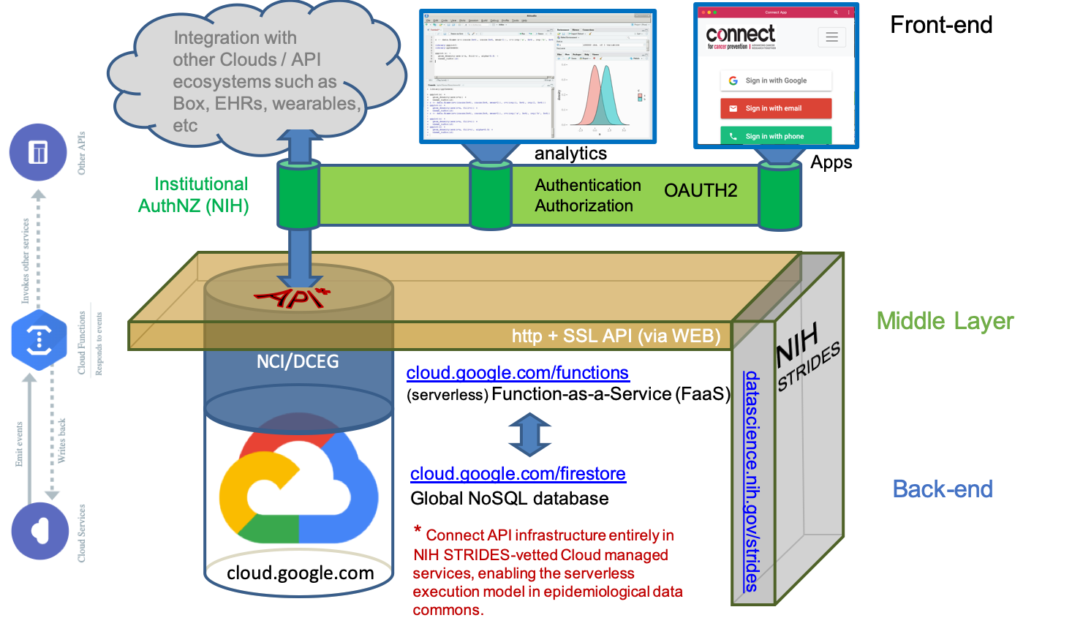
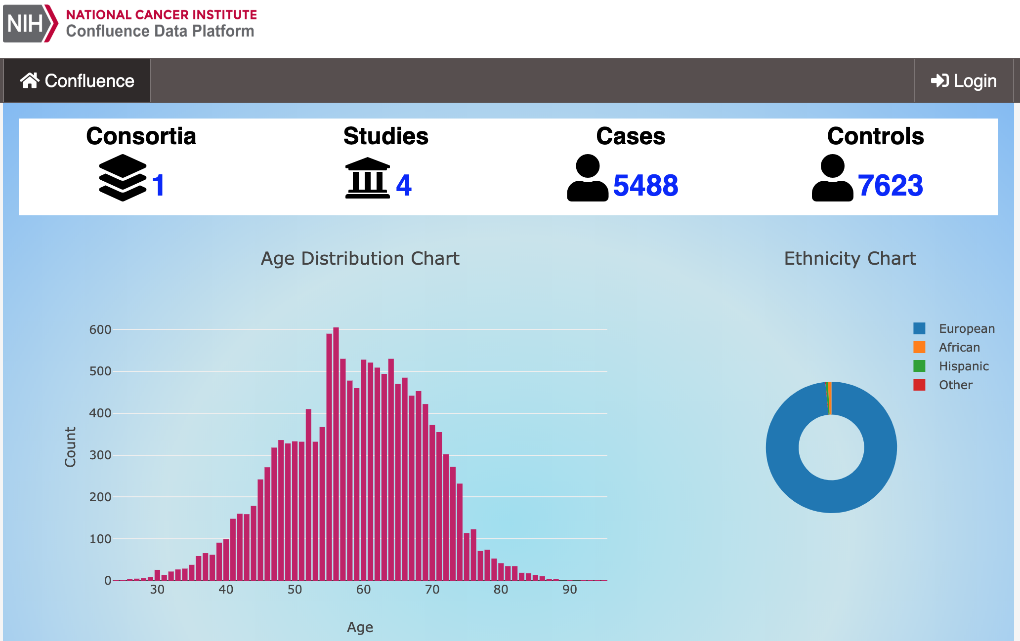
epiSphere
Frontloaded from Box
Portable user-governed Cloud container for epidemiological data commons
epiBox
You have an inbox, an outbox and … an epiBox!
(Box-backed Web commons)

Slide 4
epiSphere
Portable user-governed Cloud container for epidemiological data commons
Analysis
The “hidden structure” of the Web as a data space *
Web, http
Web
Interoperable thin middle
API
ecosystem
AuthNZ
Cloud
Data
* ONC’s Shared Nationwide Interoperability Roadmap

Slide 5
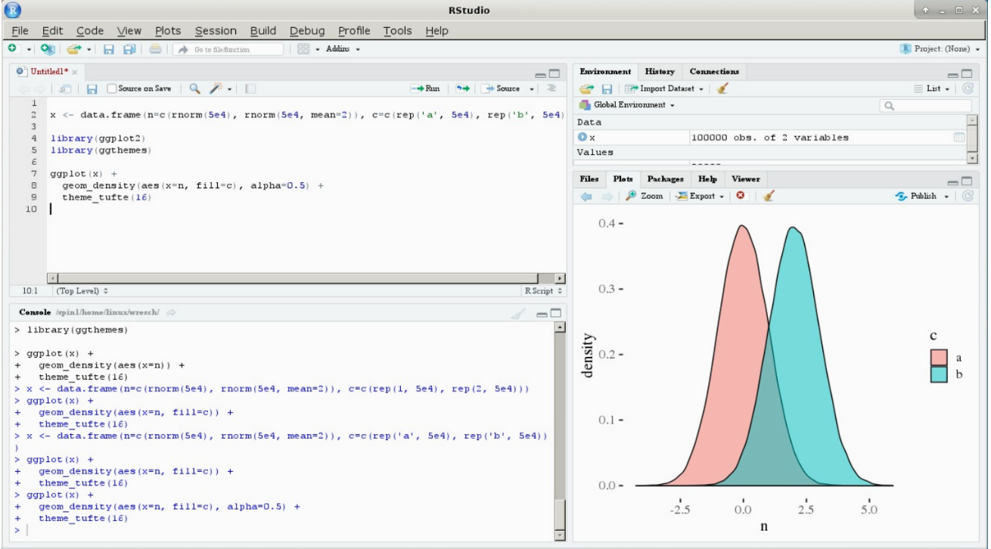

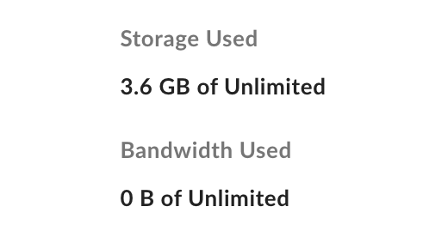
epiSphere
epiBox
You have an inbox, an outbox and … an epiBox!
(Box-backed Web computing)
Portable user-governed Cloud container for epidemiological data commons
Analysis
Web, http
analytics
Apps
Interoperable thin middle
API
ecosystem
OAuth2 + local compliance
Box.com
$
Cloud
Data

Slide 6
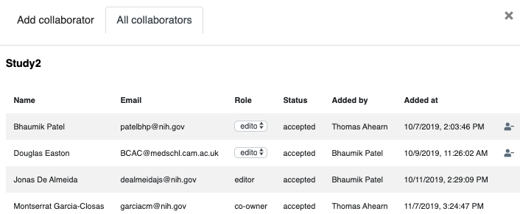
epiBox
You have an inbox, an outbox and … an epiBox!
(Box-backed Web computing)
Interoperable thin middle
OAuth2 + local compliance
GDPR
just like your emails, on the same place as everybody else’s

Slide 7
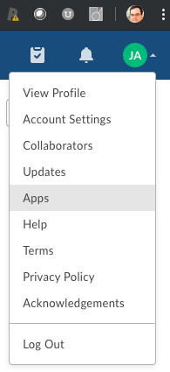
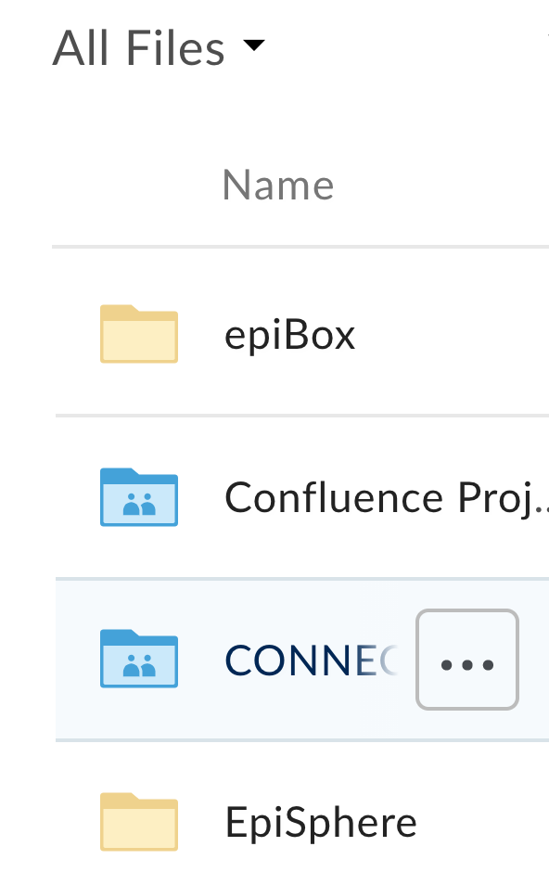

epiBox
You have an inbox, an outbox and … an epiBox!
(Box-backed Web computing)
episphere.github.io/confluence
BoxR: A high-level R interface for the box.com API
Bremer E, T Kurc , Y Gao , J Saltz , JS Almeida (2017) Safe “cloudification” of large images through picker APIs. AMIA Annu Symp Proc. 2016:342-351. [PMID:28269829].

