Slide 1
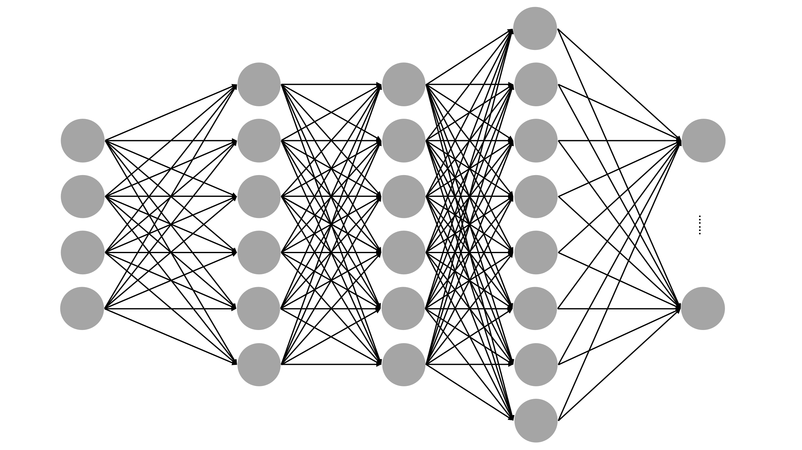
Dense
Convolutional
Convolutional
Input
Output

