Slide 1
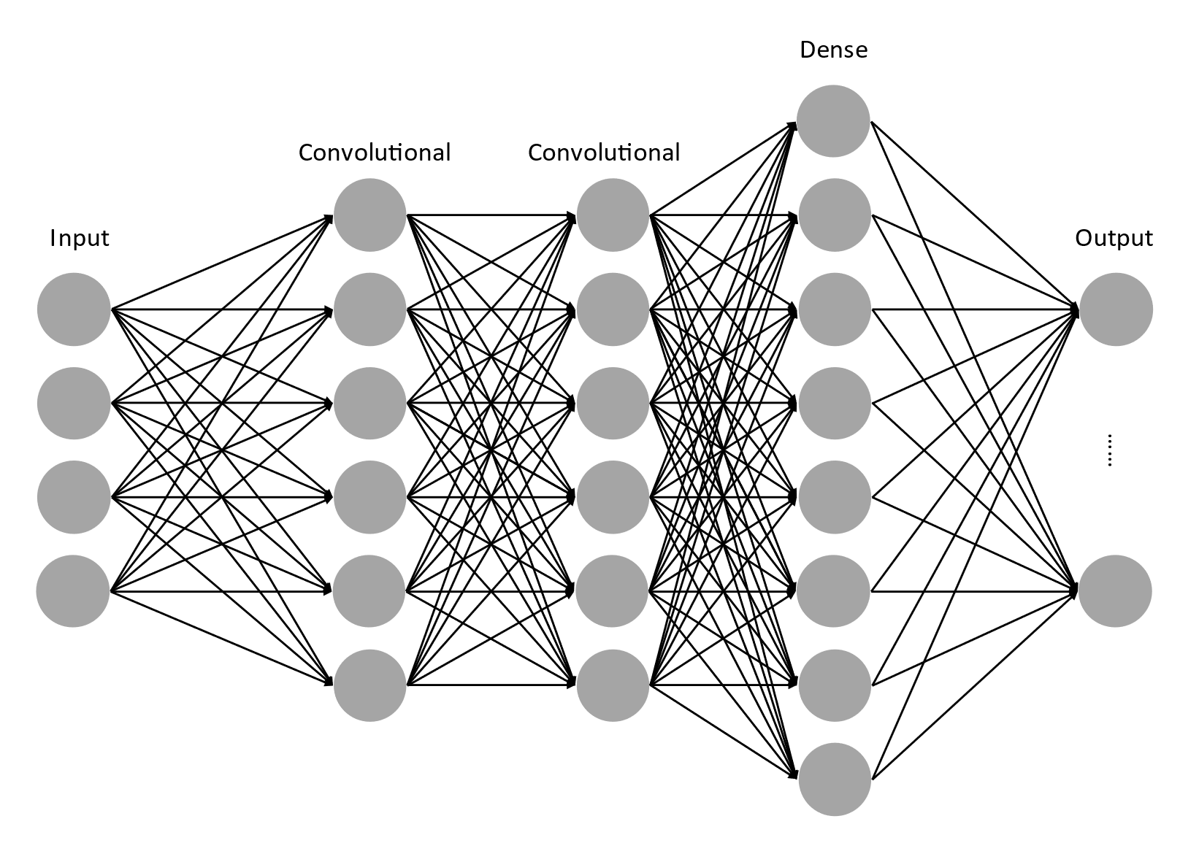
Copy weights
Policy Network
Target Network

