Slide 1
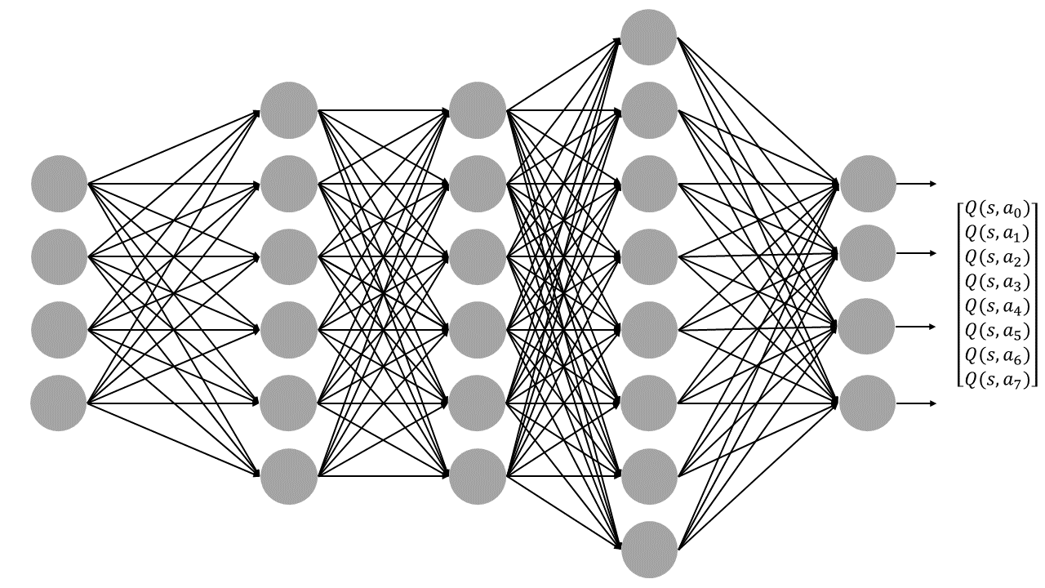


Linear
Convolutional
Convolutional
Convolutional
ReLu
Linear
8 actions
4
Stride 4
Kernel 8
512
32
Stride 2
Kernel 4
64
Stride 1
Kernel 3
3136

