Slide 1
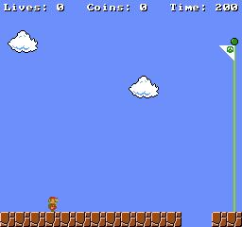

Py4J Bridge
Game Server
Start environment
Python Game Interface
boolean[]
Repeat action k times
Submit action
RL Agent
Observe reward r
Process frame
Get observation
Save to tensorboard
float, byte[]
Python Game Interface
RL Client
Py4J Bridge

