Slide 2



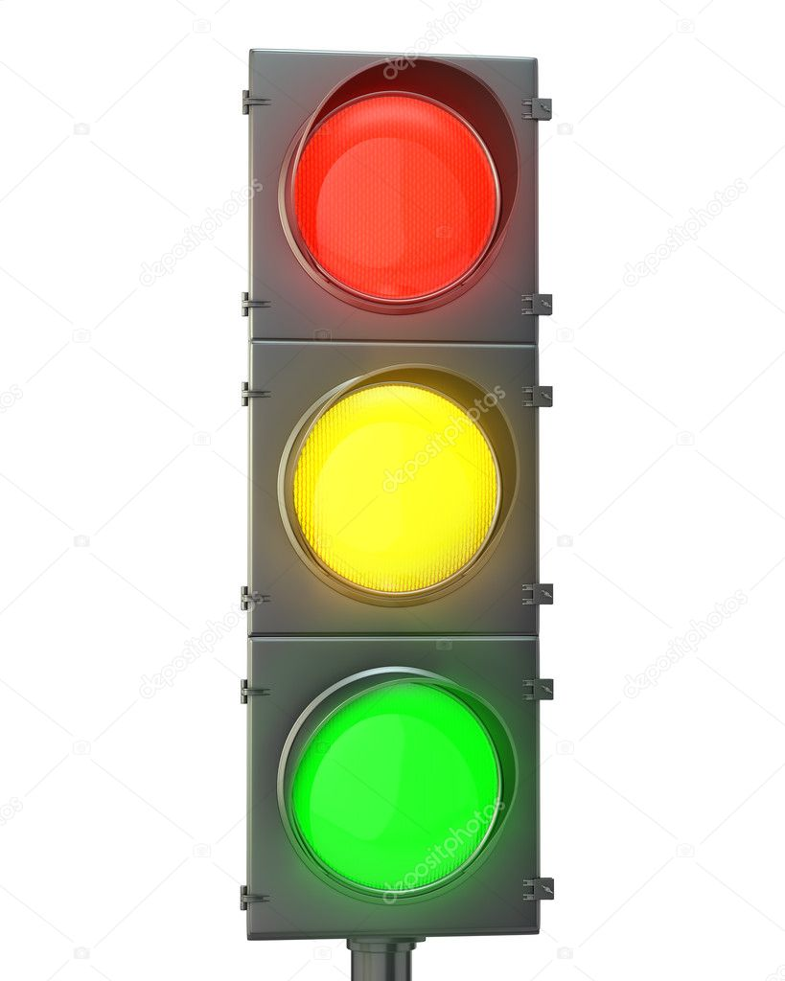
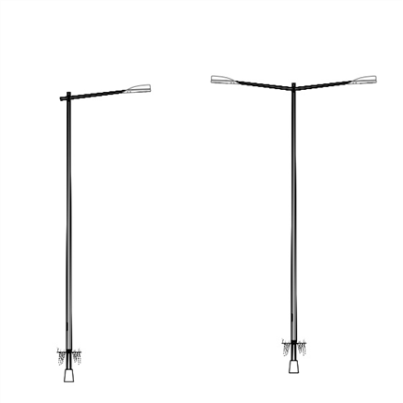
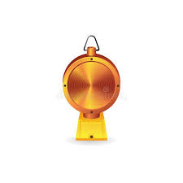

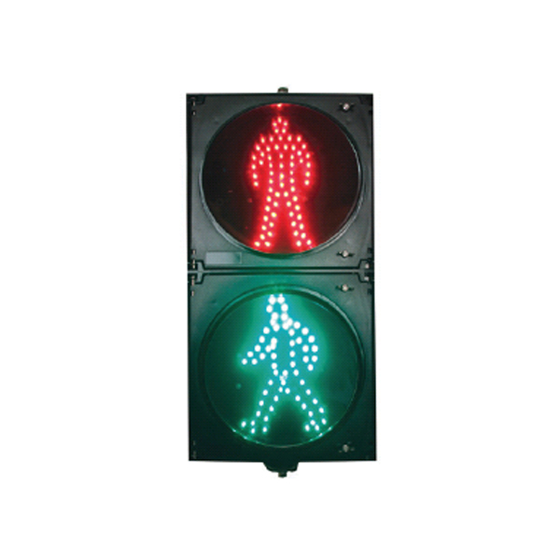

GenJMRI decoder - System overview:
GenJMRI Server (j)pythonScript
1:1
JMRI Jython API
Std config + genJMRI extension properties
GenJMRI decoder config
JMRI Server (Core)
Standard definition for the Swedish signalling system
1:N
MQTT – GenJMRI API
GenJMRI decoder (ESP32)
GenJMRI decoder (ESP32)
(Max 2 strips/lightgroups-
channels, 64 pixels or
headlights each)
GenJMRI decoder (ESP32)
WS281x
WS281x-LVDS
WS281x-LVDS
GenJMRI IOSatelite (tinyFPGA, Lattice XXXX)
[Pulse]
x8
SensorNegativeEdge
[PWM]
Inband configurable
Open drain
x4
[0/1]
(Max 8 Satlelites per loop/decoder)
GenJMRI IOSatelite
GenJMRI IOSatelite
GenJMRI IOSatelite

Slide 3
JMRI Server
Generic JMRI decoder I/O Satelite
MQTT
Generic JMRI decoder (ESP32)
-
AO0
WS2811 x4
+
WS2811 x4
AO11
WS2811 x4
DO0
WS2811 x4
Data
DO11
x12
x12
Pulse durtion
WS2811 L1 decoder /clock recovery
800 kHz
Analog
Load/Start
PWM
PWM0
Data
800 kHz
12 bit shift- register
PWM11
Load/Start
Data
12 bit latch

Slide 4
Padda med 2 byte för varje increment av satelit sekvens I kedjan Se till att dessa 2*n byte I svansen inte shiftas in I actgrenen
PAD[3:0]
FB[3:0]
Sensor [7:0]
Throw away
CRCTX[3:0]
PADTX[7:0]
CRC[3:0]
FB[3:0]
Res[3:0]
Mode[2:0]
Mode[3:0]
Mode[3:0]
Act_0[7:0]
Act_1[7:0]
Act_2[7:0]
Act_3[7:0]
Sensors[7:0]

Slide 5
Satelite sensors – alternatives:
Alt 1, Driven by internal pwr source, no galvanic isolation:
Strapping: S1 1-2; S2 1-2

