Slide 2










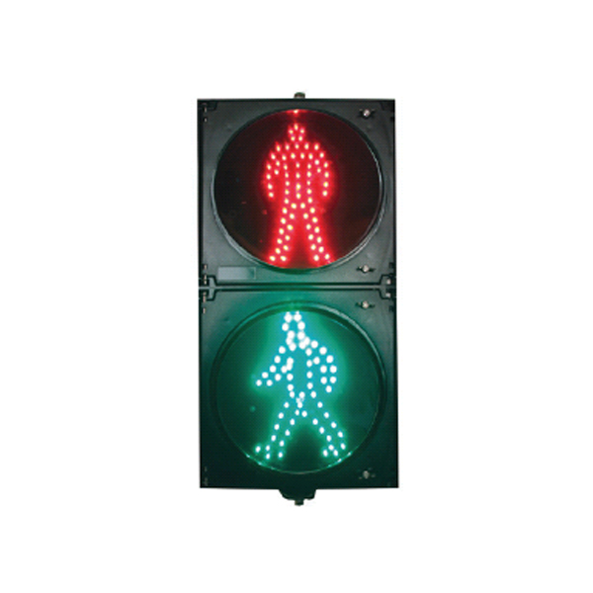
Host
File server(s)
Architecture legends: Modules (colors):
Controller, e.g. JMRI
MyRailIO 3PP services API’s(colors):
MQTT
Propriatary links
Direct sens/act connect
RPC
IPC
Other protocols
API Access methods:
WAN IP/WIFI WAN IP/WIFI or local
Direct wiring
Train controller (E.g. JMRI)
Train controller config. (file storage)
Remote config. Repo.
MyRailIO RPC-server
MyRailIO config. (file storage)
GIT Repo
Host
MyRailIO RPC-client
MQTT Broker
Sensors
Actuators
Sensors
Actuators
MyRailIO server
RSyslog
x8
x4
x8
x4
MyRailIO satelite
MyRailIO satelite
MyRailIO decoder
MyRailIO decoder
x2
NTP server
MyRailIO decoder
Satelites (0-N)
MyRailIO decoder
Satelite link (0-1)
Light group link (0-1)
x2
Light groups (0-N)

Slide 3
topDeoder
1:N
decoder
1:N
1:N
lightGroupLink
sateLliteLink
1:N
1:N
lightGroup
satellite
1:N
1:N
1:1
lightGroupType
actuator
sensor
1:1
1:1
actuatorType
sensorType

Slide 4

myRailIO decoder - System overview:
JMRI RPC Client API
Standard JMRI configuration
JMRI Jython API
myRailIO decoder config
myRailIO server pythonScript
JMRI RPC client pythonScript
HTTP RPC
JMRI RPC server (j)pythonScript
JMRI Server (Core)
Standard definition for the Swedish signalling system
1:1
1:1
1:1
MQTT – Mgmt
MQTT – Operation
1:N
1:N
myRailIO decoder (ESP32)
myRailIO decoder (ESP32)
lgLink-0 (WS281x)
(Max 2 strips/lightgroupLinks , 64 pixels or headlights each)
myRailIO decoder (ESP32)
lgLink-1
satLink-0 (WS281x-LVDS)
satLink-1
IOSatelite (tinyFPGA, Lattice XXXX)
[Pulse]
x8
SensorNegativeEdge
[PWM]
Configurable
Open drain
x4
[0/1]
(Max 8 Satlelites per loop/decoder)
IOSatelite
IOSatelite
IOSatelite

Slide 5
JMRI Server
Generic JMRI decoder I/O Satelite
MQTT
Generic JMRI decoder (ESP32)
-
AO0
WS2811 x4
+
WS2811 x4
AO11
WS2811 x4
DO0
WS2811 x4
Data
DO11
x12
x12
Pulse durtion
WS2811 L1 decoder /clock recovery
800 kHz
Analog
Load/Start
PWM
PWM0
Data
800 kHz
12 bit shift- register
PWM11
Load/Start
Data
12 bit latch

Slide 6
Padda med 2 byte för varje increment av satelit sekvens I kedjan Se till att dessa 2*n byte I svansen inte shiftas in I actgrenen
PAD[3:0]
FB[3:0]
Sensor [7:0]
Throw away
CRCTX[3:0]
PADTX[7:0]
CRC[3:0]
FB[3:0]
Res[3:0]
Mode[2:0]
Mode[3:0]
Mode[3:0]
Act_0[7:0]
Act_1[7:0]
Act_2[7:0]
Act_3[7:0]
Sensors[7:0]

Slide 7
Satelite sensors – alternatives:
Alt 1, Driven by internal pwr source, no galvanic isolation:
Strapping: S1 1-2; S2 1-2

Slide 8
Object model
topDeoder Cordidinator
1
1
1
N
decoder
SatLink
1
LightGroups
1
1
1
N
N
LightGroup/ Mast
1
1
N
satelite
1
actuators
sensors
1
N
mastApects
N
1
1
1
1
N
N
1
N
N
Actuator
Sensor

Slide 9
Call flows
topDecoderCoordinator
decoder
lightGroups
lightGroup/ mast
mastAspects
INIT
opState=INIT
Get genDecoder.xml
Parse <Decoders/>
Parse <Decoder/>
Generate discovery xml
Parse <LightGroups>
__init__(self)
INIT
configure(<LightGroups/>)
Parse <Masts/>
Get mast(s) from JMRI
__init__(self)
configure(mast)
regTopology(mast)
Get mast config from JMRI

Slide 10
Call flows
topDecoderCoordinator
decoder
lightGroups
lightGroup/ mast
mastAspects
__init__(self)
configure(mastDefinitionPath)
Read & parse mast defintion
configureRet
Refactor
Other lightgroups…
getDecoderURIs()
getDecoderURI()
decoderURI
getDecoderURIsRet[URIs…]
Actuators, Sensors
__init__(self, decoderURI)
Read mast definitions
start(lightGroups, actuators, sensors)

Slide 11
Call flows
topDecoderCoordinator
decoder
lightGroups
lightGroup/ mast
mastAspects
register(self, URI)
register(decoderHandle, URI)
Subscribe to mast change cb from JMRI
registerRet(lightGroupHandle)
registerRet(lightGroupHandles)
getXmlConfigTree(URI)
getXmlConfigTreeRet(XML Tree)
getXmlConfigTree(URI)
getXmlConfigTree(URI)
getXmlConfigTree(URI)
getXmlConfigTreeRet(XML Tree)
getXmlConfigTreeRet(XML Tree)
MQTT Publish decoder XML config
MQTT Subscribe to decode PINFs, OP States, Logs, …
MQTT Publish decoder XML config

Slide 12
Call flows - actuators
topDecoderCoordinator
decoder
sateliteLink
satelite
actuators
actuator
__init__(self)
configure(<Actuators/>)
Parse <Actuators/>
Get turnout(s) & lights from JMRI
__init__(self)
configure(actuator)
regTopology()
Get turnout & light config from JMRI
getTopology()
getDecoderTopologyRet ({satOb:[URI,satLink,sat]},..)

Slide 13
Call flows - actuators
topDecoderCoordinator
decoder
sateliteLink
satelite
actuators
actuator
Masts, Sensors
__init__(self, Toplogy)
We should do this for all (masts, actuators & sensors)
at once here
__init__(self, Toplogy)
__init__(self, decoder, Toplogy)
register(self, decoder, satLink, Toplogy)
OPCONFIG
start()
getXmlConfigTree(URI)
getXmlConfigTreeRet(XML Tree)
getXmlConfigTree(XML URI)

Slide 14
Call flows - actuators
topDecoderCoordinator
decoder
sateliteLink
satelite
actuators
actuator
getXmlConfigTree(URI)
getXmlConfigTreeRet(XML Tree)
getXmlConfigTreeRet(XML Tree)
OPCONFIG
getXmlConfigTree(URI)
OPCONFIG
getXmlConfigTree(URI)
getXmlConfigTreeRet(XML Tree)
getXmlConfigTreeRet(XML Tree)
OPCONFIG
OPCONFIG
OPCONFIG
register(self, URI)
register(decoderHandle, URI)

Slide 15
Datastructures
getDecoderTopology()
return {“decoderURI” : uri, “link” : link, “linkAddr” : linkAddr, “object” : object}

Slide 16
New Ideas – new overall config file deployment:
GUI/CLI/NB
Top
Subordinate 1
Subordinate 2
….
onNewXmlConfig(from file)
Create a config candidate (copy from current Config.)
Parse new config to candidate config
parseErr (ret!=rc.Ok)
parseXmlConfig
File XMLParse error
Create a config candidate (copy from current config.)
Parse new config to candidate config
parseErr (ret!=rc.Ok)
parseErr (ret!=rc.Ok)
parseXmlConfig
Create a config candidate (copy from current config.)
Parse new config to candidate config
parseErr (ret!=rc.Ok)
parseErr (ret!=rc.Ok)
parseErr (ret!=rc.Ok)
Create a config candidate (copy from current config.)
Parse new config to candidate config
parseErr (ret!=rc.Ok)
parseErr (ret!=rc.Ok)
parseErr (ret!=rc.Ok)
parseErr (ret!=rc.Ok)
AbortConfig
Delete candidate config
AbortConfig
Delete candidate config
AbortConfig
…….
AbortConfig
Aborted (ret==rc.Ok)
Aborted (ret==rc.Ok)
Aborted (ret==rc.Ok)
Aborted (ret==rc.Ok)

