Slide 1
OpenFly Telemetry System description

Slide 2
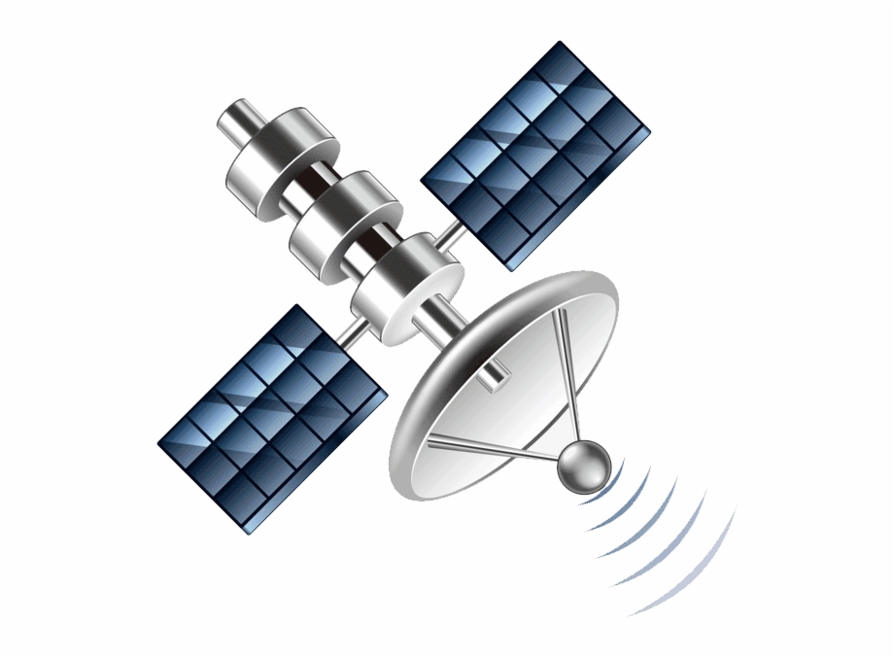
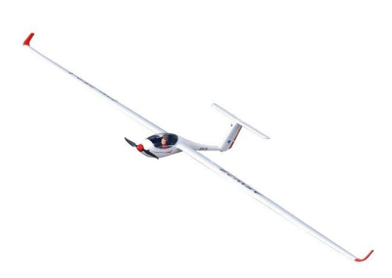

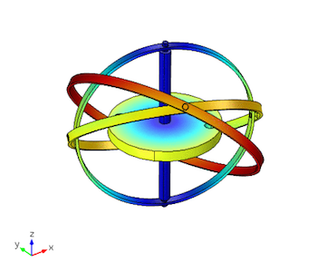

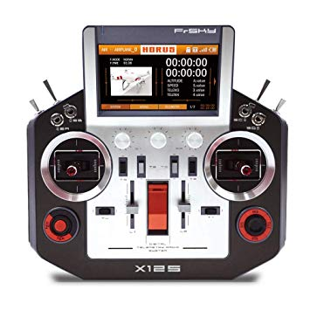
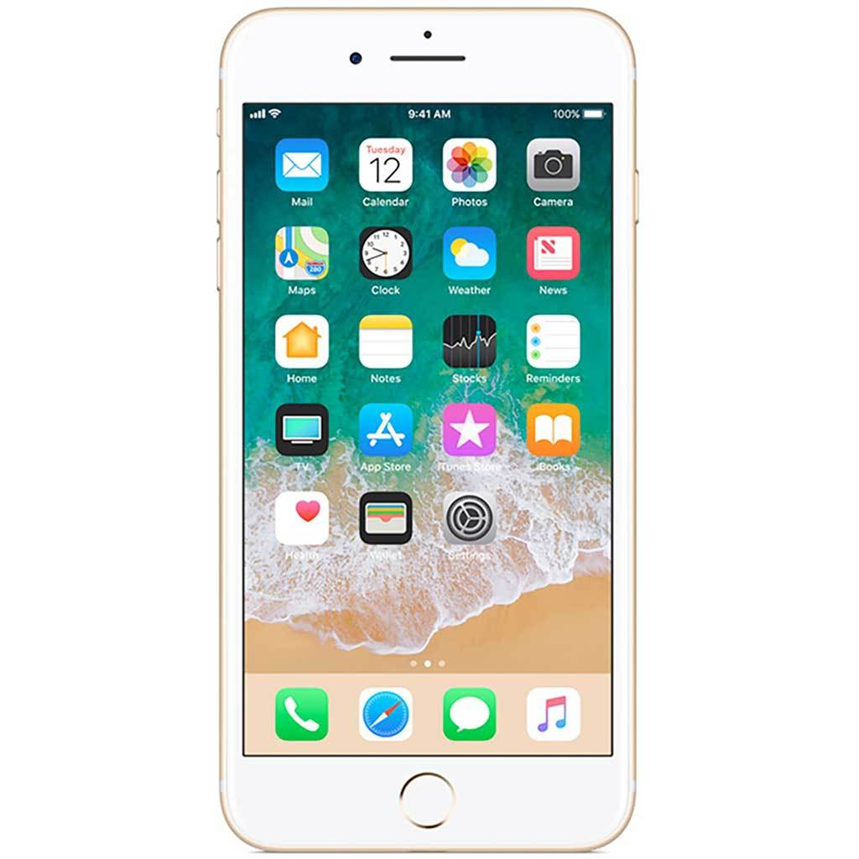

Slide 3
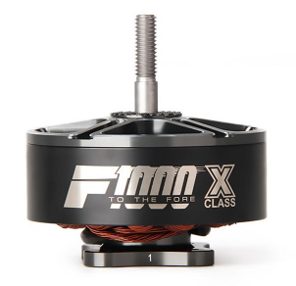
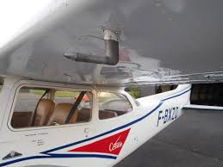


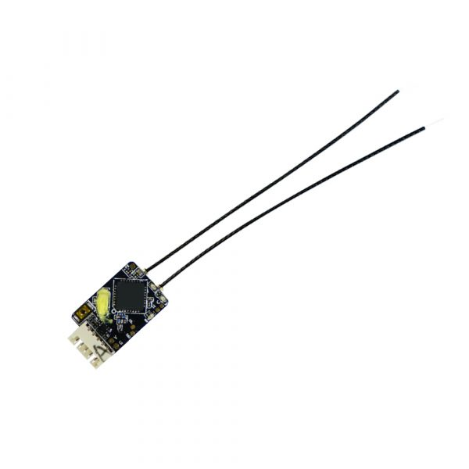
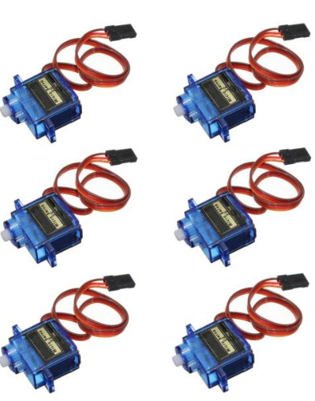
OFT001 Inertial Nav board
GPS
Barometer
Accel, Gyro,
Magneto
Inverter
PT1000
PT1000
2S LIPO Backup/STBY
ESP32 Huzzah CPU board
OFT003
Analog capture board
WIFI/ BT
ESP32
-
USB
+
Frsky XR4 RX
OFT002 System board
Servos
FPGA
uSD

