Slide 1
Shedder use-cases

Slide 2



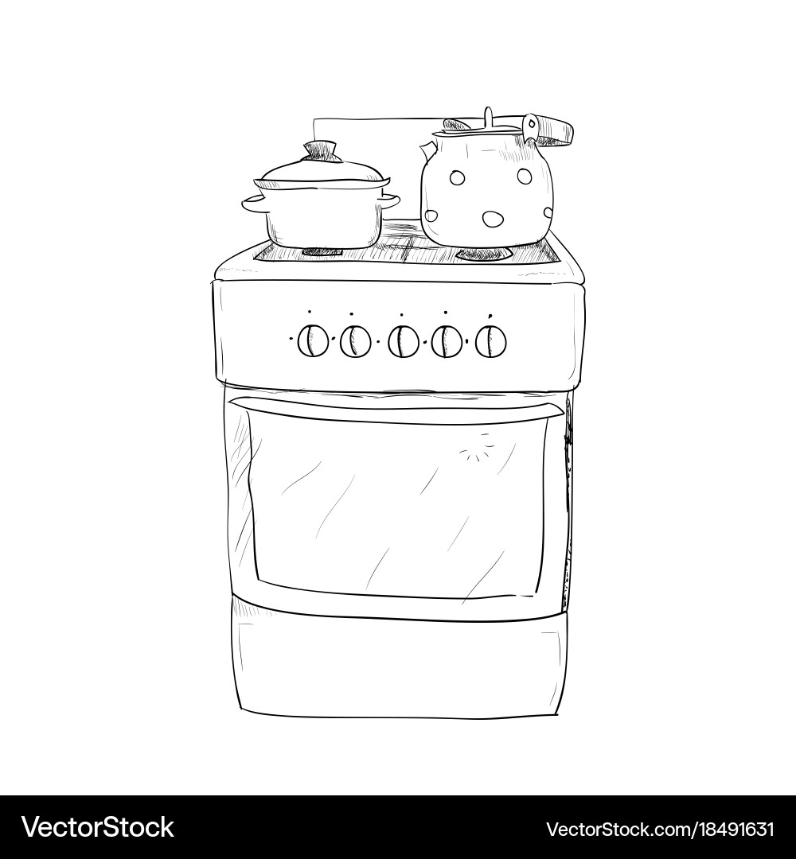

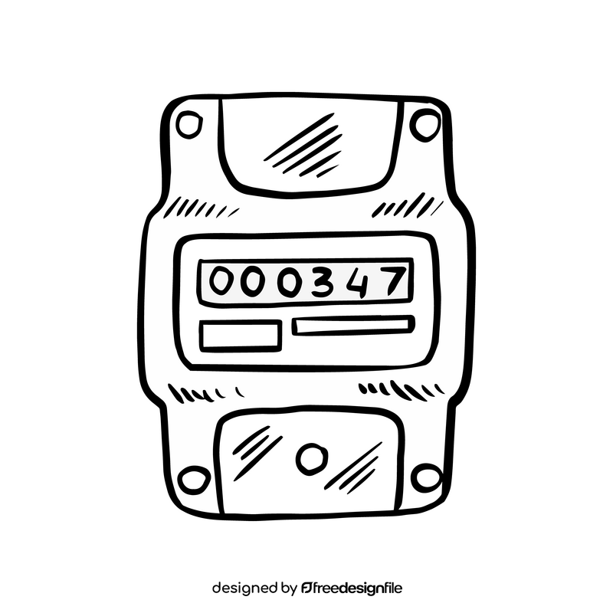


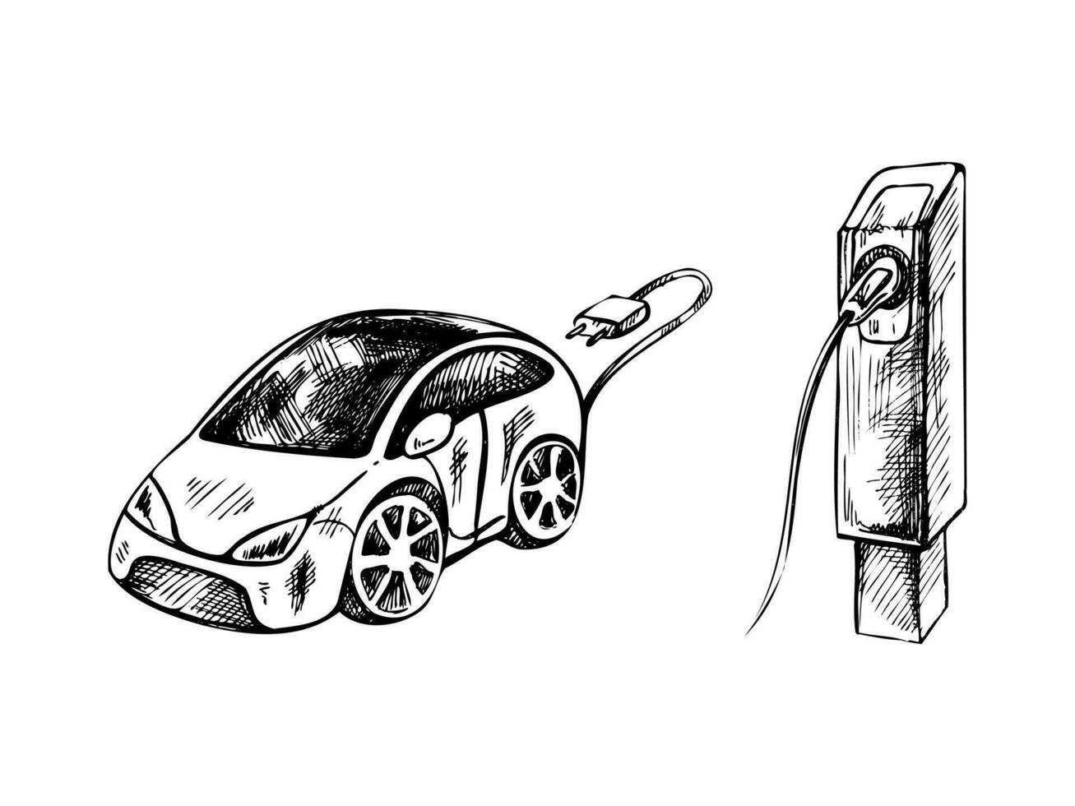
Prio: -1
Shedder
script
Prio: 0
Prio: 1
Group fuse
Shelly relay Eg. pro4pm
Prio: 2

Slide 3


Prio: -1
Prio: 0
Eg. Shelly HVAC
Prio: 1
Group fuse
Shelly 1-ph relay Eg. Shelly Pro 1
Shedder
script
Prio: 2
Shelly energy meter Eg. Shelly Pro 3EM
Shelly 3-ph relay Eg. Shelly Pro 3

Slide 4
Load price information
Prio: -1
Auromation entity
Prio: 0
Eg. Shelly HVAC
Prio: 1
Group fuse
Shelly 1-ph relay Eg. Shelly Pro 1
Shedder
script
Prio: 2
Shelly energy meter Eg. Shelly Pro 3EM
Shelly 3-ph relay Eg. Shelly Pro 3

