Slide 1
DevOps
Jonas Britto
Sep 2022

Slide 2
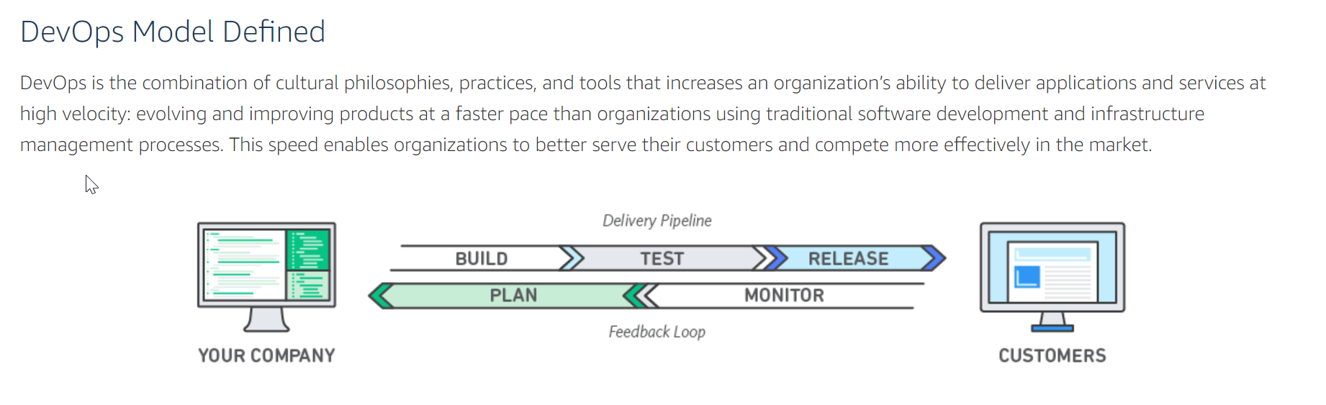
DevOps – What is it?
Pic – Courtesy Amazon AWS

Slide 3
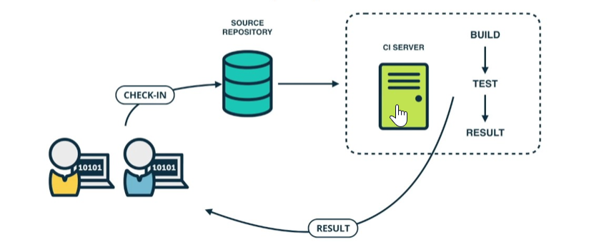
DevOps- Tools Interoperability
Configuration management Tool
SVN, ClearCase, GitLab
Build Management Tool
Jenkins, GitLab
Build Scripts
Custom Ant vs PTC’s BIF
3. Merge to Master
1. Develop
2. Peer Review
Develop – IDE configured to show code quality in real time. Developer fixes on the go
Peer Review using the Configuration management tool – Capture comments inline within the config. tool
Sonar score at Merge request. Only merge high quality code to master. Also, Test results to be shared at Merge request.

Slide 4
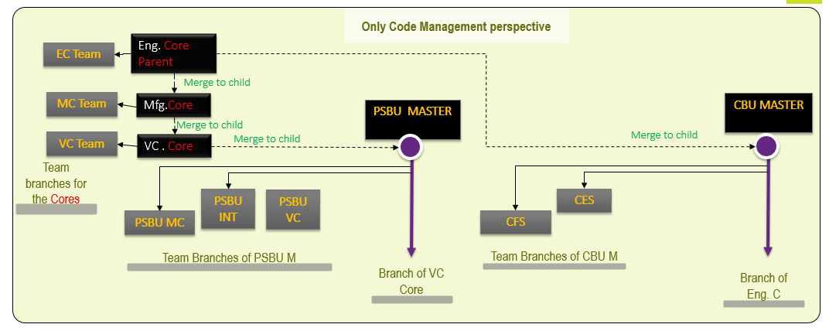

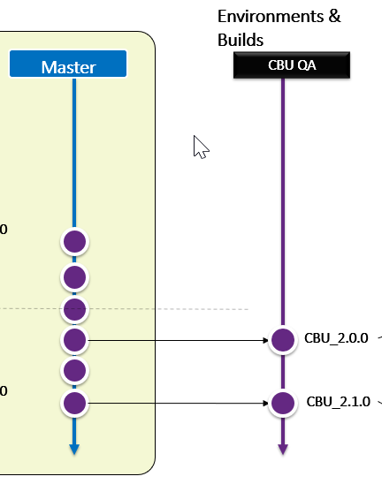


Recommendations summary – Case study for an Engine Major
Configuration Management
Process - Multi-Master
Tool - GitLab
Release Management
Process - Application Based - Single Release
Tool – GitLab*
Build Management
Process – Automated Build**
Tool – ANT custom
However, Due to Licensing issues for PTCS’ BIF, decision was taken to write our custom code (JAV + ANT)
*a slight win over Jenkins
** whatever is supported by PTC code

Slide 5
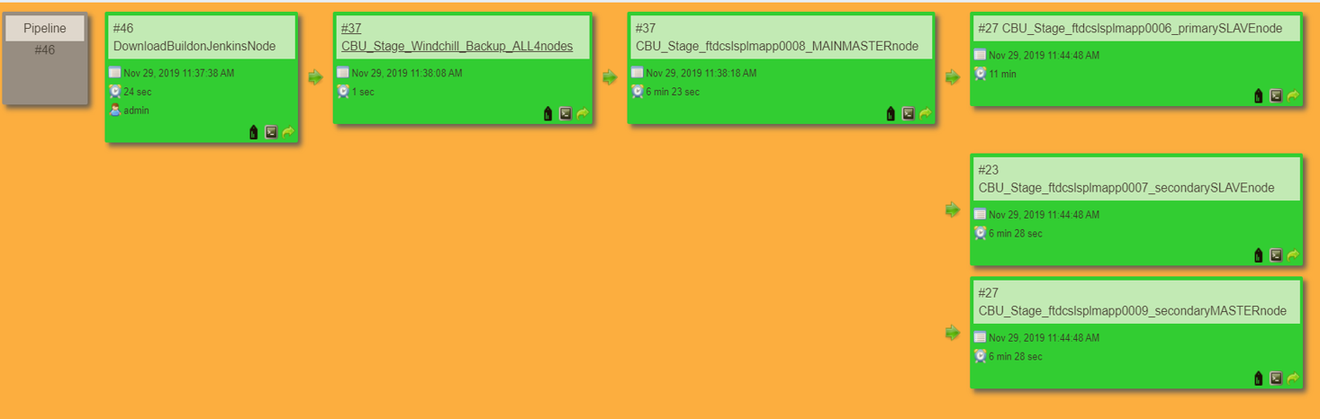
Case Study | Pipeline View For Stage Environment
As this has the FGMS1, does all the Targets mentioned in the below target and runs the LoadFiles.
Target : firstslavebuild_incremental
Approx. Time : 12 mins
Master Node 2
Main Master Node
Windchill_Backup_ALL4nodes– Takes the Backup of Windchill folder on all the 4 nodes on the demand and stores it in LATEST BACKUP folder and moves the existing backup files to PREVIOUS BACKUP folder
Target : backup
Approx. Time:2 Hours
As this has the BGMS1 , does all the Targets mentioned in the the below target and does not run the LoadFiles
Target : othernodes_incremental
Approx. Time:7 mins
DownloadBuildonJenkinsNode –Downloads the files from the GitLab which are between the EARLIER SHA and the NEW SHA commit numbers.
Target : downloadsource
Approx. Time: around 60 seconds.
Slave Node 1
As this has the FGMS2 and BGMS2 respectively , does all the Targets mentioned in the below target and does not runs the LoadFiles.
Target : othernodes_incremental
Approx. Time :7mins
Slave Node 2
Download Job → Backup Job → Windchill Build Jobs (on each node)

Slide 6






Go DevOps | RoadMap
Phase 1 :Development
Continuous Integration (Git),
Continuous development (Jenkins),
Build Automation
Code Quality ChecksSonarQube)
Continuous Testing (Junit, RFT)*
Duration : 4-6 months
Challenges:
Cloud Based focus
Adapting to pure Agile methodology -Some tools (Jira) more suited for Agile
Cultural shift in way of working:
Continuous improvement required by all groups. Tool knowledge a must.
Production Support
Development
Customer Requirements
Development
Agile
Projects
1
Supporting
Documents
Customers
Stakeholders
Scrum Master
Confluence
Document
Management
JIRA
2
Build & Release
Standards
Developer
Eclipse IDE
3
Code Check-in
GITLAB
Phase 2 :Requirements & Project Management
Requirements Management (Confluence)
Issue Tracking(Jira)
Traceability Integrations
JFROG
JUNIT
Automation Test Pipelines
Duration : 3-6 months
PMD
Junit*
Source code Control
4
JENKINS
Functional Testing* (TOSCA/RFT)
Enforce
Cummins
Standards
Code Quality
Check
Sonar Qube
CI-CD
5
PLM Environment
JFrog
ANT
Cummins Development
Standards
Project Artifacts
DEV
QA
Build Procedure Document
Build Automation
STG
PROD
Cummins Internal Use Only

Slide 7








DevOps | Process Flow
Developers checkout code from GitLab via GitHub Desktop
Eclipse configured for sync from GitLab folder to Windchill codebase
Code changes in Team branch and code quality live inspection in Eclipse
Merge requests to Environment specific Branch
Automated Build using Jenkins
Deploy to Dev/QA. Auto-Email Requests to start Automated Testing
Deploy to Staging and Production Clusters
Roll back Strategy
Inline Code review (via Merge. Req) + Inspect Code Quality report
Cummins Internal Use Only

Slide 8
Configuration Management

Slide 9
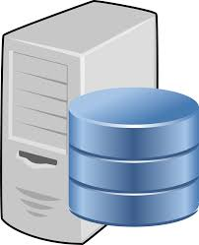
CM| Code Progression
`
Code Management
DEV MASTER (DEV)
Environment and Build
Team1
Team 2
Team 3
QA
STAG + PROD
Support Branch
A single commit
Module specific branch
Merges downstream
REL_1.0.0
Build
Build
Build
Module specific labels are shown in Release scheme slides
patch
Build
REL_1.0.1
2.0
Server specific Branches of MASTER repo
Requests to
Merge upstream
TIME
Build
Bug fixes
Planned for 3.0
REL_2.0.0
Build

Slide 10
GIT

Slide 11
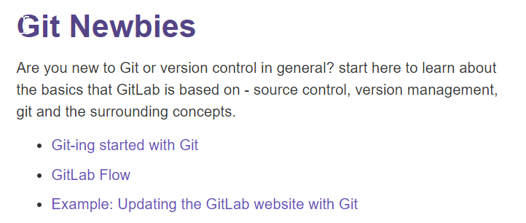
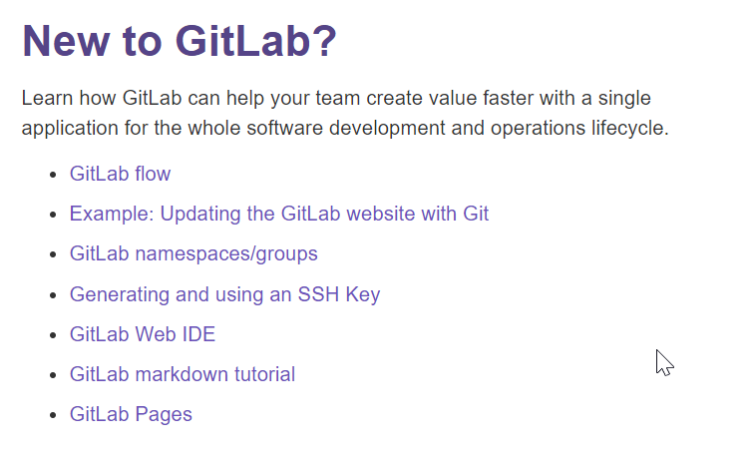
GitLab Training
https://about.gitlab.com/training/
All users need to undergo training available on above URL for the below 2 sections only.

Slide 12

GIT - basics
What’s GIT?
Git is a version control system, like SVN. However, there are some things that differentiate these two systems. First of all, the main difference is that GIT, unlike SVN, is decentralized. This means that we do not need to have access to the internet to approve our changes and each time to load them on the central server. The repository is kept locally so that you can develop functionality on your computer, having the option to return to any of the approved versions. Then, at the moment when we find out that we want to share our work, we use the command to place it on the server
In order to work effectively with the GIT system, you should familiarize yourself with a few basic concepts.

Slide 13
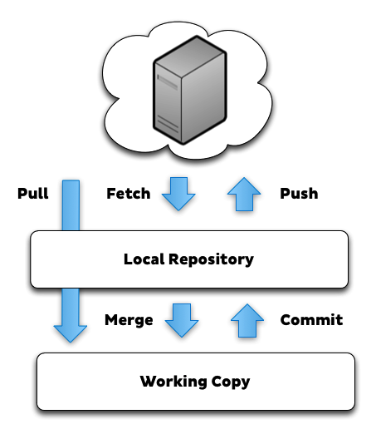
GIT - basics
Nearly Every Operation Is Local. For example, to browse the history of the project, Git doesn’t need to go out to the server to get the history and display it for you — it simply reads it directly from your local database. This means you see the project history almost instantly.
If you want to see the changes introduced between the current version of a file and the file a month ago, Git can look up the file a month ago and do a local difference calculation, instead of having to either ask a remote server to do it or pull an older version of the file from the remote server to do it locally.

Slide 14
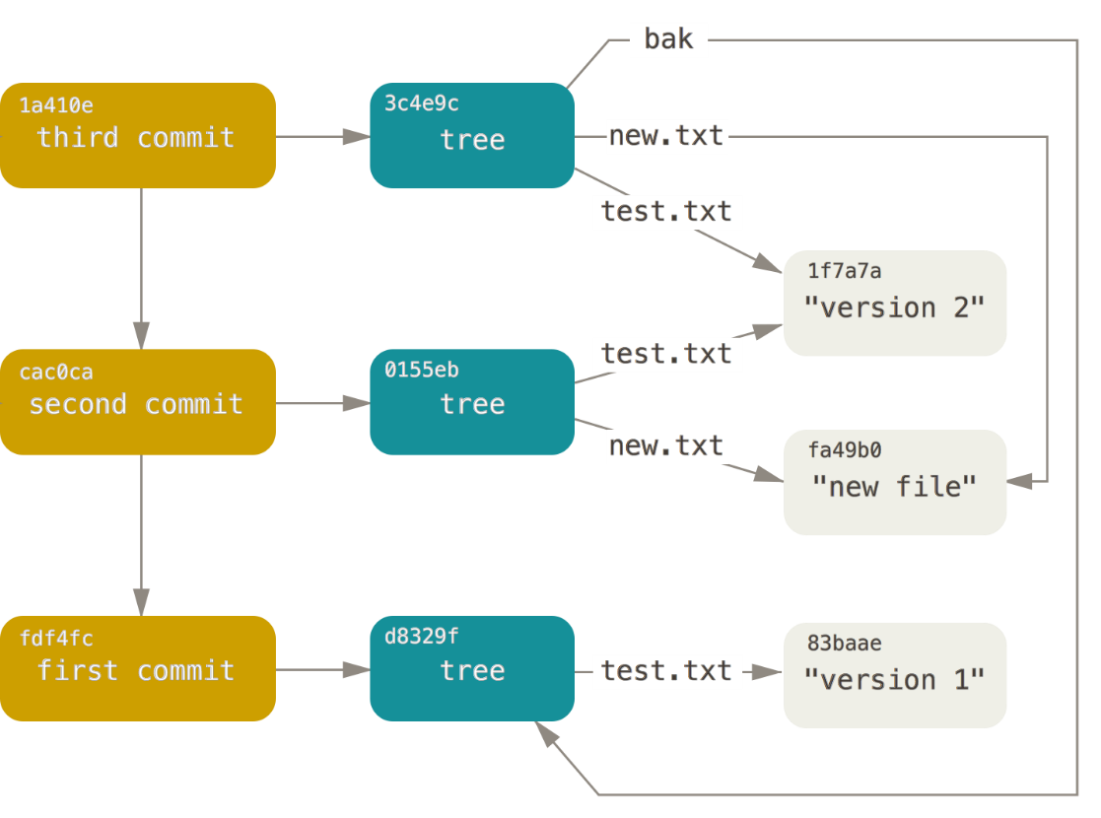
GIT - basics
Every commit in Git is check-summed before it is stored and is then referred to by that checksum. This means it’s impossible to change the contents of any file or directory without Git knowing about it. You can’t lose information in transit or get file corruption without Git being able to detect it.
The mechanism that Git uses for this checksumming is called a SHA-1 hash. This is a 40-character string composed of hexadecimal characters (0–9 and a–f) and calculated based on the contents of a file or directory structure in Git. A SHA-1 hash looks something like this:
90a9da6550002987aa493b52f8696cd6d3b55555
You will see these hash values all over the place in Git because it uses them so much. In fact, Git stores everything in its database not by file name but by the hash value of its contents.

Slide 15

GIT – basics – Tale of 3 states
Git has three main states that your files can reside in: committed, modified, and staged:
Committed means that the data is safely stored in your local database.
Modified means that you have changed the file but have not committed it to your database yet.
Staged means that you have marked a modified file in its current version to go into your next commit snapshot.
The Git directory is where Git stores the metadata and object database for your project. This is the most important part of Git, and it is what is copied when you clone a repository from another computer.
The working tree is a single checkout of one version of the project. These files are pulled out of the compressed database in the Git directory and placed on disk for you to use or modify.

Slide 16
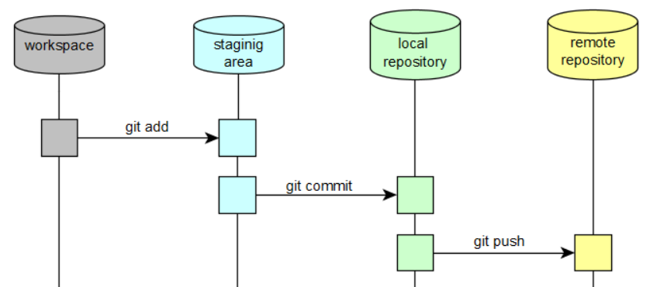
GIT – basic commands
After some part (or all) development is done, the changes should be sent first to the local, then to the remote repository.
First, add new files to the staging area:
git add file_or_files
If a file existed before, git will automatically detect the changes, no need to add anything.
Then do a commit, it will simply make record of your changes that you have made on your local machine. It will not mark the change in the remote repository.
git commit
If your code is ready to be sent to the remote repository, run:
git push
Most of the Git clients has also bellow functionality:
Commit and Push - will do the above and push it to the remote repository. This means that any changes you have made will be saved to the remote repository as well.
Commit and Sync - does three things. First, it will commit. Second, it will perform a pull (grabs the updated information from the remote repo). Finally, it will push. It prevents from push rejection – if there would be any changes on remote repo, Git would not allow to push.

Slide 17
Developer basics| Developer
Trunk / Master
Branch
Module
Branch
Developer’s
Branch
Objectives
Un-interrupted Development of new features and functions regardless of production bugs or change requests
Developers can work directly on Team branch or create their own branches
Main master
Team branch
Hanumesha
Notes
Best practice - users need to regularly ‘update’ their branches from parent branch to avoid merge conflicts piling up at a later date
Best practice - Merge back to Master branch would need an approval workflow.
Traceability to Requirements and Defects – Developer must tag the Ticket number as part of commit.

Slide 18
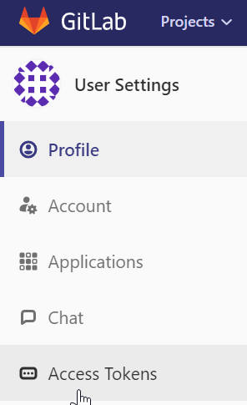
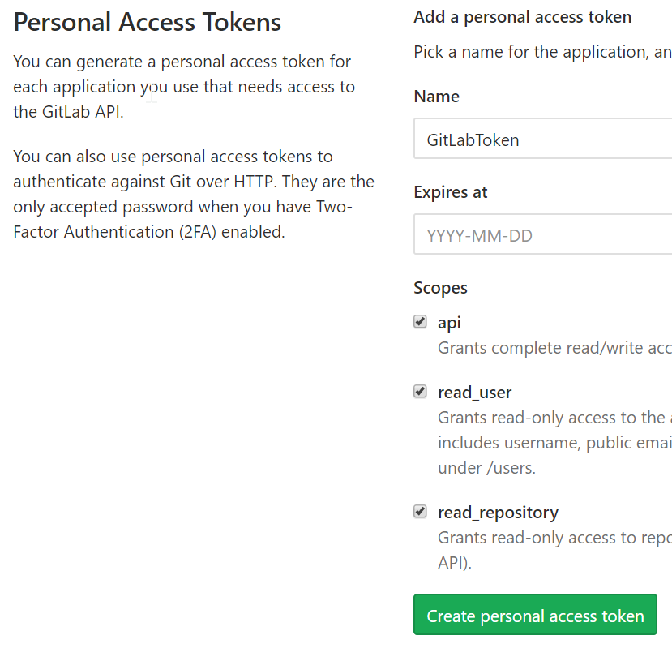
GitHub Desktop setup
GitHub Desktop
Client UI that significantly improves productivity for Developers, Download here. This is a pre-requisite for Developers!
Is compatible with GitLab. All developers need to undergo training available on below URL
https://www.youtube.com/watch?v=77W2JSL7-r8
2 step process post install and you are ready (note that the GitLab URL below may have changed at time of this training)
If you are not directly on Cummins n/w you need to create a tokenGenerate token on GitLab site for your user profile Login to GitLab with your ID and Password > Settings > Access Token. Select ALL rights
Create Personal access Token and keep it safe with you (code format is something like as2ztpAxx3M4mHCWH-Ad ). PLEASE SAVE IT somewhere safe, since you will not be able to copy it later (you will have to re-create a new token)

Slide 19
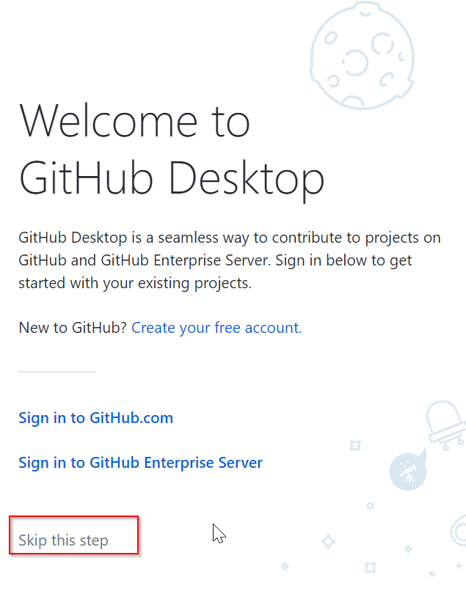
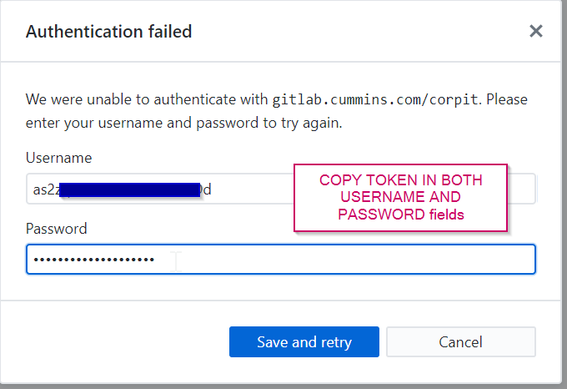
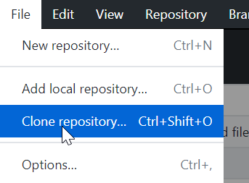
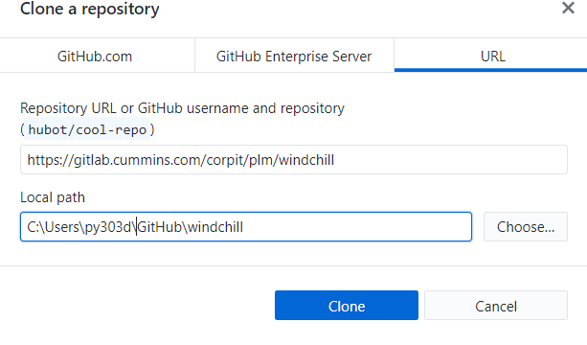
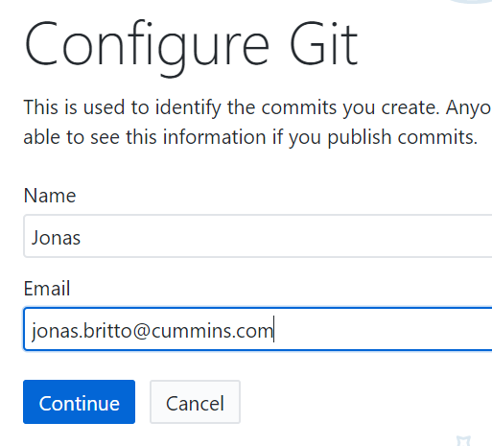

GitHub desktop setup
Gitlab URL for this project - https://TODOCHECKWITH YOUR TEAM LEAD!
Go to GitHub Desktop> Skip the step>Enter your mail> Clone Repository the repo to any local folder, while doing that use the token (only) generated for credentials (if your regular GitLab credentials don’t work. Authentication Failed message should come up next. To which, you enter the copied token from the GitLab page.

