Slide 1
Predicting Wind Force Based on Webcam Images
Project Work Module 3
Marco Steuri
Jonas Büchi

Slide 2
Intro
The „ Möntschelealp“ is a popular take-off spot for paragliders
With strong winds the take-off is difficult especially for inexperienced pilots
The hike to the take-off spot takes about 1 hour
There is no weather station at the take-off spot, only a windsock
However, there is a webcam that publishes a picture of the spot every 5 minutes

Slide 3
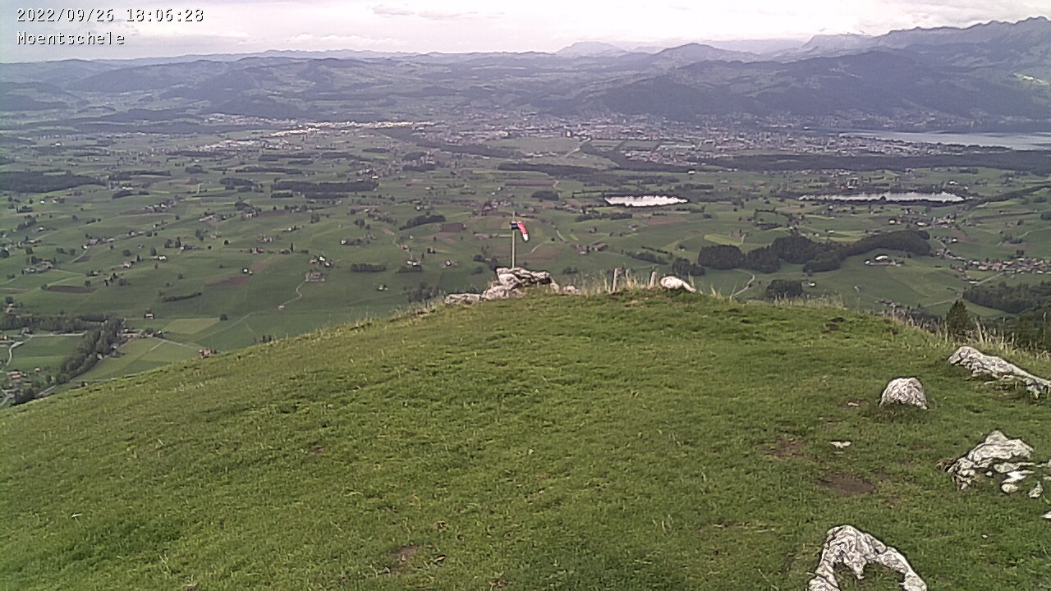
Image of the take-off spot

Slide 4
Problems & Goals
Problem
When the wind conditions are too difficult to take off (strong wind) the pilots have hiked up the mountain unnecessarily
Long term-goal:
Have a system that recognizes the current wind conditions at the take-of spot from the webcam images and extrapolates trough learning on historical data what the condition will be in the next few hours
Intermediate goal
Train a Model to correctly classify classi

Slide 5
Scraping the Images

Slide 6
Labeling of the Images

Slide 7
Data Wrangling

Slide 8
Machine Learning
Model 1: Multinomial Logistic Regression

Slide 9
Machine Learning
Model 2: Neural Network

Slide 10
Results & Diagnostics

