Slide 1
Mental Health in the tech-industry
Project Work Module 2
Nils Sommer
Jonas Büchi

Slide 2

Dataset
Dataset from Kaggle
Mental Health in the Tech Industry
Survey on Mental Health in the Tech Workplace in 2014, 2016, 2017, 2018, 2019
Included participants:
Survey years 2016 to 2019
Workplace in USA
Aged from 16 to 67 (retirement age in USA)

Slide 3
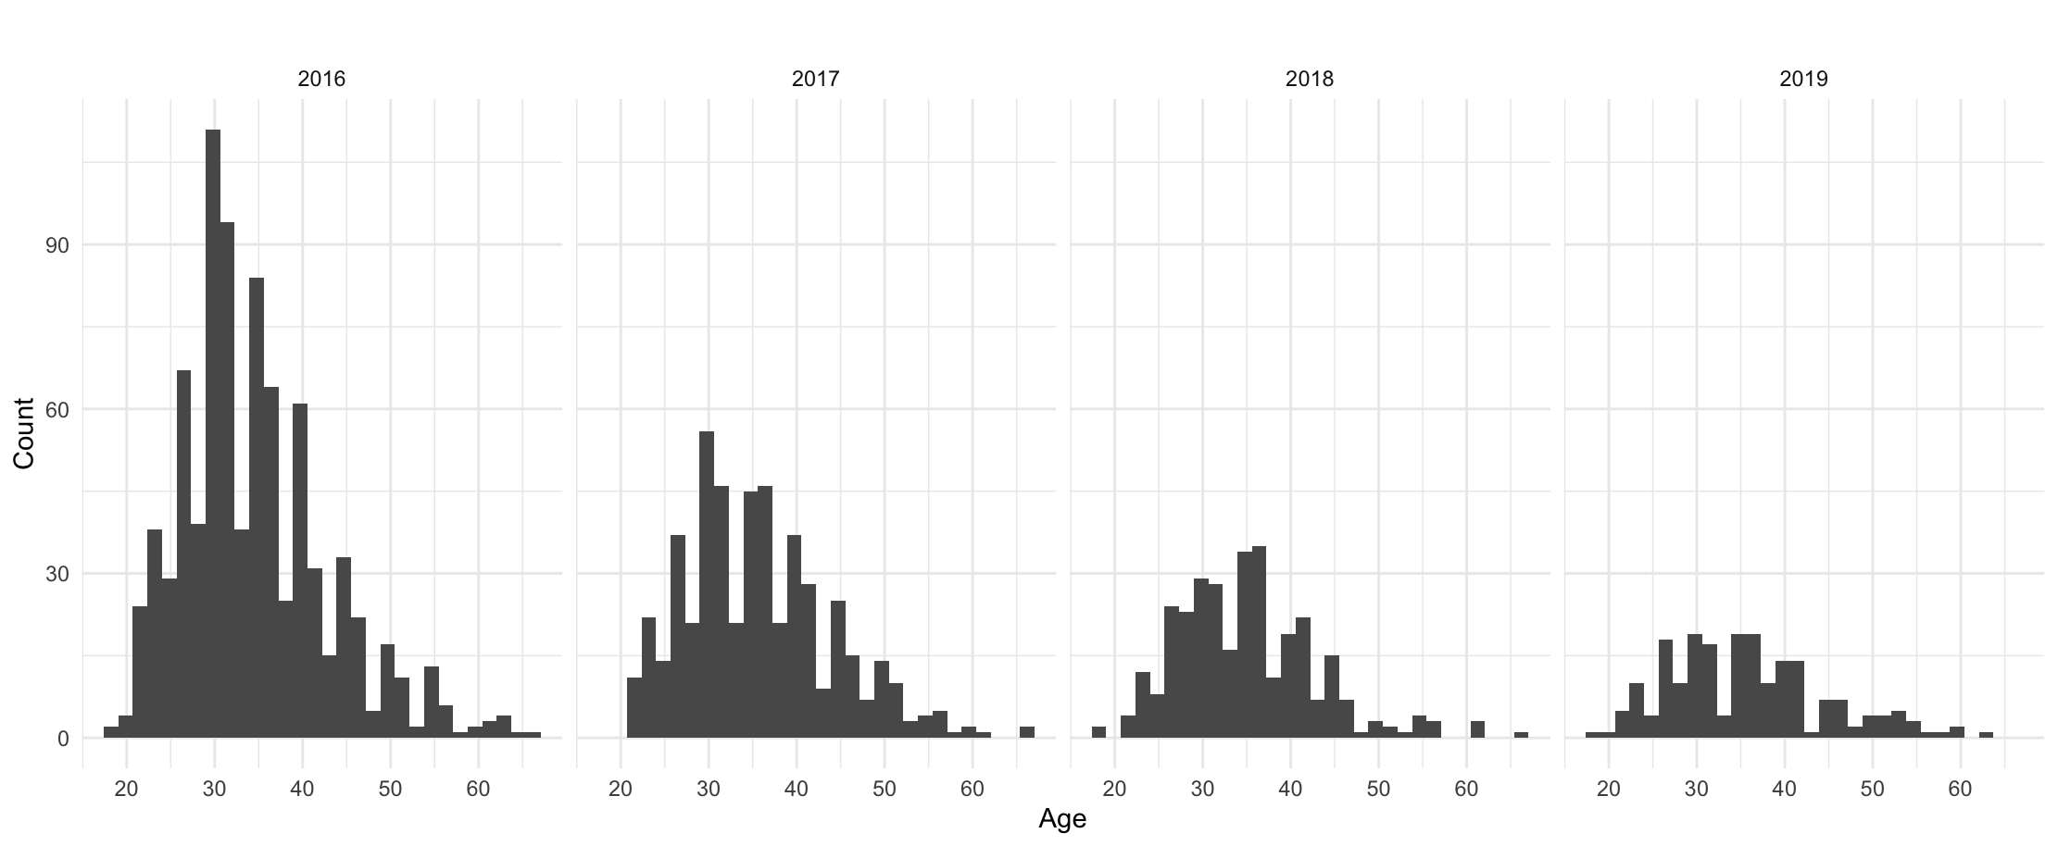
Descriptive Statistics
Distribution of age
Year | Mean | Median | SD | Min | Max | N
2016 | 34.5 | 33 | 8.4 | 19 | 66 | 847
2017 | 35.6 | 35 | 8.4 | 21 | 67 | 503
2018 | 34.9 | 34 | 8.0 | 19 | 67 | 314
2019 | 35.7 | 35 | 9.0 | 19 | 63 | 203

Slide 4
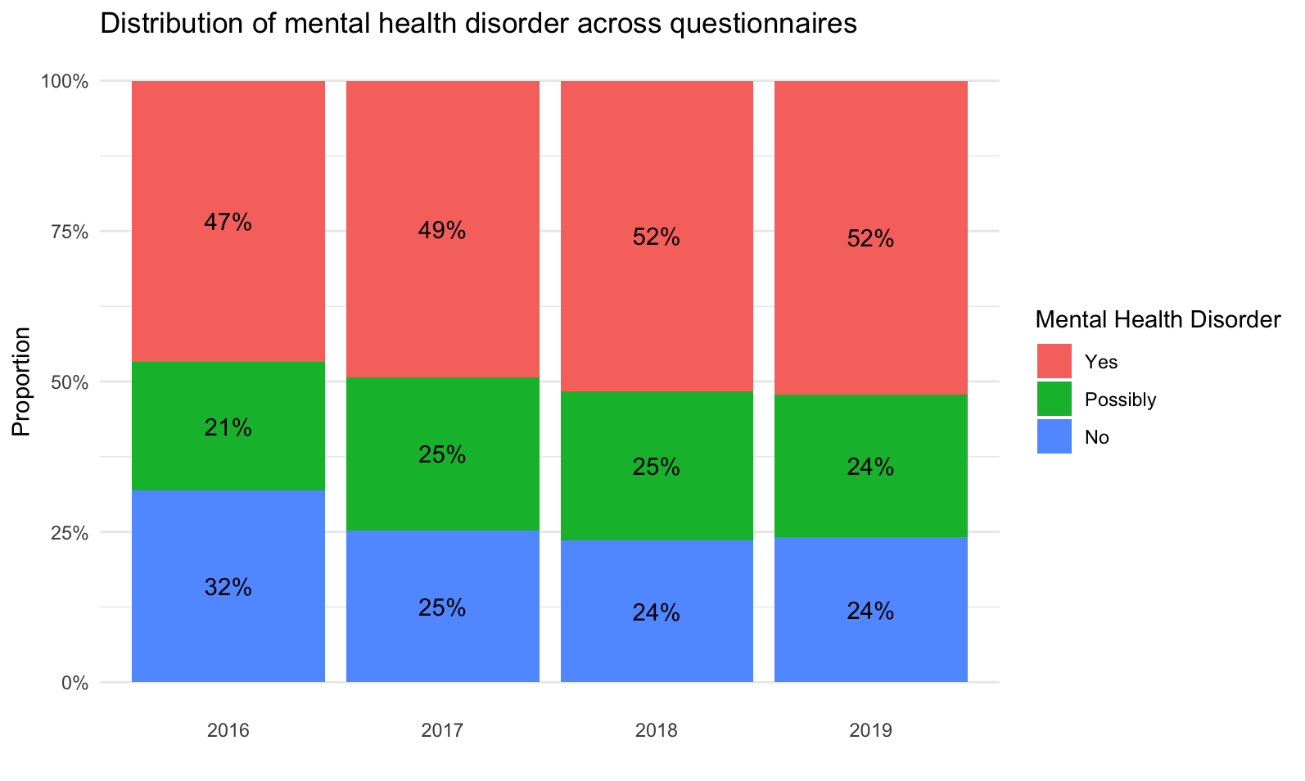
Descriptive Statistics
Distribution of Mental Health Disorder Question

Slide 5
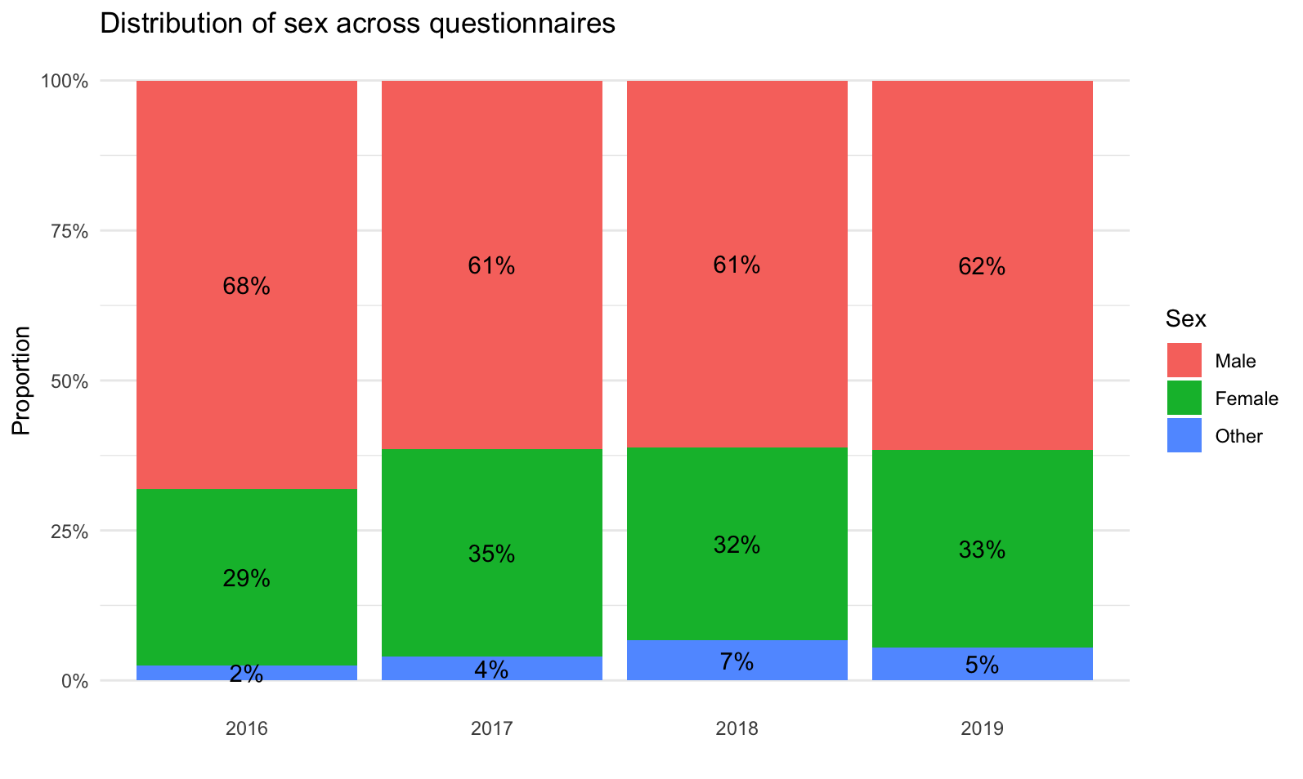
Descriptive Statistics
Distribution of Sex

Slide 6
Research Questions
Does the rate of tech-industry-employees with a mental disorder change over the years?
Is there an association between two categorical variables: year (2016-2019) and current mental disorder (yes - no)?
What factors predict having a mental disorder in the tech-industry?
Family history of mental disorders
Age
Gender

Slide 7
Change over the years
Two-sided Chi-square test of independence
Prerequisites:
Categorical variables
Observations are independent
Cells are mutually exclusive
Expected cell values > 5
df = 3
 | No disorder | disorder | Total
2016 | 270 | 396 | 666
2017 | 127 | 248 | 375
2018 | 74 | 162 | 236
2019 | 49 | 106 | 155
Total | 520 | 912 | 1432
Notes:
Total: 1867 people
Expected value: rowsum * columnsum / total sum
Degrees of freedom

Slide 8
Change over the years
Results:
Chi-square = 10.11
p = .018
Significant! The variables are dependent.
… but what does that mean?
 | No disorder | disorder | Total
2016 | 270 | 396 | 666
2017 | 127 | 248 | 375
2018 | 74 | 162 | 236
2019 | 49 | 106 | 155
Total | 520 | 912 | 1432

Slide 9
Change over the years
Post hoc tests:
Compare all the years with Chi-square tests → Where does the ratio differ?
But: Correction for multiple comparisons (Bonferroni-Holm)
2016 has a lower rate of employees with a disorder
Not significant after correction
No difference between years
 | χ² | p | p_{corrected}
2016 - 2017 | 4.53 | .033 | .167
2016 - 2018 | 6.23 | .013 | .075
2016 - 2019 | 4.22 | .040 | .167
2017 - 2018 | 0.41 | .520 | 1
2017 - 2019 | 0.25 | .616 | 1
2018 - 2019 | 0.00 | .957 | 1

Slide 10
Factors predicting mental disorder
Logistic regression
Hypotheses: the probability of having a mental disorder is …
… higher if there exists a family history of mental disorders
… lower when age is higher
… higher if gender is female
Prerequisites:
Binary dependent variable
Independent observations
No multicollinearity
Sufficient sample size (various rules of thumb)
Notes:
If asked: tested age with box Tidwell – was significant, but power problem with high sample size

Slide 11
Factors predicting mental disorder
Results:
Pseudo-R²: 0.21
Effect size f²: 0.26 → medium overall effect
 | B | e^{(B)} | p
Family history | 2.20 | 9.06 | < .001
Age | -0.03 | 0.97 | < .001
Gender | 0.47 | 1.60 | .002

Slide 12
Factors predicting mental disorder
Again, what does that mean?
If there is a family history of mental disorder, the relative probability / risk of mental disorder is 806% higher! (factor 9.06)
For each year people get older, the relative risk of having mental disorder sinks by 3 %
Women have a 60% higher relative risk of having a mental disorder

Slide 13
Sources
Dataset: https://www.kaggle.com/datasets/anth7310/mental-health-in-the-tech-industry
Kaggle-image: https://www.kaggle.com/static/images/site-logo.svg

