Slide 2
Dataset & Descriptive Statistics
Included participants:
Workplace in USA
Aged from 16 to 67 (retirement age in USA)

Slide 3
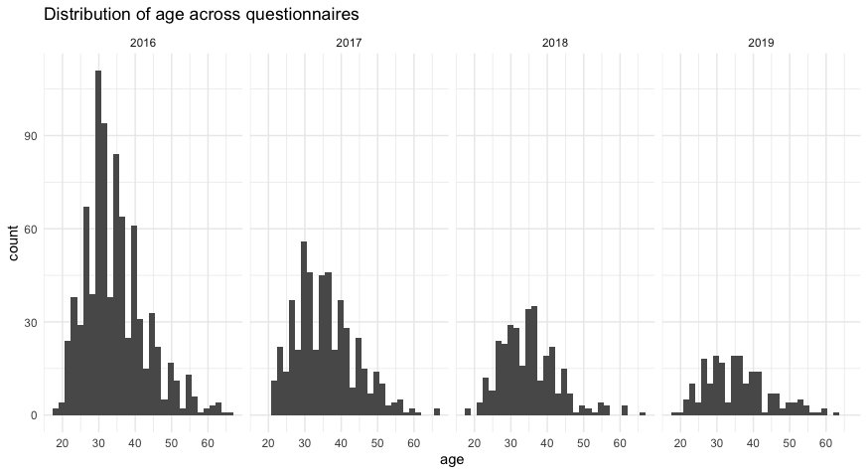
Distribution of age across questionnaires:
Year | Mean | Median | SD | Min | Max | N
2016 | 34.5 | 33 | 8.4 | 19 | 66 | 847
2017 | 35.6 | 35 | 8.4 | 21 | 67 | 503
2018 | 34.9 | 34 | 8.0 | 19 | 67 | 314
2019 | 35.7 | 35 | 9.0 | 19 | 63 | 203

Slide 4
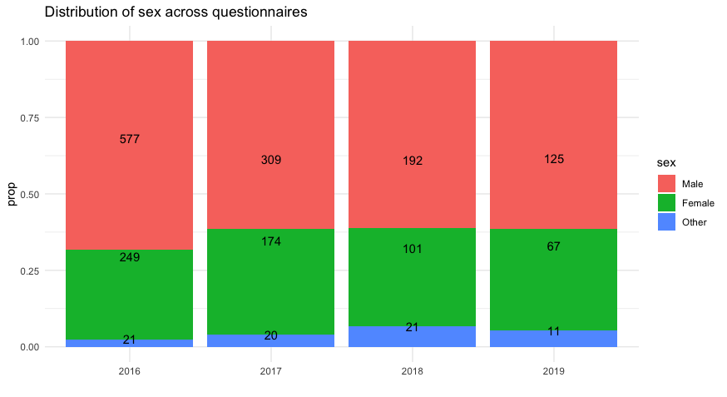
Distribution of sex across questionnaires:

Slide 5
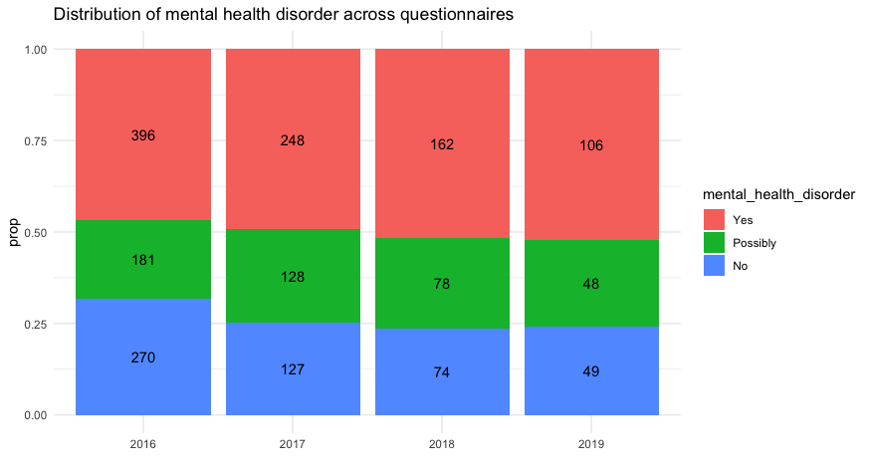
Distribution of mental health disorder across questionnaires

Slide 6
