Slide 1


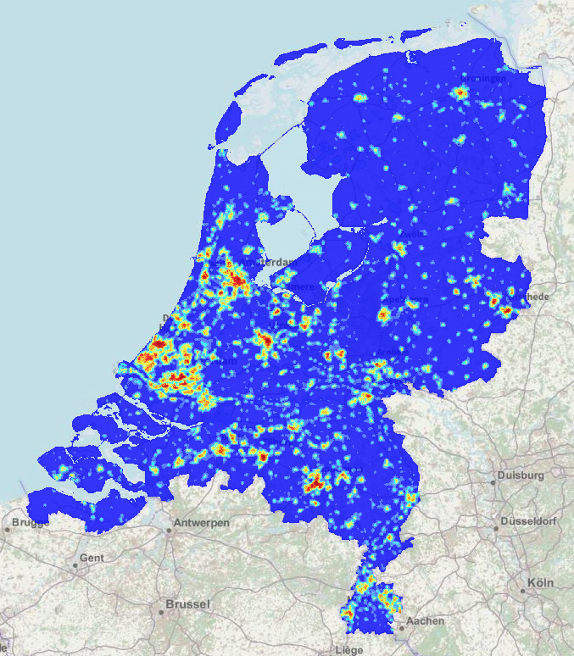




Dutch model

Slide 2
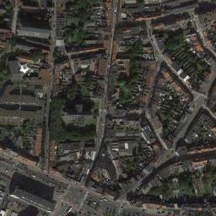
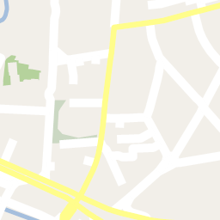

Neural network
400m
+
400m

Slide 3

Neural network
+
400m
400m

