Slide 1
Intro to Docker

Slide 2
Problem statement
In data science you often work locally on projects that will be deployed remotely.
Ensure that your application runs the same locally as remotely.
Works locally
But might fail remotely
read.csv(“C:\Users\u0110176\...\file.csv”)
python –m “script.py”
require(“tidyverse”)
minimum <- nlm(func, c(0.5))
format(date, “%b”) == “Jan”
Because local files are unavailable
Because the required software is not installed
Because the required packages are not installed
Many “stochastic” functions return a different output depending on the OS and
Because the remote server uses different language settings

Slide 3
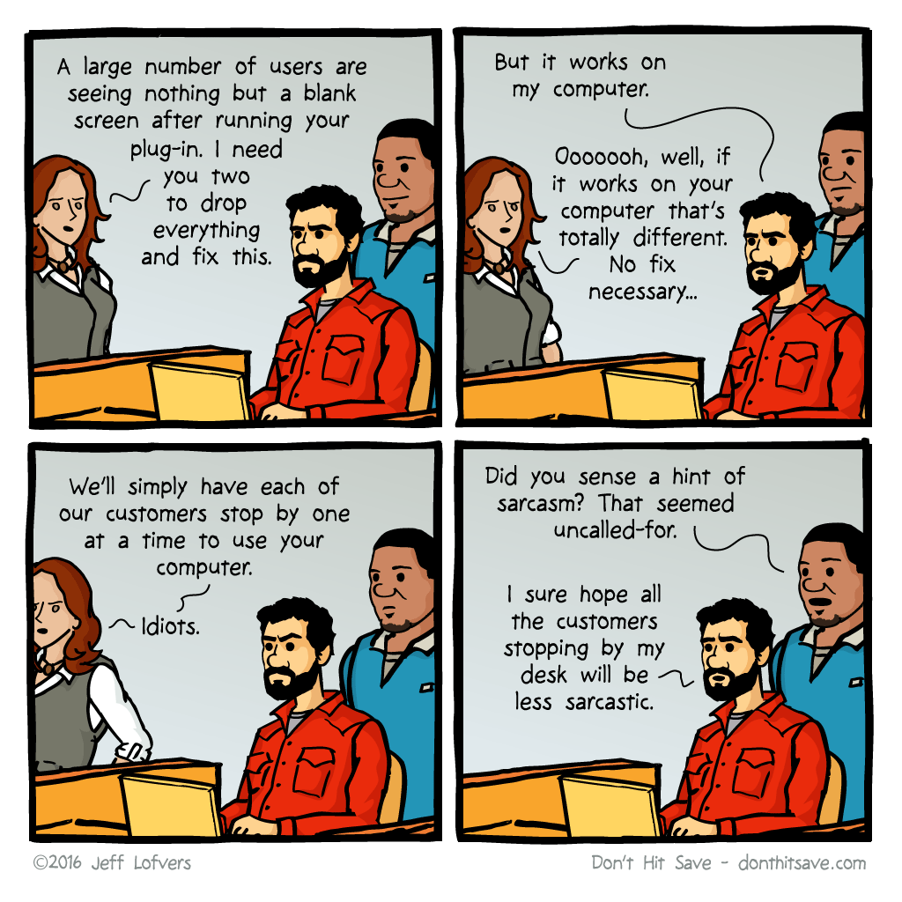
Problem statement

Slide 4
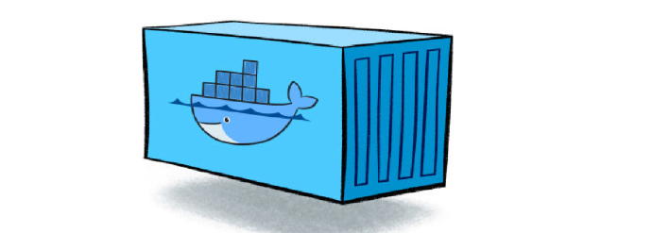
What is a container?
A package containing everything needed to run your application:
An operating system (e.g. Ubuntu 22.10)
With the required software installed (e.g. R, Python)
With the required packages installed (e.g. tidyverse, pandas)
Containing the code required to run your application
…
Building a container gives you almost full control of the execution environment. If the containerized application works on your computer, it will probably work remotely.

Slide 5
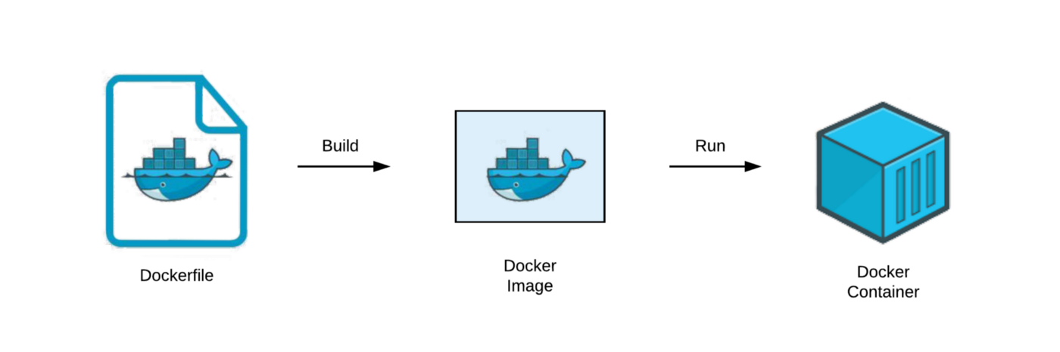
What is Docker?
Docker is a platform for creating and running containers
Dockerfile: Text file specifying how the container for your application should look (OS, packages, required files, …)
Docker image: An immutable prototype of a container for your application
Docker container: A running version of your application

Slide 6
What you will learn today
Dockerfile:
How to write a dockerfile
Docker image:
How to build a dockerfile into a docker image
How to manage local images
Docker container:
How to run a container based on a docker image
How to manage running containers

Slide 7
Docker CLI
Docker is most often used as a CLI. Docker manages images and containers which is reflected in the syntax of the CLI
> docker image < subcommand >
Manage local docker images
> docker container < subcommand >
Manage local docker containers
In practice, the main command is often omitted
> docker container run < param >
> docker run < param >

Slide 8
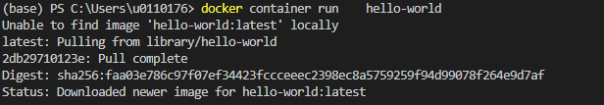
> docker container run
Run a container using an existing image
> docker container run <options> <image name>:<tag> <command>
Image name without tag
docker automatically adds the tag “latest”
When docker cannot find the image locally, it will automatically try to download the image from Dockerhub
https://hub.docker.com/_/<image_name>
When you google “docker” + “image name” this is usually the first page you find

Slide 9
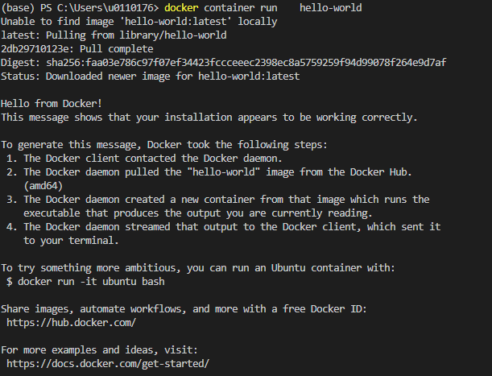
> docker container run
Run a container using an existing image
> docker container run <options> <image name>:<tag> <command>
Output from the docker run command
Logs from the container are streamed to the terminal

Slide 10
> docker container run options
Common options for docker run
--name “my-first-container”
Assign a name to your container. This makes it easier to identify and reference it later.
-d
Run the docker container in ‘detached’ mode. Logs are not streamed to the terminal.
-it
Connect your local terminal to the shell of the container. This lets you use the container interactively.

Slide 11
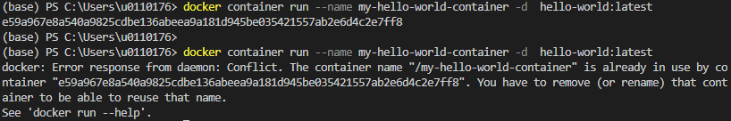
> docker container run
Run a container using an existing image
> docker container run <options> <image name>:<tag> <command>
options
tag
Docker container names are unique. An error is raised when trying to create a container with the same name.
The output from the container is not displayed in the terminal, because the option –d was used.
The returned value “e59a967…” is the ID of the container, which can be used to reference the container in other commands.

Slide 12
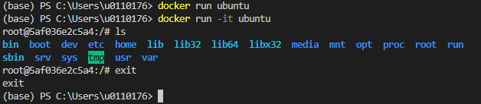
> docker container run
Run a container using an existing image
> docker container run <options> <image name>:<tag> <command>
Running commands in the shell of the ubuntu container
Interactive mode -it is very useful for inspecting and resolving issues

Slide 13
> docker container run
Run a container using an existing image
> docker container run <options> <image name>:<tag> <command>
Running commands in the shell of the ubuntu container
Interactive mode -it is very useful for inspecting and resolving issues

Slide 14
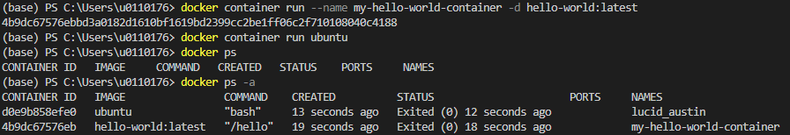
> docker container ps
List containers, ps stands for process status
> docker container ps <options>
Default only lists running containers
-a
Show all containers, including stopped ones

Slide 15
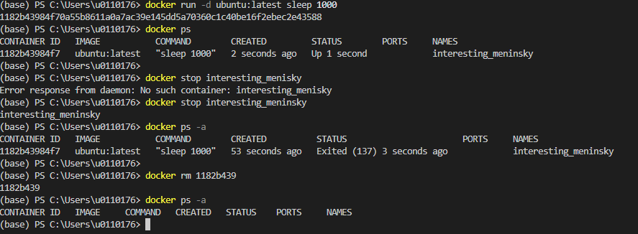
> docker container stop/rm
Stop and remove containers
> docker container stop <options> <container names or ids>
> docker container rm <options> <container names or ids>
Run this command when the container starts
Refer to the container by name
Refer to the container by name

Slide 16

Exercises
Exercises available on:
https://github.com/jonascrevecoeur/docker-training
Gitpod:
You define your workspace via a Dockerfile
Gitpod builds and runs this container remotely
You connect remotely to this container
Important, the free version of Gitpod has a timeout of 30 minutes. So make sure to commit your work regularly:
git add .
git commit –m “<commit msg>”
git push

Slide 17
Container ports
Until now we have communicated with our running docker containers using the terminal in interactive –it mode.
Many containers expose ports for interacting with the container. To use these ports, they have to be mapped to ports of the host machine.
In docker container run add the option:
-p <port host machine>:<port container>

Slide 18
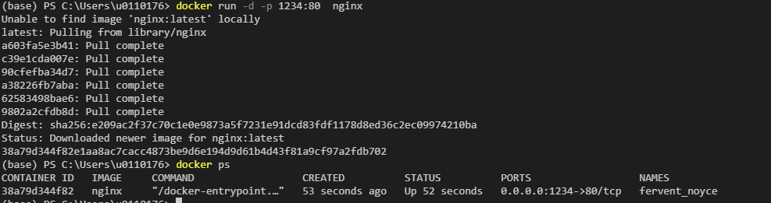
Container ports
Nginx is a popular webserver, which exposes port 80
To find out which ports are exposed read the documentation of the image: https://hub.docker.com/_/nginx
Run the image in detached mode and forward port 1234 on the local machine to port 80 of the container
Assess the webpage by typing http://localhost:1234 in a browser

Slide 19
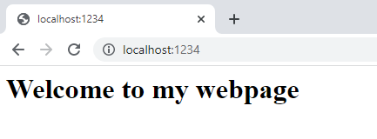
Volumes
The option –v maps a local volume (folder) to a folder in the container.
Syntax:
-v <local file path (absolute)> : < container file path (absolute) > : < settings >
Read only
Absolute, local file path
Path in the container
→ Obtained from documentation

Slide 20
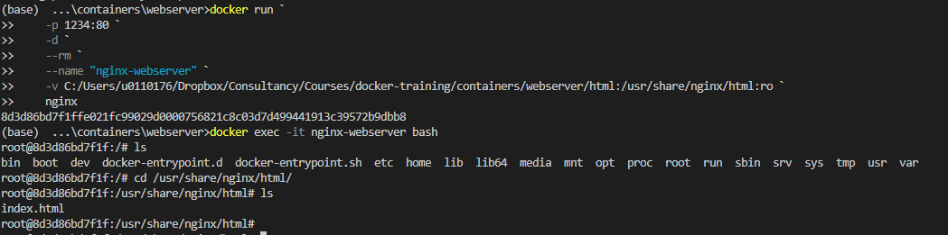
> docker exec
The debugging tool for containers … with also some other use cases
Execute a command on a running container
> docker container exec stop <options> <container names or ids> <command>
Automatically remove the container when it is stopped
Get interactive access to the containers shell

Slide 21


Exercises

Slide 22


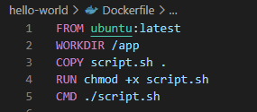
Writing a Dockerfile
Hello world in the Docker universe
Folder with files:
Dockerfile (no extension)
script.sh
Script.sh:
Prints “Hello world from inside a container!”
Executed when the container is created
Dockerfile:
Describes the container through code

Slide 23
Writing a Dockerfile
FROM
Add layers to an existing Docker image
Always the first line of a Dockerfile
WORKDIR
Create folder (if not exists) and move to it
Equivalent to mkdir + cd in a linux terminal
COPY
Copy local files into the container
COPY script.sh . copies the file script.sh in my current directory to the directory where I’m currently located in the container, i.e. /app
You can have multiple COPY statements in a Dockerfile

Slide 24
Writing a Dockerfile
RUN
Run code in the shell of the machine
On Linux this is equivalent to /bin/sh –c
Dockerfiles usually have many RUN statements. There are even advantages in breaking long RUN statements into multiple shorter RUN statements.
CMD
Sets the default code to run when starting the container
Can be overwritten in the container run command

Slide 25
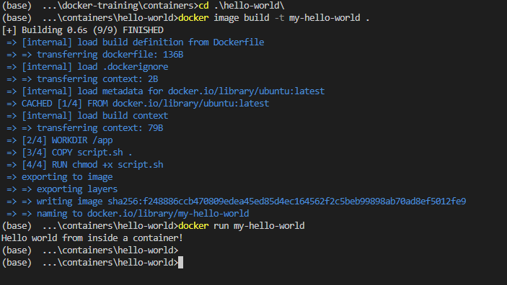
> Docker image build
Build a Docker image from a Dockerfile
> docker image build –t < image name >:<tag> <path to the Dockerfile>
Navigate to the location of the Dockerfile
This layer is cached
These layers are created during docker build

Slide 26

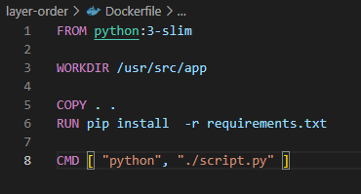

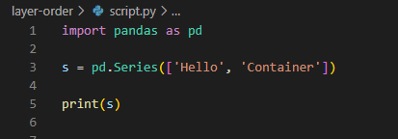
Order of layers
We are going to create a Python container, which runs a simple script. This script requires {pandas}, which we install using pip

Slide 27
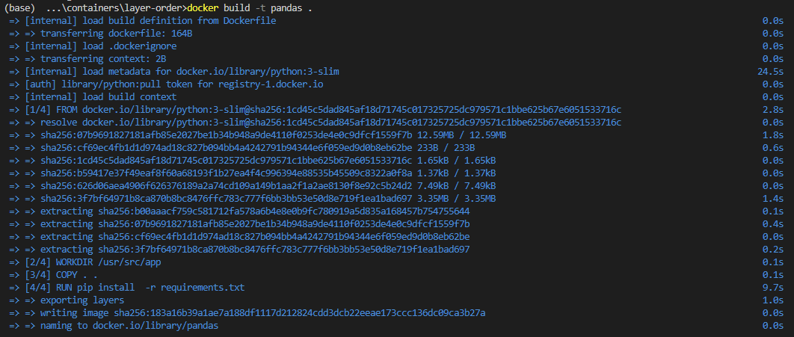
Order of layers
There are two slow tasks when building the container
Downloading metadata from Dockerhub
Installing packages

Slide 28
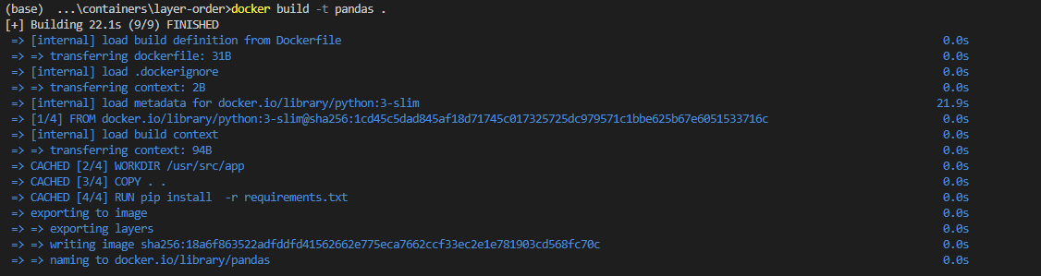
Order of layers
Let’s rebuild the image
Rebuilding is fast as the package layer has been cached

Slide 29
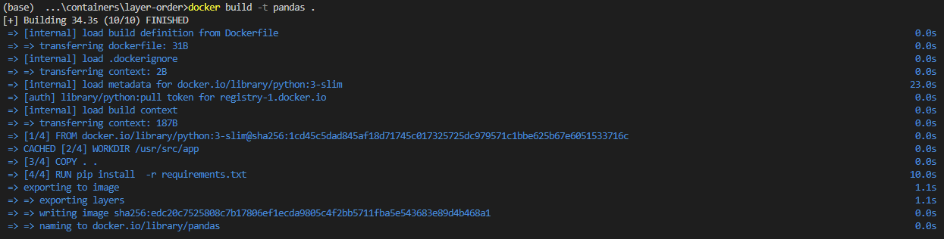
Order of layers
Edit script.py and rebuild the container once more
Because layer 3 COPY has changed, all the following steps have to be recomputed

Slide 30
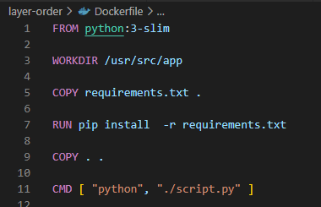
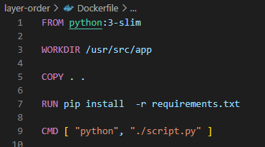
Order of layers
Fast
Slow
Try to put commands that change frequently at the bottom of the Dockerfile

Slide 31

Exercises

Slide 32
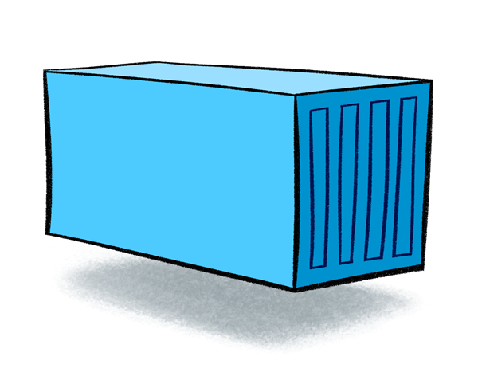



Container orchestration
Until now each container was an application on its own
In practice, many applications consist of multiple containers. Each container solving a single task.
We can run each container separately from the terminal, but as they depend on each other it would be more convenient to run them as a group
Website
Database
Database administration

Slide 33
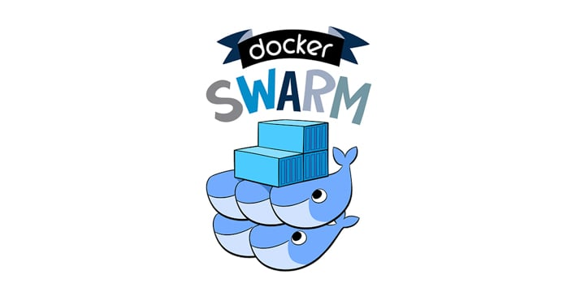
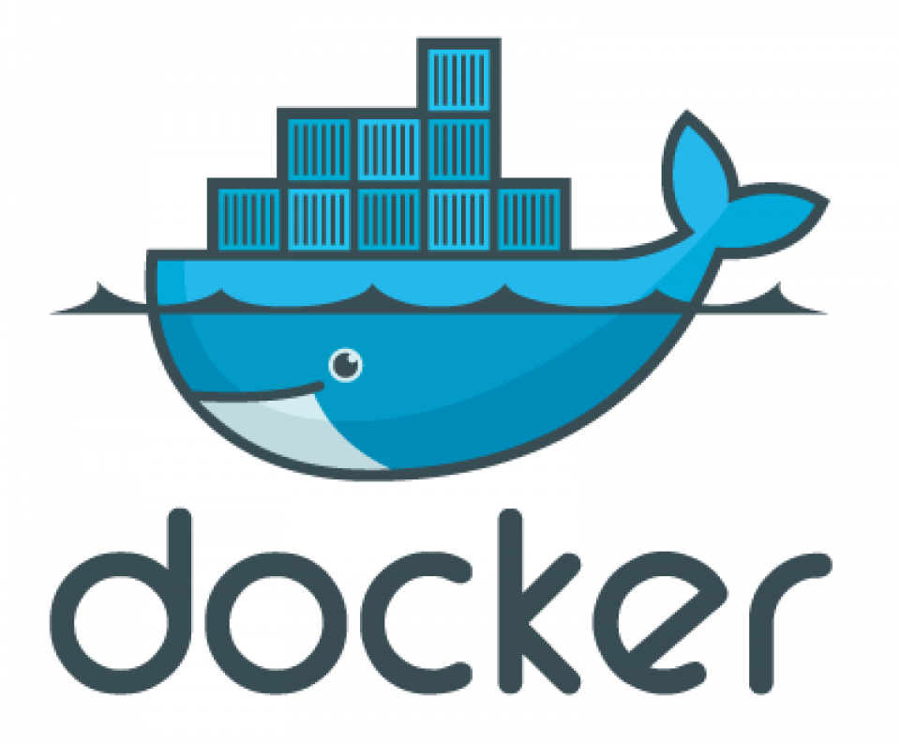

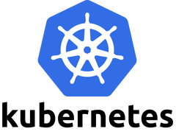
Container orchestration
More orchestration

Slide 34
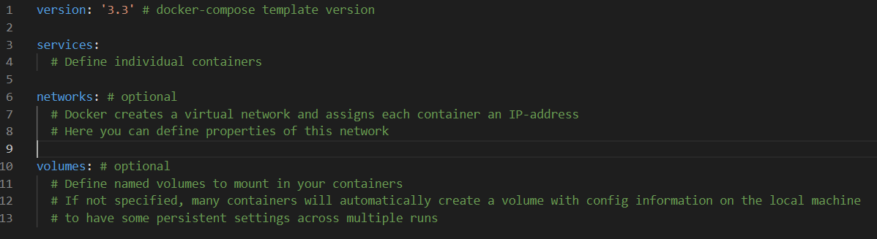
compose.yml
yml template file
Specifies all containers we want to run and their parameters + some additional settings
General structure:

Slide 35
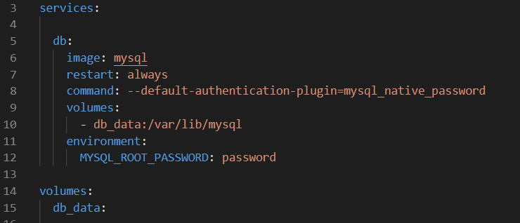
compose.yml
Creating a mysql database service https://hub.docker.com/_/mysql
Each service is given a name
Create a local volume to store the data of the database. My database is preserved when the container is stopped
See the Dockerhub page of mysql to discover the required settings

Slide 36
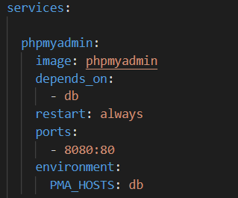
compose.yml
Adding phpMyAdmin https://hub.docker.com/r/phpmyadmin/phpmyadmin/
Create this container after the one for the mysql database
Map ports such that we can connect to this service Note that no ports were mapped for the mysql container and we will be unable to reach it directly
IP address of the database
db will resolve to the private IP address given to the mysql container

Slide 37
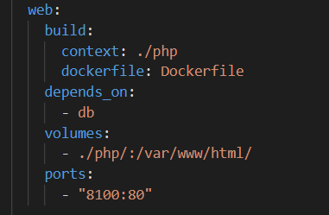
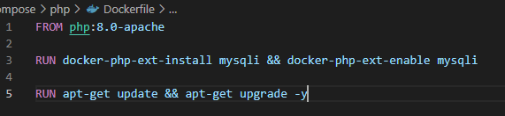
compose.yml
php website https://hub.docker.com/_/php
Use a custom Dockerfile. Provide docker-compose with the location of the Dockerfile
Website based on local files
We have to install “drivers” for mysql in the default php image

Slide 38
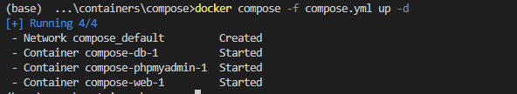
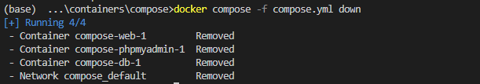
> docker compose up/down
Start the application
> docker compose –f < filename> up <options>
Default network created
Db is created first as the other two services depend on it
Stop the application
> docker compose –f < filename> down

Slide 39
Exercises

Slide 40
Container registries
Containers are stored in container registries.
In this workshop you have downloaded containers from Docker Hub and stored your containers in your local repository (own machine).
To upload your containers to a container registry, you have to:
Create an account with the registry (Docker Hub has a free option)
Login the the container registry
Name and tag your image in a specific format prescribed by the container registry
Push your image to the container registry

Slide 41
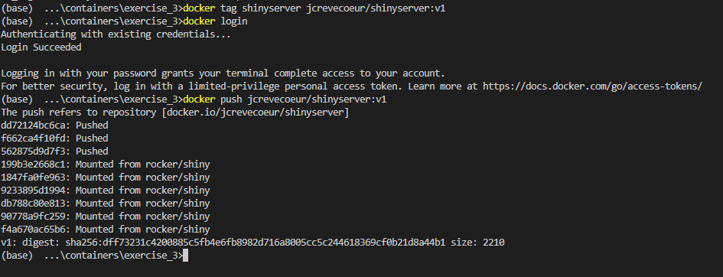
Container registries
docker tag <image>:<tag> <new name>:<tag> Add a name/tag to an existing local image
docker login <options> <server> Login to a container registry
docker push <image name> Upload an image to a container registry
Tag image in the format for Docker Hub <account name>/<image name>:<tag>
Docker Hub is the default registry. If you want to connect to a different registry you have to specify the server

