Slide 1
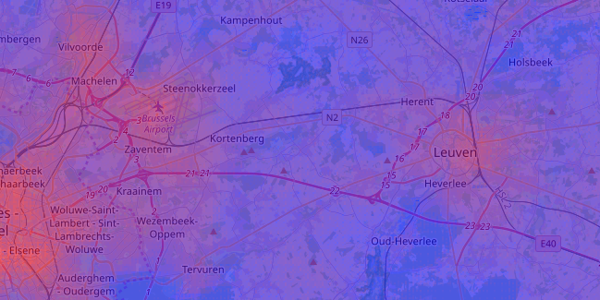

Natural elements in cities reduce heat stress

