Slide 1
Efficient Segmentation
Jonas-Lars Sitzmann 31.01.2023

Slide 2
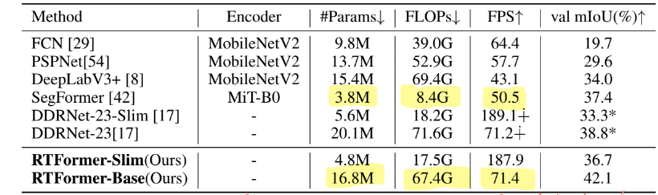
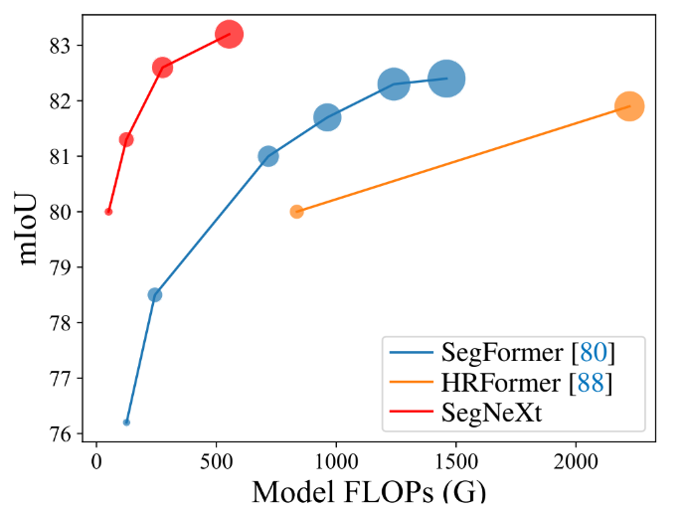
Be aware
Flops behave very differently from fps. Still helpful?
possibly still valuable when comparing similar architectures
ImageNet pre-training!
Bär: 2 weeks for resnet 18
Möller: a month for more complex models
Who suggested „when experimenting w/o imagenet pre-traing, the results transfer to experiments w/ imagenet pre-training“?
Is this meaningfull at all?

Slide 3
Common techniques
Different branches for high and low resolution features. Exchange information
Even 3 branches (PIDNet)
For convolutions
Depth-wise separable convolutions
Even separate x and y (segnext, ERFNet)
Deeper network with cheaper layers (e.g. EffCRN and convnext)
For Transformers
More efficient attention mechanisms (e.g. GPU-friendly attention, RTFormer)
General: combine attention and convolutions
Convolutions in early stage (RTFormer)

Slide 4
Possible models to consider
Name | Year | Why
Deeplabv3+ | 2018, CVPR | Common CNN Baseline
Convnext (upernet?) | 2022, CVPR | Sota general CNN
segformer | 2021, NeurIPS | Famous, efficient Transformer for segmentation
Segnext (8x 3090) | 2022, NeurIPS | Beats segformer with convs (no fps in paper)
RTFormer (4x V100) | 2022, NeurIPS | Real time, transformer based
DDRNet | 2021, arXiv | Was real time sota in 2021
PIDNet | 2022, arXiv | Beats DDRNet
Use these beause they are well established and work with the MMSeg
codebase
Real time: > 30 fps,
No common code-base

Slide 5
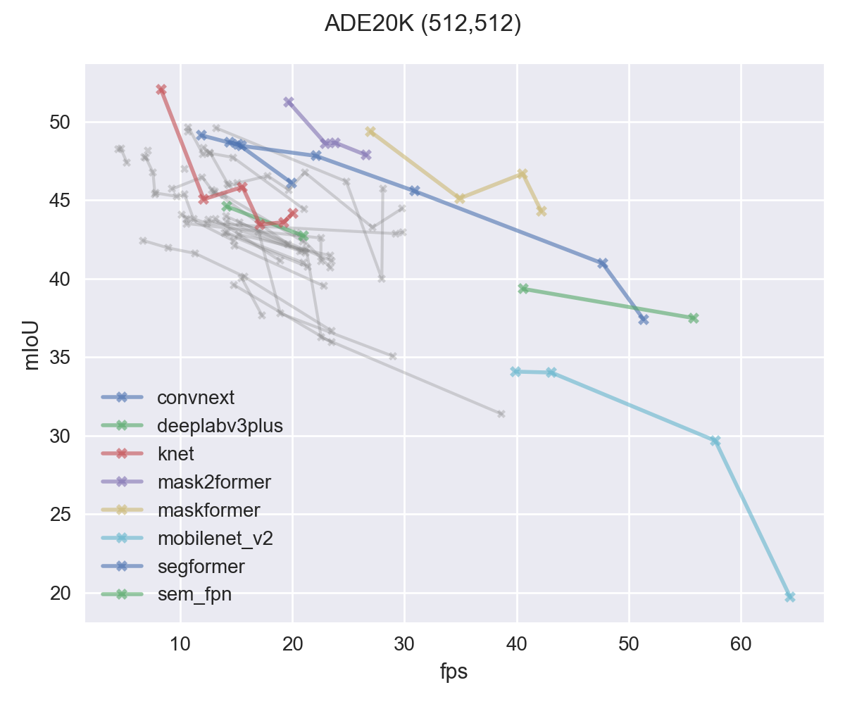
Results reported from MMSeg - not reproduced!
Many results available for ADE20K (512,512)
Same GPU
Colored: „best“ models

Slide 6
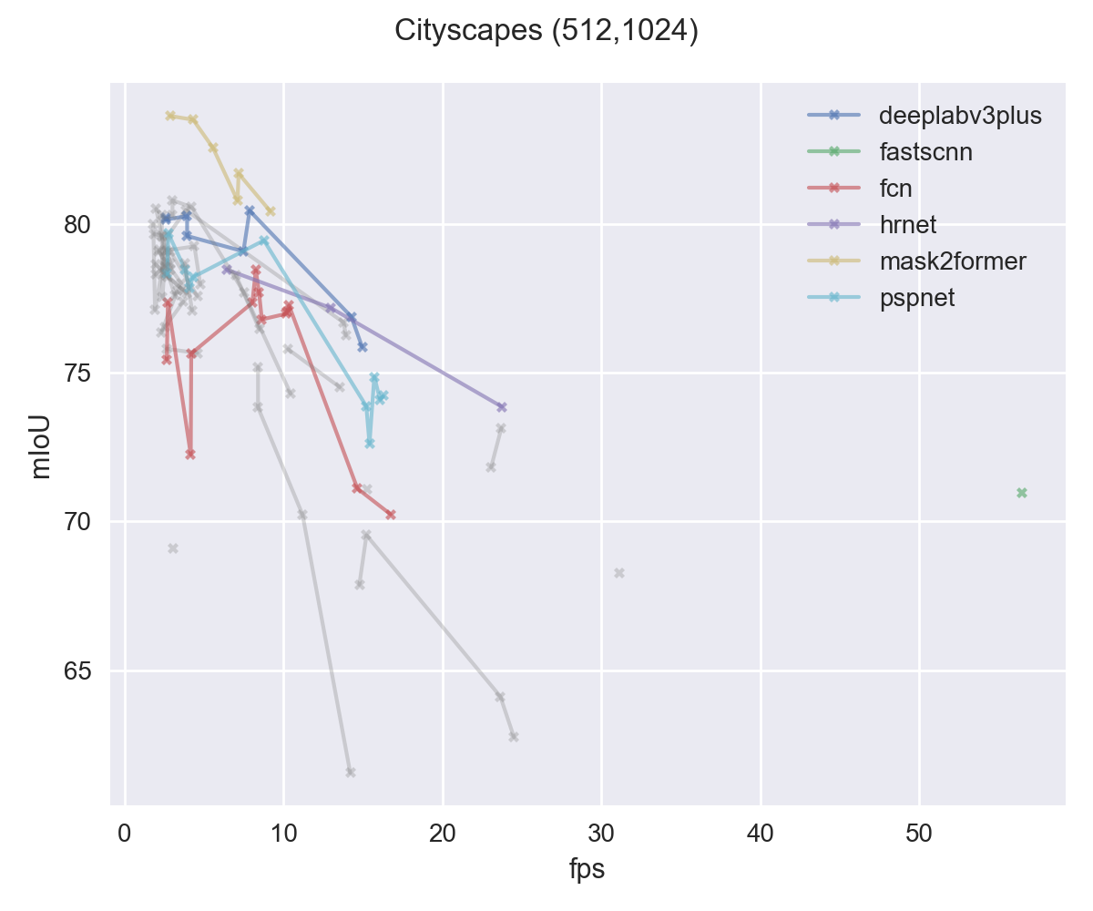
Fewer results available for Cityscapes (512,1024)
Old models still among the best

Slide 7
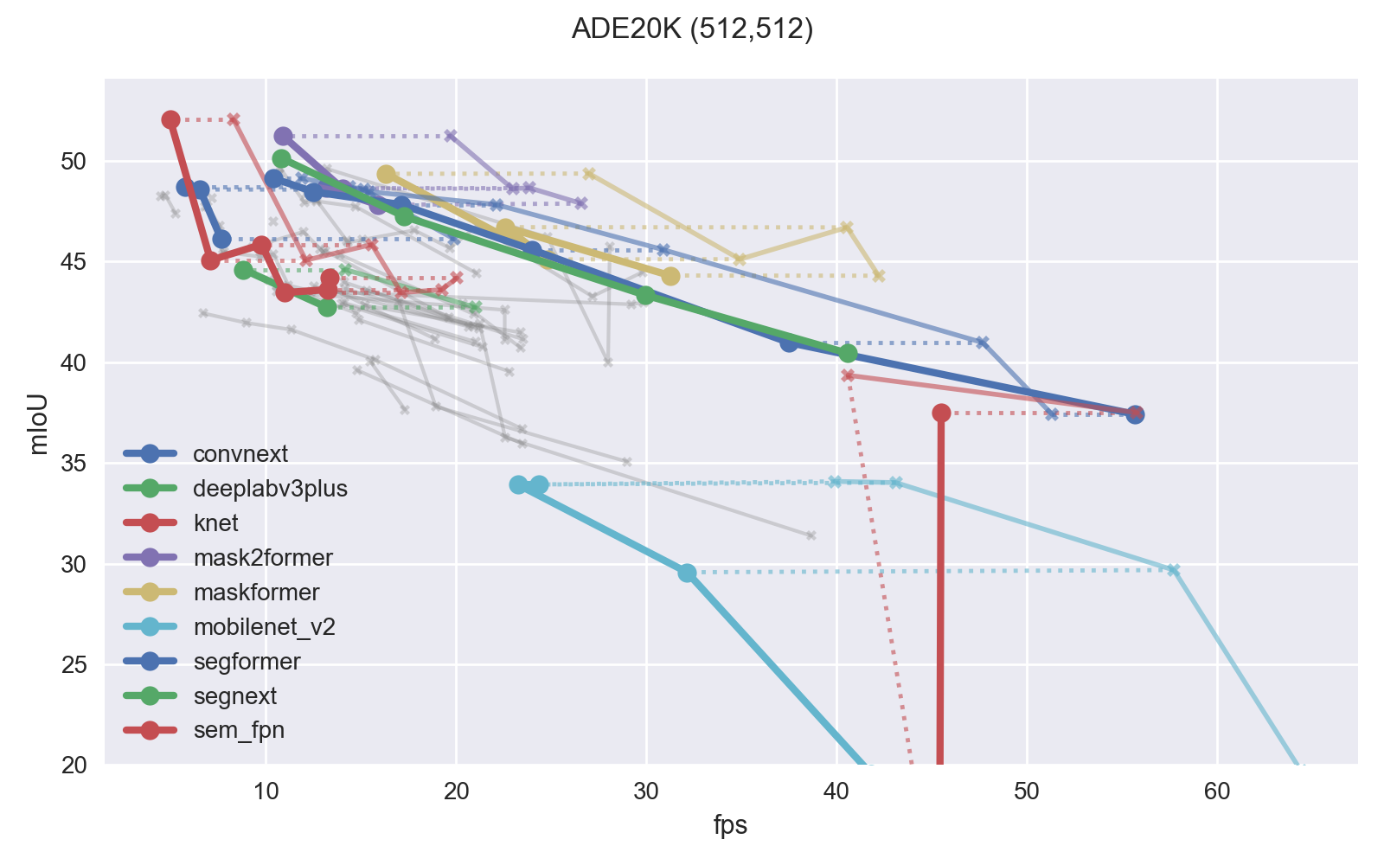
Reproduced Results with 1080ti

Slide 8
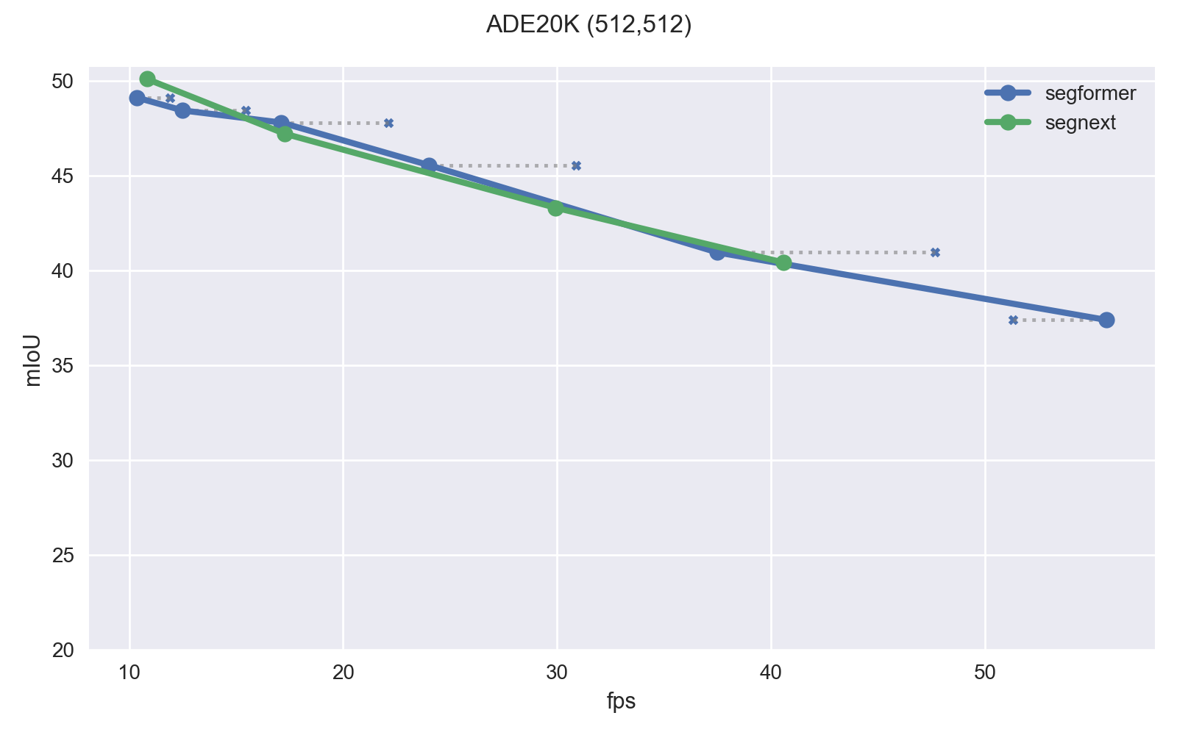
Reproduced Results with 1080ti

Slide 9
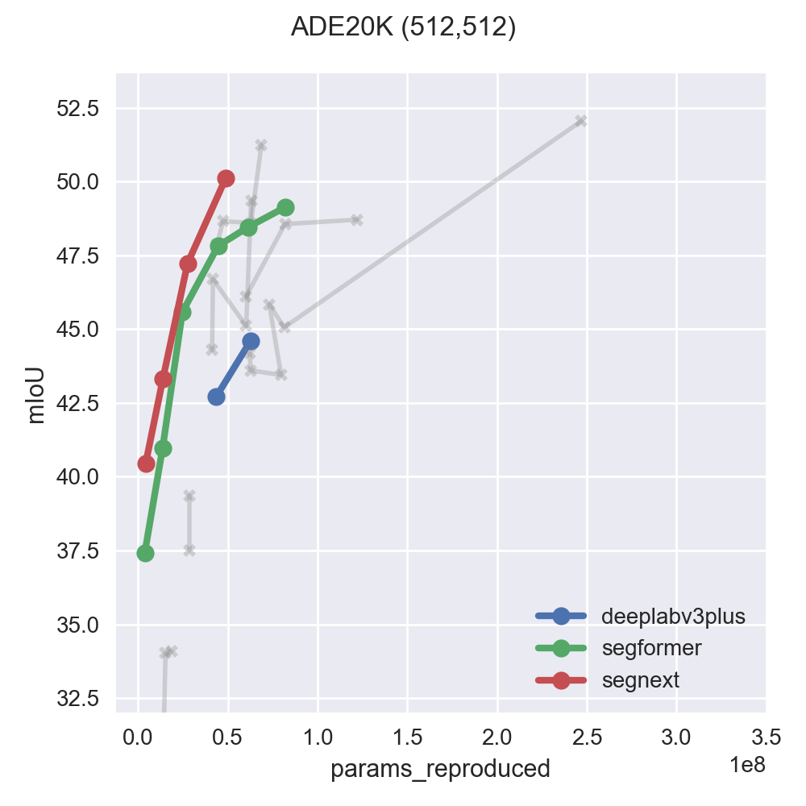
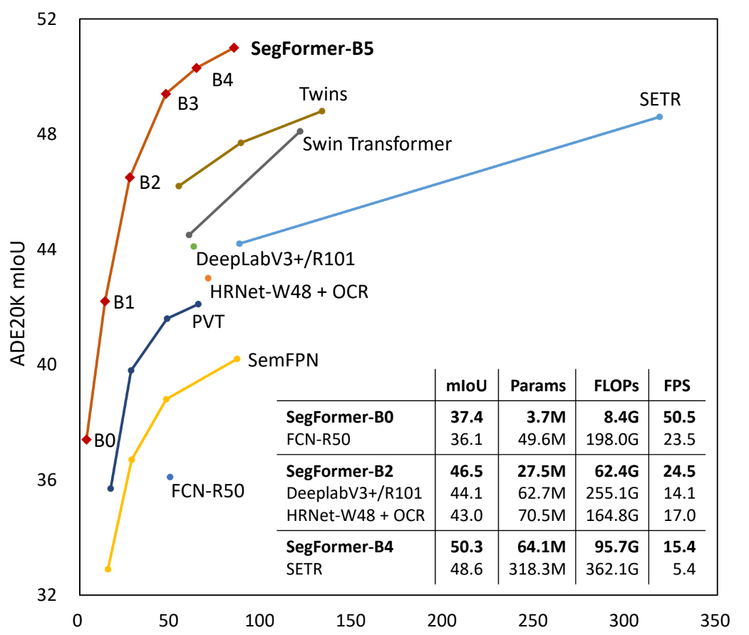
What about Parameters?
Results in line with segformer paper
However, segnext seems to be more efficient!
segformer
reproduced

Slide 10
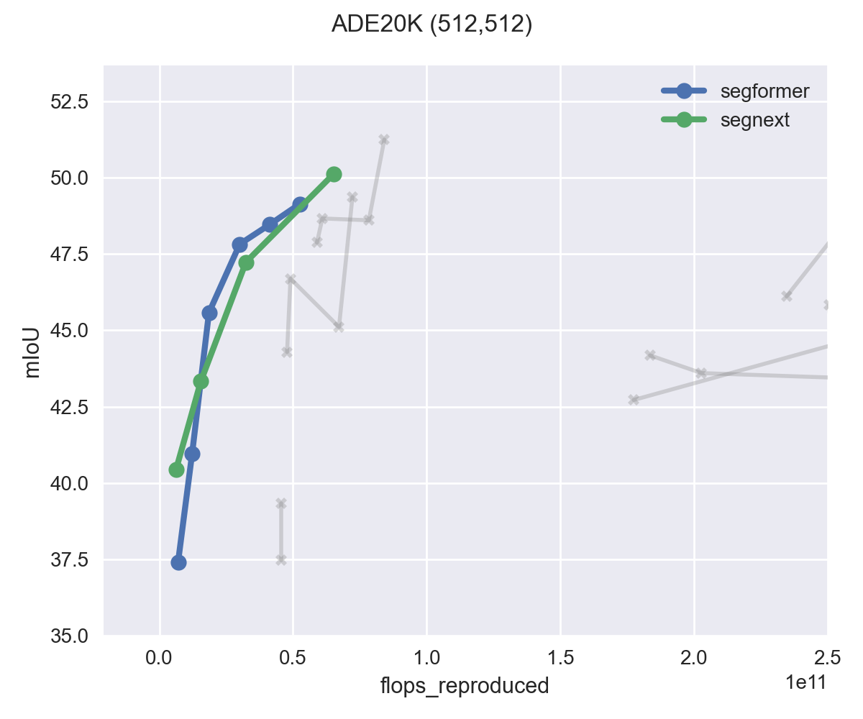
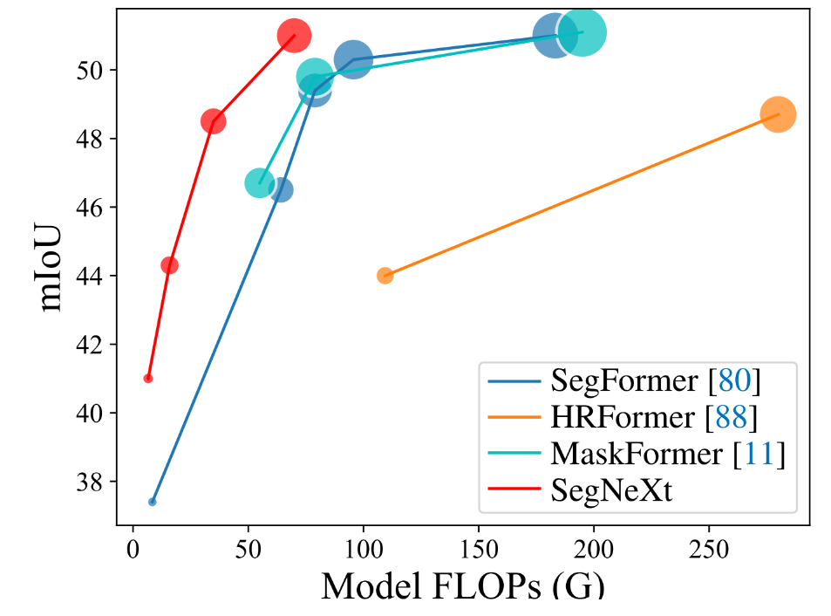
What about Flops?
Results differ massively from segnext paper!
Todos:
compare with other papers
Try different method to measure flops (used a tool wich comes with MMSeg)
segnext
reproduced

Slide 12
Outline
Training results
Fps on different gpus

Slide 13
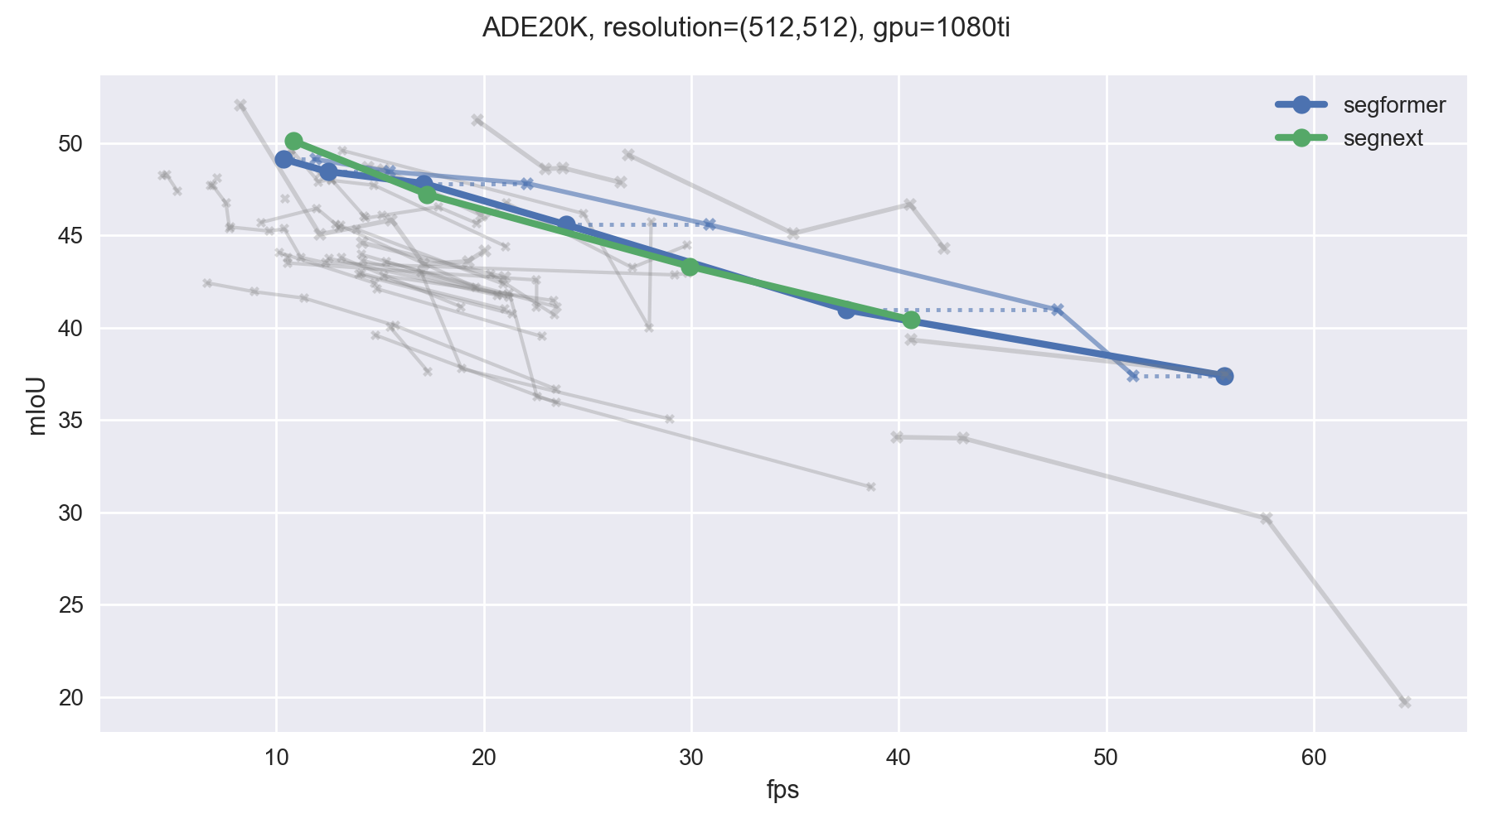
Recap – two recent models stand out
Xie, Enze, et al. "SegFormer: Simple and efficient design for semantic segmentation with transformers." NeurIPS 2021 Meng-Hao Guo et al. “SegNeXt: Rethinking Convolutional Attention Design for Semantic Segmentation” NeurIPS 2022

Slide 14
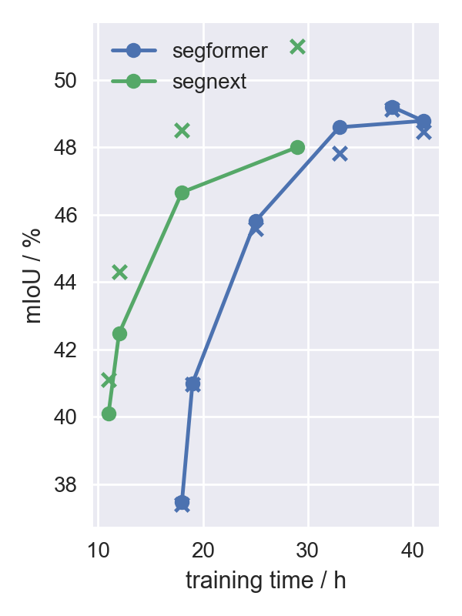
Training results for ADE20k
Largest B5 trains faster than B4 because batch size is lowered from 16 to 12
Methode | Größe | mIoU° | mIoU | time
SegFormer ✓ | B0 | 37.41 | 37.48 | 18h
 | B0 w/o Imagenet |  | 30.27
 | B1 | 40.97 | 40.99 | 19h
 | B2 | 45.58 | 45.8 | 25h
 | B3 | 47.82 | 48.59 | 33h
 | B4 | 48.46 | 48.78 | 41h
 | B5 | 49.13 | 49.2 | 38h
SegNexT ✗ | Tiny | 41.1 | 40.1 | 11h→19h
 | Small | 44.3 | 42.47 | 12h
 | Base | 48.5 | 46.66 | 18h
 | Large | 51.0 | 48 | 29h
Just found out: batch size was incorrect for SegNexT! Waiting for re-training

Slide 15
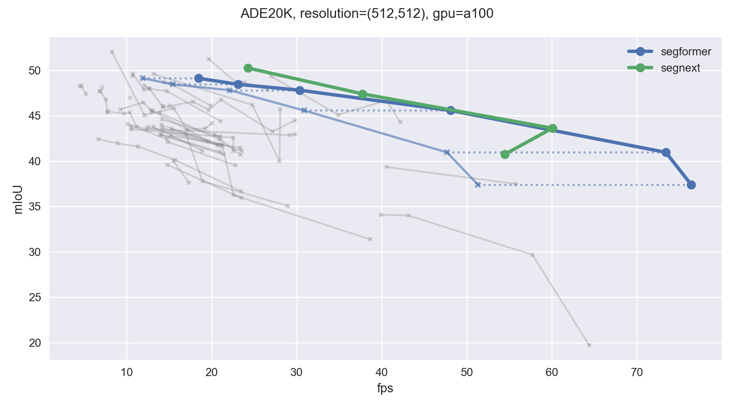
Fps with different GPU
I don‘t know why this happens (yet)

Slide 16
Outline
Still not able to reproduce all ADE20K Trainings

Slide 17
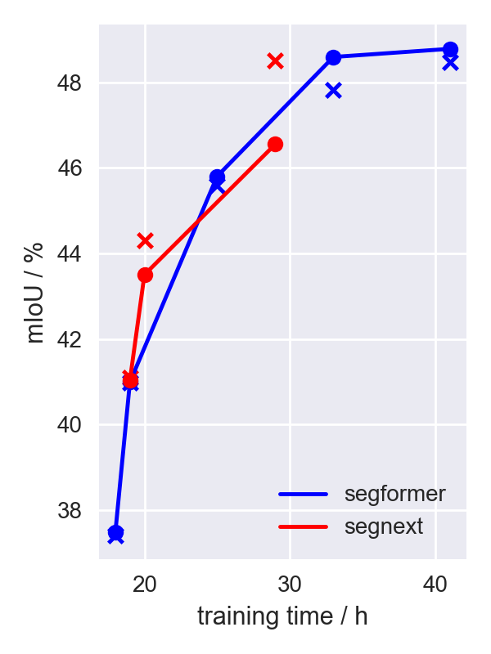
Still not able to reproduce all ADE20K Trainings
SegFormer works
SegNeXt work only for tiny model
Authors: „Training is more stable on cityscapes“
Xie, Enze, et al. "SegFormer: Simple and efficient design for semantic segmentation with transformers." NeurIPS 2021 Meng-Hao Guo et al. “SegNeXt: Rethinking Convolutional Attention Design for Semantic Segmentation” NeurIPS 2022

Slide 19
Outline
Recap
Training results
Fps on different gpus
Hamming Codes…
Talk with Youssef: OOD and Ensembles
Bachelor Thesis about Ensembles?

Slide 20
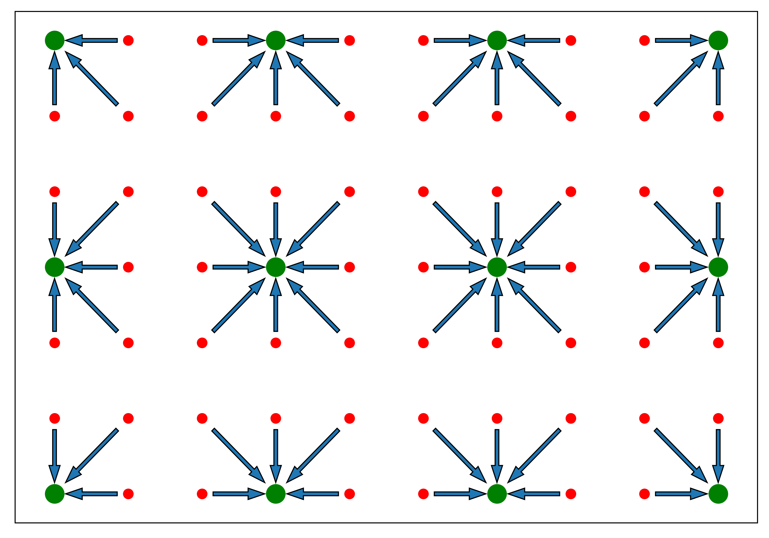



Hamming Codes…
Every message is valid
Send augmented message such that the minimum hamming distance between valid augmented messages is 3
The augmentation is a function of
A decoder can apply binary search to pin down the error location
par par m1 par m2 m3 m4
1
1
0
1
1
0
1
0
0 1 2 3 4 5 6 7 000 001 010 011 100 101 110 111

Slide 21
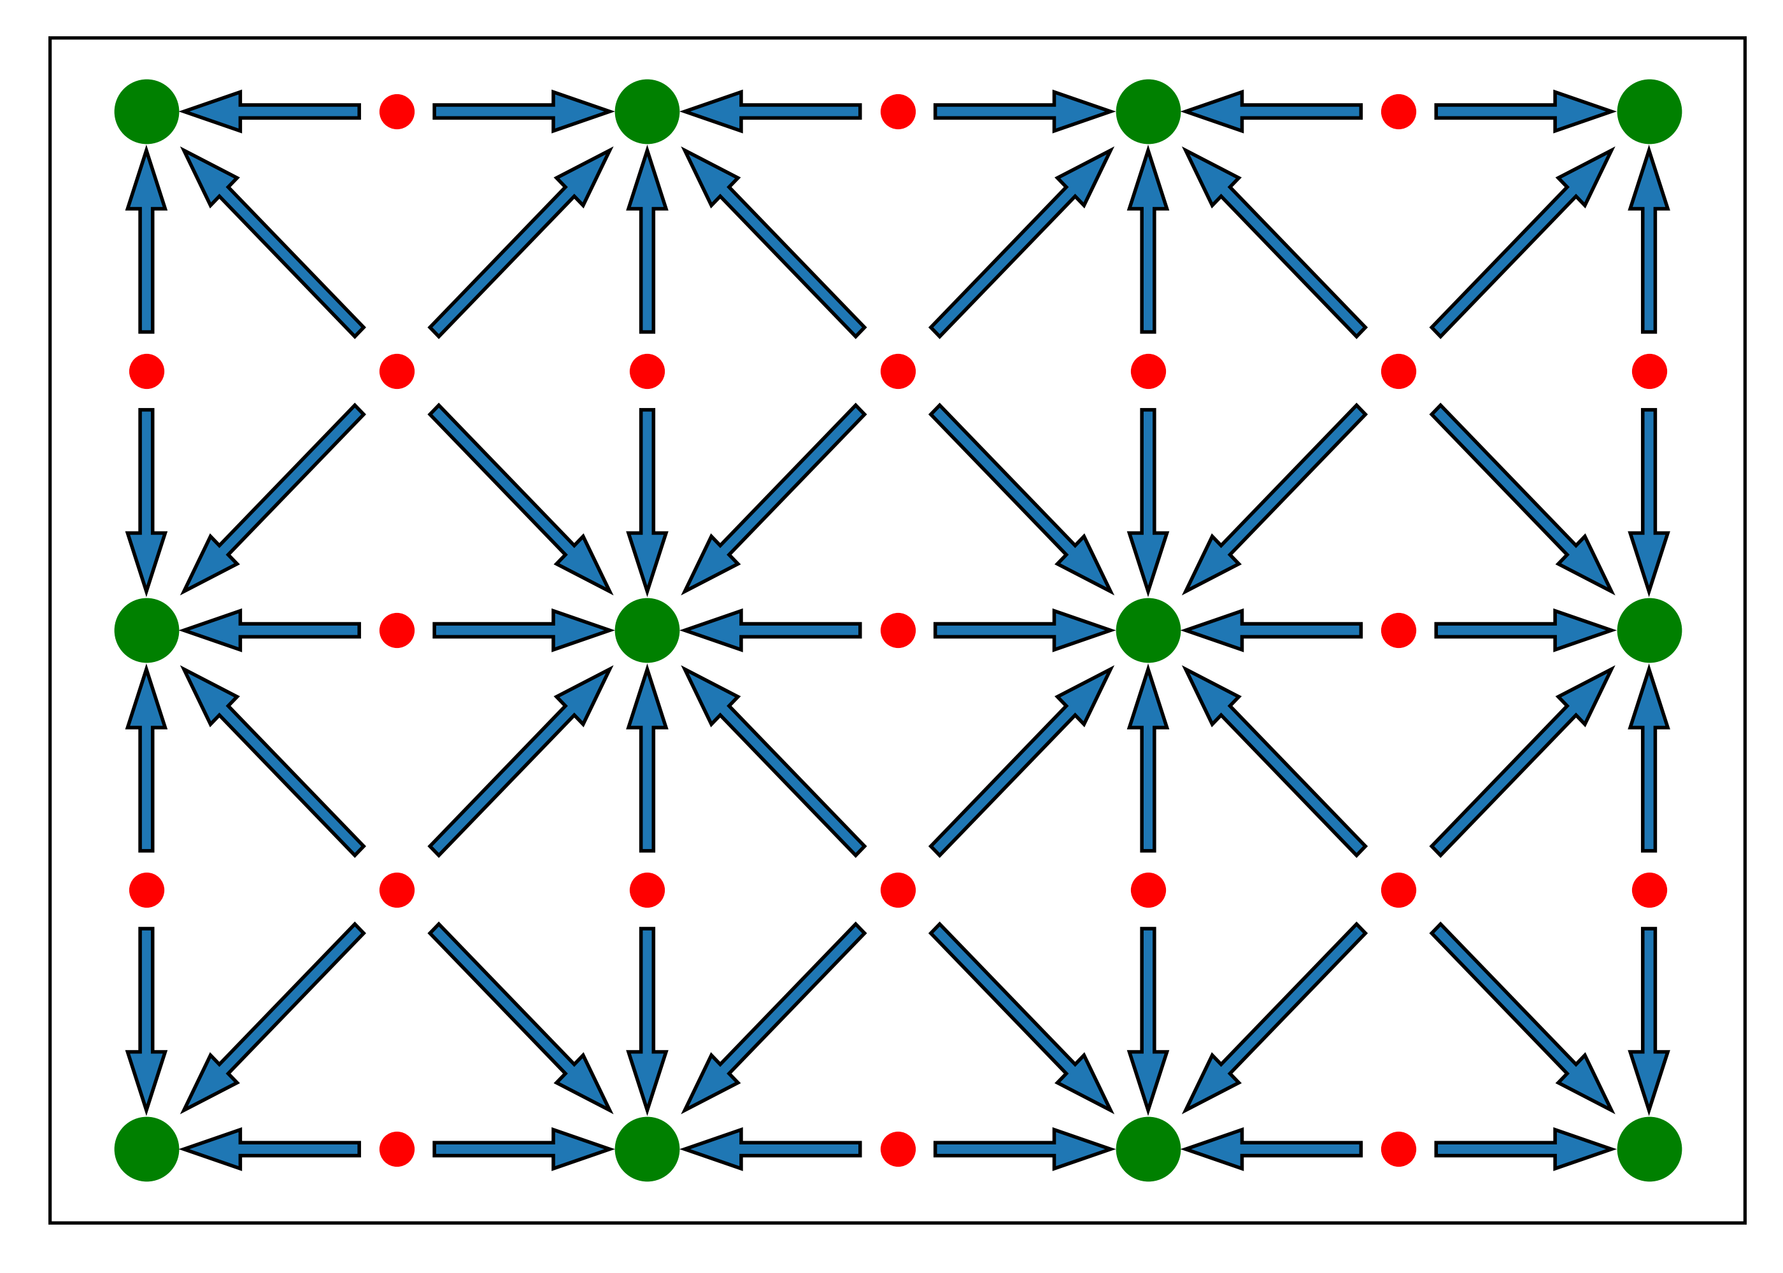
Hamming Codes (easier)
A hamming distance of 2 between valid augmented messages can be enforced with a single augmentation bit
Choose such that the number of 1s is even
Any bit flip would be deteced
How to apply this (very basic) version to machine learning?
Key: you can only protect signals which you send yourself!
Protect transmitted images from being adversarialy attacked
GT segmentation
predicted segmentation
image
Camera
Network

Slide 22
Talk with Youssef / Bachelor Thesis Topic
No concrete paper projects yet
OOD detection, confidence
Possible applications: classification, object detection, segmentation
Possible collaboration: Ensembles for segmentation
How does weight sharing affect ensembling?
E.G. how useful are last-layer-ensembles (or decoder-only-ensembles)
Investigate in a bachelor‘s thesis?

Slide 24
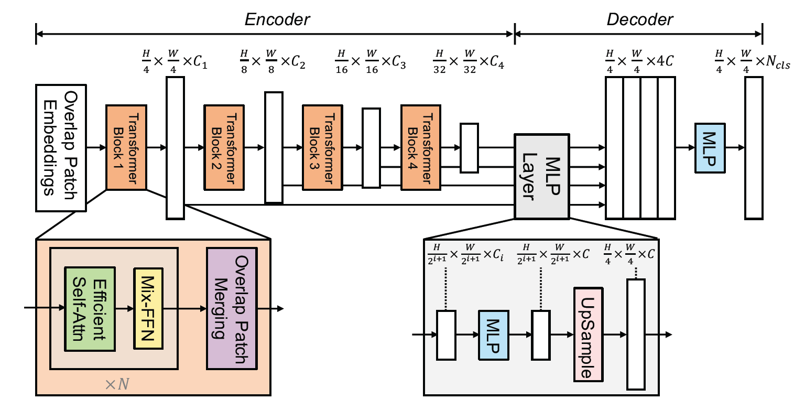
Segformer Architecture
Xie, Enze, et al. "SegFormer: Simple and efficient design for semantic segmentation with transformers." NeurIPS 2021

Slide 25
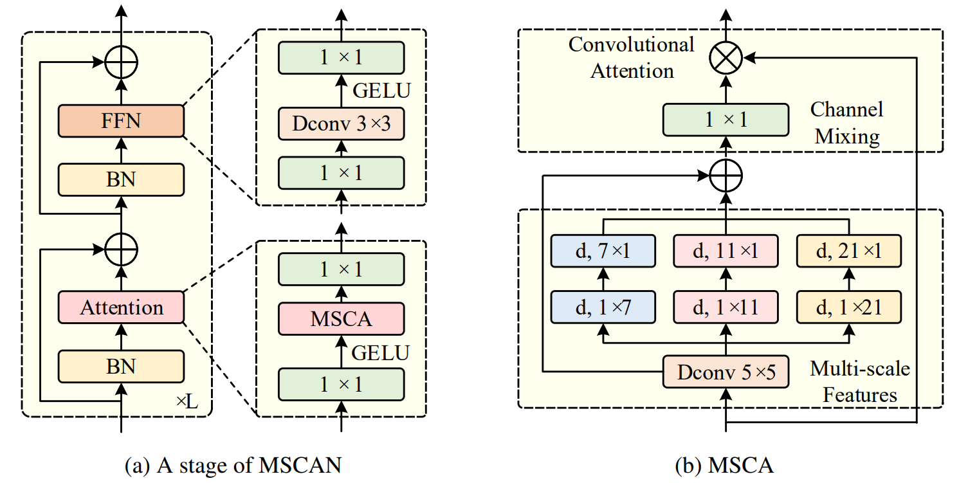
SegNexT Encoder Architecture
Meng-Hao Guo et al. “SegNeXt: Rethinking Convolutional Attention Design for Semantic Segmentation” NeurIPS 2022

