Slide 1
Report
Euro NCAP | Frontal-Impact against Rigid Wall with 100 % Overlap at 50 km/h
11391 | 14084

Slide 2
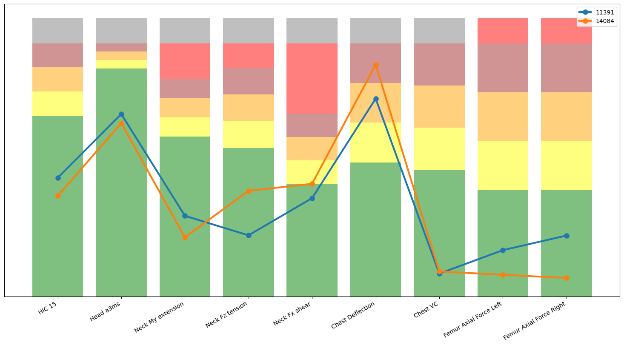
Driver Result

Slide 3
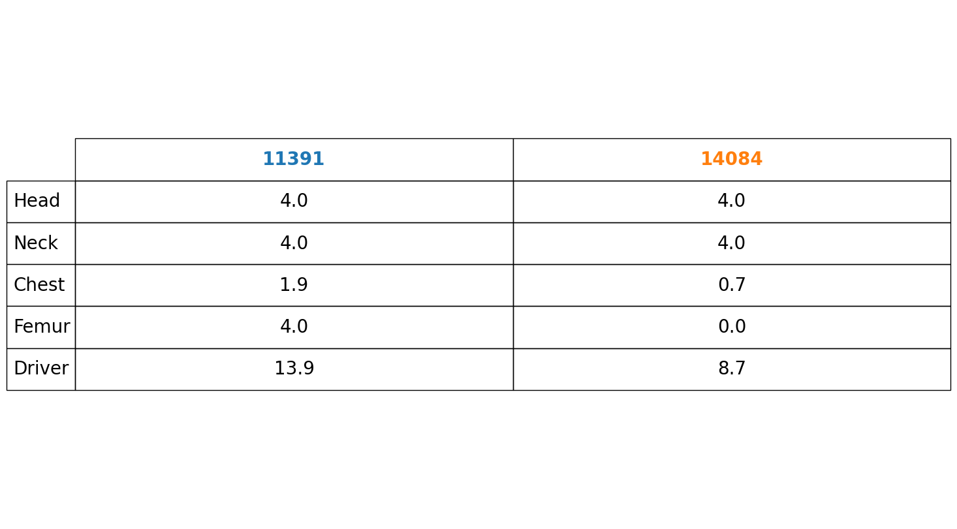
Driver Rating

Slide 4
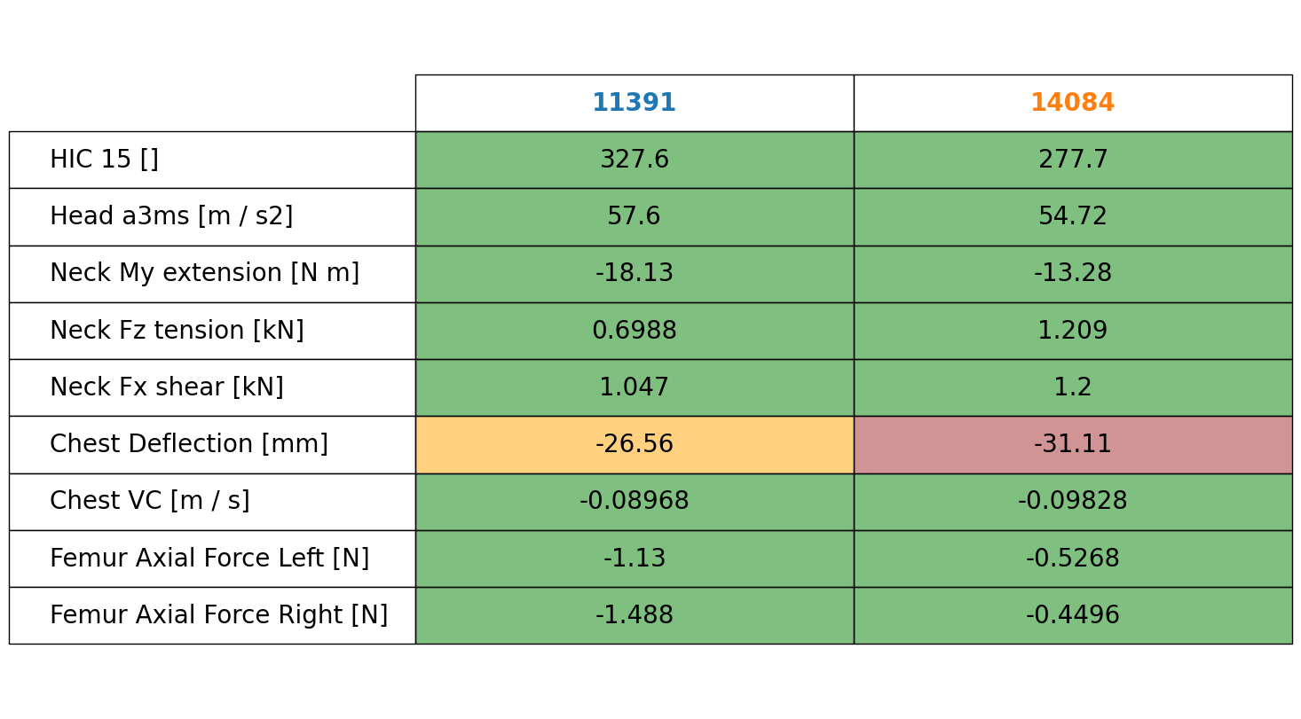
Driver Values

Slide 5
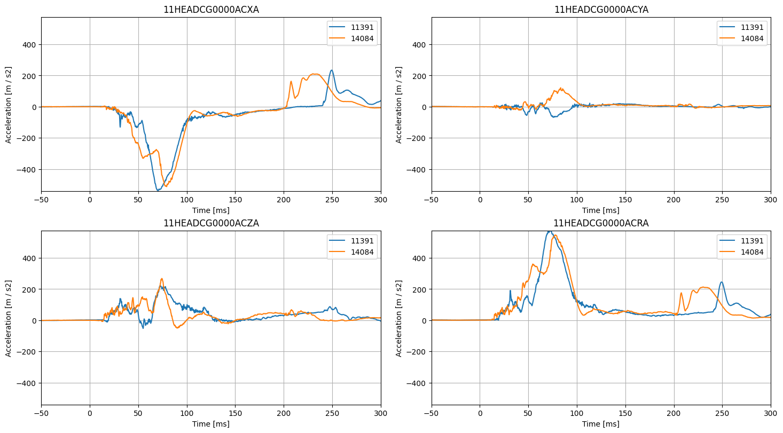
Driver Head Acceleration

Slide 6
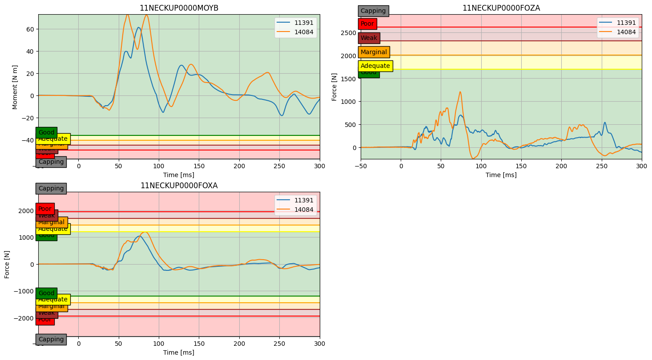
Driver Neck Load

Slide 7
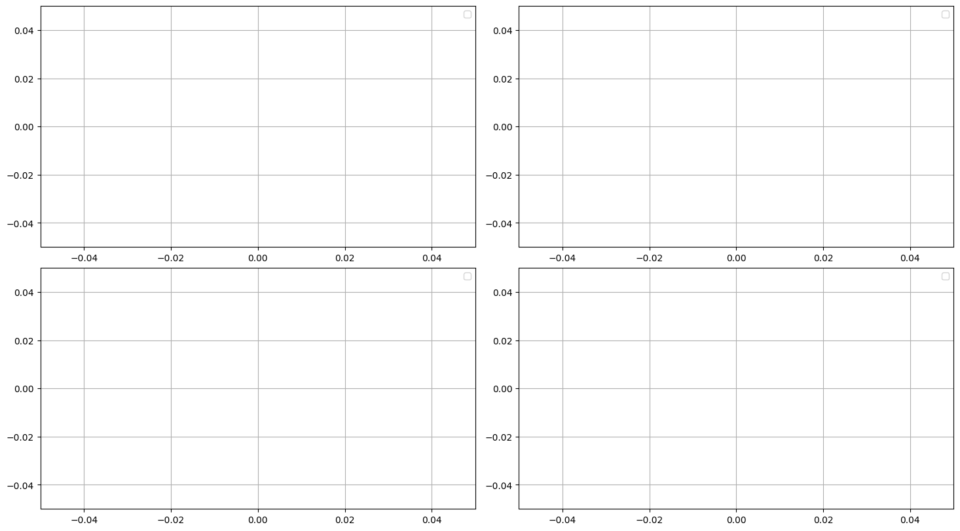
Driver Neck NIJ

Slide 8
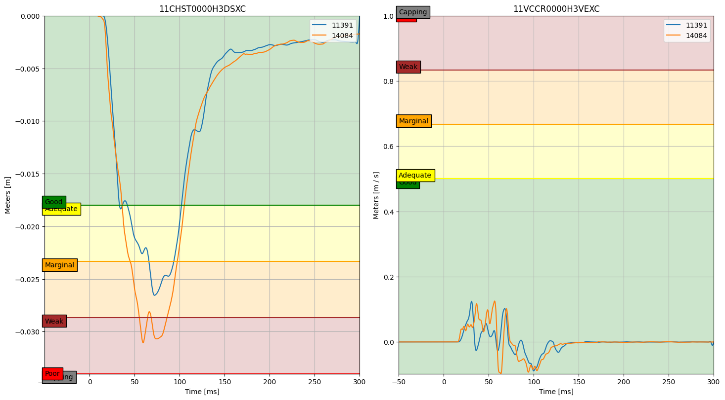
Driver Chest Deflection

Slide 9
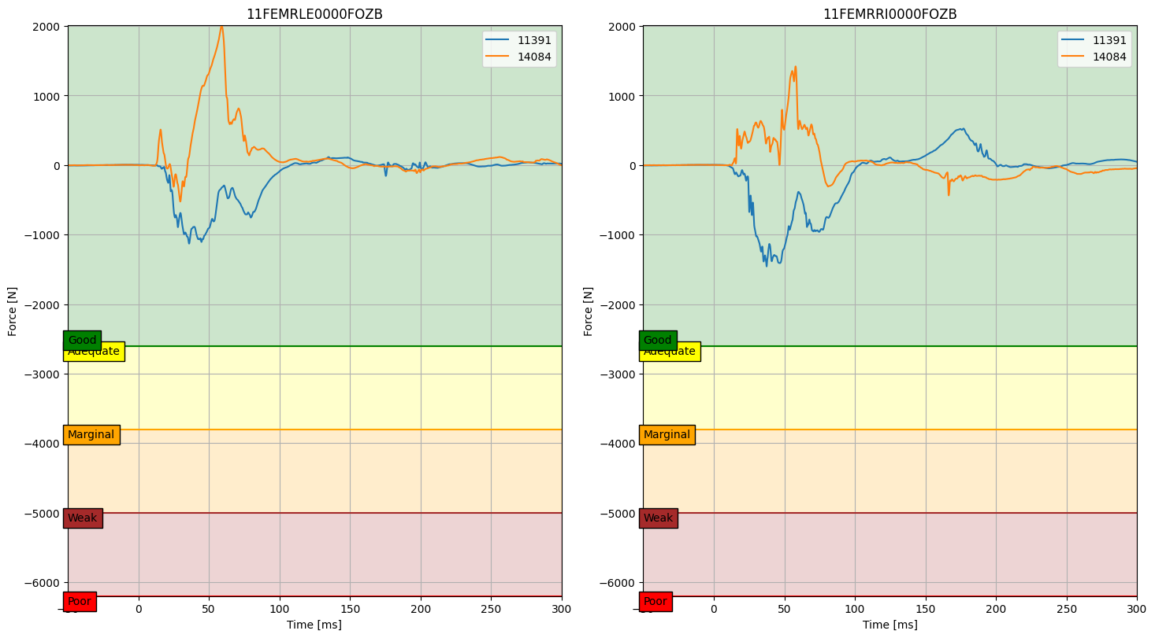
Driver Femur Axial Force

Slide 10
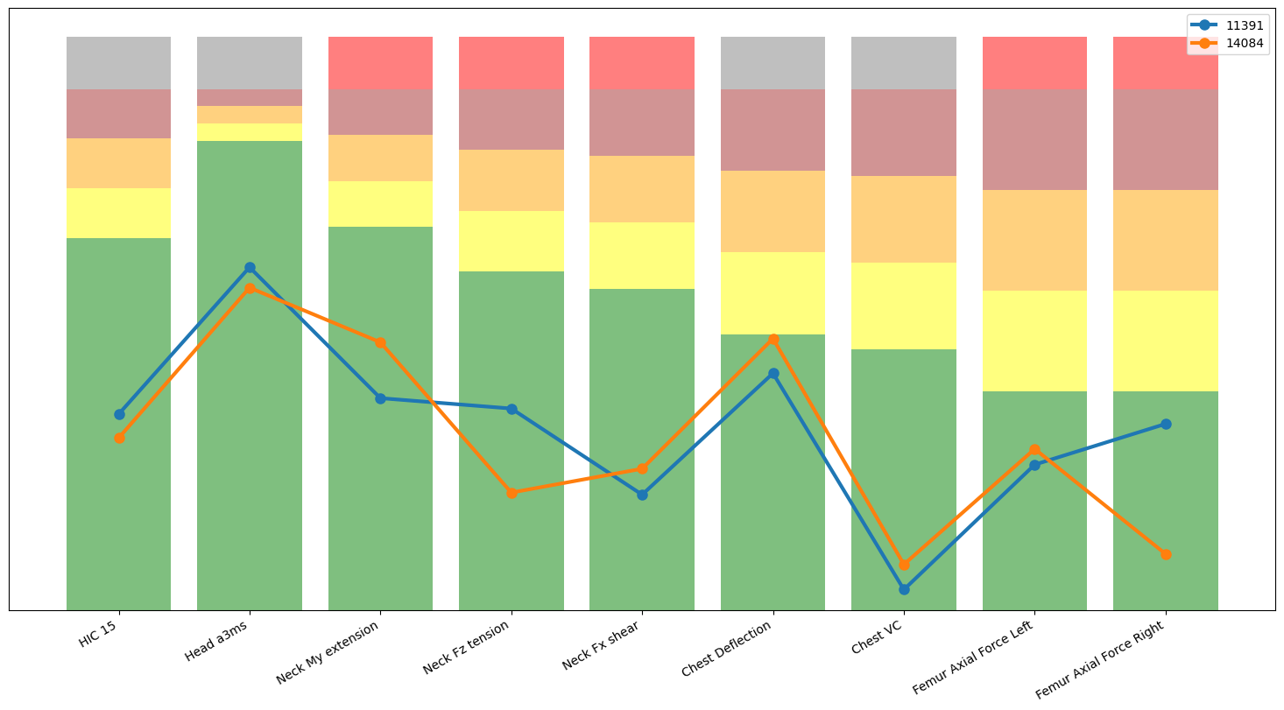
Front Passenger Result

Slide 11
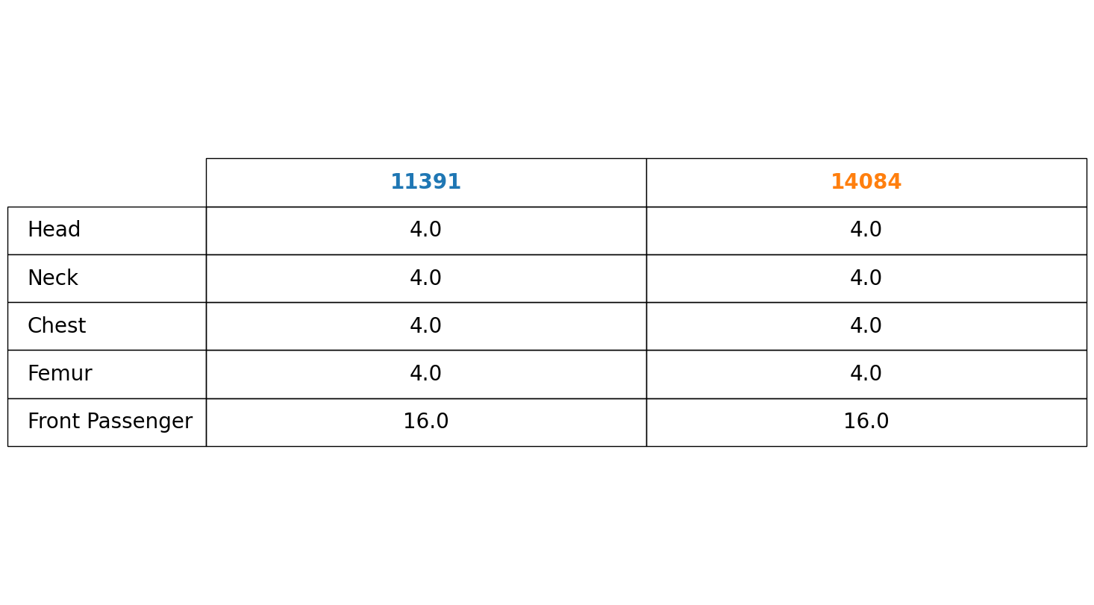
Front Passenger Rating

Slide 12
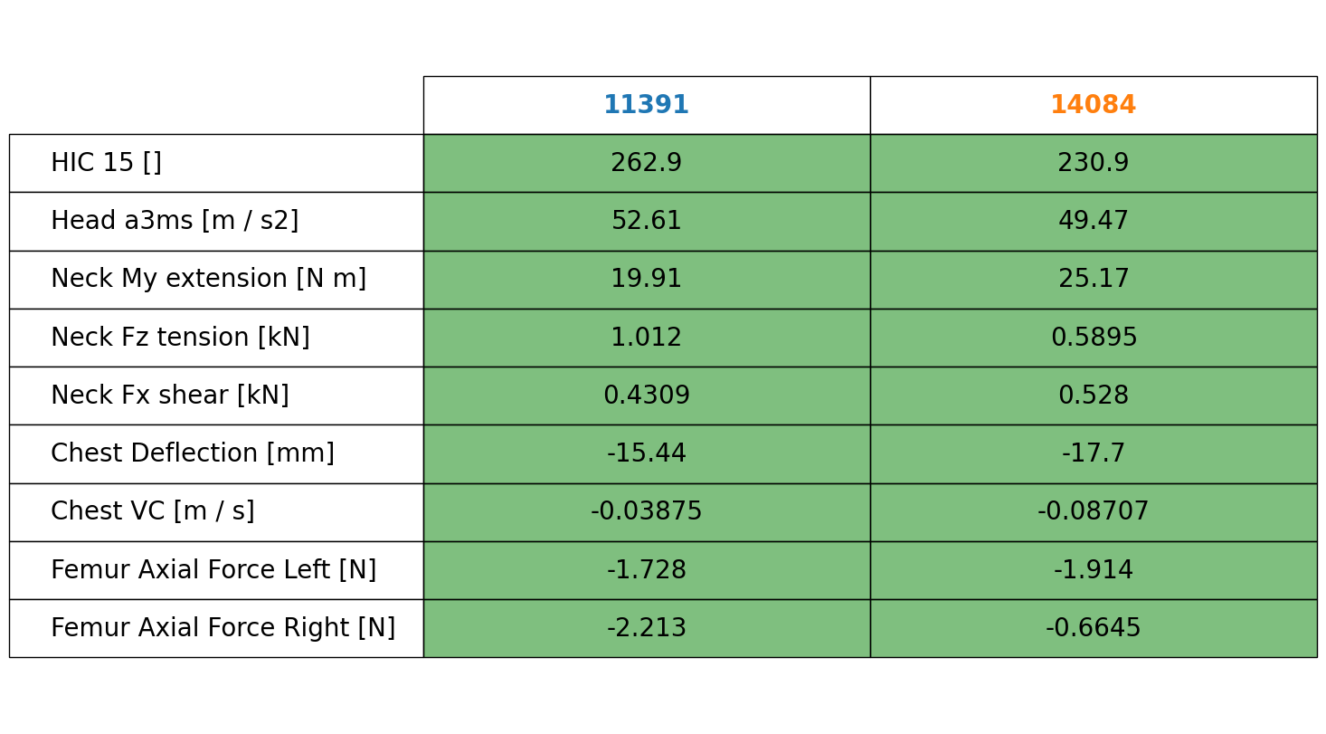
Front Passenger Values

Slide 13
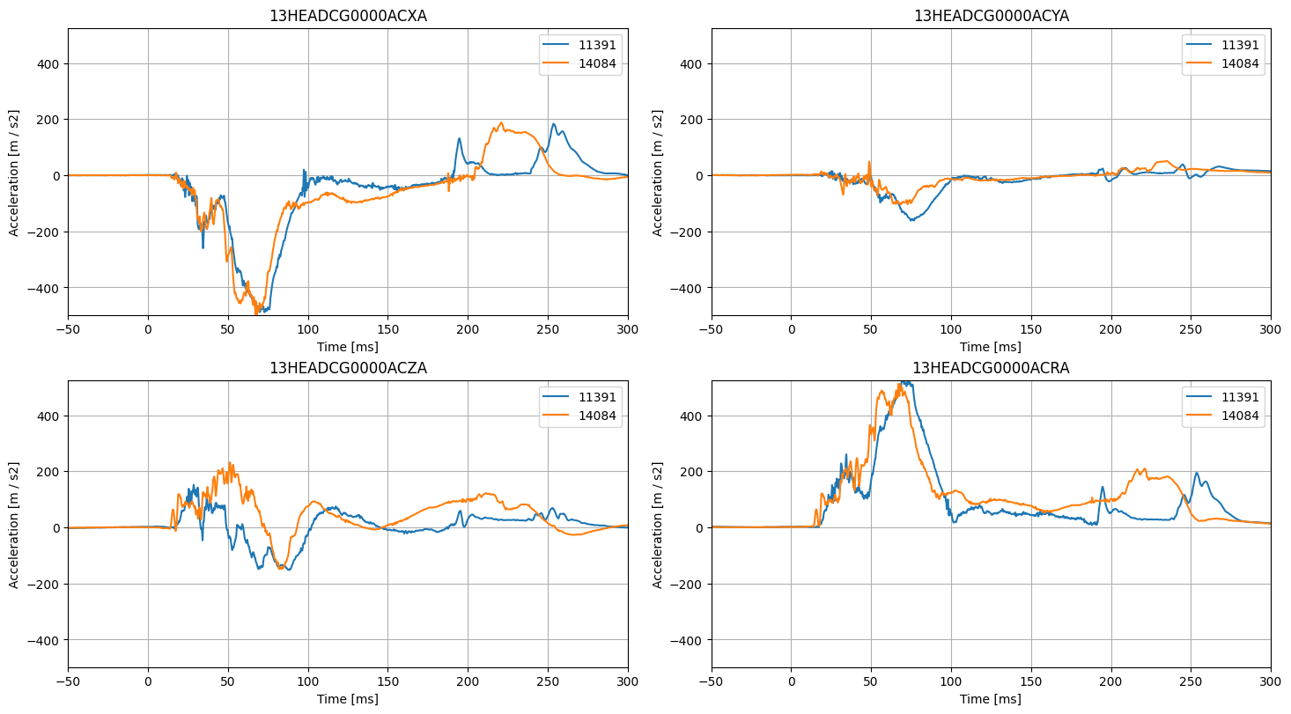
Front Passenger Head Acceleration

Slide 14
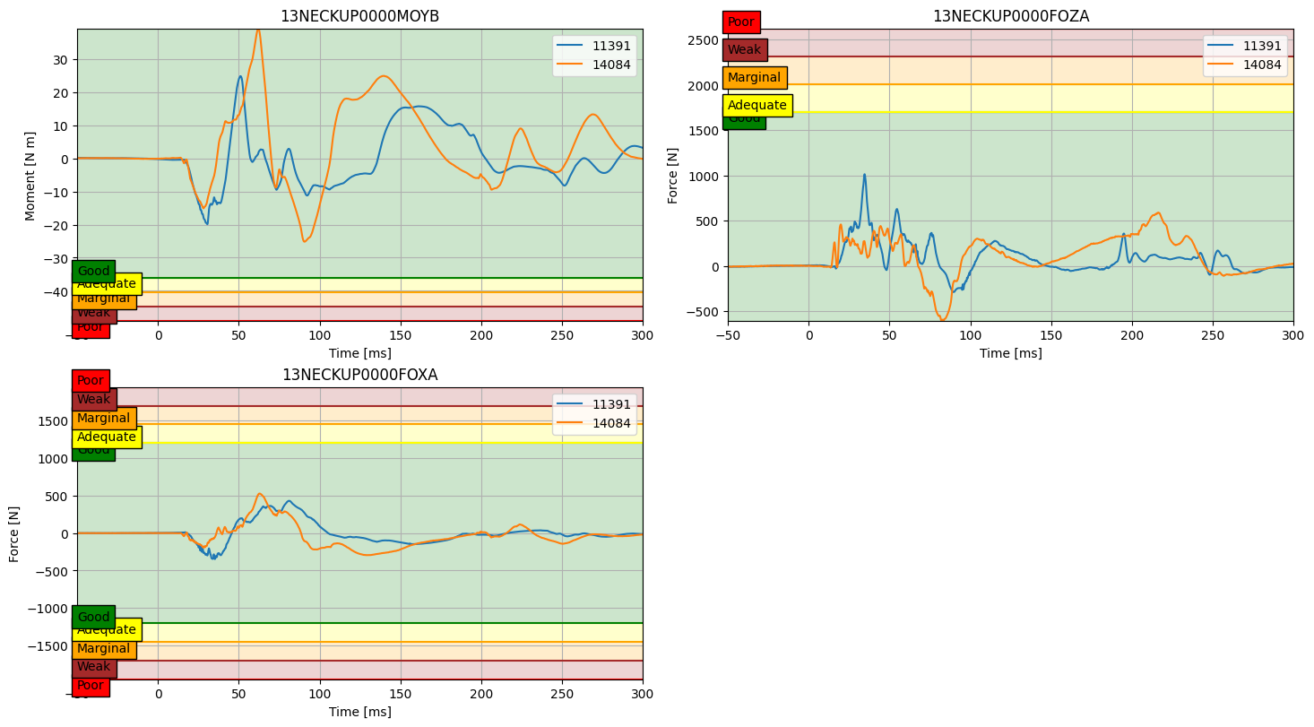
Front Passenger Neck Load

Slide 15
Front Passenger Neck NIJ

Slide 16
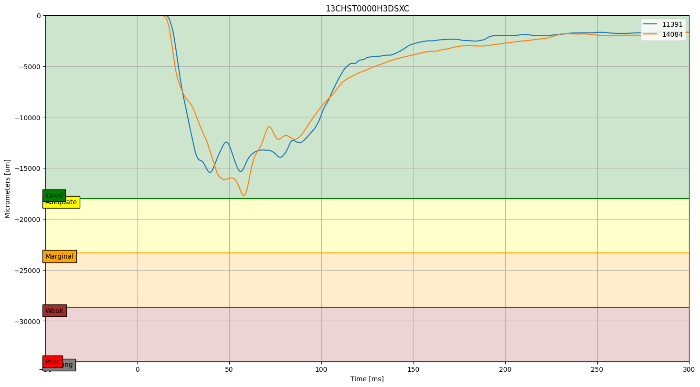
Front Passenger Chest Deflection

Slide 17
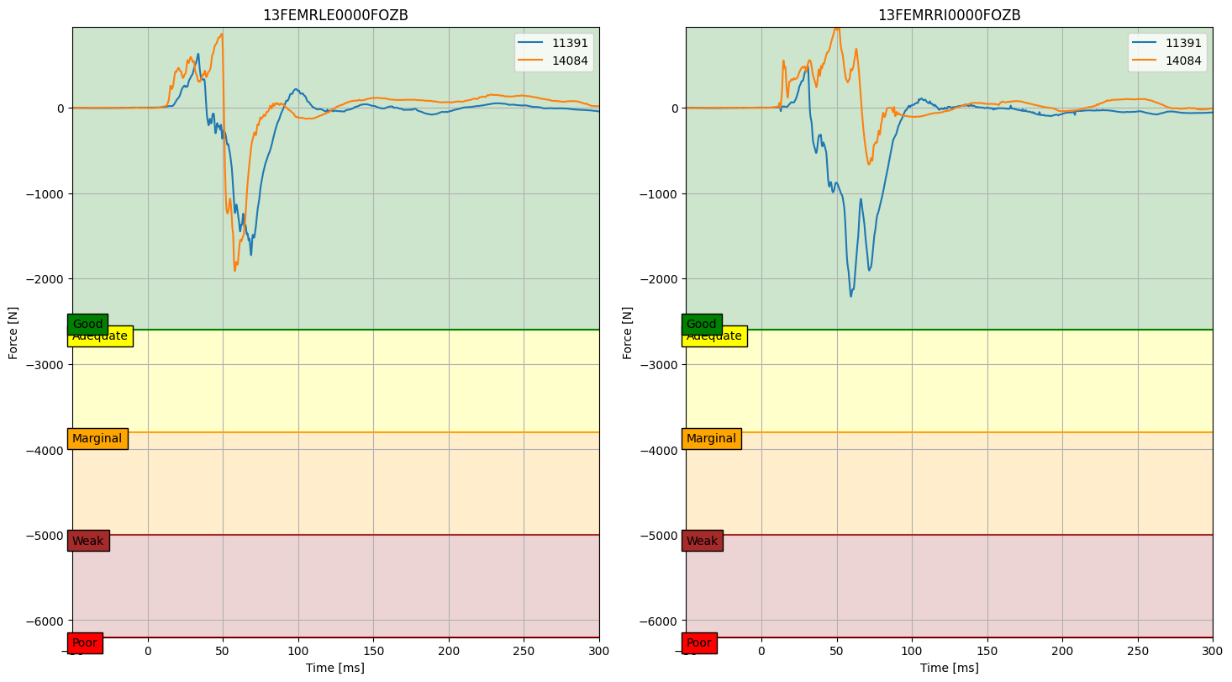
Front Passenger Femur Axial Force

Slide 18
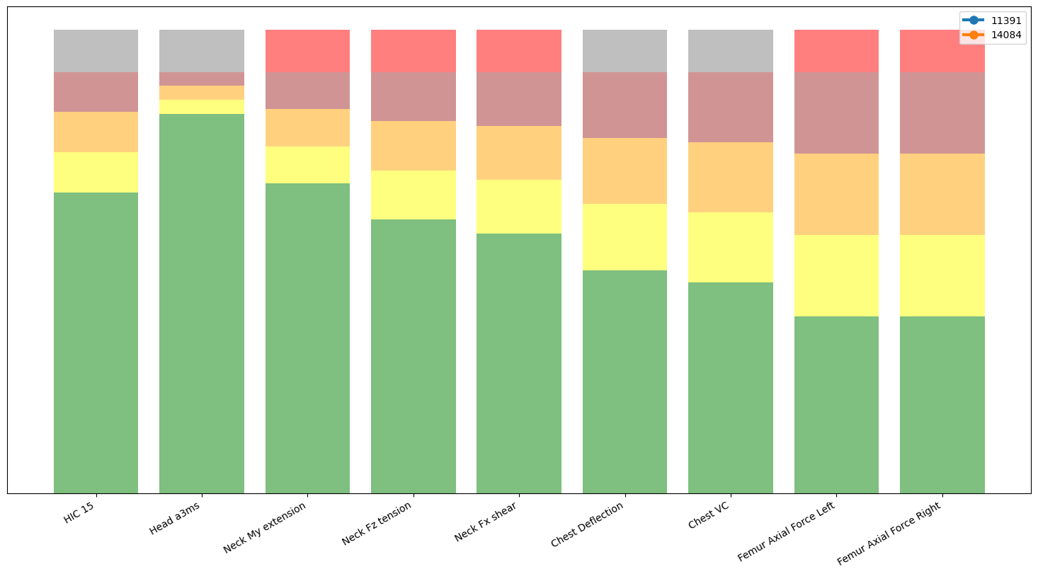
Rear Passenger Result

Slide 19
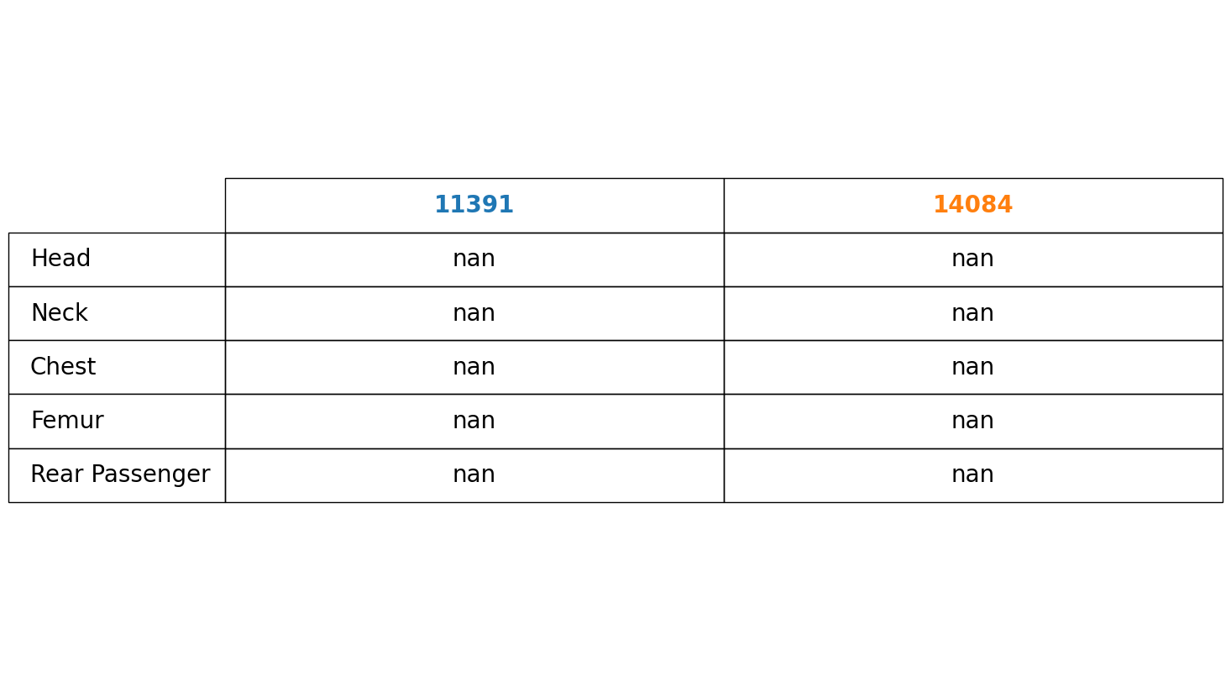
Rear Passenger Result

Slide 20
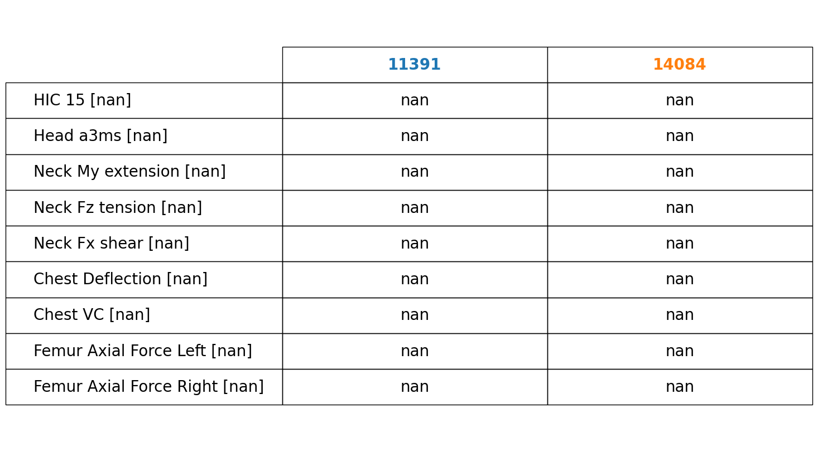
Rear Passenger Values

Slide 21
Rear Passenger Head Acceleration

Slide 22
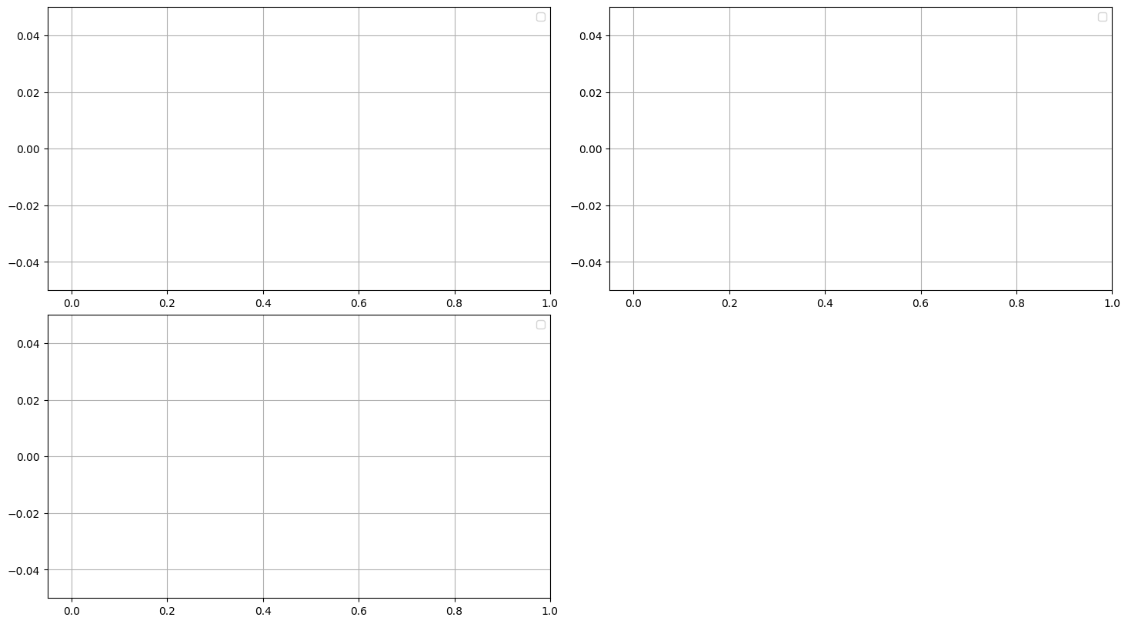
Rear Passenger Neck Load

Slide 23
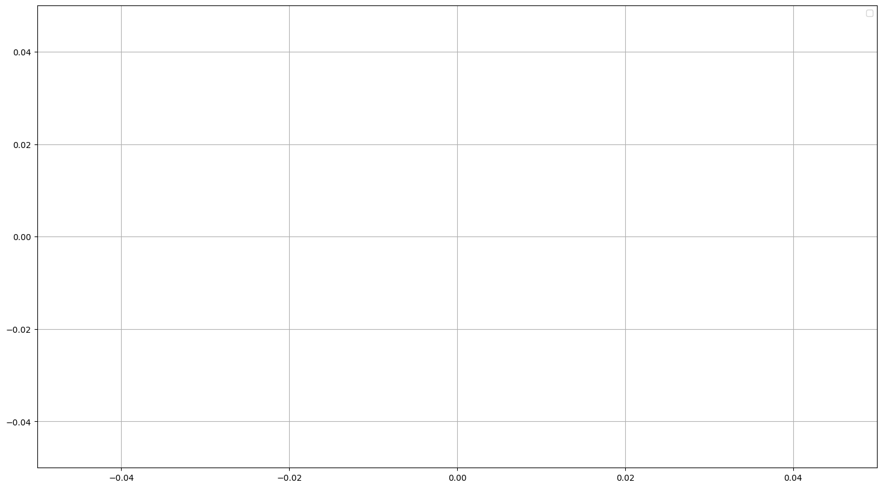
Rear Passenger Chest Deflection

Slide 24
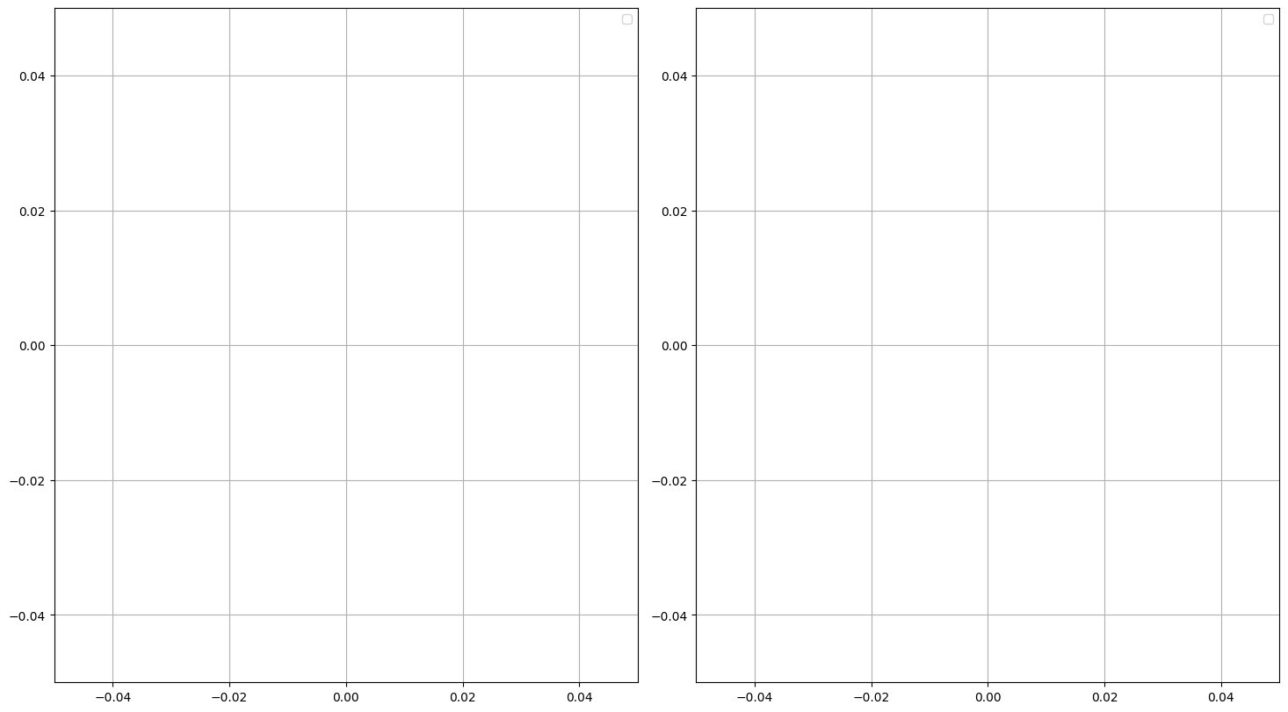
Rear Passenger Femur Axial Force

Slide 25
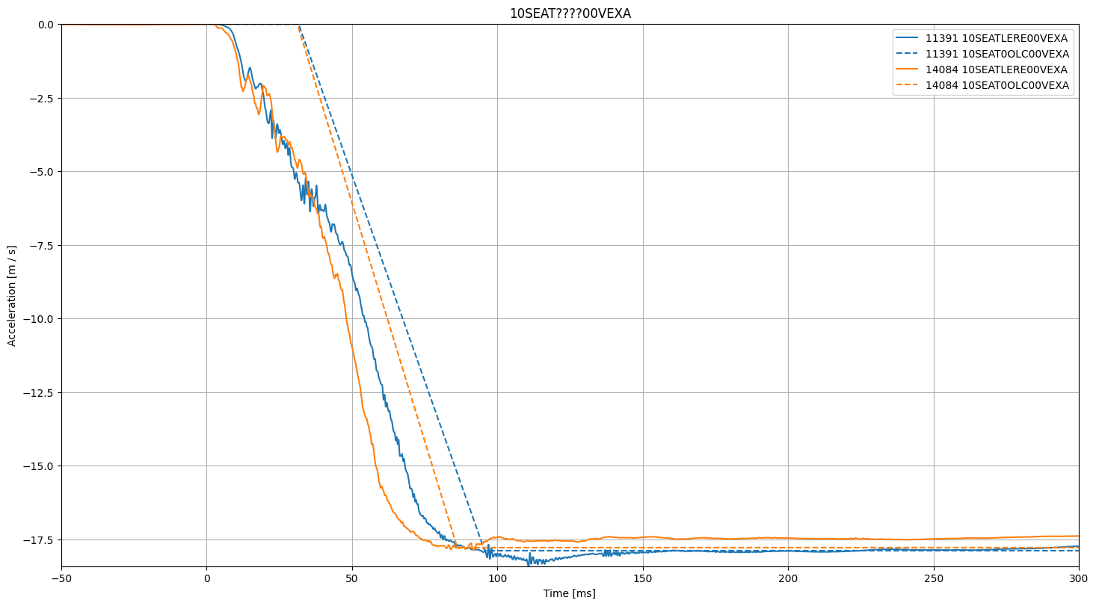
Occupant Load Criterion (OLC)

