Slide 1
Report
Euro NCAP | Frontal-Impact against Rigid Wall with 100 % Overlap at 50 km/h
11391 | 14084

Slide 2
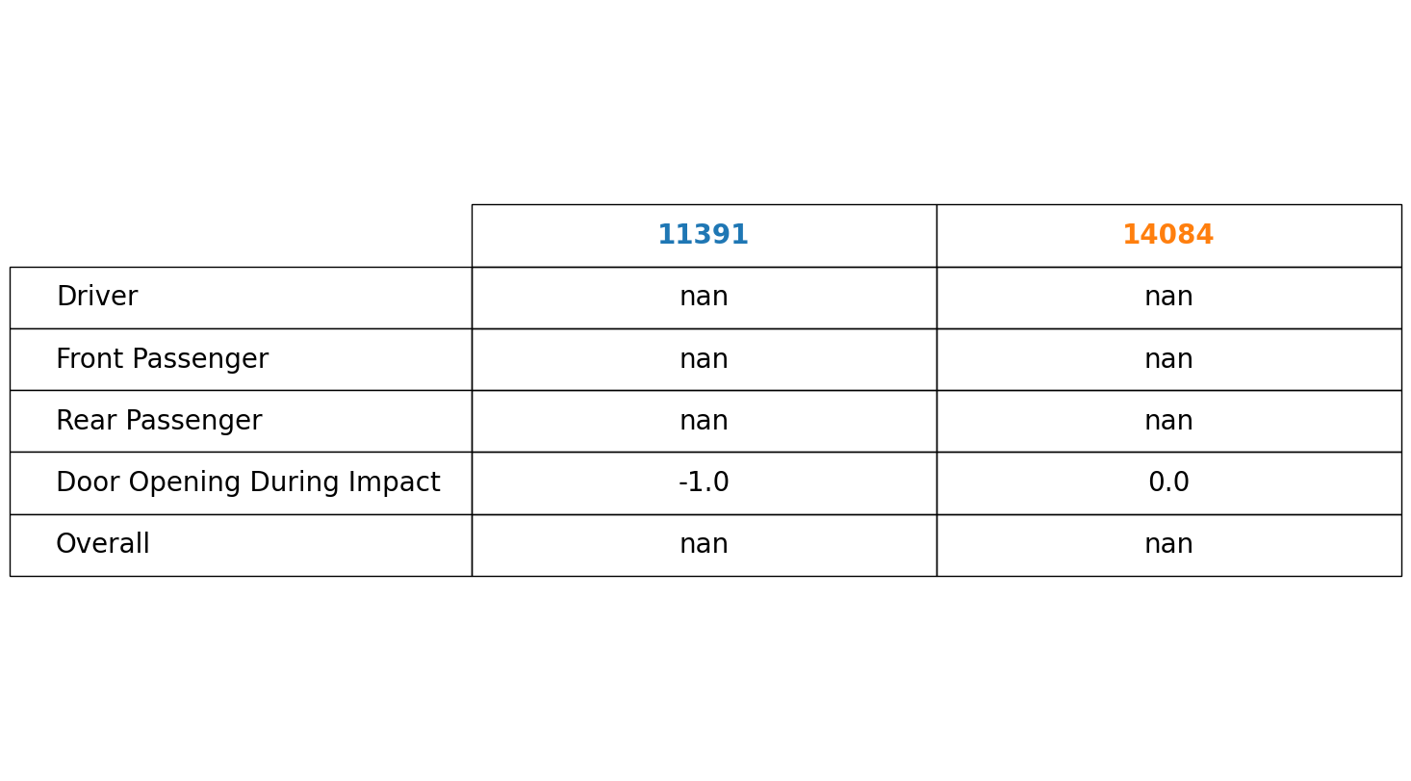
Rating

Slide 3
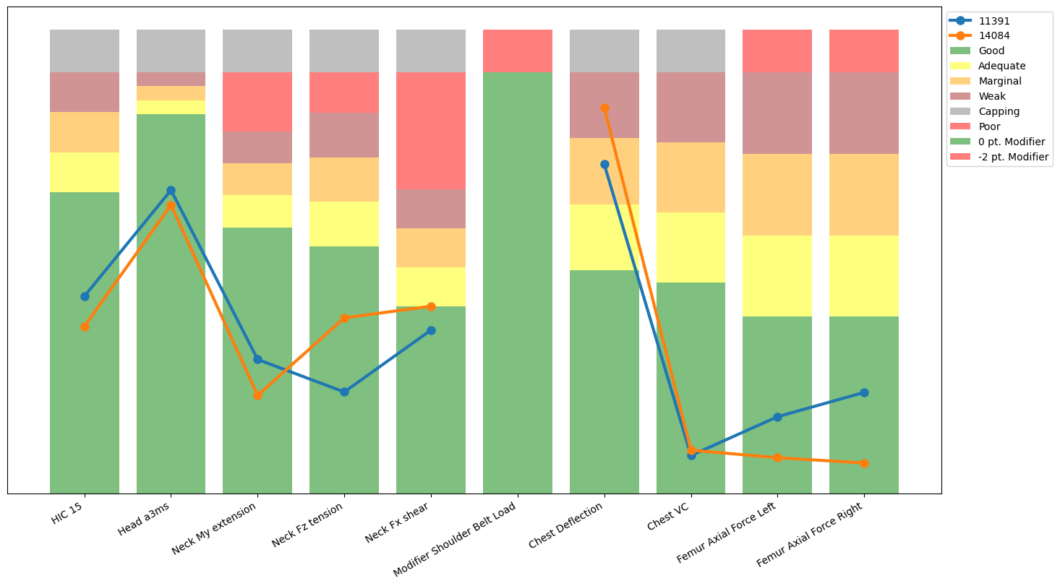
Driver Result

Slide 4
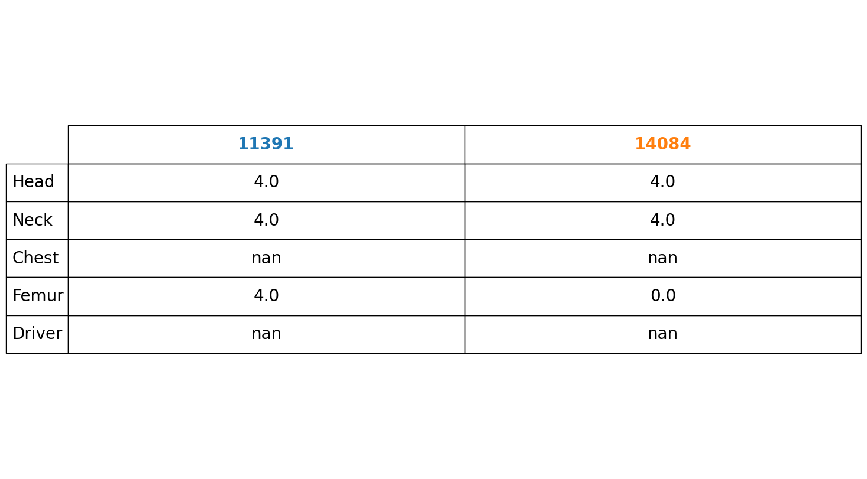
Driver Rating

Slide 5
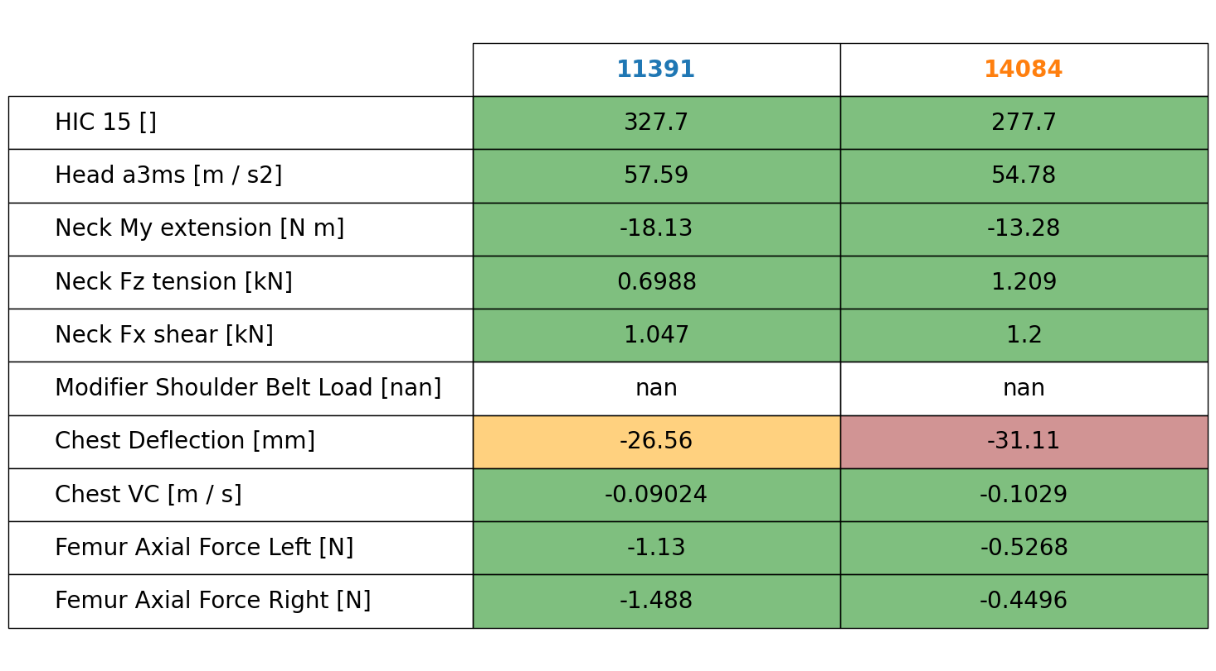
Driver Values

Slide 6
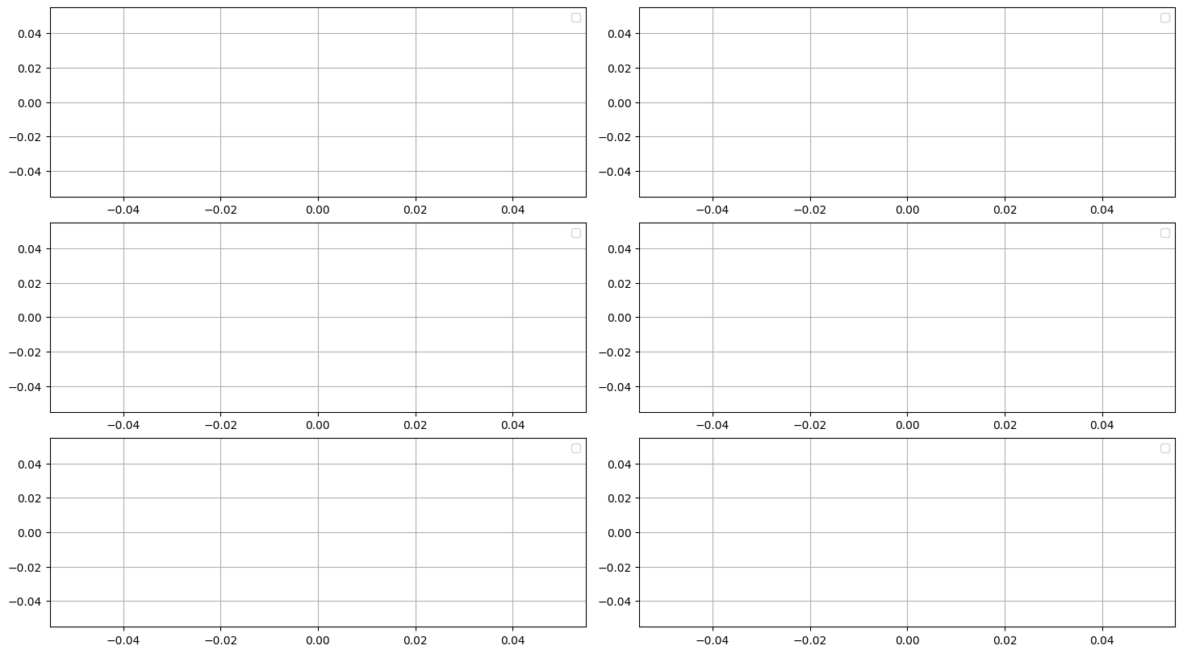
Driver Belt

Slide 7
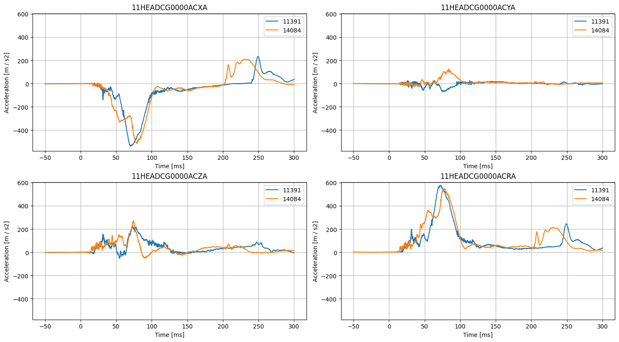
Driver Head Acceleration

Slide 8
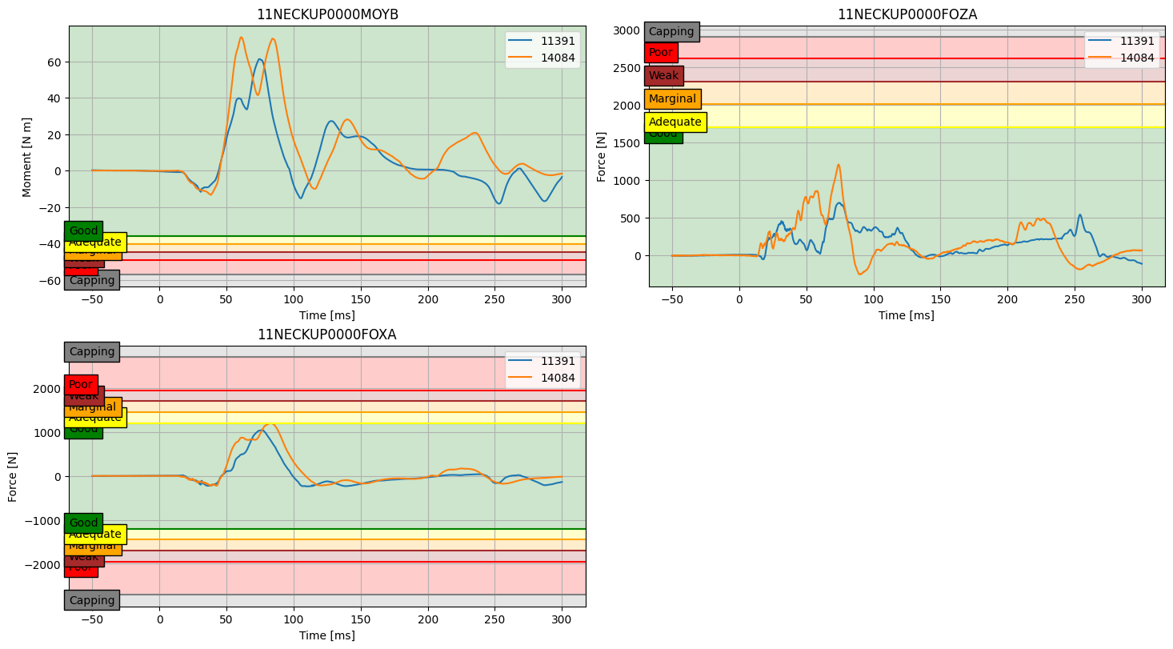
Driver Neck Load

Slide 9
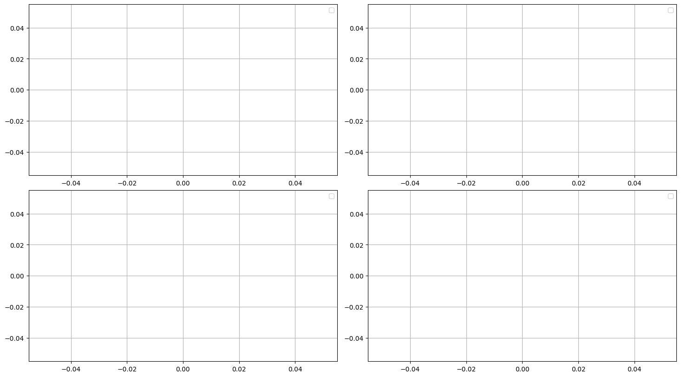
Driver Neck NIJ

Slide 10
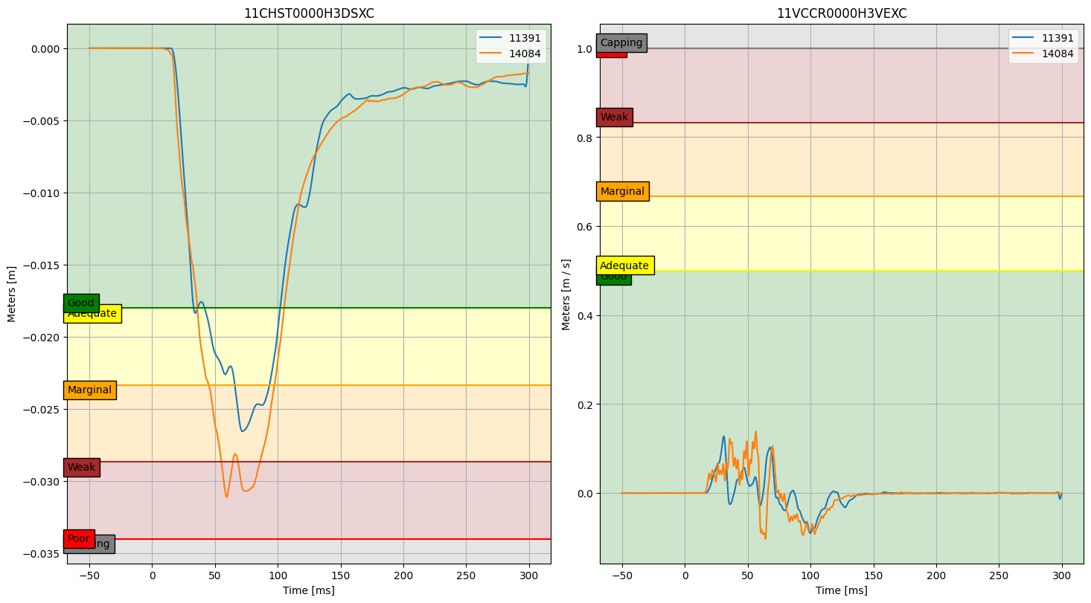
Driver Chest Deflection

Slide 11
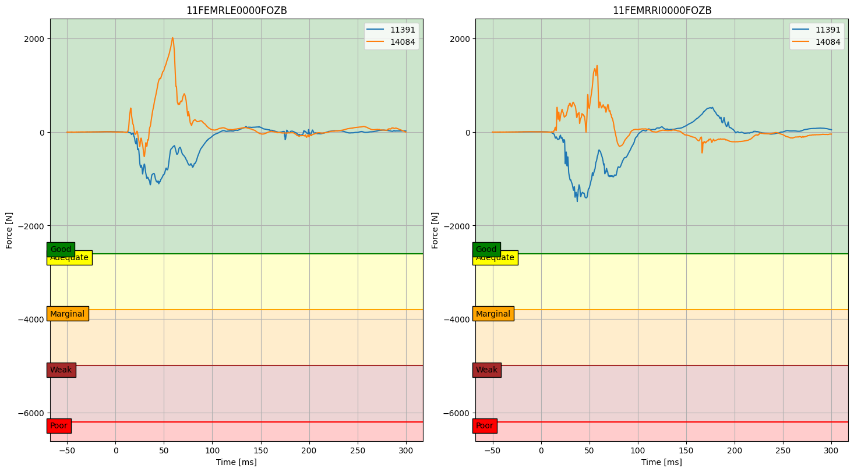
Driver Femur Axial Force

Slide 12
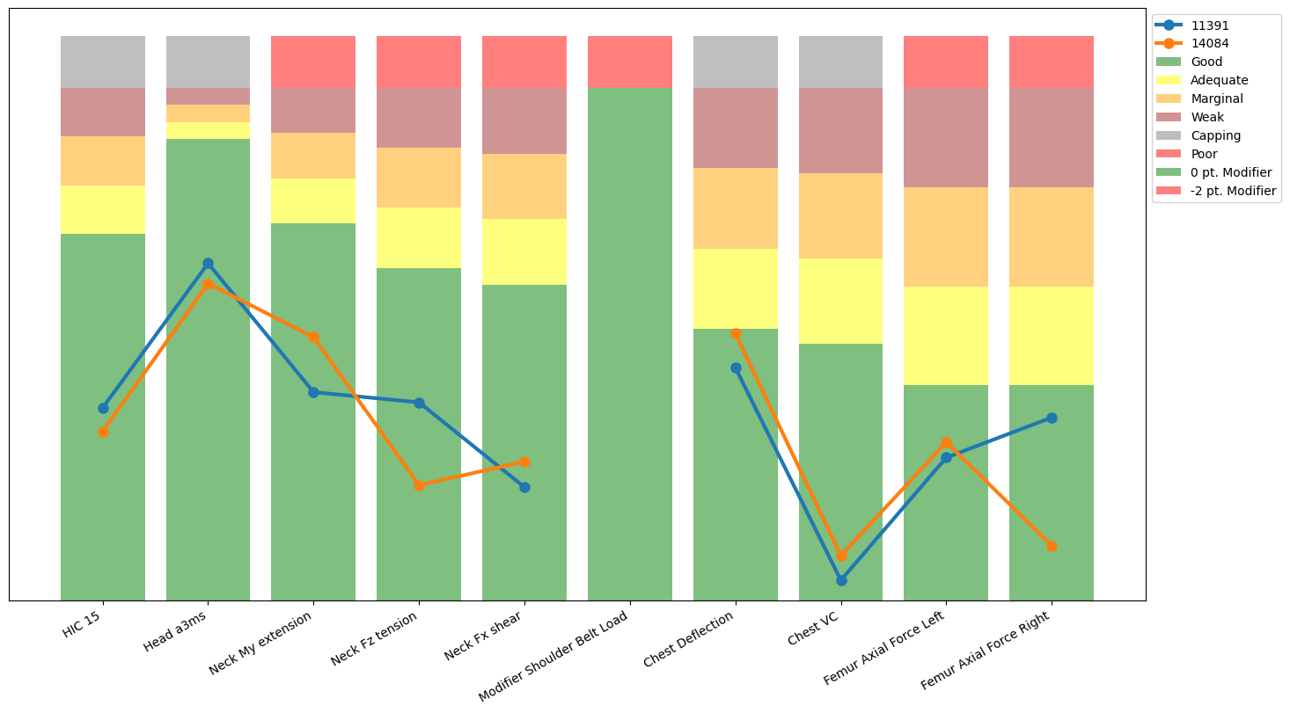
Front Passenger Result

Slide 13
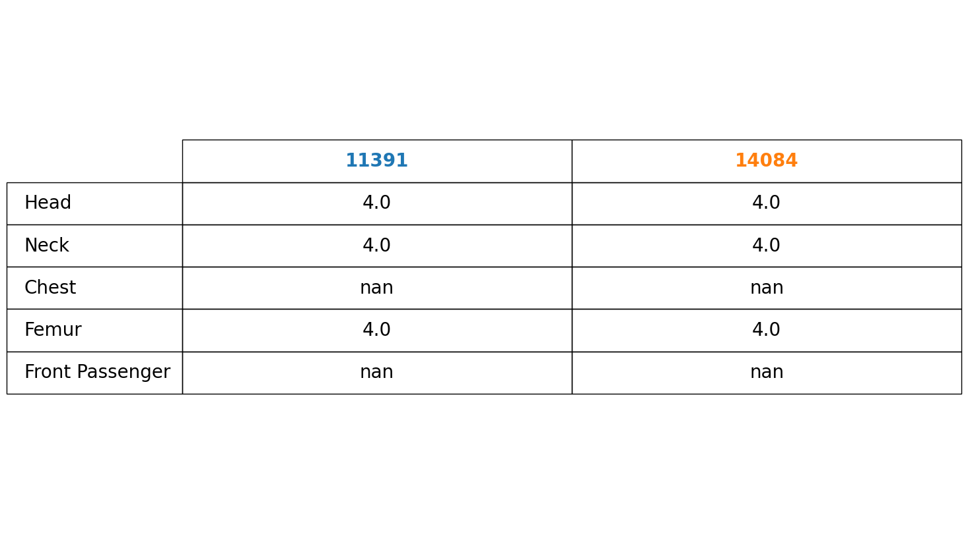
Front Passenger Rating

Slide 14
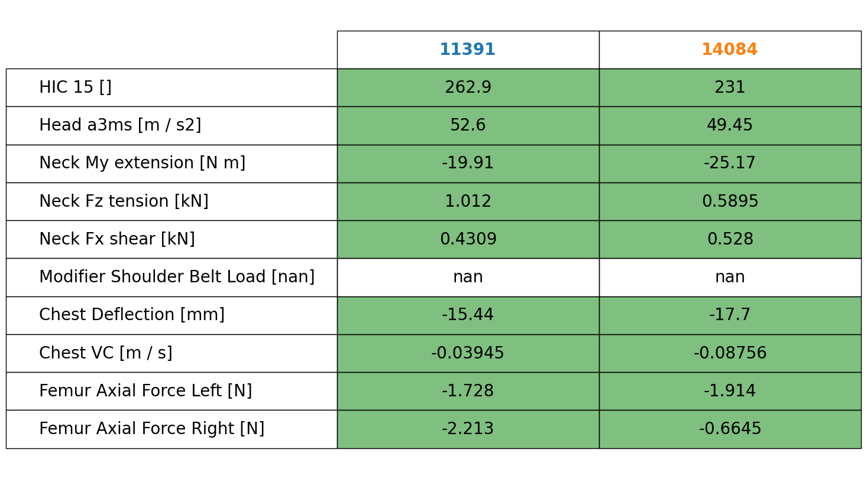
Front Passenger Values

Slide 15
Front Passenger Belt

Slide 16
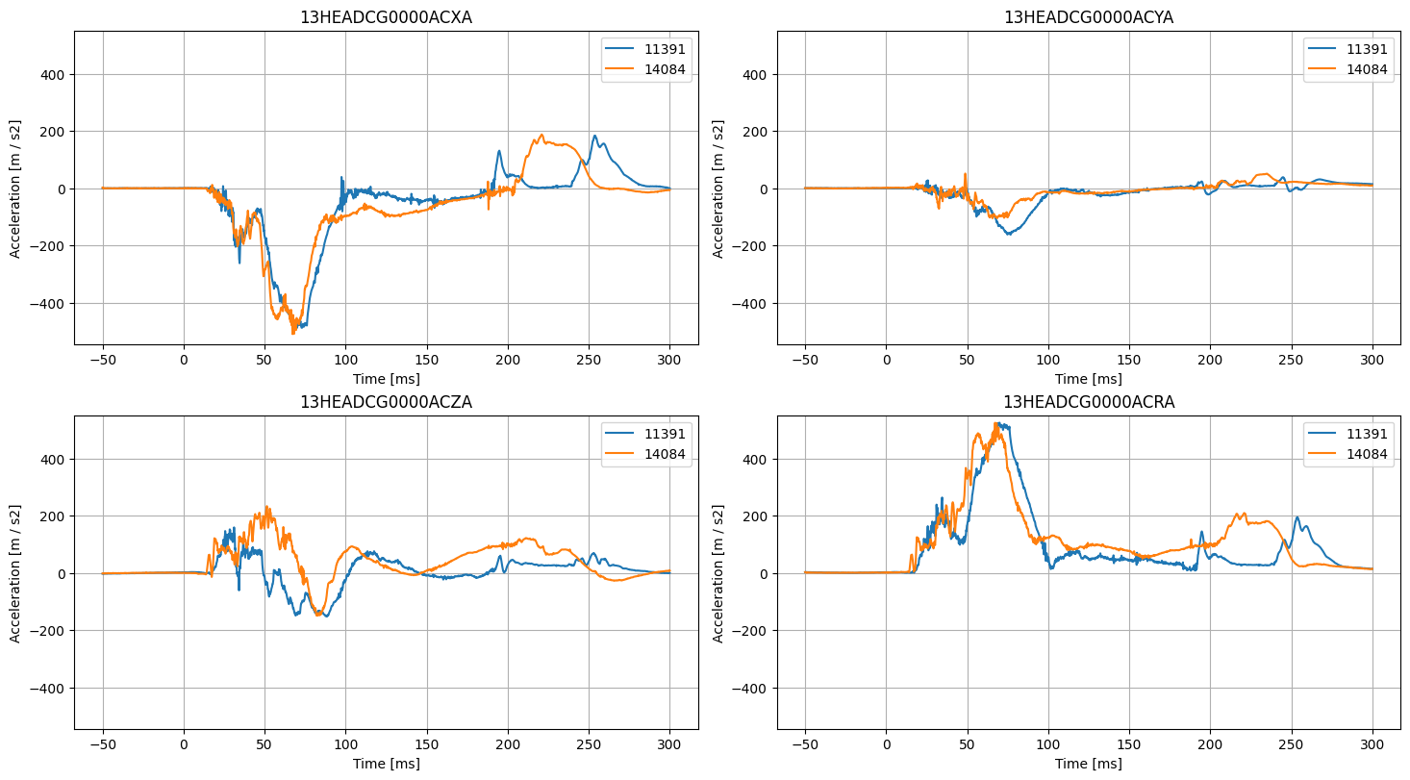
Front Passenger Head Acceleration

Slide 17
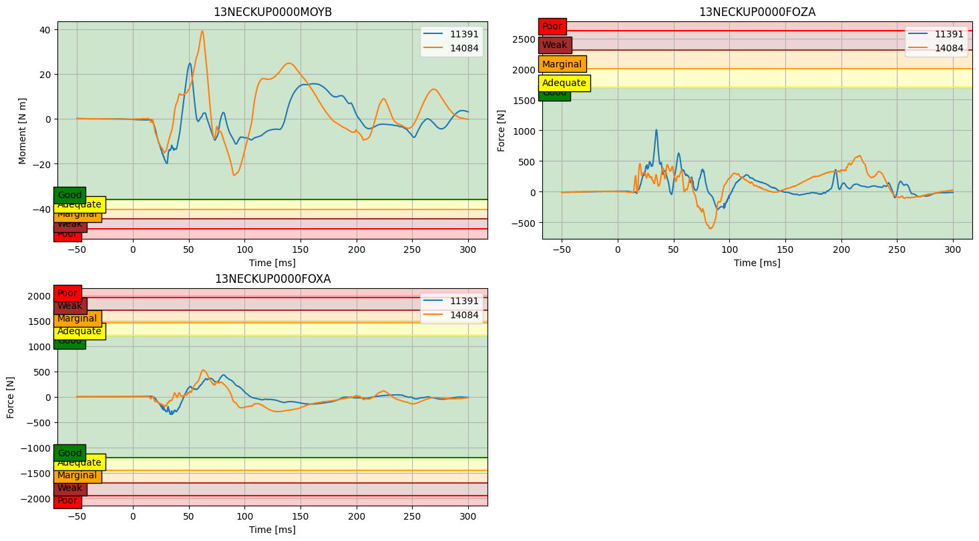
Front Passenger Neck Load

Slide 18
Front Passenger Neck NIJ

Slide 19
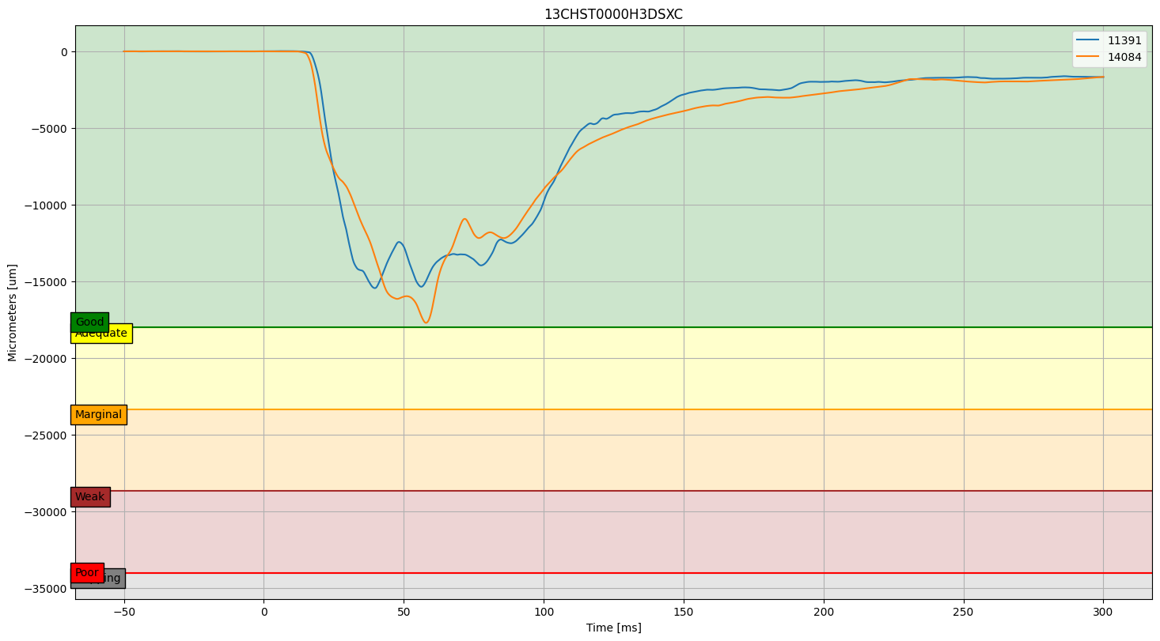
Front Passenger Chest Deflection

Slide 20
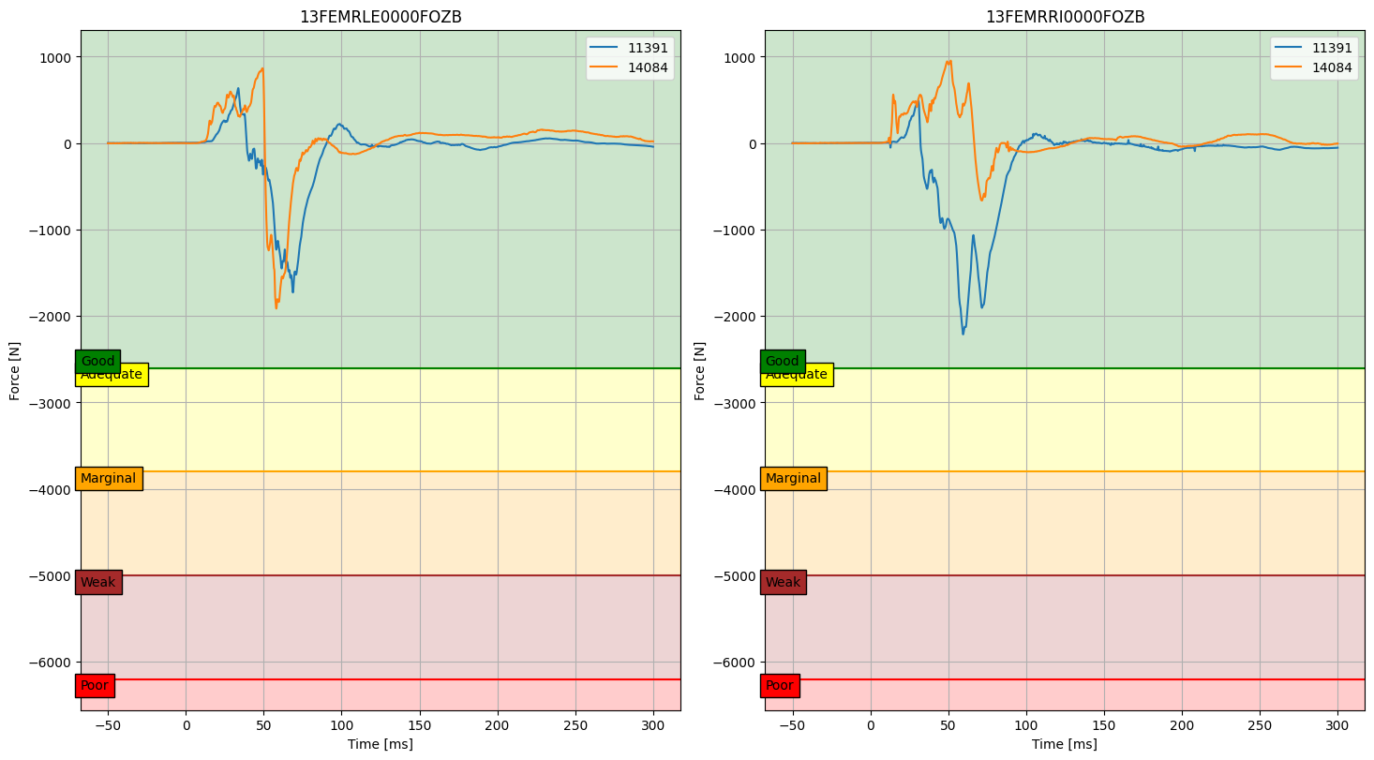
Front Passenger Femur Axial Force

Slide 21
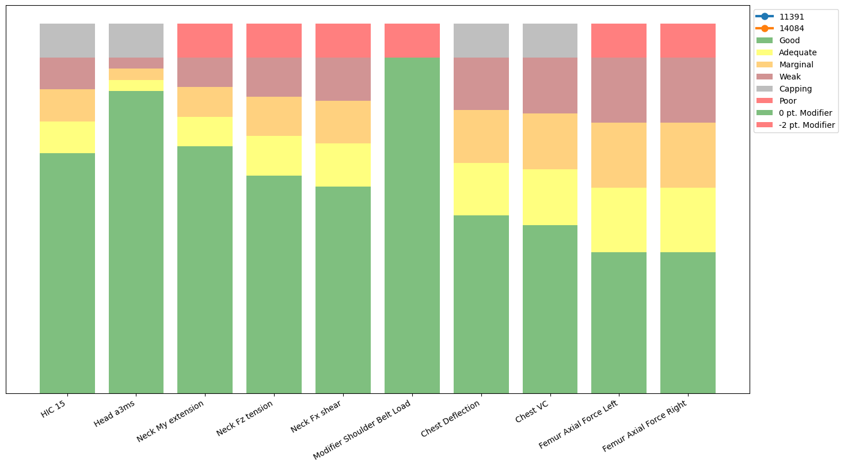
Rear Passenger Result

Slide 22
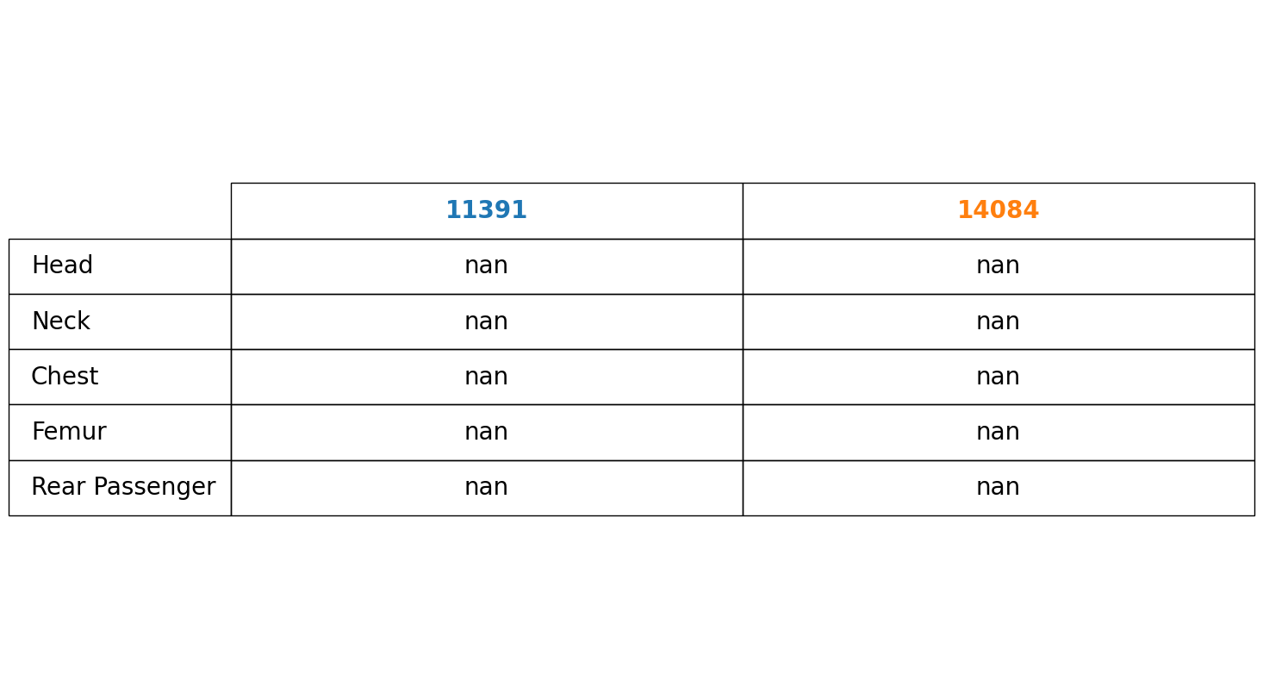
Rear Passenger Result

Slide 23
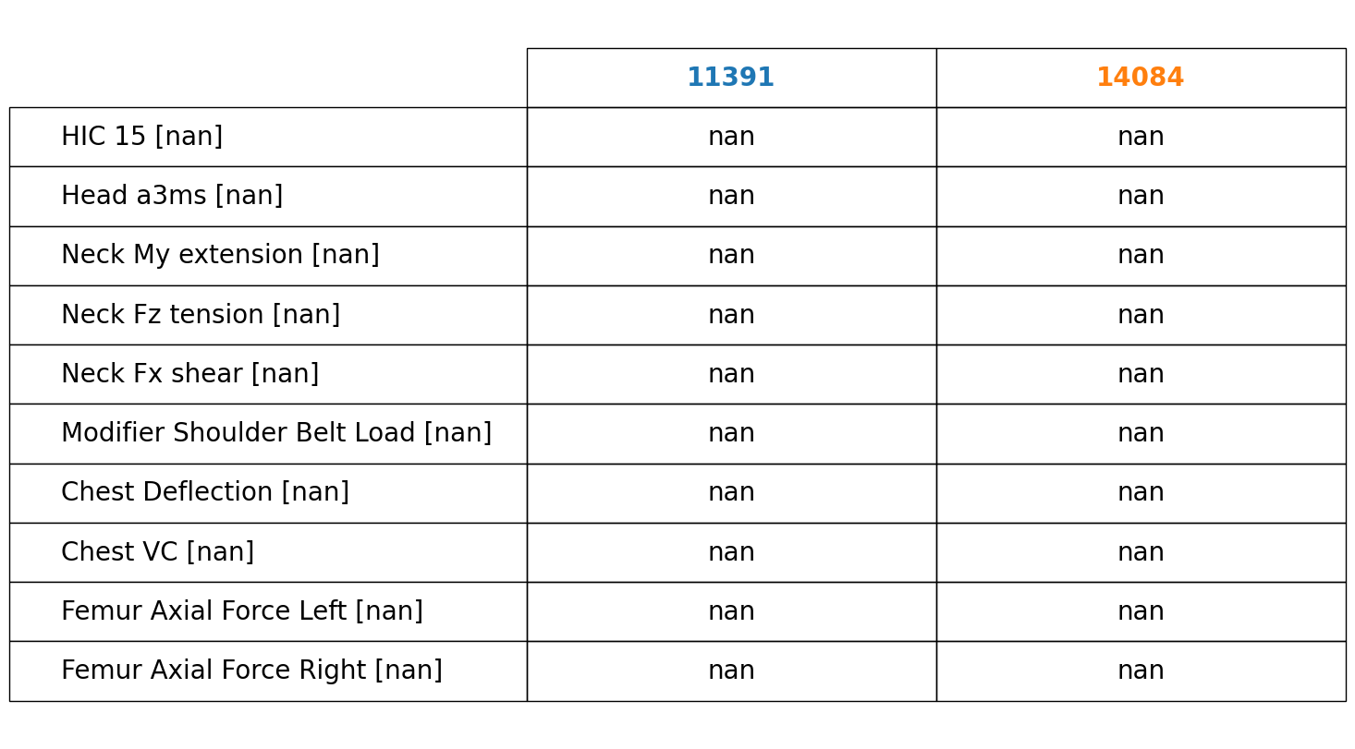
Rear Passenger Values

Slide 24
Rear Passenger Belt

Slide 25
Rear Passenger Head Acceleration

Slide 26
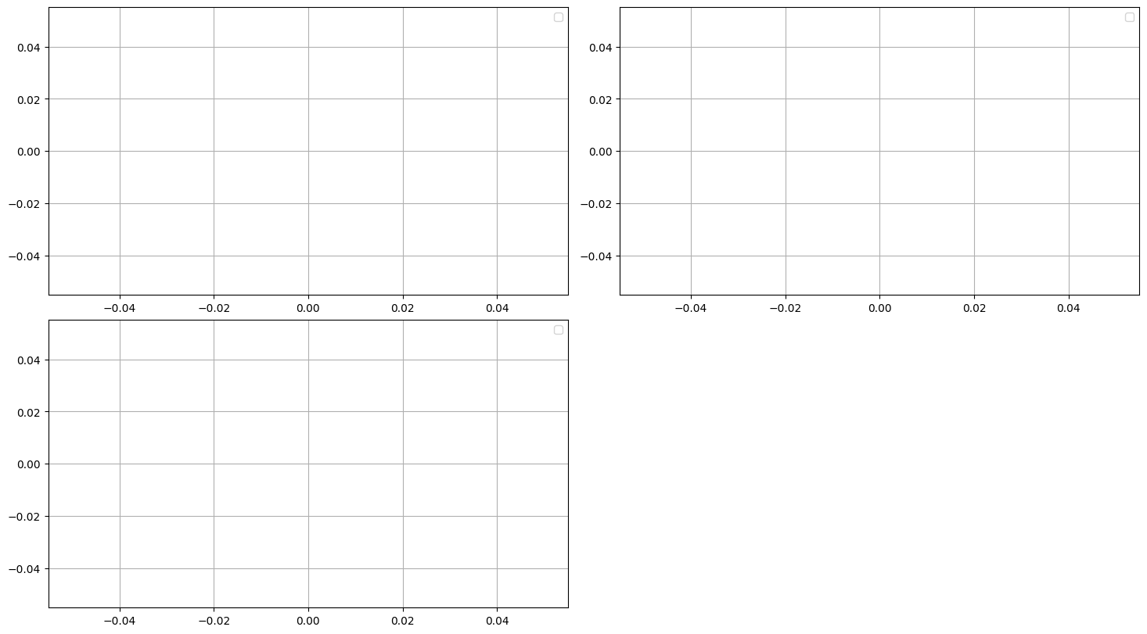
Rear Passenger Neck Load

Slide 27
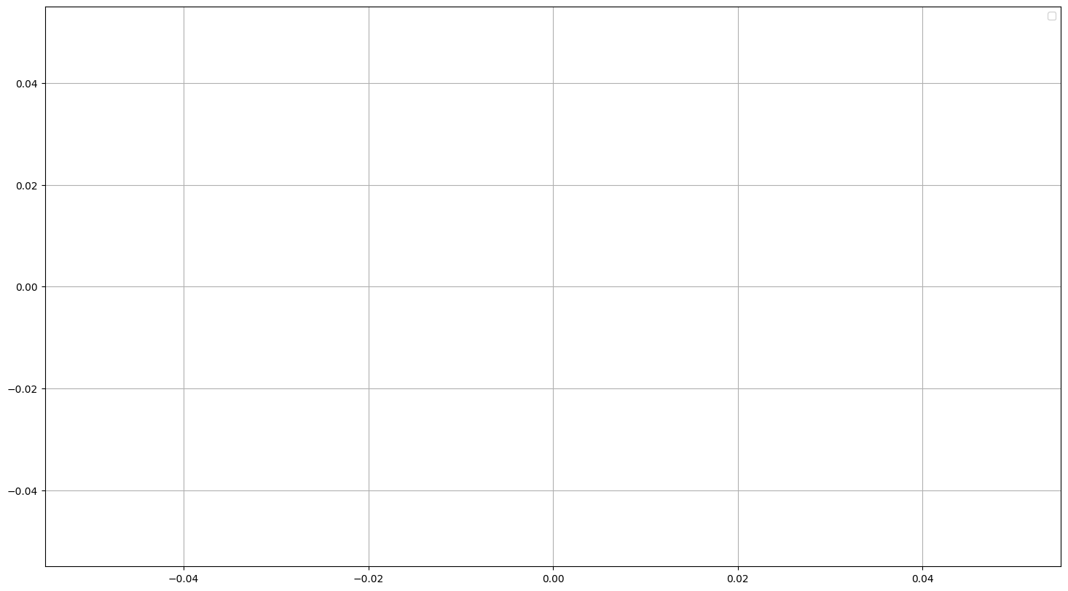
Rear Passenger Chest Deflection

Slide 28
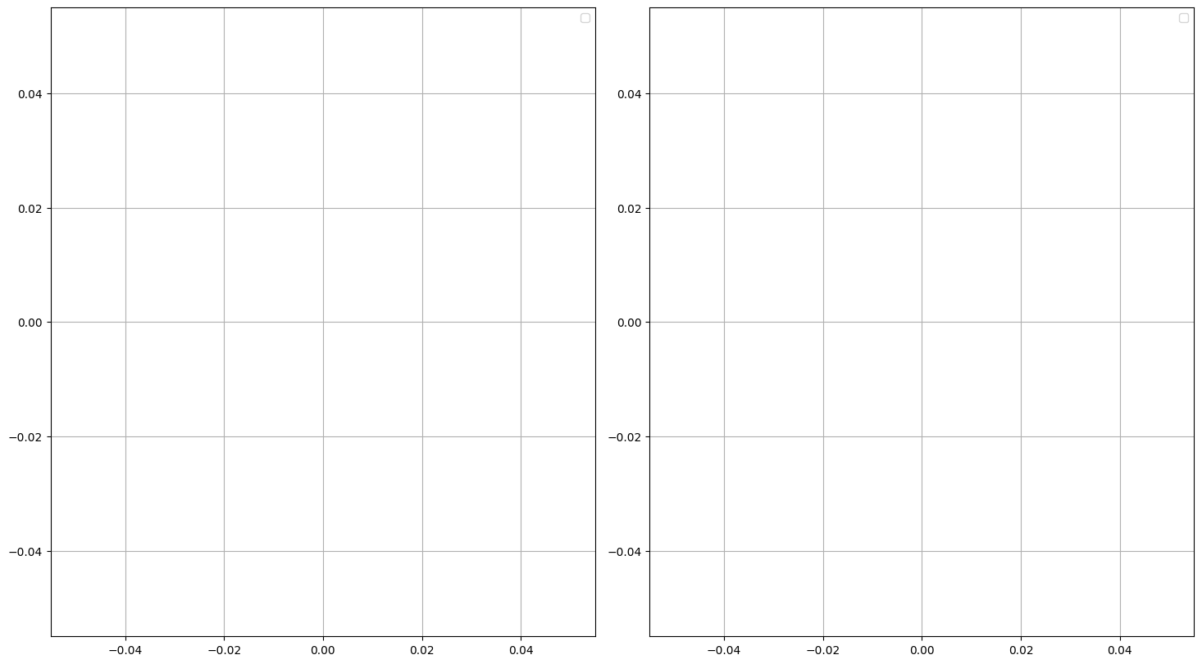
Rear Passenger Femur Axial Force

Slide 29
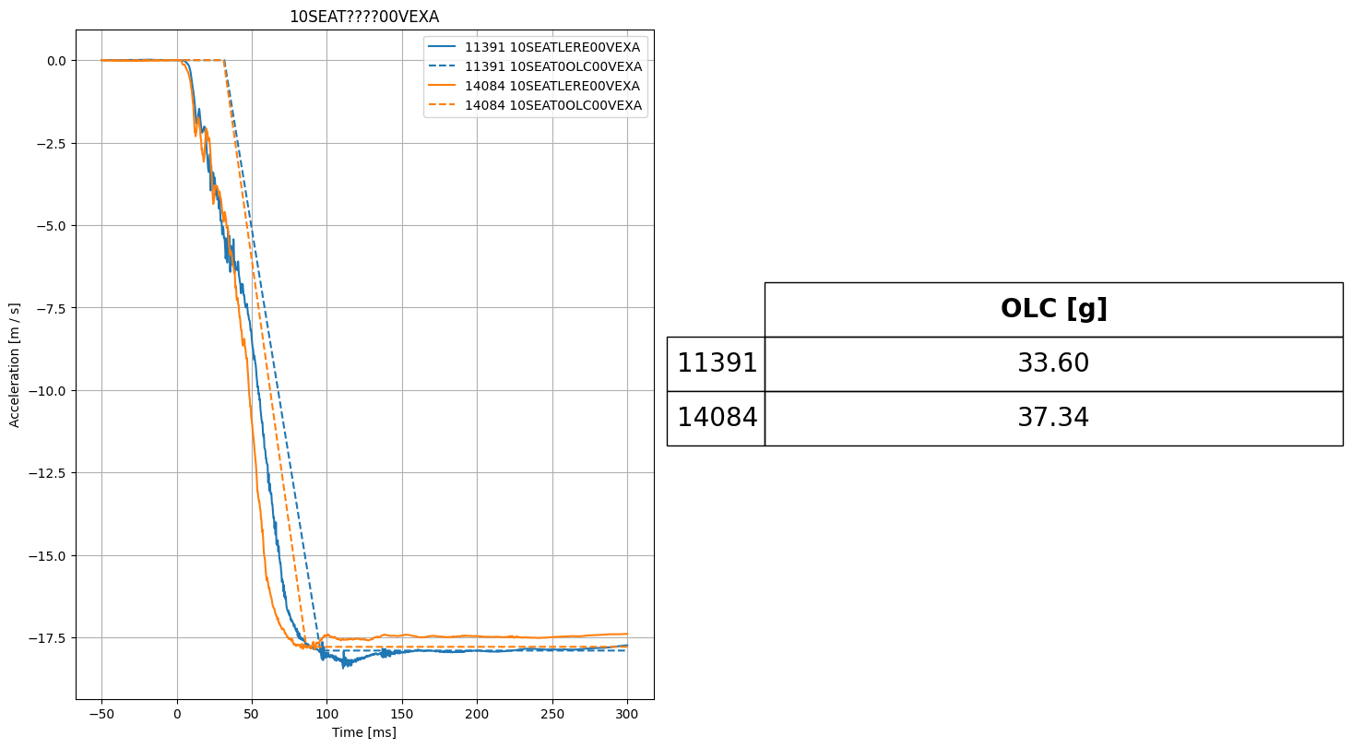
Occupant Load Criterion (OLC)

