Slide 1
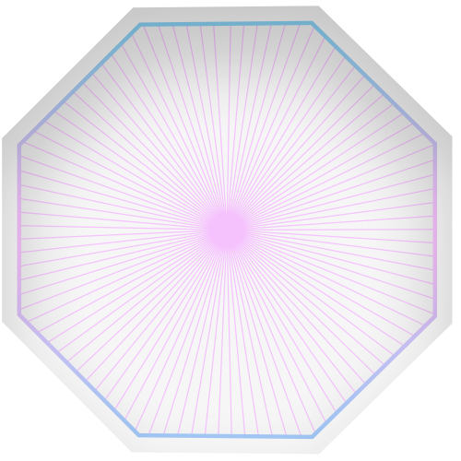
AR Mini Davinci
Training the dumb

Slide 2

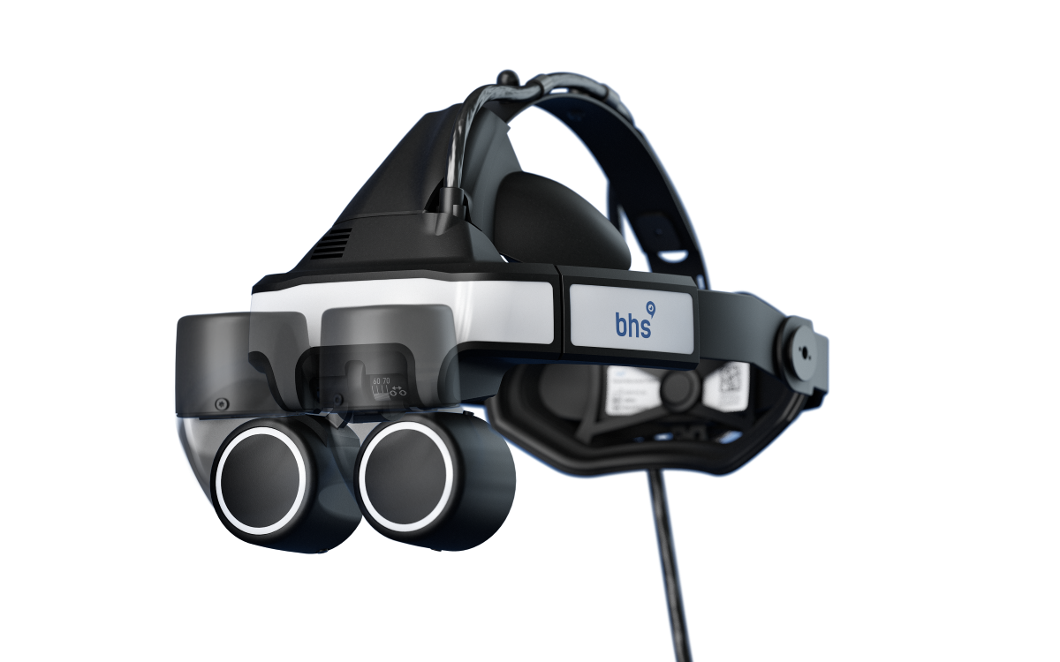

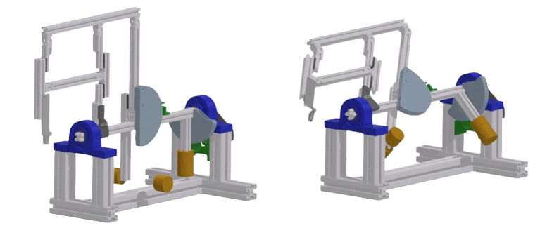
Mini Davinci for Robotic Surgery Simulation
Applications: Robotic Endo- and Exoscopic stereoscopic Optical System. Displayed on HMD, Controlled by Head Movements
Challenge: Controlling the Device with Head Movements requires some training
Goal: Enhance Training Experience and possibilities with a custom AR Guide

Slide 3



Welcome to the Tutorial!

Slide 4
Scene 1

Slide 5
1.1
Welcome to the Base Tutorial! My name is Dogtor. Corgi and I will run you through this introduction step by step. Please read the instructions carefully.
Before doing my Dogtor at the University of Dogtown I was a magician. Do you want to see a magic trick?
Press and Release the foot pedal on the floor!

Slide 6
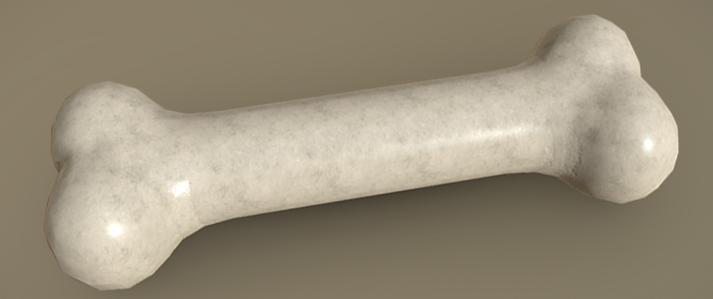
1.1
Pooof! Look, an anatomical relevant object!
Okay having an object to look at, lets move on. It seems you already found the head mounted display. The second piece of control hardware is the foot pedal. When you press it, you enter a menu. When you release it, the menu disappears.
Press and Release the Foot Pedal and ignore the menu!

Slide 7
1.3
Great!
You now know how to enter and exit the menu. Lets try to control the camera. Once in the right menu, you can use movements of your head to control the camera in two axis.
Now let's hold the foot pedal, move your head to highlight “Rotate Camera”, and move back to the center to select that mode. While keeping the pedal pressed you can now look up, down, left and right to move the camera. Move it to any other position and then release the pedal.

Slide 8
1.4
You now understand the user interface! You press the pedal to enter the menu. You highlight the menu point you want to choose and confirm it with the checkmark in the center. Then you can manipulate the camera or change lighting. Only when you want to exit the menu you release the pedal.
Not try to move the Camera to a new position in the Vertical Axis!

Slide 9
1.5
When going into the Endoscopic Mode, Lighting is quite important!
Try to turn on the light to a desired lighting intensity!

Slide 10
1.6
Great, you deserve a Treat. Oh, you’re human, you don’t work with treats. Still, well done!
You should know how to run this device. If you want to look at some test subjects or want to run through a small virtual parkour to enhance your training with the device, use some of the other AR-Cards to initialize those. I take care of the bone!

Slide 11
Scene 2

Slide 12
2.1
Hello again! I assume you have already done the Base Tutorial! If not, complete this first!
In this Session, we will run through a small Parcour. You will have to move through different Camera Positions and Lighting Settings to Complete it.
Let's start with some magic again!
Press and Release the foot pedal on the floor!

Slide 13
2.2
Poof! Hm, I preferred the bone. But this should do as well. Now you need to listen carefully to remember your task! On this object there are 5 numbered faces. You will need to orient your camera towards each of those faces in ascending order. If the number is white, turn the light on, if it is black, turn the light off. Also if the number is small, move the camera closer. If it is large move the camera all the way out!
Got it? As soon as you press the pedal, we start!

Slide 14
2.3
Great job, looks as if you were able to navigate the optical robot very well!
You can now look at some physical objects or use some other AR-Card!

Slide 15
Scene 3

Slide 16
2.3
Hello! In this session, you can just freely look at a 3D object. Have fun!

Slide 17
Scene 4

Slide 18
2.3
Hello! In this session, you can just freely look at a 3D object. Have fun!

