Slide 1
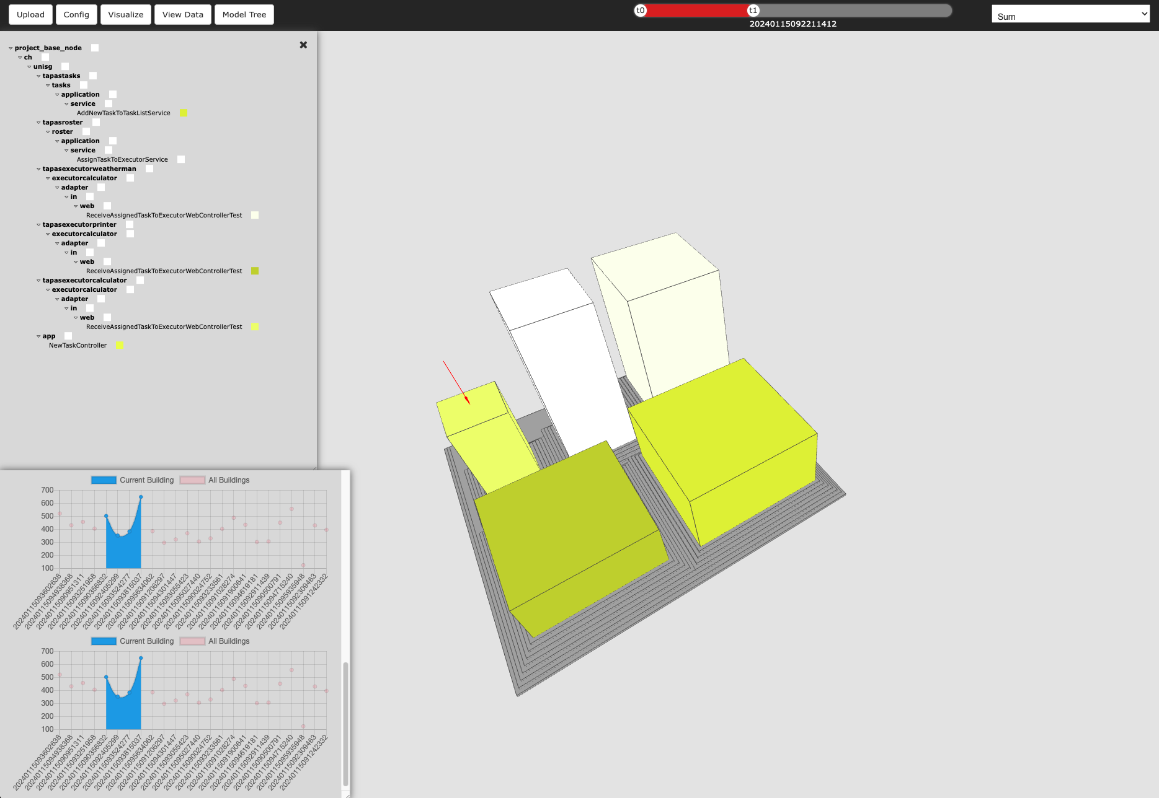
3D Visualization
Navigation in Time
Navigation in Space
Navigation in Time & Space
Data
Responsive data model
Any data support
Use Cases
Eye Tracking Experiment
Java Source Code
BPMN Model
Static Code Analysis

Slide 2
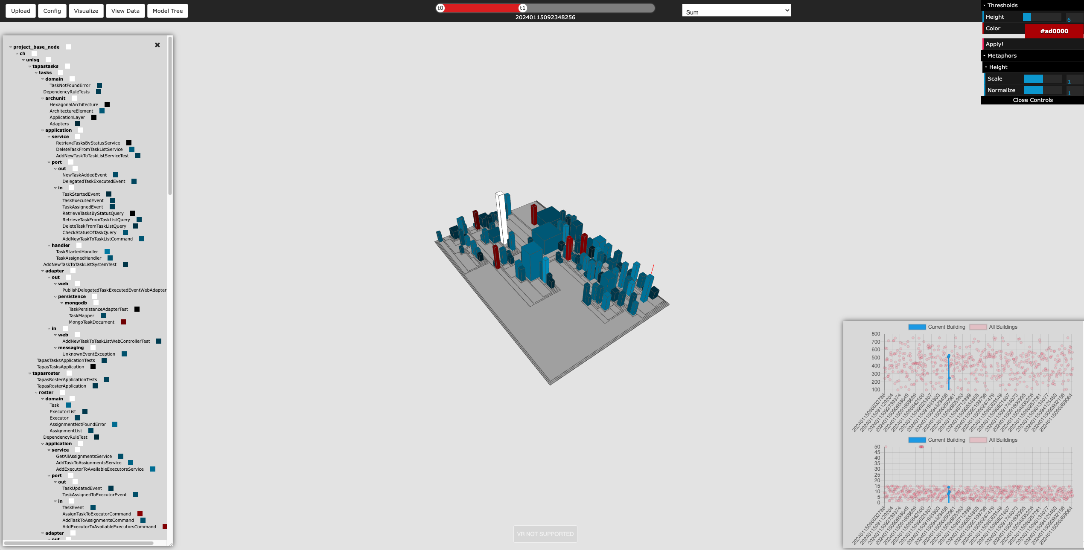
Data Configuration
Aggregation Functions
Interval
Sum
Integral Curve
Timeline (Time Navigation)
Windowed
Cumulative
Software City Metaphors
Buildings (Dimension, Height, Color, RoofColor)
Blocks
Districs
Customizable Visualization Model
Height
Coloring
Normalizing Functions
Model Tree Structure (Space Navigation)
1:1 Plot-to-Metaphor (Time & Space Navigation)

Slide 3
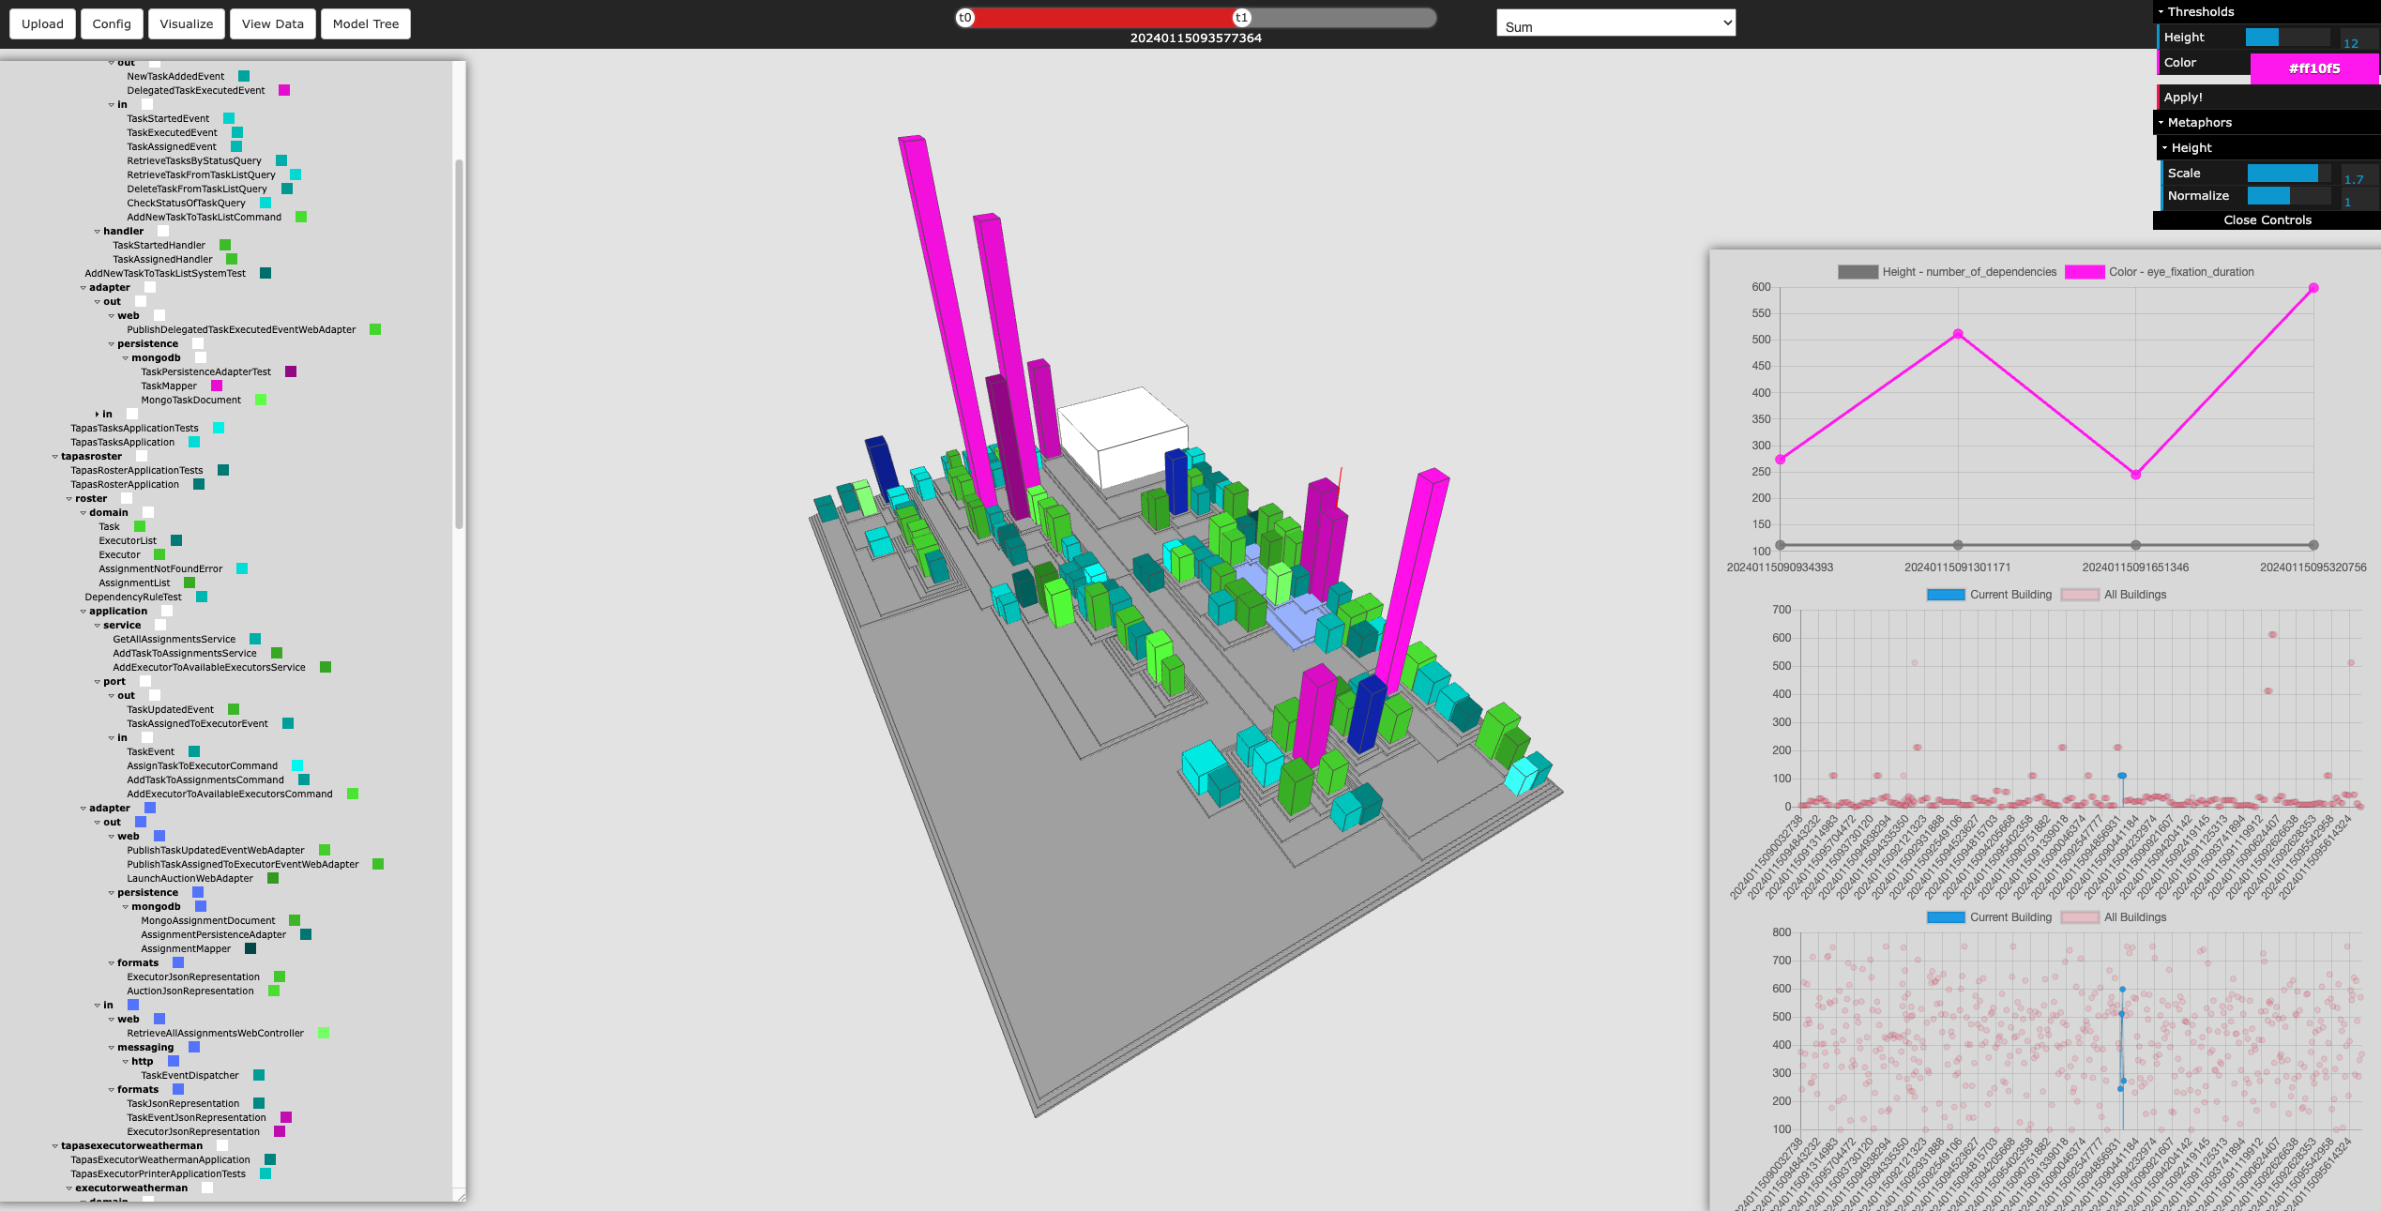
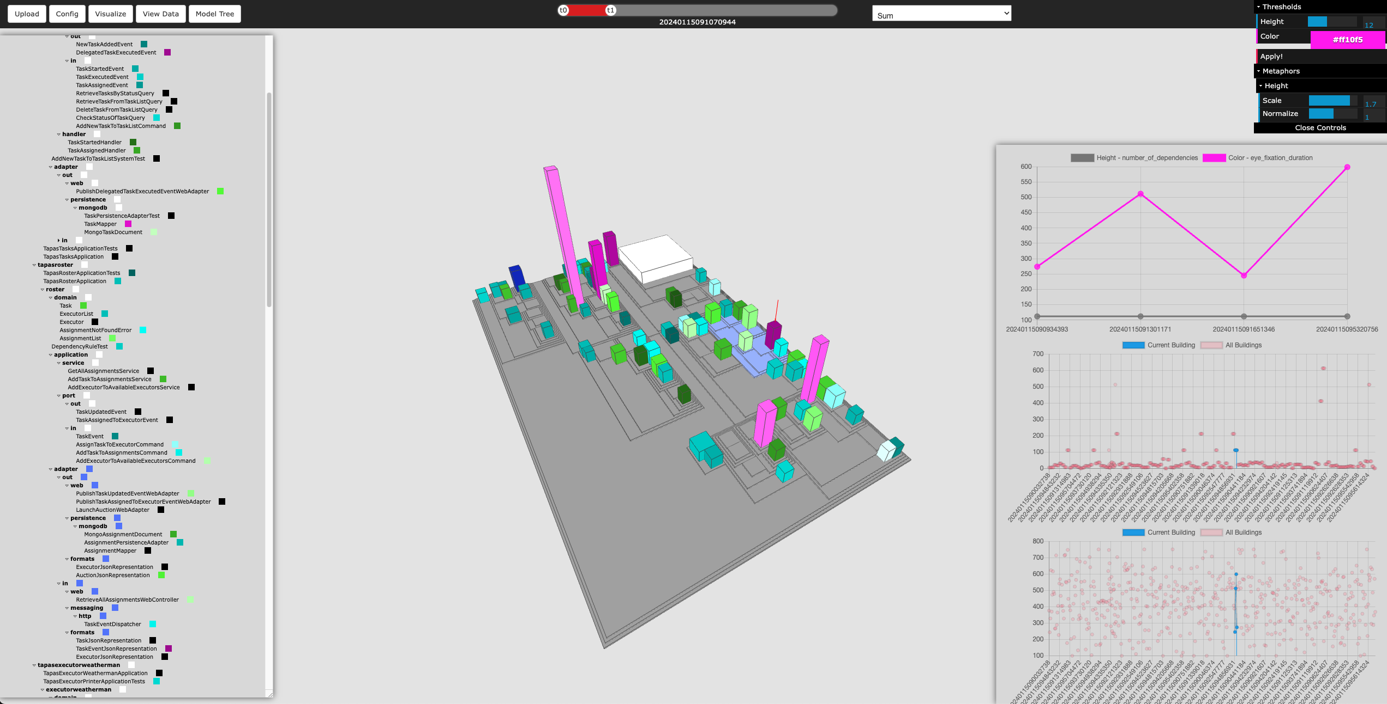
Compare States
Time & Space Navigation
Displaying the city metaphor model (space), and show how it evolves over the experiment by setting the aggregation function to “Sum” (time).
Aggregation function “Integral Curve” calculates the Height metaphor for the duration of a spectific datapoint.

Slide 4
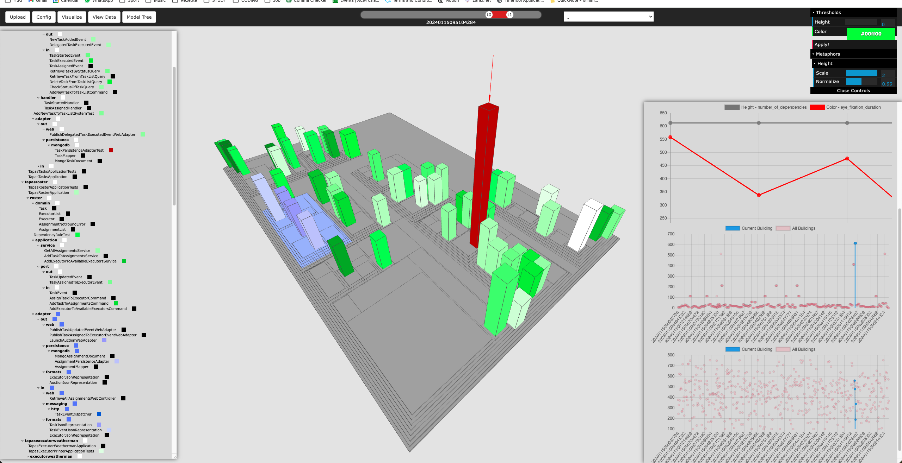
Time
Setting the aggregation function to “-”. Sliding the timeline shows the current state of the city metaphor at one specific point in time.
Windowed Mode: Setting a start- and endpoint in the timeline catches all occurences within that window; the last seen datapoints get displayed.

