Slide 1
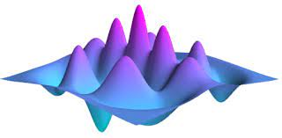


How to QuTiP
Contents
What is QuTiP?
How to use it?
Where are the examples?

Slide 2
What is QuTiP?
QuTiP is open-source software for simulating the dynamics of open quantum systems. QuTiP aims to provide user-friendly and efficient numerical simulations of a wide variety of Hamiltonians, including those with arbitrary time-dependence, commonly found in a wide range of physics applications
Based on Python libraries numpy, scipy, matplotlib, etc.
More on: http://qutip.org/

Slide 3

Steps: Rabi oscillations
Begin with operators
Define initial density matrix
Write down Hamiltonian
Solve it
Visualize results

Slide 4
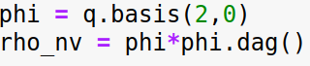
Steps: Rabi oscillations
Begin with operators
Define initial density matrix
Write down Hamiltonian
Solve it
Visualize results

Slide 5

Steps: Rabi oscillations
Begin with operators
Define initial density matrix
Write down Hamiltonian
Solve it
Visualize results

Slide 6

Steps: Rabi oscillations
Begin with operators
Define initial density matrix
Write down Hamiltonian
Solve it
Visualize results

Slide 7

Steps: Rabi oscillations
Begin with operators
Define initial density matrix
Write down Hamiltonian
Solve it
Visualize results

Slide 8
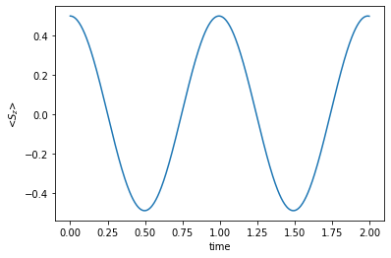
Steps: Rabi oscillations
Begin with operators
Define initial density matrix
Write down Hamiltonian
Solve it
Visualize results

Slide 9
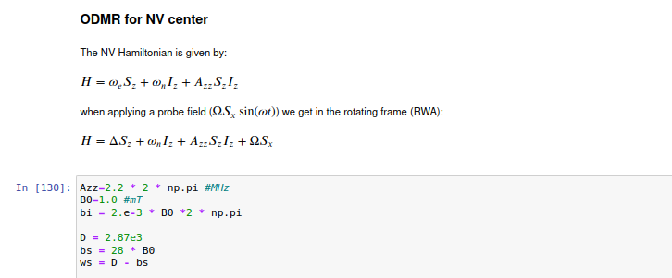
QuTiP with Jupyter Notebooks

Slide 10
Demonstration
Examples
    Time independent: Rabi, ODMR, Hartmann Hahn
    Time dependent: Non-RWA, Floquet-sidebands
    Open-system: T₁ decay electron spin and decoherence ¹⁴N nuclear spin

Slide 11
Where to find the examples?
https://github.com/jonasmeinel/how-to-qutip-4-pi3.git
It is a public repository and can be downloaded directly
Please contribute with more examples, references etc.

