Slide 1
Introduction to Bispectral Analysis and
High Order Correlations
Jonas Meinel
01.04.2022

Slide 2
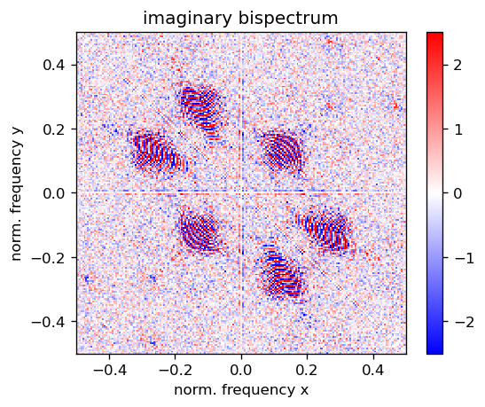
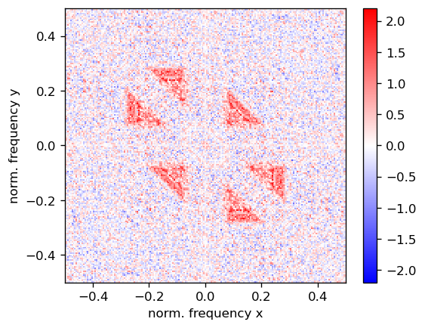
How to read Bispectra? What do they mean?

Slide 3
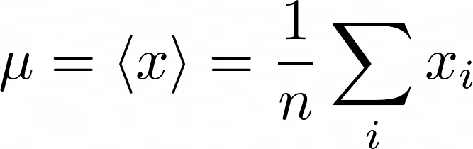

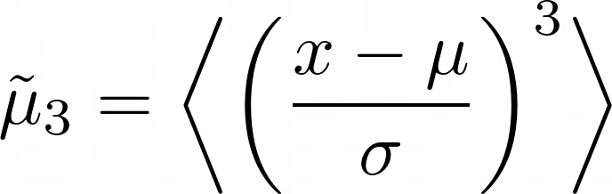
Example of Higher Order Moments in Statistics
Average
Variance
Skewness
Kurtosis
\mu = \langle x \rangle = \frac{1}{n} \sum_{i} x_i
\mathrm{var}(x)=\sigma^2 = \langle (x - \mu)^2 \rangle
\tilde{\mu}_3 = \biggl< \left( \frac{x-\mu}{\sigma} \right)^3\biggr>
\tilde{\mu}_4 = \biggl< \left( \frac{x-\mu}{\sigma} \right)^4\biggr>

Slide 4
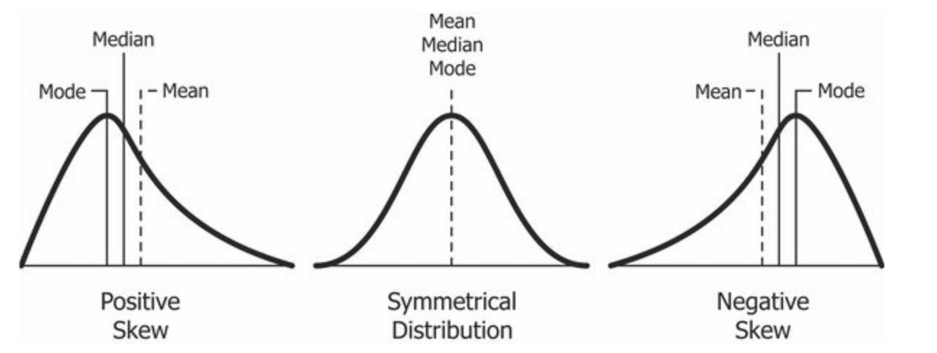
Example of Higher Order Moments in Statistics
Average
Variance
Skewness
Kurtosis
\mu = \langle x \rangle = \frac{1}{n} \sum_{i} x_i
\mathrm{var}(x)=\sigma^2 = \langle (x - \mu)^2 \rangle
\tilde{\mu}_3 = \biggl< \left( \frac{x-\mu}{\sigma} \right)^3\biggr>
\tilde{\mu}_4 = \biggl< \left( \frac{x-\mu}{\sigma} \right)^4\biggr>

Slide 5
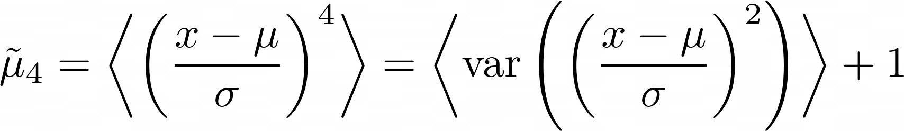
Example of Higher Order Moments in Statistics
Average
Variance
Skewness
Kurtosis
\mu = \langle x \rangle = \frac{1}{n} \sum_{i} x_i
\mathrm{var}(x)=\sigma^2 = \langle (x - \mu)^2 \rangle
\tilde{\mu}_4 = \biggl< \left( \frac{x-\mu}{\sigma} \right)^4\biggr> = \biggl< \mathrm{var}\left(\left( \frac{x-\mu}{\sigma} \right)^2 \right)\biggr> +1
\tilde{\mu}_3 = \biggl< \left( \frac{x-\mu}{\sigma} \right)^3\biggr>

Slide 6
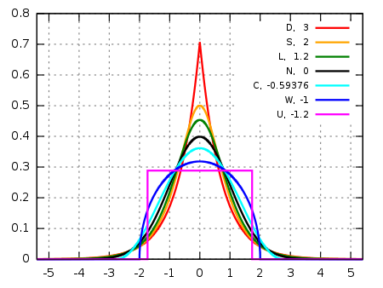
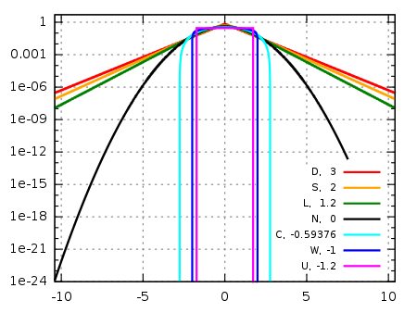
Example of Higher Order Moments in Statistics
Average
Variance
Skewness
Kurtosis
\mu = \langle x \rangle = \frac{1}{n} \sum_{i} x_i
\mathrm{var}(x)=\sigma^2 = \langle (x - \mu)^2 \rangle
\tilde{\mu}_4 = \biggl< \left( \frac{x-\mu}{\sigma} \right)^4\biggr> = \biggl< \mathrm{var}\left(\left( \frac{x-\mu}{\sigma} \right)^2 \right)\biggr> +1
\tilde{\mu}_3 = \biggl< \left( \frac{x-\mu}{\sigma} \right)^3\biggr>

Slide 7


Higher Order Correlations (HOC)
1st order
2nd order
3rd order
4th order
C_2(\tau) = \langle x(t) x(t+\tau) \rangle
C_4(\tau_1,\tau_2,\tau_3) = \langle x(t)x(t+\tau_1)x(t+\tau_2)x(t+\tau_3)\rangle
C_3(\tau_1,\tau_2) = \langle x(t) x(t+\tau_1) x(x+\tau_2) \rangle

Slide 8
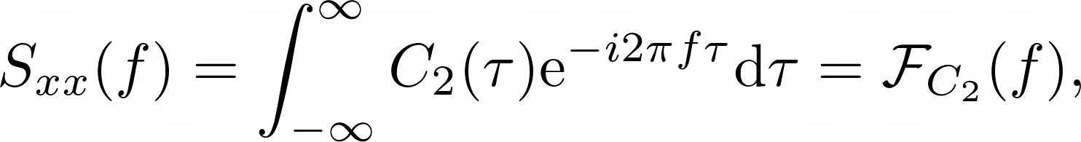
HOC and Higher Order Spectra (HOS)
S_{xx}(f) = \int_{-\infty}^{\infty} C_{2}(\tau) \mathrm{e}^{-i2\pi f \tau} \mathrm{d} \tau = \mathcal{F}_{C_{2}}(f),
B_x(f_1,f_2) = \mathcal{F}_x (f_1) \; \mathcal{F}_x (f_2) \; \mathcal{F}^{-1}_x(f_1 + f_2),
B_x(f_1,f_2) = \int \int \mathrm{d}\tau_1\; \mathrm{d}\tau_2\; C_3(\tau_1,\tau_2)\; \mathrm{e}^{-i2\pi(f_1 \tau_1+f_2\tau_2)}.
Power spectrum
Bispectrum
Trispectrum: ...
  → Why Higher order Spectra are interesting?

Slide 9



Motivation of Bispectra
Very important identity of Bispectra
Sensitive to non-linear processes
Conserving the relative phase of signals
“Gaussian noise free”

Slide 10
Motivation of Bispectra
Very important identity of Bispectrum
Sensitive to non-linear processes
Conserving the relative phase of signals
“Gaussian noise free”

Slide 11
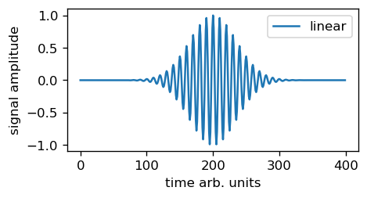
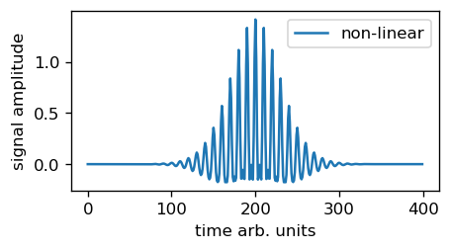
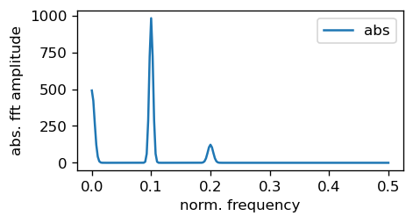
Example 1: Non Linear Process
Original signal
Signal after non linear process
Power spectrum of the signal

Slide 12
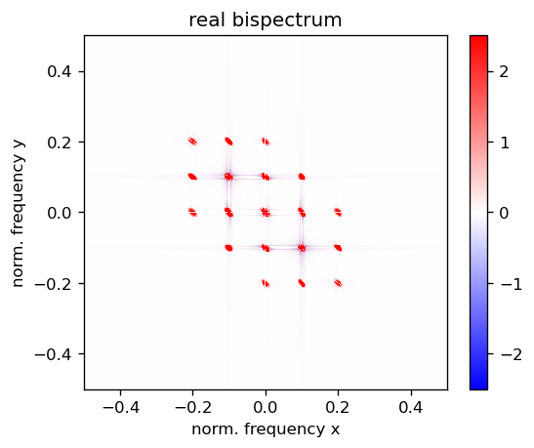
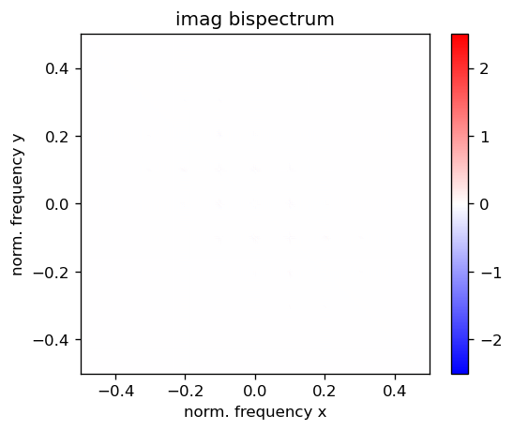
Example 1: Non Linear Process
Quadratic Phase
coupled (QPC)
component
→ real peaks
Let’s compare to
a signal not from a
non linear process
with the same PSD

Slide 13
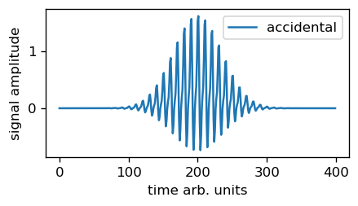
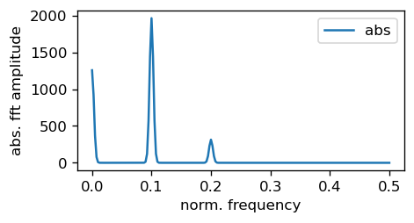
QPC vs. accidental matched
Signal with same PSD,
but 2f is phase shifted
→ accidentally matched
Top: QPC
Bottom: Accident

Slide 14
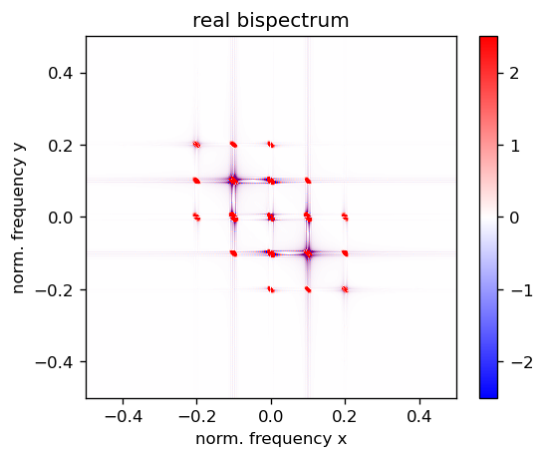
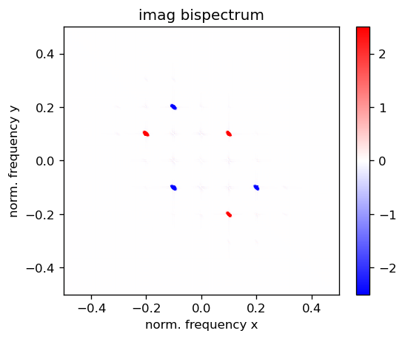
QPC vs. accidental matched - bispectrum
Top: QPC
Bottom: Accident

Slide 15
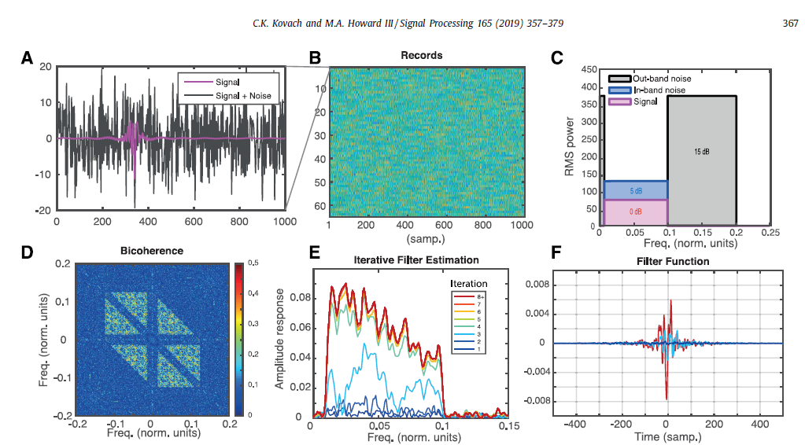
Example 2: Reconstructing a Filter for Arbitrary Signals

Slide 16
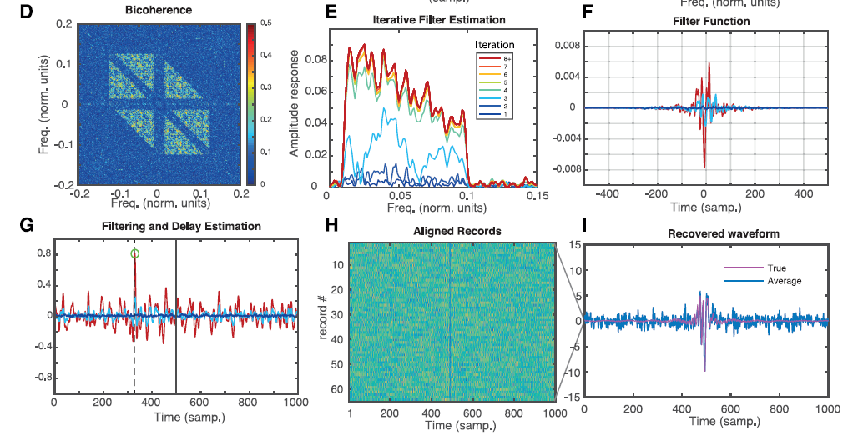
Example 2: Reconstructing a Filter for Arbitrary Signals

Slide 17
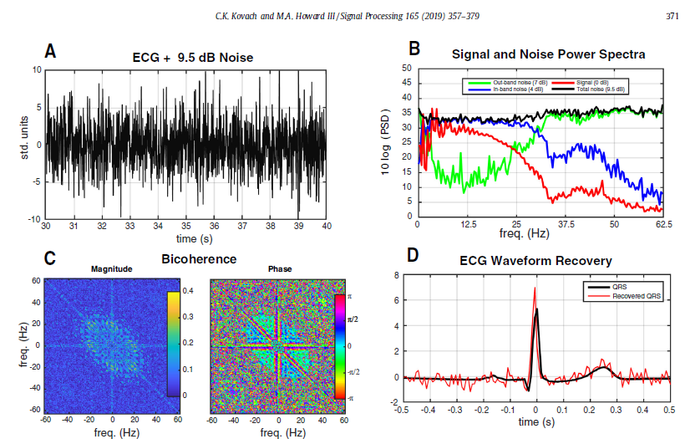
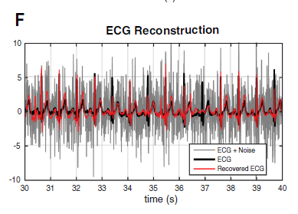
Example 2: Reconstructing a Filter for Bio Signals

Slide 18
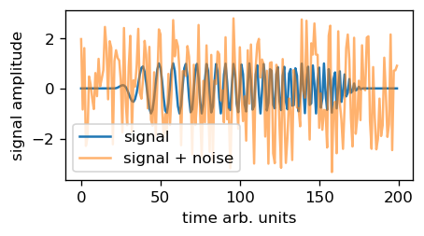
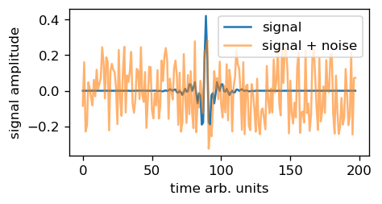
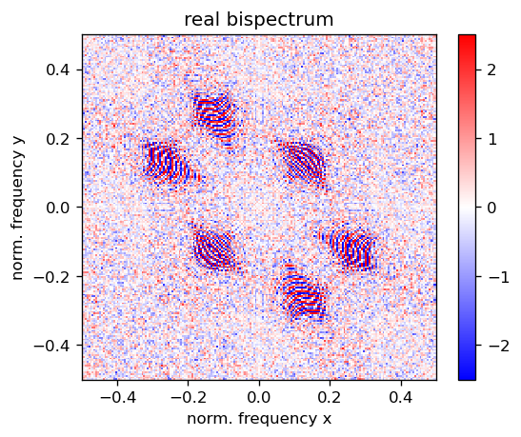
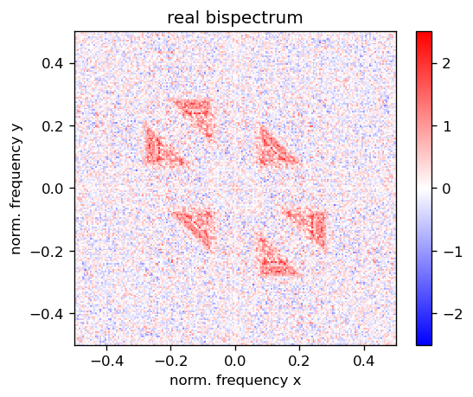
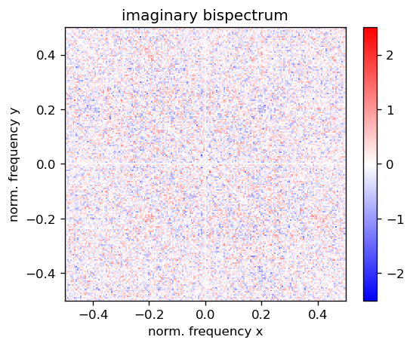
Other Examples:

Slide 19
Summary of Bispectral analysis
Very important identity of Bispectrum
Sensitive to non-linear processes
Conserving the relative phase of signals
“Gaussian noise free”

Slide 20
Questions
Questions?

