Slide 1
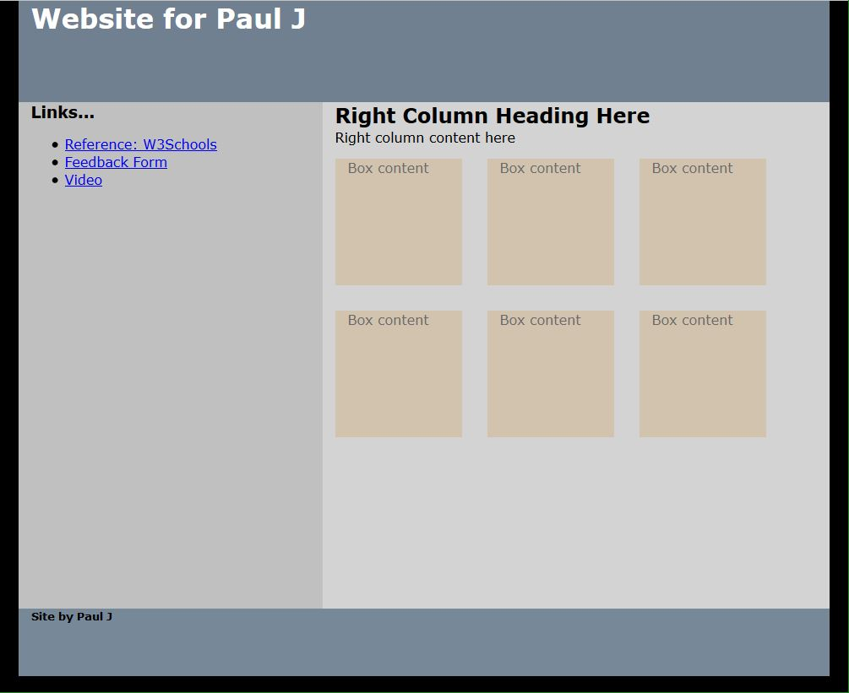
#wrapper {
background-color:LightSlateGrey ;
body {
background-color: black;
#banner {
background-color:SlateGrey;
.box:hover {
background-color:white;
.box {
background-color:tan;
#left-column {
background-color:silver;
#right-column {
background-color:LightGray;

