Slide 1
Predator-Prey Swarming Model
Luca Tondelli, Jonas Purtschert

Slide 2
Overview
Model presentation
Interpreting the parameters
Simulation results & Discussion
Summary & Outlook

Slide 3
The Base Model (BM)
Vladimir Zhdakin, J. C. Sprott
2 agents: predator, prey
2 dimensional
No environment interaction except friction
#preys > #predators

Slide 4
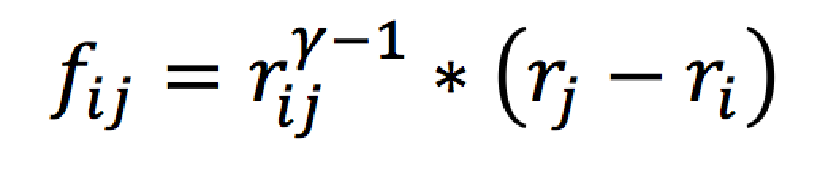
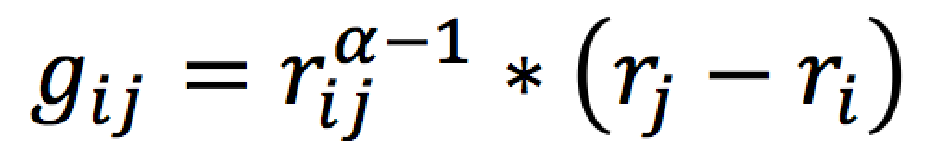
BM: Prey to Prey Forces
Radial
Power laws
Long-range (attractive)
Short-range (repulsive)

Slide 5
BM: Predator to Predator Forces
Same as preys (swarming)
Long-range attractive
Short-range repulsive
Only repulsive (spreading)
Long-range repulsive
Short-range repulsive
No force

Slide 6
BM: Prey to Predator Forces
Only long-range repulsive / attractive

Slide 7
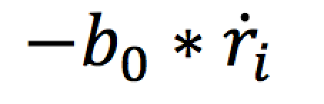
BM: Friction
On prey and predator
The only environment force

Slide 8
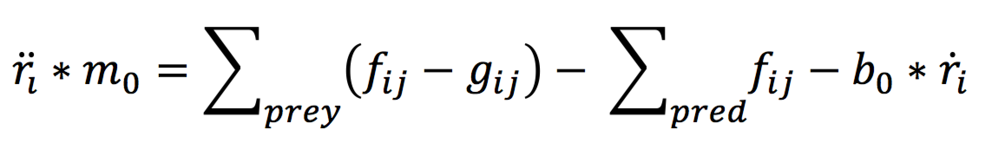
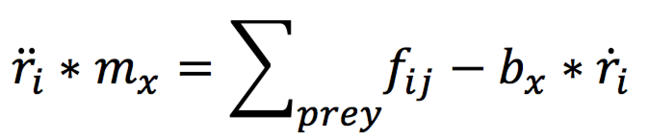
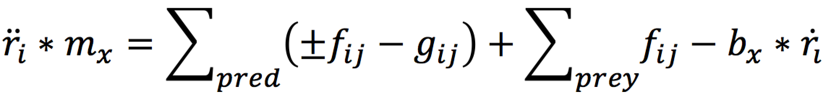
BM: Resulting Forces
Prey:
Predator:

Slide 9
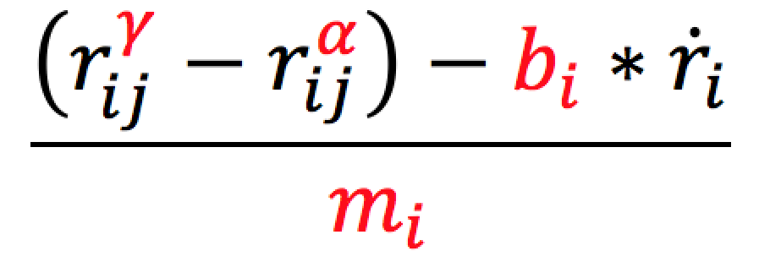
Interpretation of the Parameters (IP)
Motion parameters γ and α
The mass m
The friction b

Slide 10
IP: Motion Parameters
γ and α have to be negative
γ > α

Slide 11
IP: Motion Parameters
Difference between γ and α? -> 1

Slide 12
IP: Motion Parameters
Value of α? -> -1

Slide 13
IP: The Mass
Defines acceleration
Too big:
Slow acceleration
Fast stabilization
Too small:
Fast acceleration (jumping)
No stabilization
0.1 ≤ m ≥ 1

Slide 14
IP: Friction
Avoid outbreaks / hold swarm together
Too big:
Slow movement
Swarm always together
Too small:
Outbreaks
0.1 ≤ m ≥ 1

Slide 15
Simulation Results & Discussion (SD)
Trivial case
Single Predator
Multiple Predator
Hunting Methods

Slide 16
SD: Trivial Case

Slide 17
SD: Multiple Predator
// chaotic example
// circling example

Slide 18
SD: Chaotic Video

Slide 19
SD: Circling Video

Slide 20
SD: Separating Video

Slide 21
Summary & Outlook (SO)

