Slide 1
A Multi-Threaded Broken-Link Checker for the Marian University Website An Operating-Systems–Informed Design and Evaluation
Jonas Schaefer

Slide 2
TABLE OF CONTENTS
01
02
03
04
INTRODUCTION
OUTPUT
Why the project matters
Cascade Login
Link, run & violation summary
Why is it useful?
TECHNOLOGY
FUTURE WORK
System Overview, Threads, Cache
Worker Logic
Conclusion

Slide 3
BACKGROUND & MOTIVATION
INTERNSHIP
WEB TEAM
Startet in May in Marketing & Communications
worked on large-scale projects
MAJOR TASK
ISSUES
IDEA
Full website migration (~1,600 pages)
broken links, missing redirects, outdated content
tool to automate link checking

Slide 4
WHY THIS PROJECT MATTERS
Website migration revealed broken links & Cascade login links
~1,600 pages → impossible to check manually
Issues often found by accident
Departments frequently request help fixing links
Time-consuming and inefficient process
My crawler:
Automatically scans all pages
Detects broken + Cascade login links
Shows exactly where problems appear
Provides clear reports for fast fixes

Slide 5
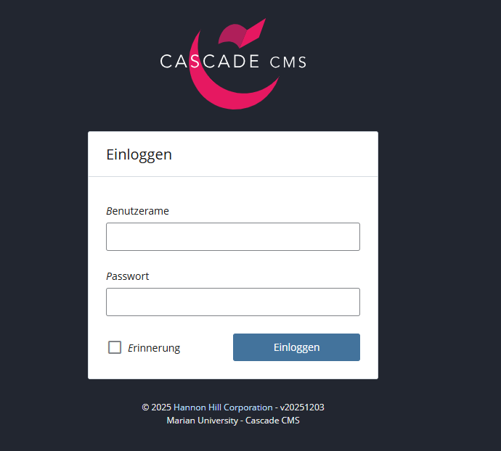

CASCADE LOGIN LINK
Some public pages accidentally link to internal admin login pages
These pages should only be visible to the Web Team
For users, seeing this link = broken / incorrect link
My crawler detects these links the same way as broken links

Slide 6
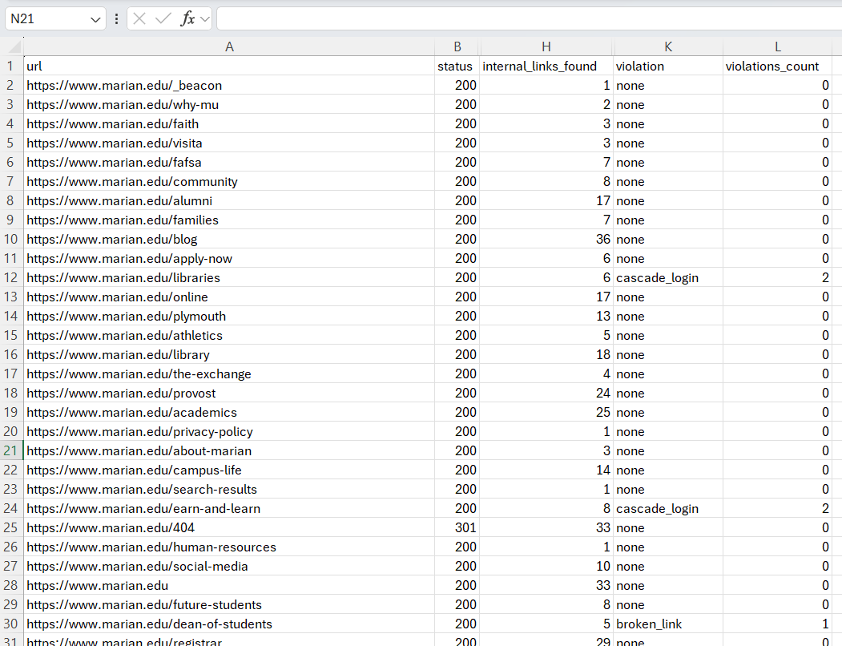
LINK SUMMARY

Slide 7
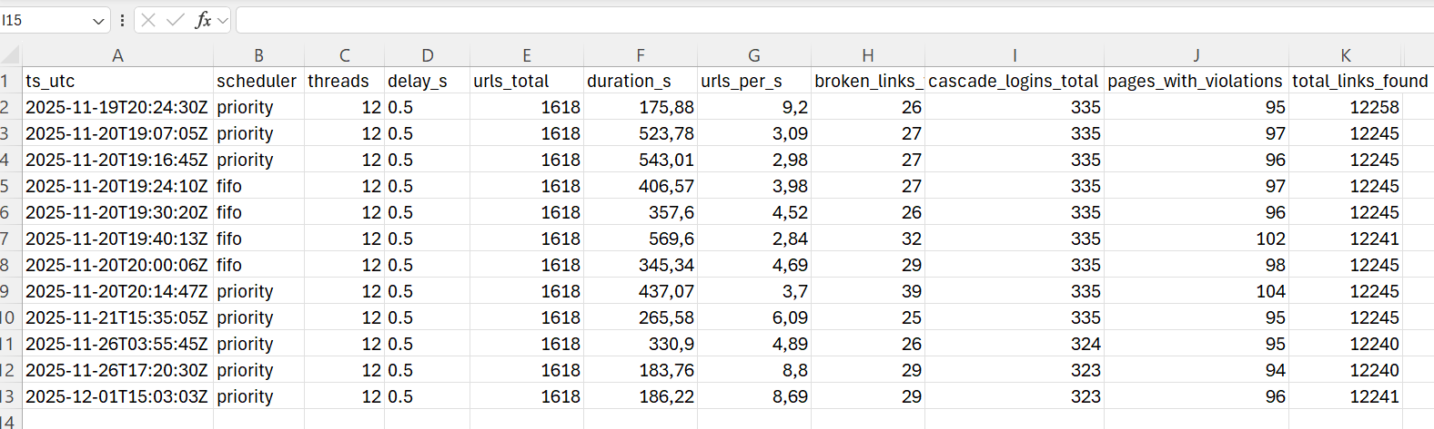
RUN SUMMARY

Slide 8
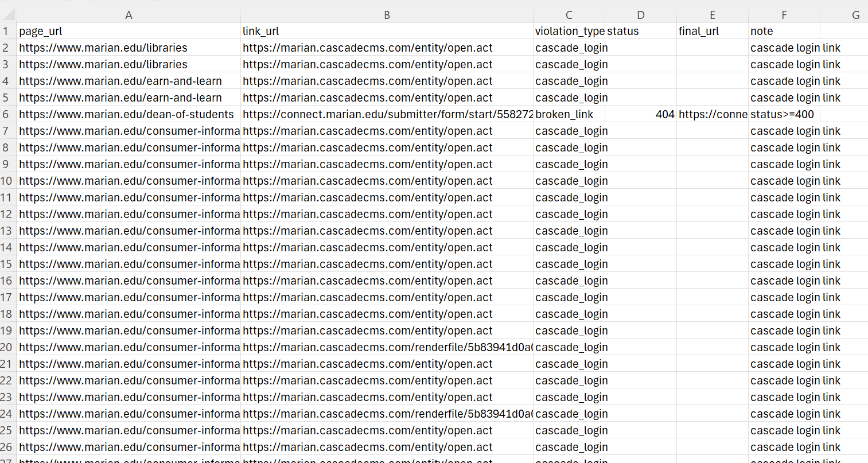
VIOLATION SUMMARY

Slide 9
SYSTEM OVERVIEW
3 main components
Config via YAML
Scheduler: loads sitemap & queues URLs
Worker Threads: process pages in parallel
Cache Layer: avoids repeated HTTP requests
Choose FIFO or Priority mode
Enable/disable cache
Easy for the web team to adjust

Slide 10
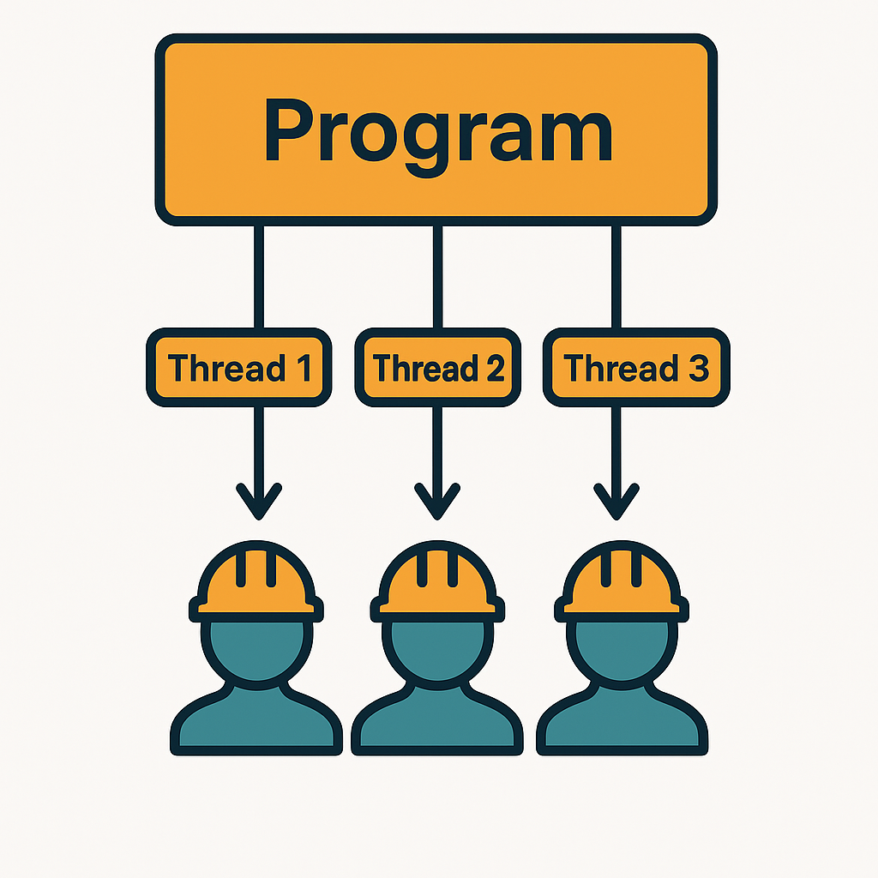
WHY THREADS?
Threads = multiple workers running in parallel
Great for I/O-bound tasks like HTTP requests
Allows:
Multiple pages checked at once
Network delay hidden
Faster overall crawl
Performance:
1 thread → ~40 min
12 threads → 3–5 min

Slide 11
LRU CACHE (LEAST RECENTLY USED)
Stores results of previously checked URLs
Avoids re-downloading the same page
Benefits:
Saves network traffic
Speeds up the crawl
Prevents redundant checks
Removes the least recently used item when full

Slide 12
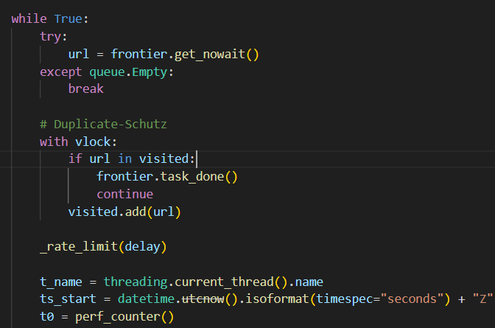
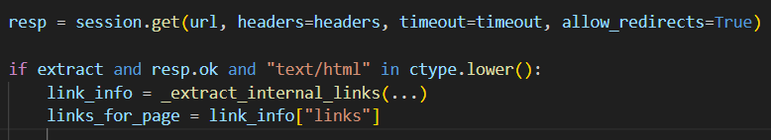
WORKER LOGIC
Takes URL from shared queue
Checks if page was already visited
Sends rate-limited HTTP request
Extracts internal links from HTML
Checks each link (Cascade login / broken link)
Records violations + page summary
Thread-safe writing using locks

Slide 13
FUTURE WORK
PDF SCANNING
WEB APPLICATION
Detect outdated content
Identify PDFs
Run crawler without my device
CSV REPORTS
MONITORING
Automatic CSV reports for the whole web team
Potential for full website quality monitoring tool

Slide 14
CONCLUSION
Combined Operating Systems concepts with real web team needs
Built a fast, safe, flexible crawler
Scans entire website in minutes instead of hours
Helps Marian fix broken links & Cascade login links across 1,600+ pages
Saves time & improves overall website quality
Strong potential for future extensions (PDF scanning, dashboard, web app)

Slide 15


THANKS!
Do you have any questions?

