Slide 1
HOUSE PRICES AND RESTAURANT TYPES IN STOCKHOLM

Slide 2
RESEARCH QUESTION
HAS THE SOARING HOUSE PRICES AFFECTED THE RESTAURANT SECTOR IN TERMS OF WHAT TYPES ARE RESTAURANT TYPES CAN AFFORD TO ESTABLISH IN CENTRAL LOCATIONS?

Slide 3
DATA
Restaurant data was retrieved from Forsquare API
RESTAURANT NAME
LOCATION (COORDINATES)
RESTAURANT TYPE
House pricing data was retrieved from mäklarstatistik (maklarstatistik.se)

Slide 4
METHODOLOGY
The data was combined to see which restaurant types was most common in each district
Kmeans Clustering was used to cluster the districts based on what type of restaurant was most common in each district

Slide 5
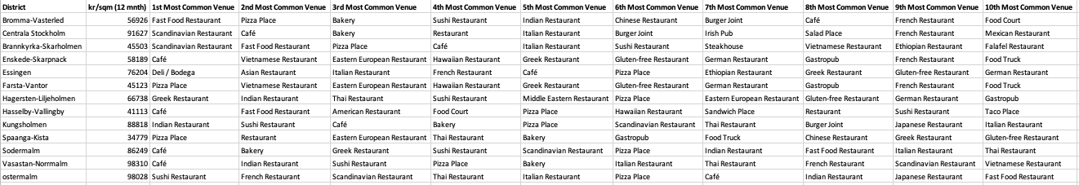
RESULTS
The most common restaurant type for each corresponding district

Slide 6
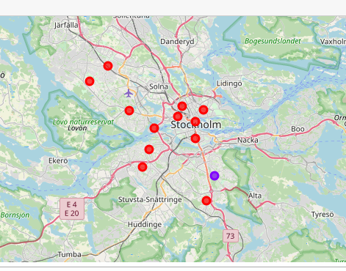
RESULTS
Map of the clustering

Slide 7
CONCLUSION
In conclusion, there seems to be no indication from this study that the house prices affects what restaurant type can afford to establish in what location in Stockholm. It seems like the kinds of restaurants are similar in each district in Stockholm.
For someone that wants to establish a new restaurant in Stockholm, one should look at the top restaurants in each district and stay away from those restaurant types if they wants to avoid competition.

