Slide 1
Robot Programs For A Bin Picking / Depalletizing Application

Slide 2
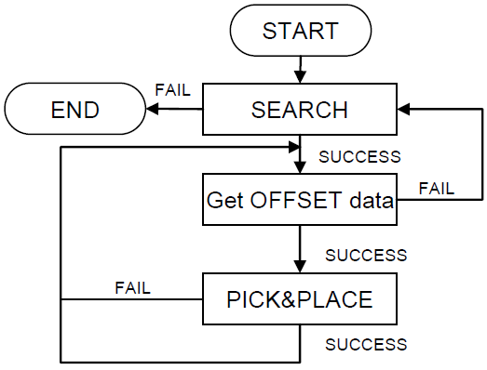
Simple TP Program For Depalletizing
1: UFRAME_NUM=1
2: UTOOL_NUM=1
3:
4: !SEARCH
5: LBL[1]
6:L P [1] 2000mm/sec FINE
7: CALL ACQVAMAP(‘SENSOR’)
8: VISION RUN_FIND 'PROG'
9: VISION GET_NFOUND 'PROG' R [1]
10: IF R [1]=0,JMP LBL[99]
11:
12: LBL[2]
13: VISION GET_OFFSET 'PROG' VR[1] JMP LBL[1]
14:
15: !PICK
16:L P[2] 2000mm/sec CNT100
17:L P[10] 500mm/sec CNT50 VOFFSET, VR[1] TOOL OFFSET, PR[11]
18:L P[10] 300mm/sec FINE VOFFSET,VR[1]
19: ! Insert program instructions to grasp the part.
20:
21: !PLACE
22:L P[3] 2000mm/sec CNT100
23:L P[4] 2000mm/sec FINE
24: ! Insert program instructions to place the part.
25:
26: !Continuous PICK
27: JMP LBL[2]
28:
29: !END
30: LBL[99]
31:J P[7] 100% FINE

Slide 3
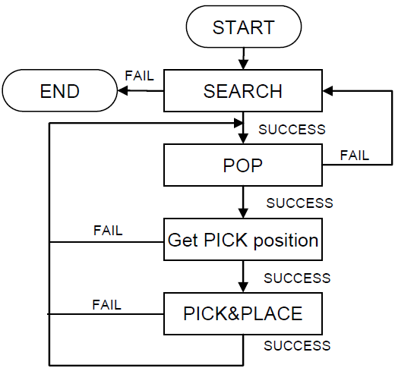
Simple TP Program For Bin Picking
1: UFRAME_NUM=1
2: UTOOL_NUM=1
3: CALL IPCLR(1)
4:
5: ! SEARCH
6: LBL[1]
7:L P[1] 2000mm/sec FINE
8: CALL ACQVAMAP(‘SENSOR’)
9: CALL IMSEARCH(1,1,1,10)
10: IF R[10]<>0,JMP LBL[99]
11:
12: ! POP
13: LBL[2]
14: CALL IMPOP(1,11,12,13)
15: IF R[11]<>0,JMP LBL[1]
16:
17: ! Get PICK position
18: CALL IMGETPICKPOS(1,1,14,20,21,22,23)
19: IF R[14]=0,JMP LBL[3]
20:
21: CALL IMSETSTAT(1,22)
22: JMP LBL[2]
23:
24: ! PICK
25: LBL[3]
26:L P[2:AboveBin] 2000mm/sec CNT100
27:L PR[22:Approach] 2000mm/sec CNT50
28:L PR[20:Pick] 500mm/sec FINE
29: ! Insert program instructions to grasp the part.
30: CALL IMSETSTAT(1,20)
31:
32: ! PLACE
33:L P[3] 2000mm/sec CNT100
34:L P[4] 2000mm/sec FINE
35: ! Insert program instructions to place the part.
36:
37: ! Continuous
38: JMP LBL[2]
39:
40: ! END
41: LBL[99]
42:J P[5] 100% FINE

Slide 4
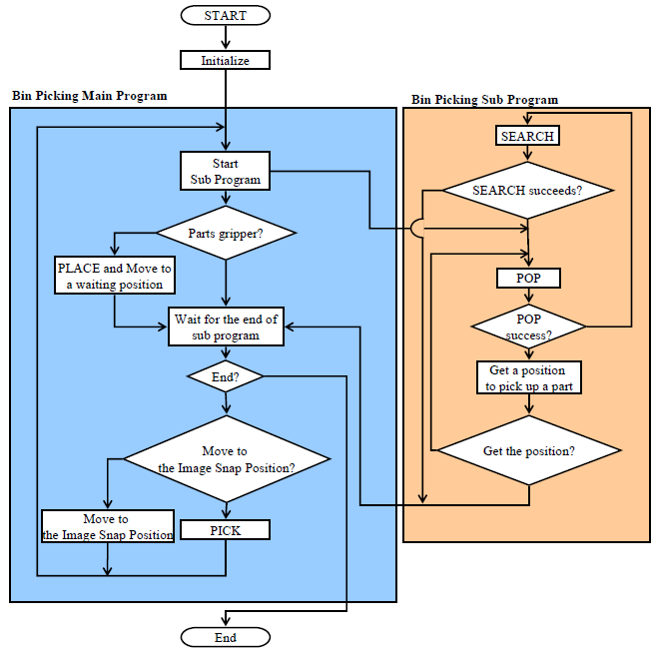
Advanced Programs For Bin Picking
Some Tips:
CHK_POS.PC Use CHK_POS Karel program (from J873 – Vision Support Tools) to check whether a calculated position is reachable before the robot actually tries to travel there.
IAAVDWALL.PC Use IAAVDWALL Karel program in order to calculate a wall-avoiding approach / escape position before / after a PICK trial!
Touch Skip Use Touch Skip software option (J921) for avoidance of severe interference with other workpieces when approaching the target workpiece.
Singularity Avoidance Use Singularity Avoidance software option (R792) for automatic avoidance of the wrist singularity
Multitasking While robot is placing a workpiece, a parallel program can be run in order to find and calculate next PICK position. Please refer to the set of “template” TP programs provided with the Bin Picking Operator’s Manual.
Parallel task to do a snapshot, find and get part data and next pick position
Note: Robot should be outside 3DAS FOV when placing parts, so the SEARCH process can be executed in parallel!

Slide 5
When To Clear The Parts List?
START
Initialize
Clear PartList! LastTrial = TRUE
Move to the Image Snap Position
LastTrial = FALSE
SEARCH till enough part data found OR all VPs executed!
PickTrials = 0; PickSuccess = 0
Remark:
Consider clearing the parts list (and then do a new SEARCH) also:
If part was picked but lost and fell back in the bin while the robot moved out of the bin
If part was dropped back in the bin deliberately (e.g. after getting no good result of part offset using 2D Vision)
FAIL
POP
IMGETPICKPOS CHK_POS
FAIL
Is there an alternative PICK position in the PICK Position List?
YES
Remark:
Robot motion instructions can/should be outsourced to a parallel running TP program (task) in order to save some cycle time by executing PLACE process and SEARCH process in parallel. (Note: Robot must be outside 3DAS FOV during the SEARCH process / when placing parts!) Please refer to the sample TP programs in the Bin Picking Operator’s Manual, Appendix.
Try to PICK and PLACE
NO
PickTrials < MaxPickTrials?
YES
PickSuccess > 0?
YES
NO
NO
LastTrial = TRUE?
YES
END

Slide 6
IA – KAREL Programs – Overview (please refer to the Bin Picking manual for detailed description)
KAREL Program | Short Description
IACHECK.PC | Checks whether interference between specified robot (tool) and system objects (box etc.) would occur at specified target position, and outputs 0 to a register if no interference was calculated or 1 otherwise.
IACALAVOID.PC | Calculates – based on specified target position, position offset, and IA condition – a set of positions at which interference between specified robot (tool) and system objects (box etc.) would be avoided.
IAGETAVOID.PC | Obtains one, not yet obtained interference avoidance position calculated by IACALAVOID and outputs the obtained position to a position register. IAGETAVOID can be used repeatedly in order to obtain an alternative avoidance position.
IAAVDWALL.PC | Calculates and outputs the position offset value to be used to make the robot end of arm tooling retreat from the wall to the center of the container.
FOR CUSTOMIZATION / DEBUGGING
USUALLY ENOUGH
Notes:
IACHECK.PC is the basic IA KAREL program which is used by all other IA KAREL programs internally. Usually, there is no need to use IACHECK.PC directly, except when debugging IA using a test TP program. Example: Check interference at current robot position and output 1 in R[100] if TRUE, 0 if FALSE.
1: PR[100]=LPOS 2: CALL IACHECK(100,'O',0,0,'BIN','ROB','CND_CHECK',100)
IACALAVOID.PC and IAGETAVOID.PC are used internally by the IMGETPICKPOS.PC KAREL program of the Parts List Manager. Usually, there is not need to use IACALAVOID.PC and IAGETAVOID.PC directly because IMGETPICKPOS is more convenient!
IAAVDWALL.PC is the only IA KAREL program which should be called from a user TP program during production in order to calculate an additional intermediate approach position right after the “AboveBin” position / an escape position right before the “AboveBin” position!

Slide 7
PM – KAREL Programs – Overview (please refer to the Bin Picking manual for detailed description)
KAREL Program | Short Description
IMSEARCH.PC | Selects a SEARCH vision process from the SEARCH VP LIST, execute it, create part data and push it to the parts list.
IMPOP.PC | Pops a part data from the specified parts list.
IMGETPICKPOS.PC | Calculates a PICK position from an offset value by a SEARCH vision process and a reference PICK position.
IMSETSTAT.PC | Sets a status to a popped part data. By executing the KAREL program, a specified action specified in the PM is done.
IPCLR.PC | Deletes all part data from specified parts list.
IPCRT.PC | Obtains the found result from the specified vision process and creates part data.
IPPUSH.PC | Pushes part data created by IPCRT.PC in a parts list.
IPDEL.PC | Deletes the specified part data from a parts list.
IPPOP.PC | Places the specified part data in the popped state.
IPGTLSTPRM.PC | Outputs the value of a parameter such as the push count in a parts list to a register.
IPSTLSTPRM.PC | Sets the specified value for a parameter such as the push count in a parts list.
IPGTPRTPRM.PC | Outputs the value of a parameter of part data to a register, vision register, or character register.
IPSTPRTPRM.PC | Sets the specified value for a parameter of part data.
IPFNDPOS.PC | Searches a range from the specified position for part data and outputs the ID of the part data.
IPFNDPUSH.PC | Searches for part data whose push count when it is added to the parts list is within the specified range and outputs the ID of the part data.
IPFNDPRI.PC | Searches for part data with high priority and outputs the ID of the part data.
IPFNDVP.PC | Searches for part data whose SEARCH vision process name is the specified vision process name and outputs the ID of the part data.
USUALLY ENOUGH
FOR CUSTOMIZATION

