Slide 1
Estimate annual maximum crest heights with random storm approach
61 years of Hs & Tp pairs
ULS & ALS annual extreme
crest height
3 hour sea state
Jonas Jam, Mohammed Nizar
Shuzhou Jiang, Taewoo Kim
Group 1 Project 2
Notes:
Good day. welcome to our presentation.
We estimated annual maximum crest heights with random storm approach.
We have hindcast data with sixty one years of Hs and Tp pairs. Each Hs, Tp is 3 hour sea state.
Our research goal is finding ULS and ALS annual extreme crest height

Slide 2
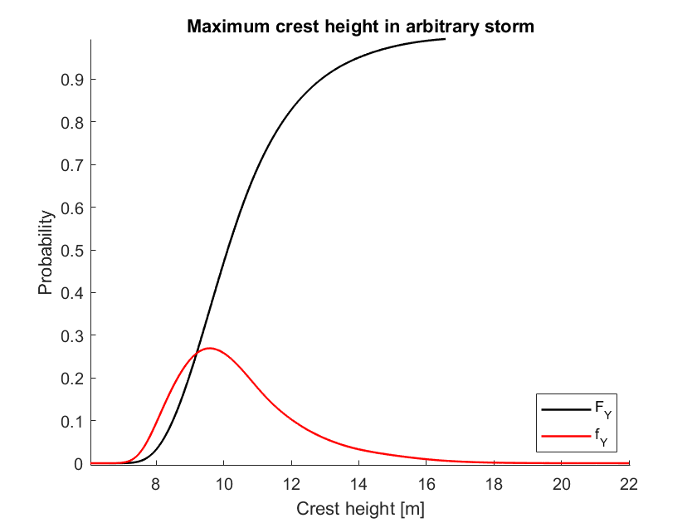
Term explanation
PDF = d/dx CDF
ULS -> 10⁻² annual probability
ALS -> 10⁻⁴ annual probability
Method of Moments (MoM)
Maximum Likelihood Estimator (MLE)
Notes:
[Can Be skipped]
Let me explain terms are used from now on
CDF is cumulative distribution function, you can see the black curve on right side.
PDF is probability distribution function. rred one
ULS means ultimate limit state. 10 power -2 annual probability. That means once in a hundred years
ALS means accidental limit state. 10 power -2 annual probability. That means once in ten thousand years
We used 2 methods to determine parameters of related statistical functions.
One is method of moments (MOM)
One is maximum likelihood estimator (MLE)

Slide 3
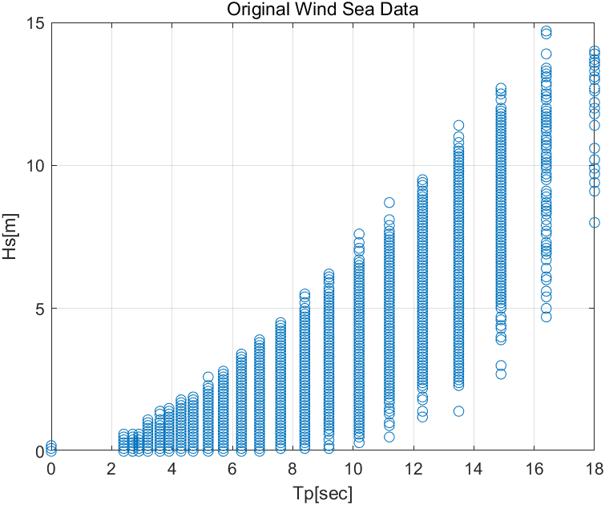
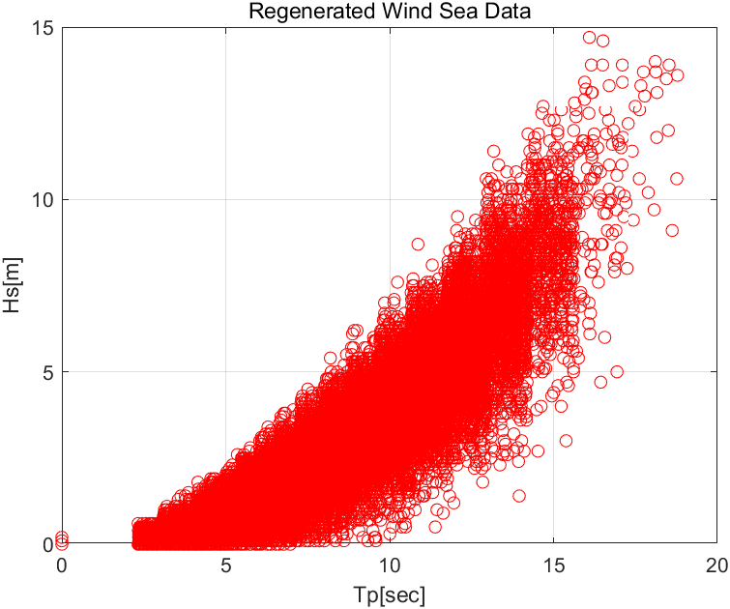
Hindcast data --> Corrected Tp
Discrete Tp
Metocean book appendix D
Adjusted Tp
Notes:
[Can be skipped]
Original Hindcast data Tp is discrete
We made adjustment by use of method in Appendix D
As results, we can get continuous and natural Tp distribution.

Slide 4
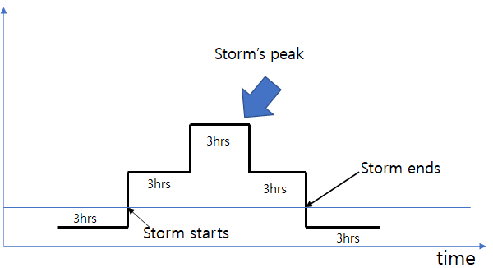
Our storm definition
H_{S}
Storm Peak
281 storms in hindcast data.
934 steps
8m Threshold
Notes:
Here is our storm definition.
We pick up all Hp which are above 8m.
Finally, we got 281 storms.
A storm can have several steps of sea state.
For example, you can see this storm has three steps.
Total step in all storms are 934 steps.
Each storm has it own peak and it is used for data fitting.

Slide 5
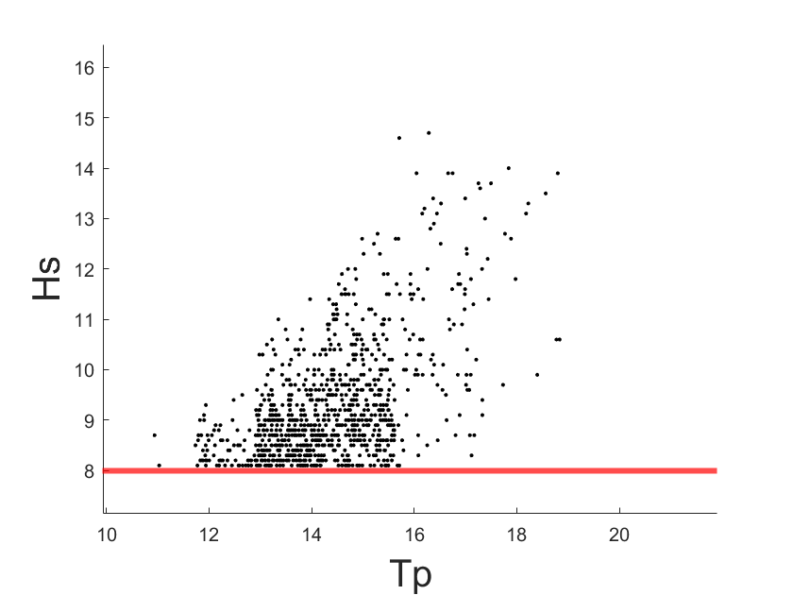
Storms defined as Hs>8m
Notes:
Here is the Hs, Tp scatter plot of all storms.

Slide 6
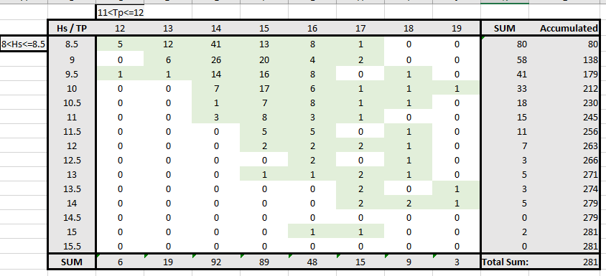
Hs and Tp Scatter Diagram
Notes:
Also, now you see Hs, Tp scatter diagram of peak values of all storms

Slide 7
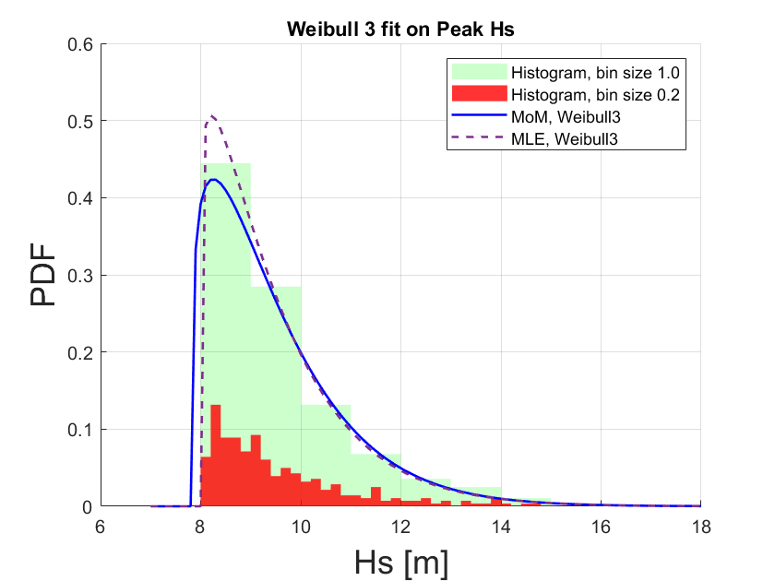


Weibull distribution on Hs storm peaks
è
(Formula 78 in pekovic,2015)
Method | alfa | beta | lambda | ULS [m] | ALS [m]
MLE | 1.5689 | 1.1159 | 8 | 15.97 | 21.16
MoM | 1.7724 | 1.2067 | 7.8394 | 15.80 | 20.51
Notes:
This is Weibull distribution on Hs storm peaks.
The Weibull distribution is a special case of the generalized extreme value distribution
You can see Weibull distribution function on left side.
We tried to fit this function to storm peak data.
We got these parameters by use of MLE and MOM.
We draw ULS and ALS wave height.
ULS are almost same in both methods.
However, MLE is larger than MOM in ALS evaluation.

Slide 8
Results for Hs
Input | ULS [m] (MoM) | ULS[m] (MLE) | ALS [m] (MoM) | ALS[m] (MLE)
Peaks 7 | 16.02 | 16.02 | 21.21 | 21.37
Peaks 8 | 15.80 | 15.97 | 20.51 | 21.16
Peaks 9 | 15.54 | 16.15 | 19.49 | 21.52
Gumbel Annual Extremes. | 16.14 |  | 22.07
[ For MLE: Lambda = threshold. (7m,8m,9m), 3 largest hs in hindcast is 14.7, 14.6 & 14.0.. 61.15 years. ]
[Gumbel from RP-205 3.6.2.5. Input: largest Hs each year]

Slide 9
Our storm definition
H_{S}
Hs | Tp
8.5 m | 12.4 s
9.2 m | 14.1 s
8.1 m | 10.2 s
8m Threshold
Notes:
Let’s come back storm definition.
This storm has three steps and each step has its own Hs, Tp.

Slide 10
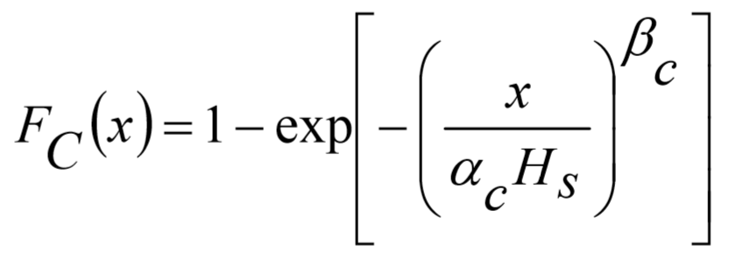
Forristal wave crest distribution above still water (short-term)
Hs | Tp
8.5 m | 12.4 s
9.2 m | 14.1 s
8.1 m | 10.2 s
Rp-205 3.5.10
Notes:
[Can be skipped]
This is forristal wave crest distribution.
Hs, Tp, Now these values are input this formula.

Slide 11
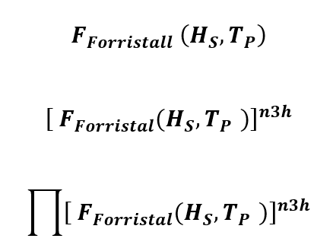
Forristal wave crest
Maximum crest of each step in each storm
Maximum crest of each storm
Notes:
n3h is the number of waves during 3 hours
power of n3h gives maximum crest of each step in each storm.
If we multiply all them in one storm, we get maximum crest of each storm.

Slide 12
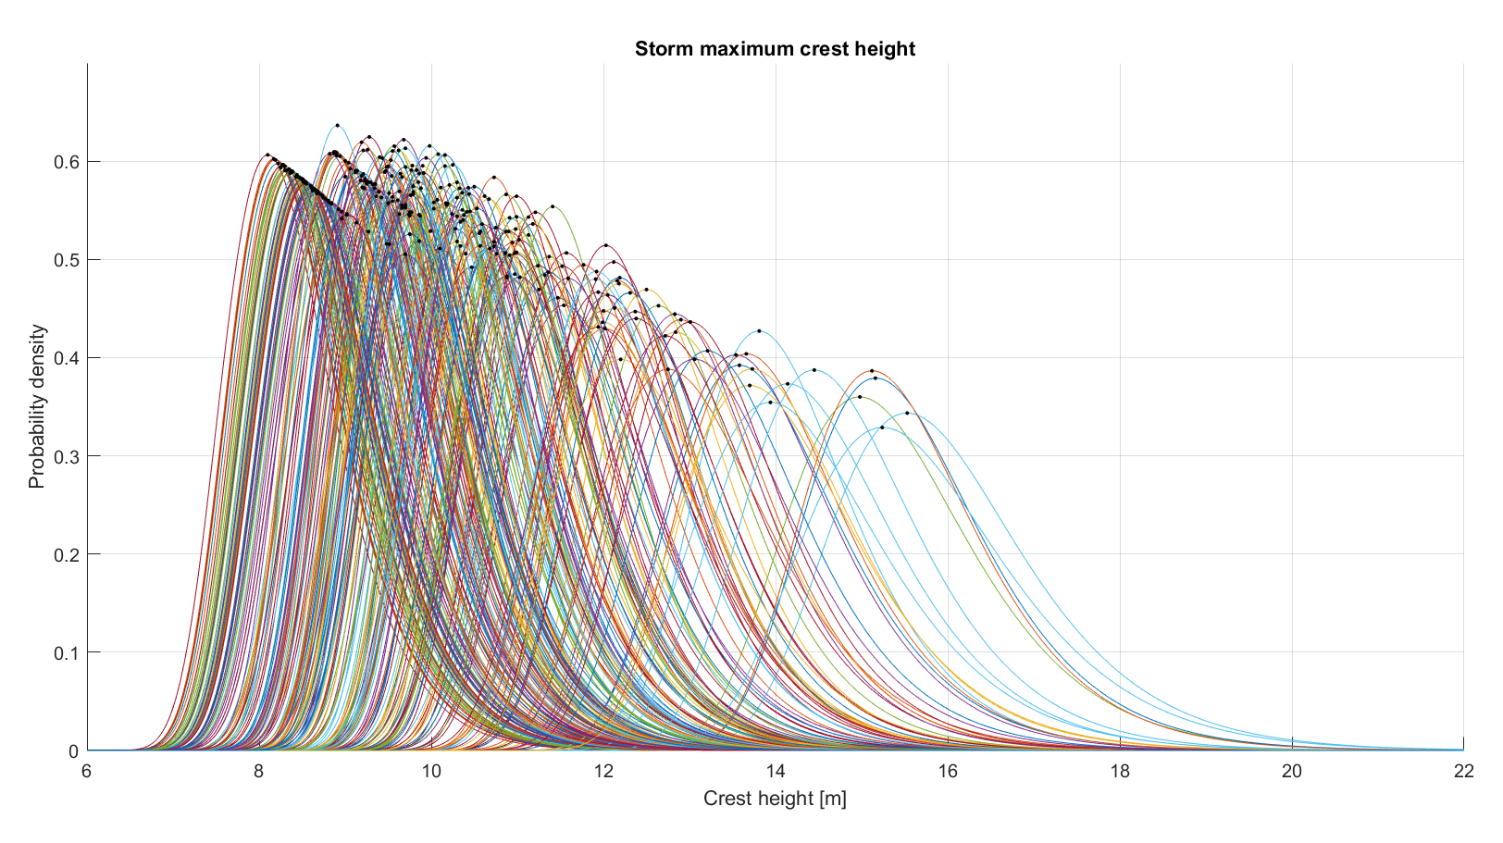
Notes:
These are pdf plots of all storms.
The black dots represent most likely maximum crest height of each storm

Slide 13



Random storm approach
Notes:
Now let’s adapt the random storm approach.
First adding all the CDF of storm, second divide them by number of storm.
Then we can get CDF of maximum crest height in arbitrary storm

Slide 14
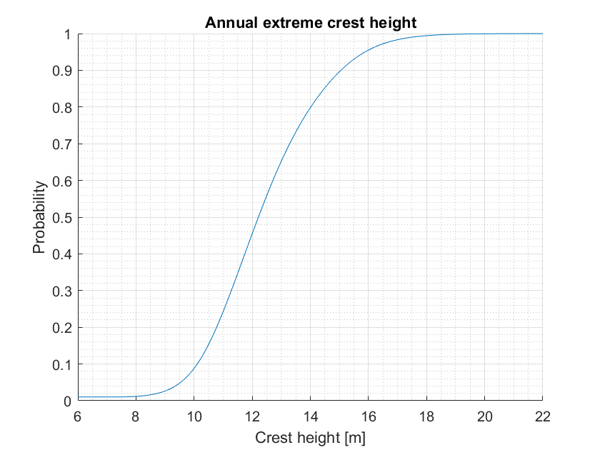


Random storm approach
= 4.6 storms per year
[Metocean book 9.33]
Notes:
Now we have the maximum crest height in arbitrary storm.
We can find annual extreme crest height by using below formula.
In this equation, rho is average number of storm and 4.6 for our case.

Slide 15
Maximum annual crest height results
Method | ULS [m] | ALS [m]
Random Storm Approach (A) | 17.40 | 20.71
But wait…?
Notes:
With annual extreme crest height, we can draw ULS and ALS.
But wait. we have something to check.

Slide 16
A lot of data
Unobserved Data ??
Gaps?
Notes:
Let’s see PDF of storm maximum crest height agian.
In left hand side, we have lots of data.
But on the right hand side, there are gaps between the curves.

Slide 17
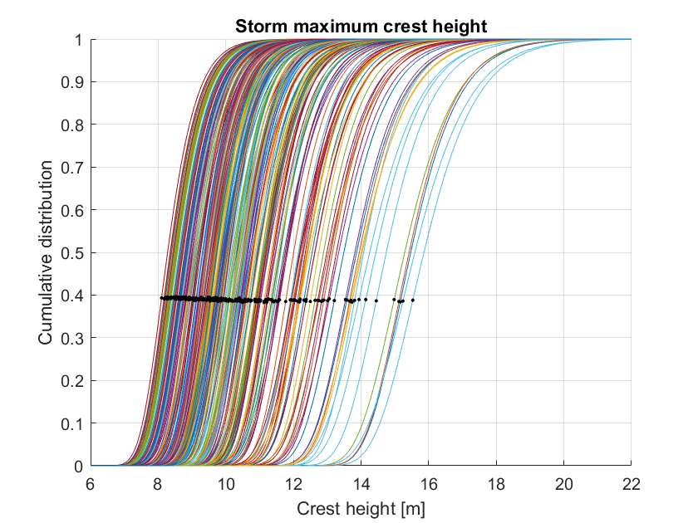
Ops, there are Gaps!
Notes:
It is same in the CDF
There is gaps between the curves.
Gap means that no storm is observed in this area.
So, we need to set the probability distribution we haven’t observe
Please remind those black dots.

Slide 18
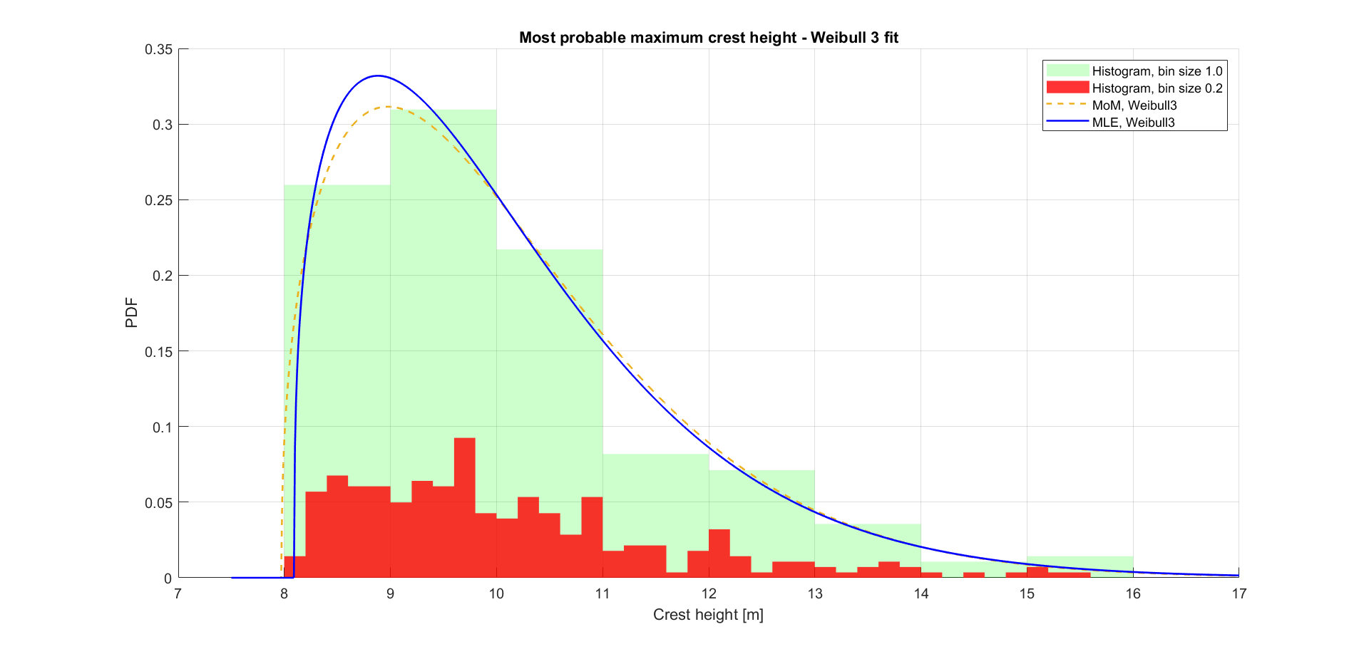
Fit data to dots.
Dot = most likely maximum crest height of each storm
Notes:
We fitted weibull distribution based on data of dots.
NOM and MLE gives different results.

Slide 19
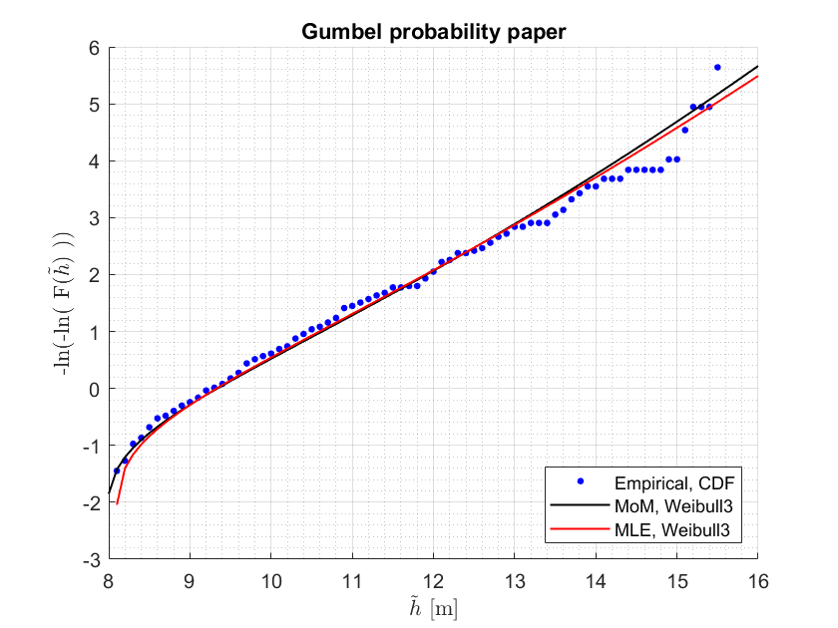
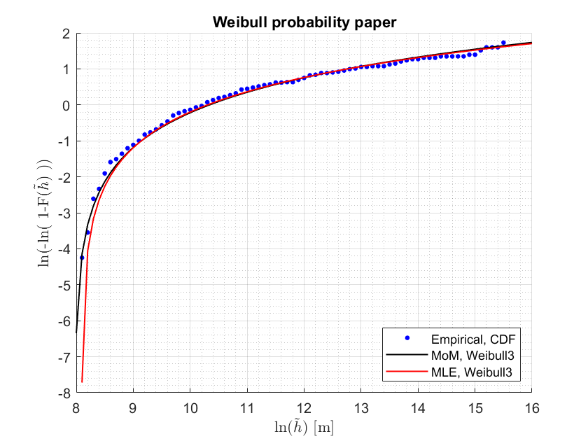
Notes:
We plot Gumbel probability paper and Weibull probability paper of each storm.
You can see both distribution fits well to empirical data.
Please pay attention to the Gumbel paper in the extrem area.
Black line, that s MOM, is close to the dots on the extreme for extreme waves and storms.

Slide 20
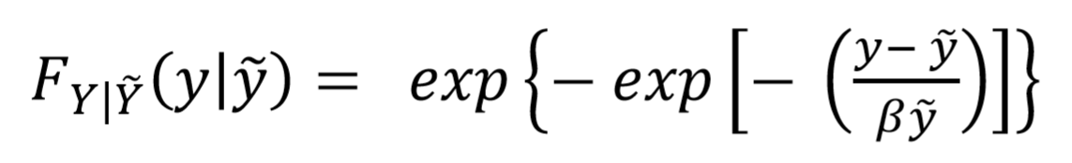

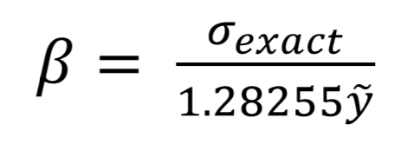
Each storm maximum crest height distribution can be approximated by a Gumbel distribution.
is the dot. Every CDF has its own and it own beta.
Notes:
Now we want to find CDF
We can use this, which is Gambel distribution to fit these same cdf
Here, y tilda is same with h tilda which is most likely maximum crest height of storms
beta can be determined by empirical equation.
if you put the beta in the equation, you will get CDF which fits well with data

Slide 21
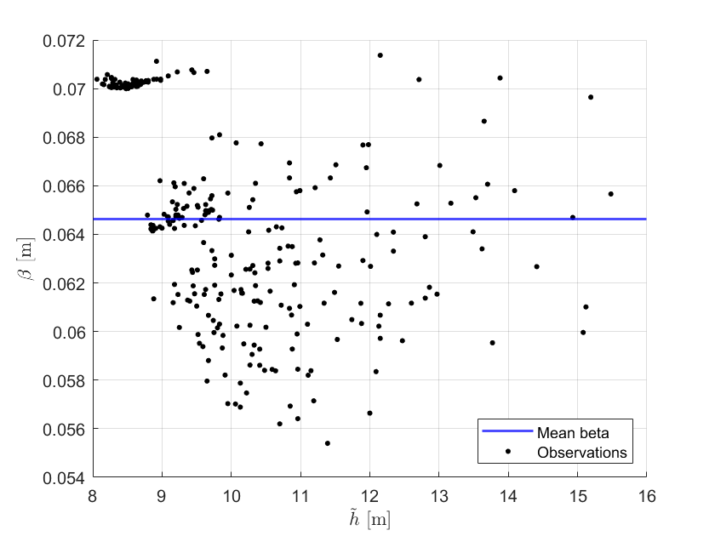
Small change in Beta. Is simplified with the mean
BETA = 0.0646
Notes:
[Can be skipped]
We plotted beta and h tilda, same with y tilda.
Please pay attention that beta has short range.
It is from about 0.05 to about 0.072.
Futhermore, beta has not good correlation with h tida.
In this regard, we can fix beta from its average value.

Slide 22
The maximum crest height of an unobserved storm can be estimated if we know the (dot).
is most likely crest height of each storm
0.0646
Notes:
Now beta is fixed.

Slide 23

CDF of an arbitrary storm. Now unobserved storms are accounted for
Then find the annual maximum crest height CDF as before
Notes:
can be skipped

Slide 24
CDF of an arbitrary storm. Now unobserved storms are accounted for
Find the annual CDF as before
Notes:
Finally we can determine CDF of arbitrary storm.
Now unobserved storms are accounted for .

Slide 25
Maximum annual crest height results
Method | ULS [m] | ALS [m]
Random Storm Approach (A) | 17.40 | 20.71
Random Storm Approach (B), Accounting for unobserved storms, MoM | 17.96 | 23.89
Notes:
With the CDF of the previous page, we can draw ULS and ALS again.
By accounting for unobserved storms, ULS and ALS shows more conservative results.
ALS became far more conservative.

Slide 26
Thank you for your attention!

Slide 27
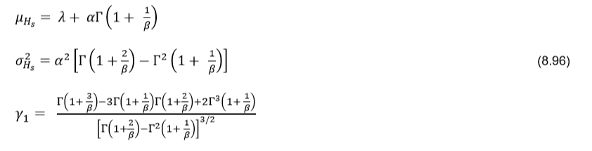
Method of Moments (Will not be presented)
Notes:
is skipped

Slide 28
Skip this page
Data | Method | alfa | beta | lambda
Peaks 7 | MLE | 1.6227 | 1.1141 | 7
Peaks 7 | MoM | 1.7432 | 1.1543 | 6.8995
Peaks 8 | MLE | 1.5689 | 1.1159 | 8
Peaks 8 | MoM | 1.7724 | 1.2067 | 7.8394
Peaks 9 | MLE | 1.5050 | 1.0902 | 9
Peaks 9 | MoM | 1.9342 | 1.3427 | 8.6798

Slide 29
Annual maximum Hs
Method | ULS [m] | ALS [m]
Peaks8, MLE | 15.96 | 21.17
Peaks8, MoM | 15.97 | 20.71
Peaks7, MoM | 15.29 | 20.51
Peaks9, MoM | 16.15 | 20.01
Gumbel Annual Extremes. (For comparison) RP-205, | 16.14 | 22.07
Notes:
For further research, we compared results according to different methods.
Peaks8 means threshold is 8 meter
Peaks7 means threshold is 7 meter.
You can see different threshold affects to the results a lot.

