Slide 1

Senior Operations Analyst
Jonas Vyshniauskas Matera
Fulfillio’s warehouse operations are reaching a breaking point With rising order volumes, late deliveries and workforce strain are exposing cracks in our operations.
This analysis dives deep into the data behind Q1 operations: Quantifying risks and exploring mitigation strategies that can turn pressure on operations into performance advantages.
Case Study 1 Operations Performance Review Analysis of warehouse performance data from Q1 to identify key trends, visualize results and brief leadership on operational risks and opportunities.
Case Study 2 Prioritization & Decision-Making Evaluation of five simultaneous operational issues ranked by prioritization and outline of immediate actions for the top priority.
Case Study 3 Process Mapping Design of a clear process flow for the new Express Fulfillment service plus identification of one key operational risk and one opportunity it presents.

Slide 2
Case Study 1
Operations Performance Review
Key Trend #1: Operations Deterioration Outpacing Volume Growth Q1's 30% volume growth has exposed critical capacity constraints. Operations metrics are deteriorating at 2-3x the rate of volume growth signaling systemic issues, not temporary.
Key Trend #2: Unsustainable Resource Strain Our warehouse operations are optimized for lower volumes and simpler orders. We're now experiencing an operations collapse, particularly on complex orders (>5 items), which now represent 10.4% of volume but 40% of all errors.
Picking Errors: Growing 3.5x faster than volume Large Order Error Rate: Nearly doubled in 90 days Staff Burnout: Clear signals in absenteeism spike Processing Efficiency: Declining 17.7% January: 12,500 orders processed in 19.5 min avg = 3.1 orders/hour per worker March: 16,300 orders processed in 23.7 min avg = 2.5 orders/hour per worker

Slide 3
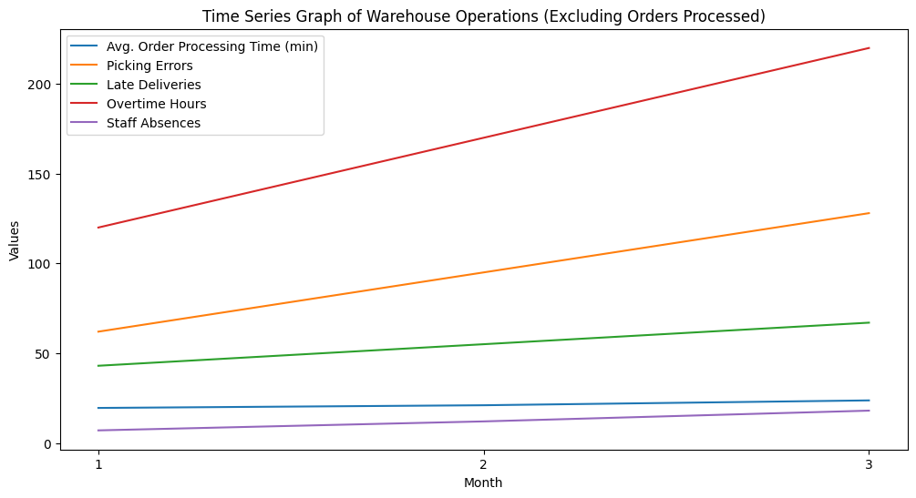
Let’s visualize the data…
Q1 Dataset (%∆ Jan-Mar)
Orders Processed | 30.4%
Avg. Order Processing Time (min) | 21.5%
Picking Errors | 106.5%
Late Deliveries | 55.8%
Overtime Hours | 83.3%
Staff Absences | 157.1%
Large Orders Subset (%∆ Jan-Mar)
Orders >5 Items | 36.00%
Picking Errors (Large Orders) | 145.45%
Error Rate (%) | 80.68%
Orders vs Errors
Orders: +30% vs Errors: +106%
Time Management
Avg Time: +22% (19.5→23.7 min)
Overtime: +83% (120→220 hrs)
Monthly Error Rate:
January: 1.76%
February: 2.35%
March: 3.18%

Slide 4
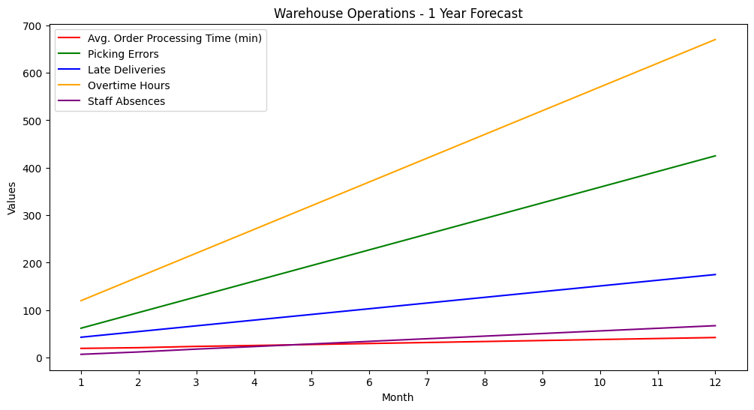
Consequences of inaction
Operational Risks
Cost increases due to overtime
Customer churn due to late deliveries
Staff burnout due to increasing overtime
Recommendations
Immediately: Implement a dedicated large-order picking workflow/force to mitigate delays
Short-term: Hiring plan to replace structural overtime with sustainable capacity
Q2: Invest in picking technology/automation specifically for orders >5 items

Slide 5
Case Study 2
Task Priority Ranking & Rationale
 | Major client - 15 late deliveries last week | Picking system 10% error rate on orders with >5 items) | Spike in warehouse staff absenteeism | Manager report: overtime impact on error rates | IT input on barcode scanner test plan
Prioritization | #1 | #2 | #3 | #4 | #5
Rationale | Immediate revenue risk, relationship in jeopardy, contractual implications | Systemic problem causing late deliveries and client issues | Leading indicator of retention problems, driving errors and delays | Analytical request, important for planning but not crisis | Future improvement, doesn't block IT timeline significantly
Impact | Could lose major client | Affects multiple clients daily, quality foundation issue | Root cause contributor to other issues | Informs future hiring vs overtime decisions | Long-term efficiency, current scanners functional
Time Sensitivity | Already escalating: damage control mode | Has time for proper solution vs immediate firefighting | Can be addressed over 1-2 weeks | Can be scheduled, internal stakeholder only, low effort | Scheduled rollout, planned change

Slide 6
First 3 Actions to take to mitigate top priority
 | #1. Suggest Immediate Client Engagement | #2. Analyze Data To Identify Root Cause | #3. Implement Safeguards
Detail | • Schedule call with client within 24 hours • Pull detailed data on all 15 late deliveries (dates, status, delay, etc.) • Mitigate issues: offer compensation if appropriate • Customers value transparency! Communicate actions. | • Assemble team (ops, logistics, quality) • Check delays across processes (receiving, picking, packing, shipping) • Check for patterns (same picker, shift, product category, order size) • Get feedback from warehouse staff involved • Correlate with overtime/absenteeism periods | • Picking errors: Mandatory double-check, assign best pickers • Capacity/timing: Prioritize on picking stage, real-time alerts • Ensuring staff coverage during their order windows • Create daily tracking dashboard for this client • Define/assign project owner • Measure impact of safeguards
Rationale | • Shows that we value the client • Shows we are actively prioritising the issue • Prevents further escalation | • We can't fix the issue without understanding it! • Might reveal deep rooted ongoing issues • Data informs whether fix is process, people, or technology | • Buys time while fixing core issues • Shows client concrete action • Reduces risk of additional failures • Provides data on intervention effectiveness

Slide 7
Case Study 3
2-Hour Express Service Workflow
Shipment
Package in transit with GPS tracking, proof of delivery and client confirmation SMS
Quality Check & Packing
Priority Queue Insertion
Tracking, packing in branded EXPRESS packaging, and shipping label generated
105-120 min
Express order jumps to front of picking queue and assigned to trained staff
75-105 min
45-75 min
10-45 min
5-10 min
Staging & Handoff
0-5 min
Package moved to EXPRESS staging, courier called, and client notified with tracking
Picking Process
Picker scans items, verifies in real-time, and places in EXPRESS basket
Order Receipt & Validation
Order received, inventory checked, and flagged as EXPRESS

Slide 8
Risk & Opportunity
RISK Running Standard & Express in one warehouse could cause conflicts that degrade both operations
• Cannibalizing of standard operations by diverting staff/deprioritizing clients • Added complexity: More workflows can cause overload & more errors • Capacity: Quality is already slipping, can we handle more? • Quality vs Speed: High pressure from 2-h SLA might increase error rates.
Safeguards: • Dedicated express staff + space • Cap volumes until stable • Mandatory training before launch • Real-time performance dashboard
OPPORTUNITY Express Fulfillment additional revenue stream leads to operations development
• Higher Margins: premium pricing tier for 2-h SLAs. • Reinvestment: surplus can be reinvested to improve operations • Improve employee and customer satisfaction!
Reinvestments: • Picking tech upgrades • Additional staff • Training & inventory frameworks
Notes:
Evidence
10% error rate on complex orders
Absenteeism ↑157%
Processing times rising

Slide 9









Thanks!
Tech Stack
https://docs.google.com/presentation/d/1drFxzZMyBCCZGf-KiL_mSDdo7cRbzTtqmhAfmtL6a5s/edit?usp=sharing
https://docs.google.com/spreadsheets/d/1fFo5fiju01IhFq74oo7J1nOkPZI2YuycyYxDCyF4ts0/edit?usp=sharing
https://github.com/jonasvyma/GETYOURGUIDE_THTSOA
A.I. Stack
VSCode Agent Assistant
Plotting with python: https://deepnote.com/workspace/jonas-336b482a-085f-4eb9-991a-051cfd0c9234/project/jonasvm-8010d9fd-d258-4542-bf88-2e6a3aa0868c/notebook/Notebook-2-c0fe8f96faa047649922fbb50f708694?utm_source=share-modal&utm_medium=product-shared-content&utm_campaign=notebook&utm_content=8010d9fd-d258-4542-bf88-2e6a3aa0868c
Research & text formatting
Flowchart creation: https://app.napkin.ai/page/CgoiCHByb2Qtb25lEiwKBFBhZ2UaJDJmYjcwZjBjLTZkY2MtNDZlYy1iMDc3LTJlY2I4MWMyMWRiZg?s=1
22.10.2025 Task start/completion date
Jonas Vyshniauskas Matera jonasvyma@gmail.com

