Slide 1
Instructions (delete this slide)
Save this document with a new name before you begin work.
When adding a new slide, click on the small arrow next to “New Slide” on the toolbar. Select the layout that will best fit the content you want to add.
Change the layout of an existing slide: click the “Layout” button on the top toolbar to reformat your existing content to another master slide.
The dashed lines on the slide are guides. If you prefer to turn them off, go to the View menu, down to Guides and uncheck Guides.
Refer to utdallas.edu/brand for specific rules on using the University logos and wordmarks.
UTD_Light.pptx

Slide 2

Secure Distributed Observers for a Class of Linear Time Invariant Systems in the Presence of Byzantine Adversaries
Jackson Reed and Jonas Wagner
MECH 6V29 – Multi-agent Robotic Systems
Spring 2022 – Paper Presentation
Notes:
Save this document with a new name before you begin work.
When adding a new slide, click on the small arrow next to “New Slide” on the toolbar. Select the layout that will best fit the content you want to add.
Change the layout of an existing slide: click the “Layout” button on the top toolbar to reformat your existing content to another master slide.
Refer to utdallas.edu/brand for specific rules on using the University logos and wordmarks.

Slide 3







Notation, Problem Formulation, and Definitions
System Model
An edge from node j to node I implies that node j can transmit information to node i.

Slide 4
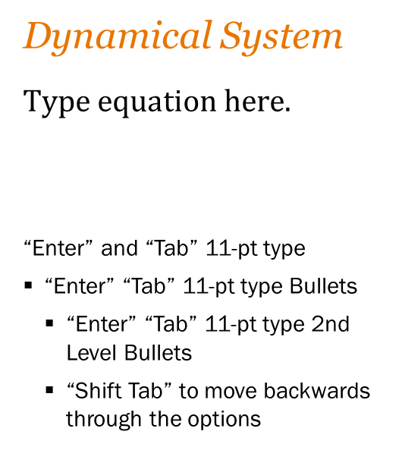
Problem Formulation
Structure
Dynamical System
“Enter” and “Tab” 11-pt type
“Enter” “Tab” 11-pt type Bullets
“Enter” “Tab” 11-pt type 2nd Level Bullets
“Shift Tab” to move backwards through the options

Slide 6
Secure Distributed Estimation
Coordinate Transformation

