Slide 1
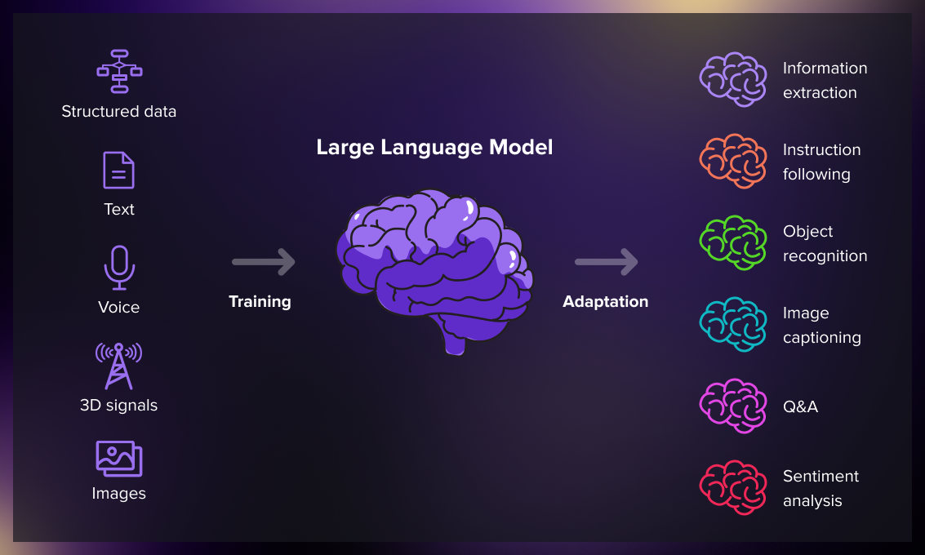
Pre-Trained Language Models for Interactive Decision-Making
Universitetet i Oslo
September 28th, 2023

Slide 2
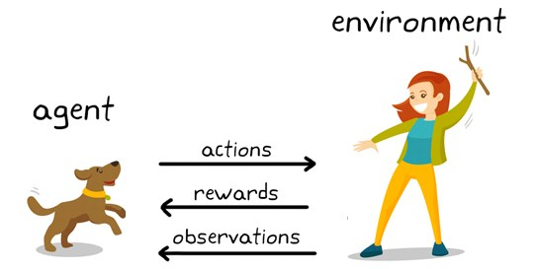
Introduction
Reinforcement Learning
Non-trivial planning and reasoning capabilities
LM-based policy
Active Data Gathering
Why do LM perform so much better?

Slide 3
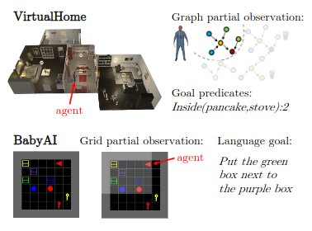
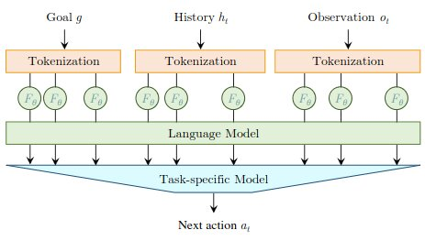
LID → Pre-Trained Language Model for Interactive Decision-Making
LID integrated into the policy network
Convert goal, history and observations to text, and feed it to LM/LID.
Receive “contextualized token” represantation, which is averaged and used to predict next action.
Uses a standard LM, GPT-2, to process the input sequence rather than to predict future tokens

Slide 4
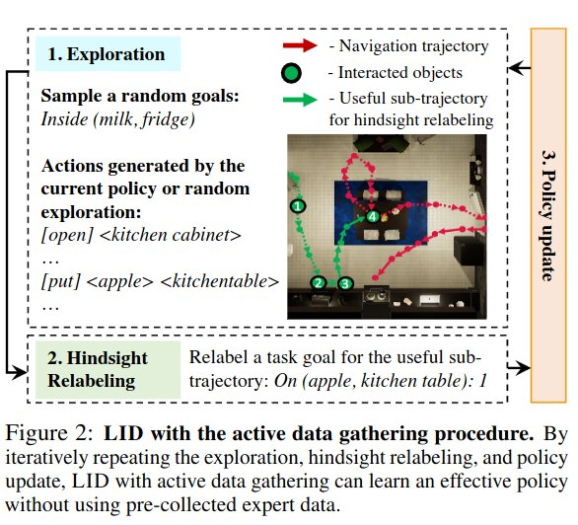
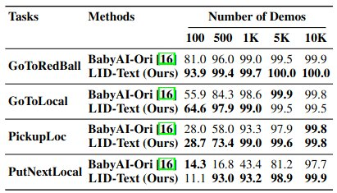
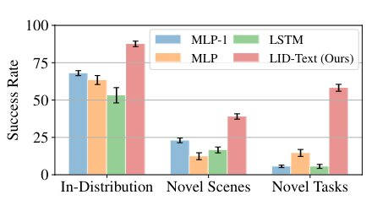
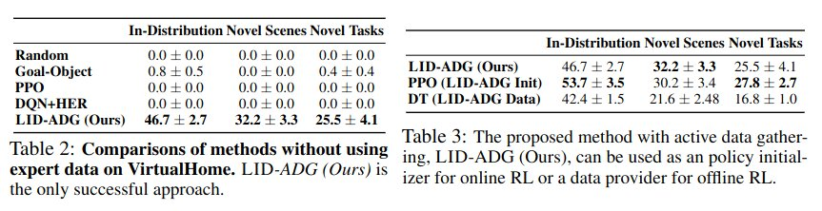

Slide 5
Favorable Weight Initialization (I.E. Pre-Trained LM)
Why do Language models perform so well at generaliztion to embodied decision-making problems?
Input Encoding Scheme
Sequential Input Representation

