Slide 1

Climate Change SWAT Model
Mr. Nuttapong Pantong
Thai Meteorological Department
www.tmd.go.th
Notes:
This template can be used as a starter file to give updates for project milestones.
Sections
Right-click on a slide to add sections. Sections can help to organize your slides or facilitate collaboration between multiple authors.
Notes
Use the Notes section for delivery notes or to provide additional details for the audience. View these notes in Presentation View during your presentation.
Keep in mind the font size (important for accessibility, visibility, videotaping, and online production)
Coordinated colors
Pay particular attention to the graphs, charts, and text boxes.
Consider that attendees will print in black and white or grayscale. Run a test print to make sure your colors work when printed in pure black and white and grayscale.
Graphics, tables, and graphs
Keep it simple: If possible, use consistent, non-distracting styles and colors.
Label all graphs and tables.

Slide 2
Outline
Introduction
Model chain
Climate Change Data
Results
www.tmd.go.th
Notes:
What is the project about?
Define the goal of this project
Is it similar to projects in the past or is it a new effort?
Define the scope of this project
Is it an independent project or is it related to other projects?
* Note that this slide is not necessary for weekly status meetings

Slide 3
Introduction
The objective of the study is to quantify the impacts of climate change
Water Quantity
www.tmd.go.th
Notes:
What is the project about?
Define the goal of this project
Is it similar to projects in the past or is it a new effort?
Define the scope of this project
Is it an independent project or is it related to other projects?
* Note that this slide is not necessary for weekly status meetings

Slide 4
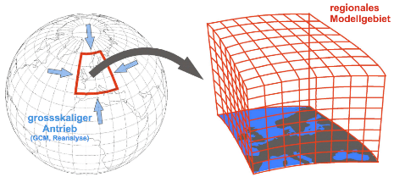
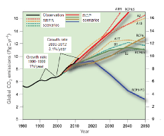
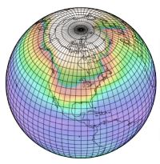
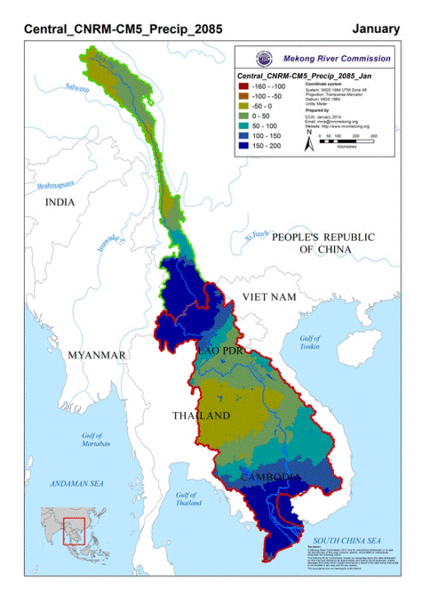
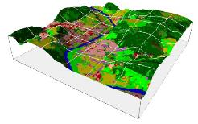
Model chain
Emission scenarios
Global circulation model (GCM)
Pattern Downscaling
Change factors
Hydrological impact modeling
www.tmd.go.th
Notes:
What is the project about?
Define the goal of this project
Is it similar to projects in the past or is it a new effort?
Define the scope of this project
Is it an independent project or is it related to other projects?
* Note that this slide is not necessary for weekly status meetings

Slide 5
Climate Change Data
Variable | Frequency | Unit
Rainfall | monthly | Change of Rainfall in Percent
Maximum Temperature | monthly | Change of Temperature in Degree Celsius
Minimum Temperature | monthly
Solar Radiation | monthly | Change of Solar Radiation in MJ/m2
Relative Humidity | monthly | Change of Relative Humidity in Fraction
www.tmd.go.th
Notes:
What is the project about?
Define the goal of this project
Is it similar to projects in the past or is it a new effort?
Define the scope of this project
Is it an independent project or is it related to other projects?
* Note that this slide is not necessary for weekly status meetings

Slide 6
Climate Change Data
Change of Rainfall | Change of Temperature
Rainfall adjustment for January (%) | Temperature adjustment for January (ºC)
Rainfall adjustment for February (%) | Temperature adjustment for February (ºC)
Rainfall adjustment for March (%) | Temperature adjustment for March (ºC)
Rainfall adjustment for April (%) | Temperature adjustment for April (ºC)
Rainfall adjustment for May (%) | Temperature adjustment for May (ºC)
Rainfall adjustment for June (%) | Temperature adjustment for June (ºC)
Rainfall adjustment for July (%) | Temperature adjustment for July (ºC)
Rainfall adjustment for August (%) | Temperature adjustment for August (ºC)
Rainfall adjustment for September (%) | Temperature adjustment for September (ºC)
Rainfall adjustment for October (%) | Temperature adjustment for October (ºC)
Rainfall adjustment for November (%) | Temperature adjustment for November (ºC)
Rainfall adjustment for December (%) | Temperature adjustment for December (ºC)
www.tmd.go.th
Notes:
What is the project about?
Define the goal of this project
Is it similar to projects in the past or is it a new effort?
Define the scope of this project
Is it an independent project or is it related to other projects?
* Note that this slide is not necessary for weekly status meetings

Slide 7
Climate Change Data
Change of Solar Radiation | Change of Relative Humidity
Radiation adjustment for January (MJ/m2) | Humidity adjustment for January (fraction)
Radiation adjustment for February (MJ/m2) | Humidity adjustment for February (fraction)
Radiation adjustment for March (MJ/m2) | Humidity adjustment for March (fraction)
Radiation adjustment for April (MJ/m2) | Humidity adjustment for April (fraction)
Radiation adjustment for May (MJ/m2) | Humidity adjustment for May (fraction)
Radiation adjustment for June (MJ/m2) | Humidity adjustment for June (fraction)
Radiation adjustment for July (MJ/m2) | Humidity adjustment for July (fraction)
Radiation adjustment for August (MJ/m2) | Humidity adjustment for August (fraction)
Radiation adjustment for September (MJ/m2) | Humidity adjustment for September (fraction)
Radiation adjustment for October (MJ/m2) | Humidity adjustment for October (fraction)
Radiation adjustment for November (MJ/m2) | Humidity adjustment for November (fraction)
Radiation adjustment for December (MJ/m2) | Humidity adjustment for December (fraction)
www.tmd.go.th
Notes:
What is the project about?
Define the goal of this project
Is it similar to projects in the past or is it a new effort?
Define the scope of this project
Is it an independent project or is it related to other projects?
* Note that this slide is not necessary for weekly status meetings

Slide 8
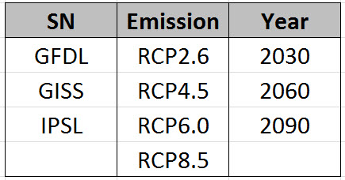
Climate Change Data
Scenarios
GFDL-CM3 (wetter overall)
GISS-E2-R-CC (drier overall)
IPSL-CM5A-MR (wetter wet seasons and drier dry seasons)
www.tmd.go.th
Notes:
What is the project about?
Define the goal of this project
Is it similar to projects in the past or is it a new effort?
Define the scope of this project
Is it an independent project or is it related to other projects?
* Note that this slide is not necessary for weekly status meetings

Slide 9
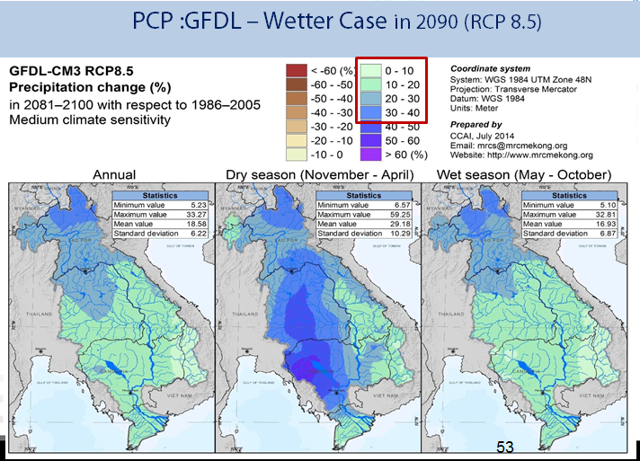
Precipitation change(%)
www.tmd.go.th
Notes:
What is the project about?
Define the goal of this project
Is it similar to projects in the past or is it a new effort?
Define the scope of this project
Is it an independent project or is it related to other projects?
* Note that this slide is not necessary for weekly status meetings

Slide 10
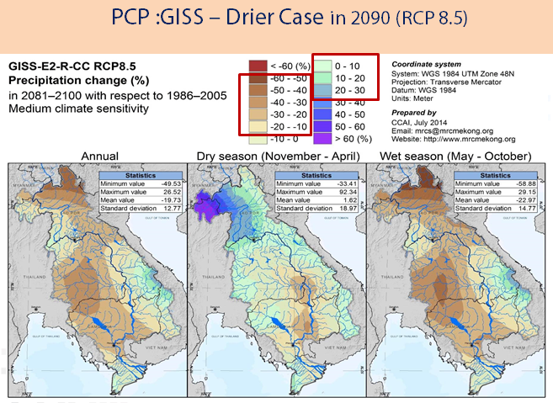
Precipitation change(%)
www.tmd.go.th
Notes:
What is the project about?
Define the goal of this project
Is it similar to projects in the past or is it a new effort?
Define the scope of this project
Is it an independent project or is it related to other projects?
* Note that this slide is not necessary for weekly status meetings

Slide 11
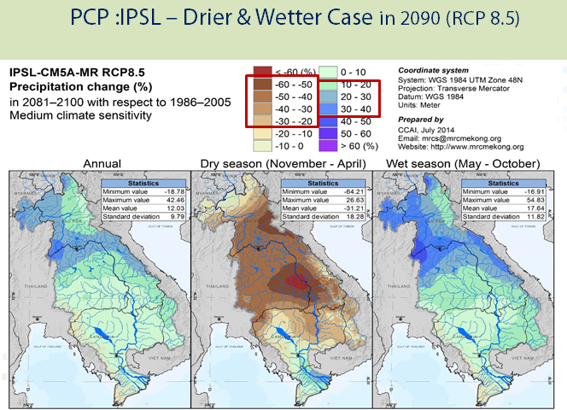
Precipitation change(%)
www.tmd.go.th
Notes:
What is the project about?
Define the goal of this project
Is it similar to projects in the past or is it a new effort?
Define the scope of this project
Is it an independent project or is it related to other projects?
* Note that this slide is not necessary for weekly status meetings

Slide 12
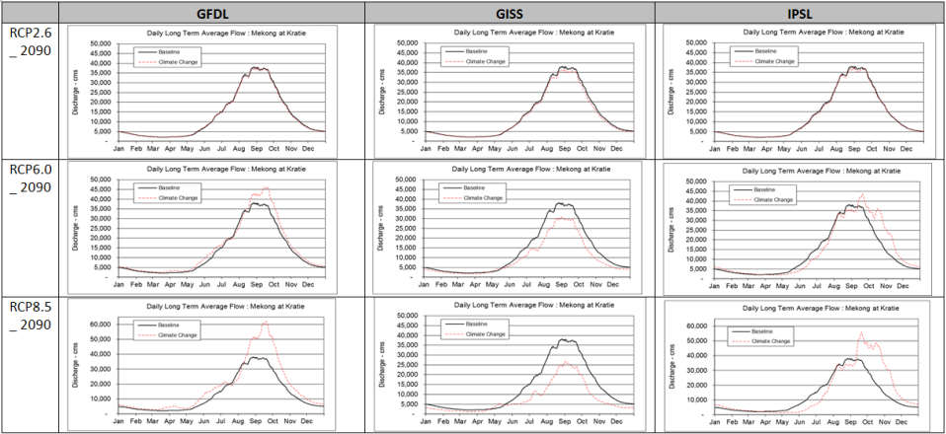
Water flow (Baseline & Climate Change)
www.tmd.go.th
Notes:
What is the project about?
Define the goal of this project
Is it similar to projects in the past or is it a new effort?
Define the scope of this project
Is it an independent project or is it related to other projects?
* Note that this slide is not necessary for weekly status meetings

Slide 13
Exercise - input climate data - compare flow out
Contract Email: Nuttapong34@gmail.com
www.tmd.go.th
Notes:
Prepare slides for the appendix in the event that more details or supplemental slides are needed. The appendix is also useful if the presentation is distributed later.

