Slide 1

Calibration
SWAT Model
Mr. Nuttapong Pantong
Thai Meteorological Department
www.tmd.go.th
Notes:
This template can be used as a starter file to give updates for project milestones.
Sections
Right-click on a slide to add sections. Sections can help to organize your slides or facilitate collaboration between multiple authors.
Notes
Use the Notes section for delivery notes or to provide additional details for the audience. View these notes in Presentation View during your presentation.
Keep in mind the font size (important for accessibility, visibility, videotaping, and online production)
Coordinated colors
Pay particular attention to the graphs, charts, and text boxes.
Consider that attendees will print in black and white or grayscale. Run a test print to make sure your colors work when printed in pure black and white and grayscale.
Graphics, tables, and graphs
Keep it simple: If possible, use consistent, non-distracting styles and colors.
Label all graphs and tables.

Slide 2
Outline
Introduction
Calibration
SWAT Parameter
Technique for SWAT Calibration
www.tmd.go.th
Notes:
What is the project about?
Define the goal of this project
Is it similar to projects in the past or is it a new effort?
Define the scope of this project
Is it an independent project or is it related to other projects?
* Note that this slide is not necessary for weekly status meetings

Slide 3
Hydrological Calibration
To calibrate water balance and stream flow we need to have some understanding of the actual conditions occurred in the watershed:
  Data of the stream flow located at the outlet of your model sub basin
  Quality check on the observed flow data
  Compare hydrograph of your model result with the observed flow at selected gauge site , and trial to match with calibration criteria ( Volume ratio and COE)
www.tmd.go.th

Slide 4
Calibration and Validation
Calibration : Model testing with know input and output used to adjust or estimate factors
Validation : Comparison of model results with an independent data set
(without further adjustment)
www.tmd.go.th

Slide 5
How to Calibration ?
Compare Simulated data with Observed data
Look into sequence
  annual water balance
  Seasonal variability
  Base flow
  Overall Time Series
Statistics
  Mean & Standard deviation
  Coefficient of Efficiency (COE)
  Volume Ratio
www.tmd.go.th

Slide 6
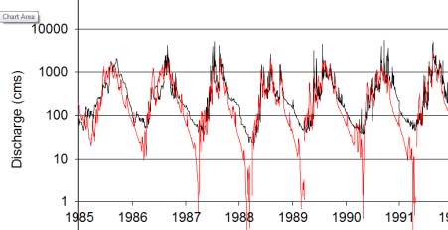
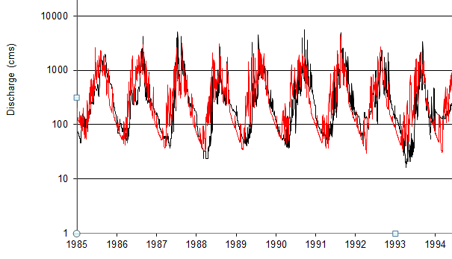
Calibration criteria
Look into sequence
Simulated data with Observed data
www.tmd.go.th
Notes:
What is the project about?
Define the goal of this project
Is it similar to projects in the past or is it a new effort?
Define the scope of this project
Is it an independent project or is it related to other projects?
* Note that this slide is not necessary for weekly status meetings

Slide 7
Calibration criteria
Compare Simulated data with Observed data
1. Achieve Mass Balance
Good comparison of volume ratio
2. Match Flow hydrograph (Yearly, monthly and daily)
Good comparison of hydrograph shape
3. Match Flow Distribution Patterns
Good comparison of flow duration curves
www.tmd.go.th

Slide 8
Calibration criteria
Statistics
1. Assessment of preservation of mass (Error of Volume Ratio, %)
2.Assessment of preservation of daily and monthly flow peaks
(Coefficient of Efficiency, Nash-Suttcliffe)
90 - 110
> 0.65
www.tmd.go.th
Notes:
What is the project about?
Define the goal of this project
Is it similar to projects in the past or is it a new effort?
Define the scope of this project
Is it an independent project or is it related to other projects?
* Note that this slide is not necessary for weekly status meetings

Slide 9
Evaluate the efficiency of model
Coefficient of efficiency
Value | Performance Rating | Modeling Phase | Reference
> 0.65 | Very Good | Calibration and validation | Saleh et al.(2000)
0.54 to 0.65 | Adequate | Calibration and validation | Saleh et al.(2000)
> 0.50 | Satisfactory | Calibration and validation | Santhi et al. (2001); adopted by Bracmort et al. (2006)
< 0.65 | Satisfactory | Calibration and validation | Santhi et al. (2004); adopted by Narasimhan et al. (2005)
After D.N.Moriasi et al. (2007)
www.tmd.go.th
Notes:
What is the project about?
Define the goal of this project
Is it similar to projects in the past or is it a new effort?
Define the scope of this project
Is it an independent project or is it related to other projects?
* Note that this slide is not necessary for weekly status meetings

Slide 10
Calibration Method
Optimization Method ( Auto-Calib.)
→ SWAT CUP
Manual Method ( Trial & Error )
www.tmd.go.th

Slide 11
Calibration steps
1. Separate base flow (using base flow filter program)
2. Extract result from the model for comparison
3. Check compared values then select parameters for calibration
4. Adjust Parameters
www.tmd.go.th
Notes:
What is the project about?
Define the goal of this project
Is it similar to projects in the past or is it a new effort?
Define the scope of this project
Is it an independent project or is it related to other projects?
* Note that this slide is not necessary for weekly status meetings

Slide 12
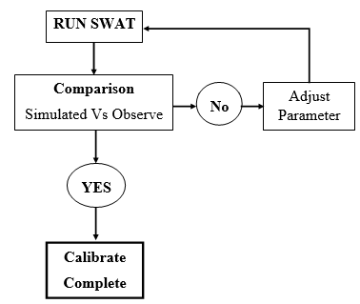
Calibrate flowchart
www.tmd.go.th
Notes:
What is the project about?
Define the goal of this project
Is it similar to projects in the past or is it a new effort?
Define the scope of this project
Is it an independent project or is it related to other projects?
* Note that this slide is not necessary for weekly status meetings

Slide 13
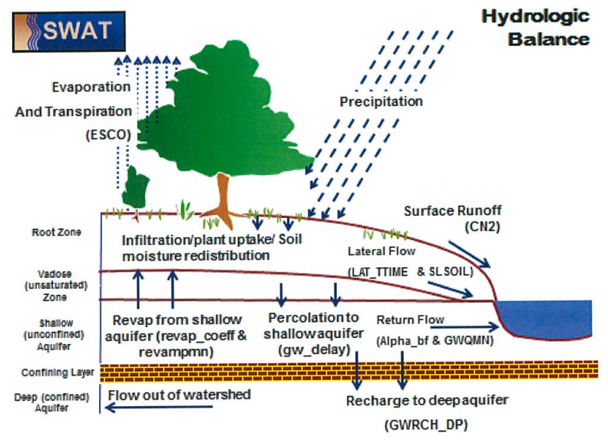
Parameter for SWAT Calibration
www.tmd.go.th
Notes:
What is the project about?
Define the goal of this project
Is it similar to projects in the past or is it a new effort?
Define the scope of this project
Is it an independent project or is it related to other projects?
* Note that this slide is not necessary for weekly status meetings

Slide 14
Parameter for SWAT Calibration
Group | Parameter | Description | Value | Sensitive
GW | AlPHA_BF | Base flow recession factor, days | 0.02 - 0.8 | low
 | REVAPMN | Threshold depth for revaporation to occur, mm | 0 - 1500 | low
 | GWQMN | Threshold depth for ground water flow to occur, mm | 0 - 500 | low
 | GW_DELAY | Ground water deleys, days | 0 - 150 | high
 | RCHRG_DP | Deep aquifer recharge fraction | 0 - 0.4 | high
 | GW_REVAP | Ground water revaporation coefficient | 0.02 - 0.2 | low
HRU | ESCO | Soil evaporaion compensation factor | 0.7 - 1 | low
 | CANMX | Maximum canopy storage (mm H₂O) | 0 - 10 | low
 | SLSOIL | Average slope length, m² | 0 - 150 | high
 | LT_TIME | Lateral flow travel time, hours | 0 - 180 | high
www.tmd.go.th
Notes:
What is the project about?
Define the goal of this project
Is it similar to projects in the past or is it a new effort?
Define the scope of this project
Is it an independent project or is it related to other projects?
* Note that this slide is not necessary for weekly status meetings

Slide 15
Technique for SWAT Calibration
Check Surface Runoff
Check Subsurface Runoff
www.tmd.go.th
Notes:
What is the project about?
Define the goal of this project
Is it similar to projects in the past or is it a new effort?
Define the scope of this project
Is it an independent project or is it related to other projects?
* Note that this slide is not necessary for weekly status meetings

Slide 16
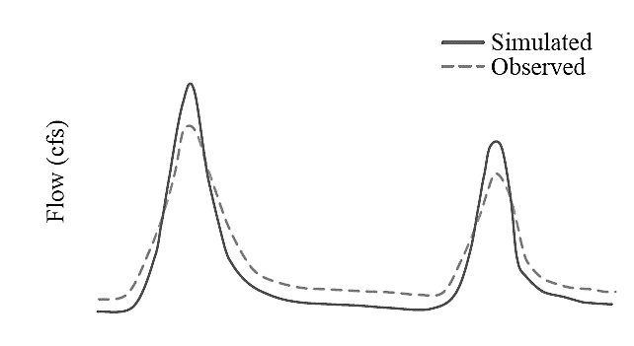
Technique for SWAT Calibration
Example 1
1. High Surface flow
Adjust :
CN ( *.mgt)
SOL_AWC (*.sol)
ESCO (*.sub)
Time
2. Little Base flow
Adjust : GW parameter ( *.gw)
www.tmd.go.th
Notes:
What is the project about?
Define the goal of this project
Is it similar to projects in the past or is it a new effort?
Define the scope of this project
Is it an independent project or is it related to other projects?
* Note that this slide is not necessary for weekly status meetings

Slide 17
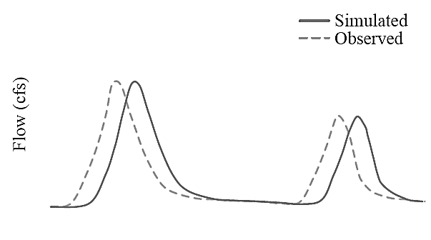
Technique for SWAT Calibration
Example 2
Lag Time
- Tc is too long
- Less than actual slope for
overland flow
- Over estimated surface
roughness
- Flood routing coefficients
Time
Adjust
- Increase slope for overland flow (SLOPE)
Manning’s roughness coefficient , lower it after checking OV_N tables
(OV_N)
The value of overland flow length- lower to 5-10m, if necessary
(SLSUBBSN)
www.tmd.go.th
Notes:
What is the project about?
Define the goal of this project
Is it similar to projects in the past or is it a new effort?
Define the scope of this project
Is it an independent project or is it related to other projects?
* Note that this slide is not necessary for weekly status meetings

Slide 18
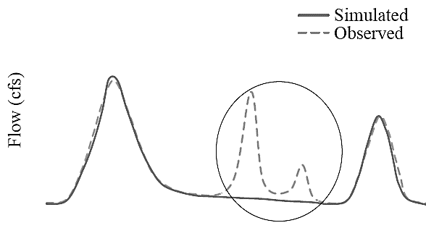
Technique for SWAT Calibration
Example 3
Flow missing
Rainfall data is not represent or missing
Time
www.tmd.go.th
Notes:
What is the project about?
Define the goal of this project
Is it similar to projects in the past or is it a new effort?
Define the scope of this project
Is it an independent project or is it related to other projects?
* Note that this slide is not necessary for weekly status meetings

Slide 19
Common Problems on Calibration
Too little data or monitoring period too short
No observed data
Prediction of future conditions which are outside the model conditions
Adjustment of the wrong parameter
Adjustments destroy physical representation of system by model
www.tmd.go.th
Notes:
What is the project about?
Define the goal of this project
Is it similar to projects in the past or is it a new effort?
Define the scope of this project
Is it an independent project or is it related to other projects?
* Note that this slide is not necessary for weekly status meetings

Slide 20
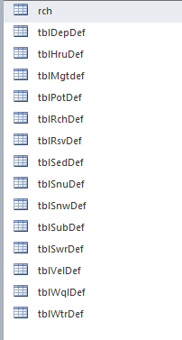
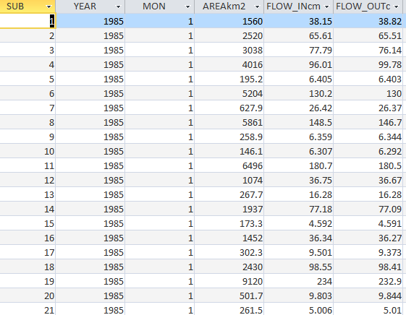
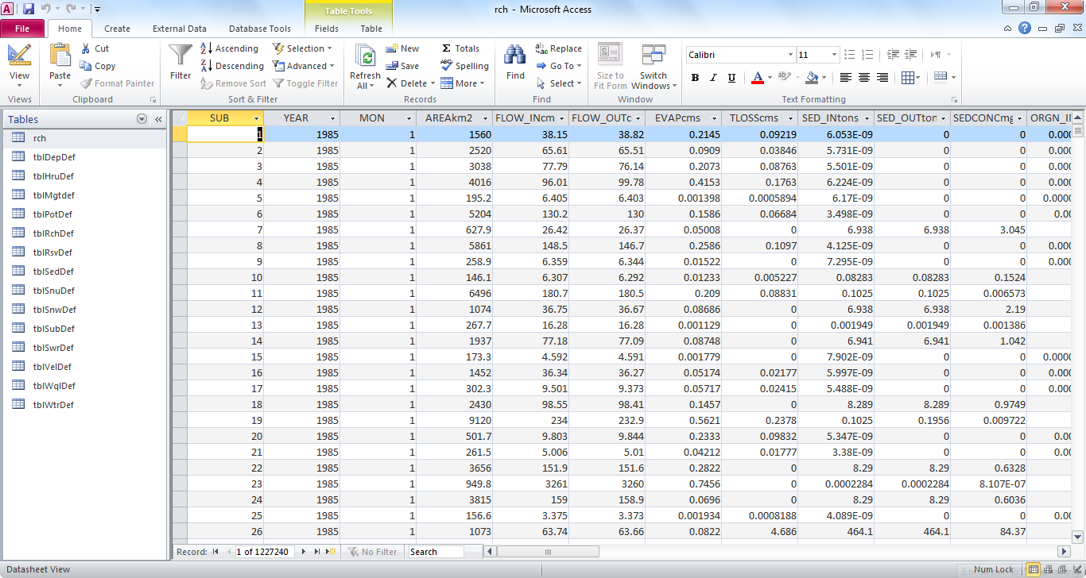
Output SWAT model
www.tmd.go.th

Slide 21
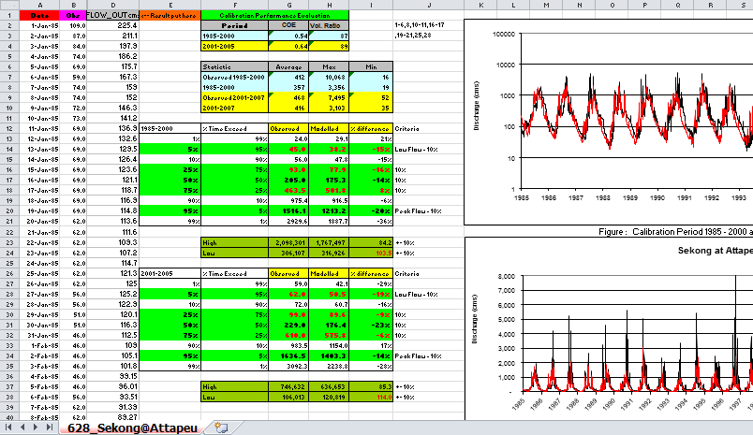
SWAT Calibration
Simulation Flow out
Observe Flow out
www.tmd.go.th
Notes:
What is the project about?
Define the goal of this project
Is it similar to projects in the past or is it a new effort?
Define the scope of this project
Is it an independent project or is it related to other projects?
* Note that this slide is not necessary for weekly status meetings

Slide 22
Exercise
- Calibration and see results
Contract
Email: Nuttapong34@gmail.com
www.tmd.go.th
Notes:
Prepare slides for the appendix in the event that more details or supplemental slides are needed. The appendix is also useful if the presentation is distributed later.

