Slide 1
TSBK07 Computer Graphics
Real Time Rendering Using Modern GPU Techniques
Jonatan Olofsson, Mikael Silvén
6/5 - 2012

Slide 2
Overview
Grass creation
  Geometry Shaders
Fustrum Culling
  OpenCL
Post Processing
  Framebuffer Objects, Multiple Rendertargets, OpenCL

Slide 3
Cheating is allowed!

Slide 4


Slide 5
Grass Creation 1
Shader Pipeline
Vertex→ Geometry → Fragment
Points → Primitives → Pixels
Geometry shader can create new points, creating primitives out of nothing

Slide 6
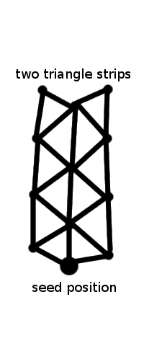
Grass Creation 2
Geometry Shader gets fed “seeds” as input
Creates two triangle strips
Tricks
  Dynamic Level of Detail
  Apply wind force

Slide 7
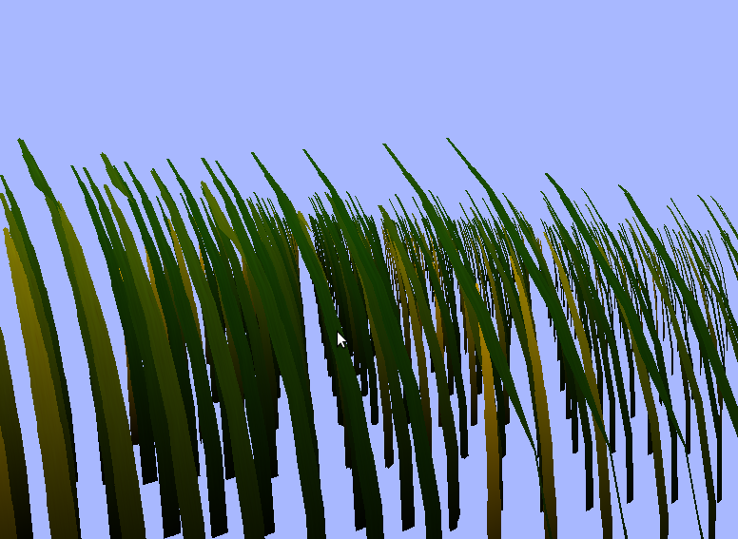
Grass Creation 3

Slide 8

Fustrum Culling
Render only the visible world
Decreases the computational load - beneficial in large worlds
Finding the visible world: Multi-dimensional two-point boundary problem, numerically solved

Slide 9
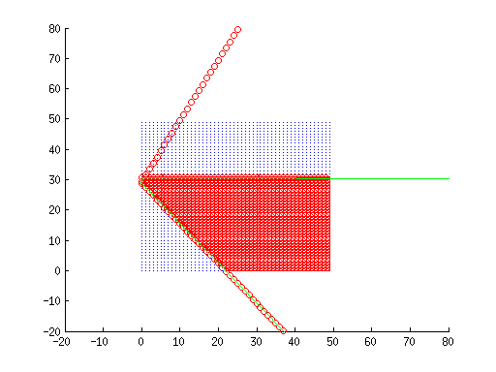
Fustrum Culling
OpenCL applied on GPU for speed
Index handling in shared OpenCL/OpenGL Element Array Buffers
Find the frustum corners
in the ground plane
Determine where the visible
vertices are
Place the N visible triangles
first in the EAB
Render N triangles

Slide 10
Post Processing 1
Current technique
  Fog
  Field of Focus
Did not do
  Blooming
  HDR lighting

Slide 11
Post Processing 2
Fog
  Render world off screen using FBO
  Save world coordinates and depth
  Calculate fog intensity
  Depends on height.

Slide 12
Post Processing 3
Field of Detail
  Apply Gaussian blur on FBO
  Interpolate between blurred copy and original
  Because rendering the grass is too expensive

Slide 13
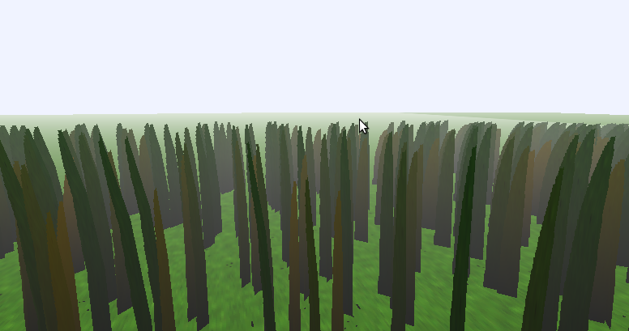
Post Processing 4

Slide 14
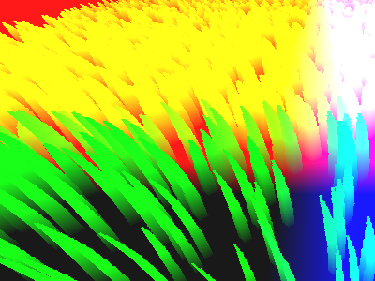
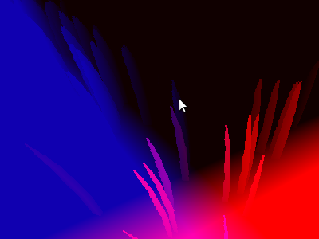
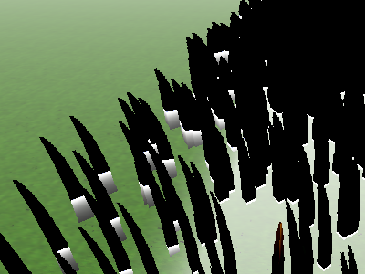
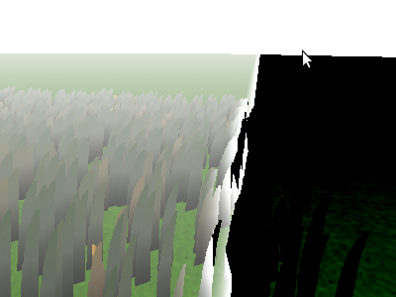
Post Processing 5

Slide 15
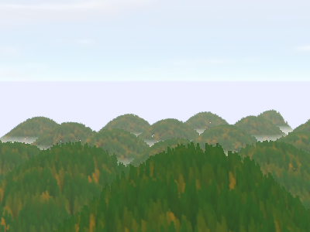
End Result

Slide 16
Further Work
Optimize!
  Better level of detail code
  Reduce density of grass further away
  Reduce to static texture
  Instanced drawing
  Better kernel and shader code

Slide 17
Questions
?

