Slide 1
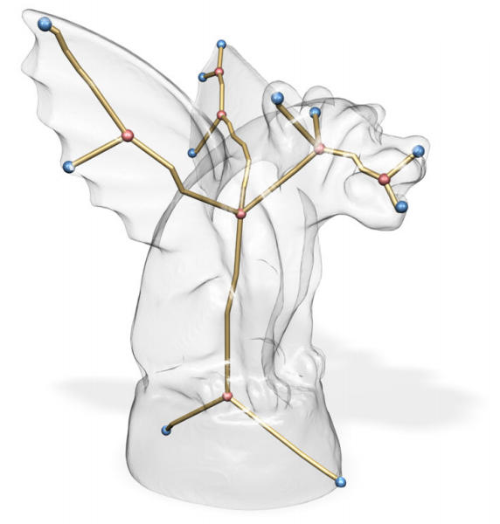
Skeleton Extraction by Mesh Contraction
Guilherme N. Oliveira
Jonatas Medeiros
Rosália Galiazzi Schneider

Slide 2
Introduction
=P

Slide 3
Questions?

