Slide 1
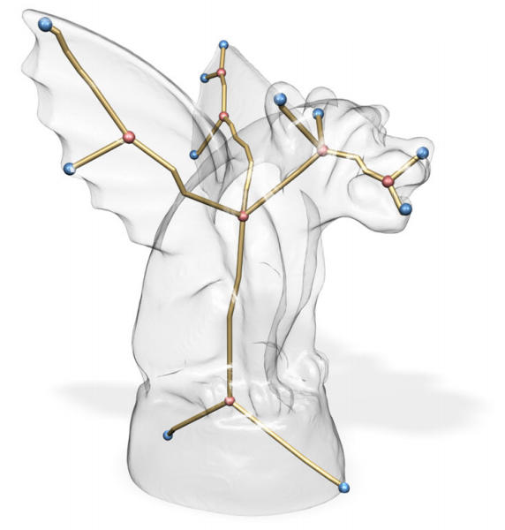
Skeleton Extraction by Mesh Contraction
Guilherme N. Oliveira
Jonatas Medeiros
Rosália Galiazzi Schneider

Slide 2
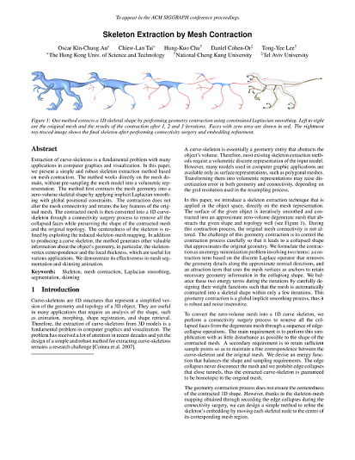
Introduction
Skeleton extraction by mesh contraction.
Au, O. K. C., Tai, C. L., Chu, H. K., Cohen-Or, D., and Lee, T. Y.
ACM Trans. Graph. 27, 3, Article 44 (August 2008)

Slide 3
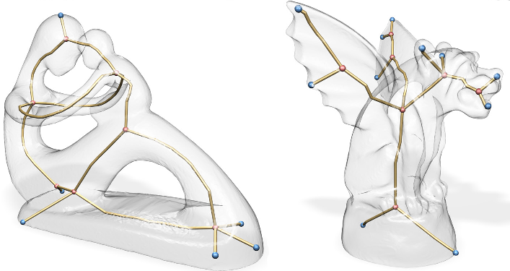
Motivation
Model Animation
Shape Retrieval
Morphing

Slide 4
Outline
Solution Overview
Geometry Contraction
Connectivity Surgery
Embedding Refinement
Results
Conclusion

Slide 5
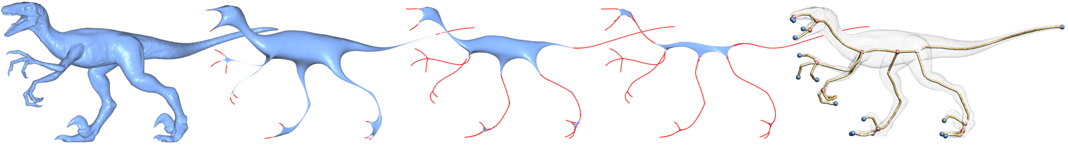
Geometry Contraction
Smoothly contract the mesh
Retain overall shape
Iterative process

Slide 6
Geometry Contraction
Starting with the triangle mesh G=(V,E)
V = (V₁^{T}, V₂^{T}, ... V_{n}^{T})
E = edges of G
Find new vertices V’ such that the mesh G’=(V’,E) is a contracted version of G

Slide 7

Geometry Contraction
Find V’ by solving LV’ = 0
L_{nxn} is the curvature-flow Laplacian operator:
with α and β being the oposite angles of edge (i,j)
The rows of L are the contraction constraints

Slide 8

Geometry Contraction
Add more constraints to force a unique solution for V’, and ensure that the contracted mesh retain the overall original shape. The new constraints are called attraction constraints.
System LV’ = 0 becomes
where and are diagonal matrices to balance the contraction and attraction factors respectively.
The new system is over-determined.
Uses least-squares to solve.

Slide 9


Geometry Contraction
Iteration t
Solve for
Update
Update where and are the current and the original one-ring area of the vertex i.
Compute the new with the new vertex positions

Slide 10
Geometry Contraction
where A is the average face are of the mesh.

Slide 11
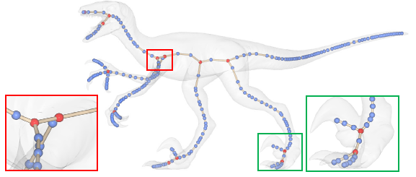
Connectivity Surgery
Quadric Error Metric Simplification
GARLAND , M . , and HECKBERT, P. S Surface simpliﬁcation using quadric error metrics. In Proceedings of ACM SIGGRAPH 97

Slide 12
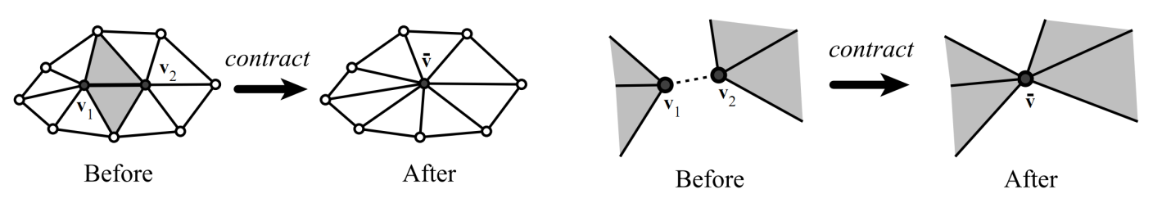
Connectivity Surgery
QEM over edges instead of faces
Contract only connected vertices
Ordered contraction
Cost minimization

Slide 13


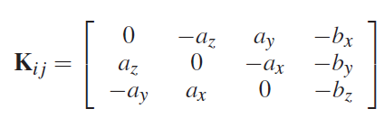

Connectivity Surgery
Shape cost
Vertex error metric
is the normalized edge vector of edge (i,j) and

Slide 14




Connectivity Surgery
Sampling Cost
Avoids over-simplification and long skeleton edges in straight regions.
Total Cost

Slide 15
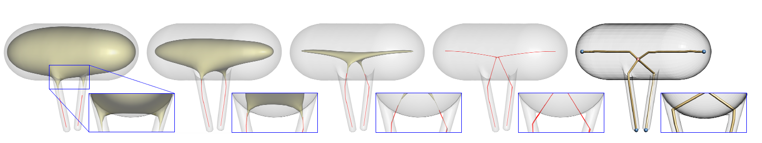
Embedding Refinement
Centralizes the skeleton
Ensure the skeletons edges are inside their respective regions

Slide 16
Results
Implementation
C++
OpenGL
Qt for UI
OpenMesh for mesh management
Cholmod for system solving

Slide 17
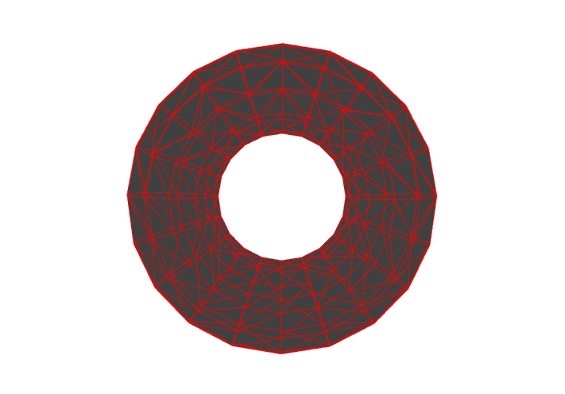
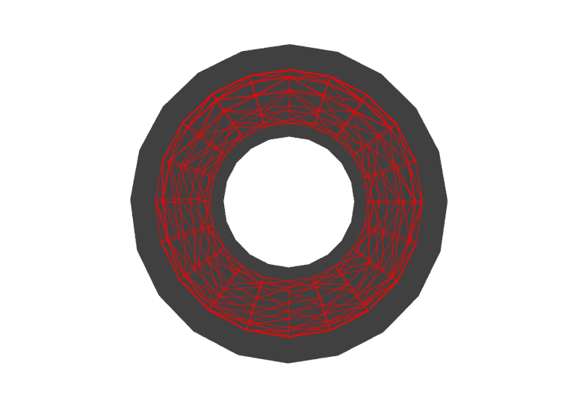
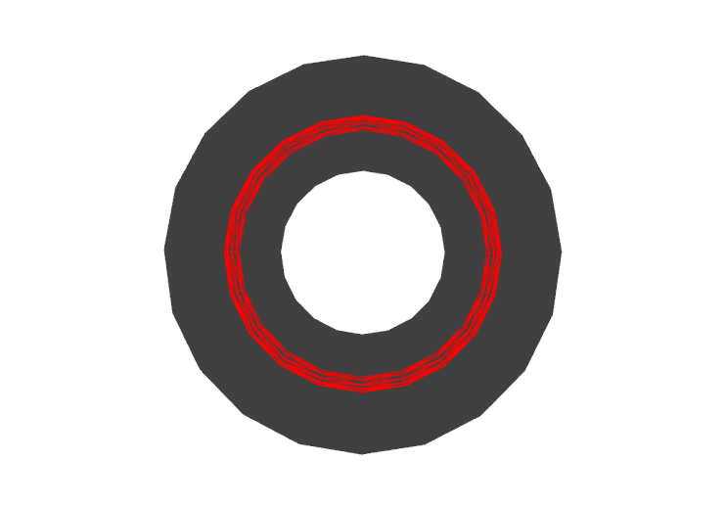
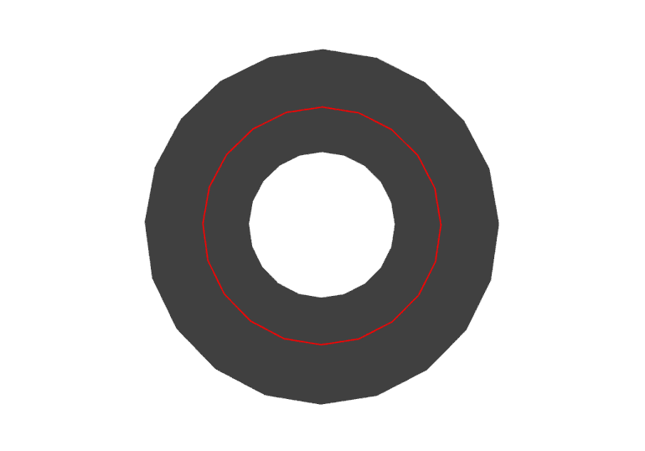
Results
Torus

Slide 18
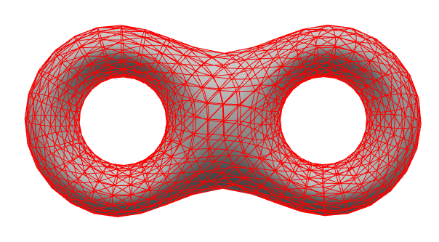
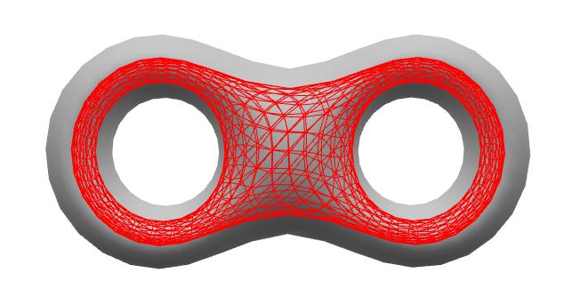
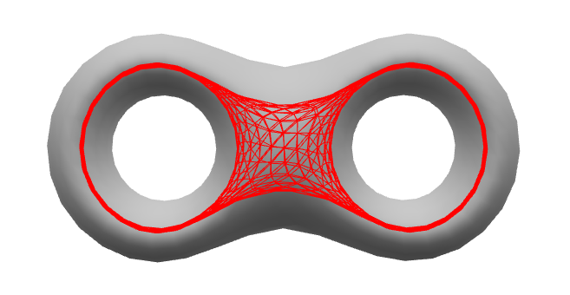
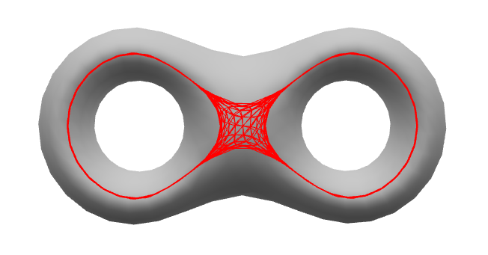
Results
Bitorus

Slide 19
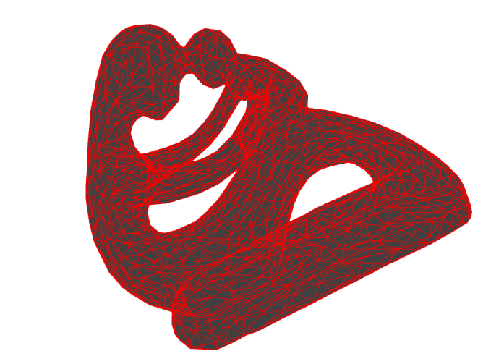
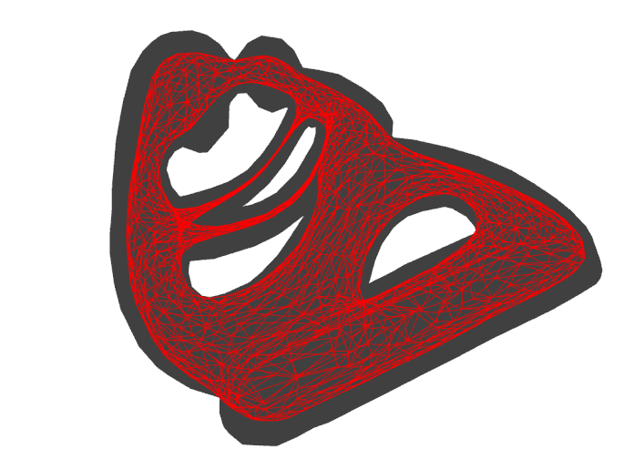
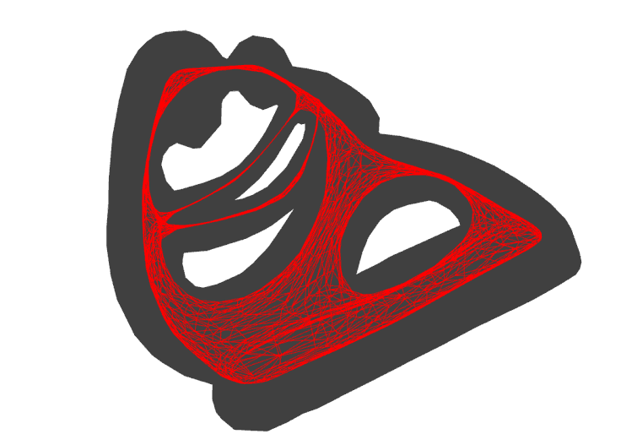

Results
Fertility

Slide 20
Conclusion
=P

Slide 21
Questions?

