Slide 1
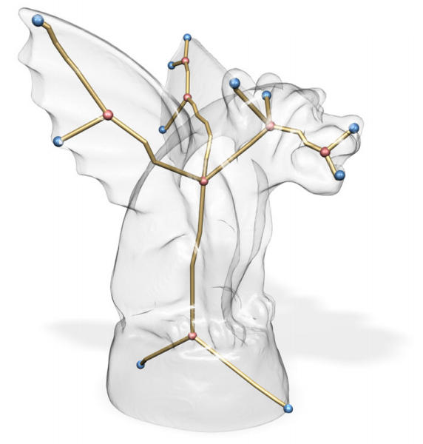
Skeleton Extraction by Mesh Contraction
Guilherme N. Oliveira
Jonatas Medeiros
Rosália Galiazzi Schneider

Slide 2
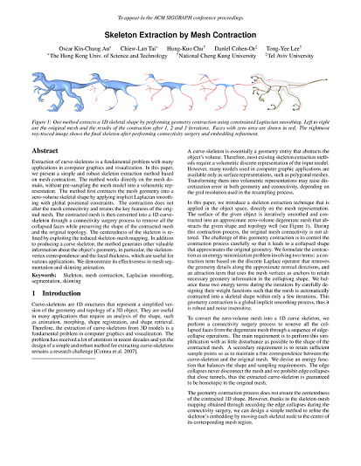
Introduction
Skeleton extraction by mesh contraction.
Au, O. K. C., Chiew-Lan Tai, Hung-Kuo Chu, Daniel Cohen-Or, and Tong-Yee Lee.
ACM Trans. Graph. 27, 3, Article 44 (August 2008)

Slide 3
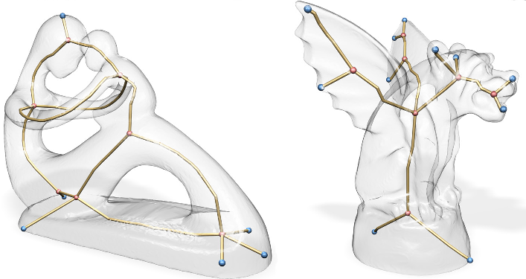
Motivation
Model Animation
Shape Retrieval
Morphing

Slide 4
Outline
Solution Overview
Geometry Contraction
Connectivity Surgery
Embedding Refinement
Results
Conclusion

Slide 5
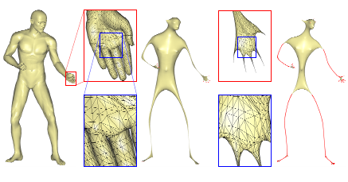
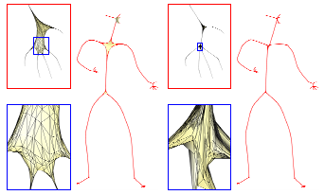
Geometry Contraction
Smoothly contract the mesh.
Retain overall shape.
Iterative process

Slide 6
Geometry Contraction - Algorithm
Starting with the triangle mesh G=(V,E)
V = (V₁^{T}, V₂^{T}, ... V_{n}^{T})
V_{i}^{T} are the coordinates of vertex i
E = edges of G
Find new vertices coordinates V’ such that the mesh G’=(V’,E) is a contracted version of G

Slide 7

Geometry Contraction - Algorithm
Find V’ by solving LV’ = 0
L_{nxn} is the curvature-flow laplacian operator:
with α and β being the oposite angles of edge (i,j)
The rows of L are the contraction constraints.

Slide 8

Geometry Contraction - Algorithm
(3)
Add more constraints to force a unique solution for V’, and ensure that the contracted mesh retain the overall original shape. The new constraints are called attraction constraints.
System LV’ = 0 becomes
where and are diagonal matrices to balance the contraction and attraction factors respectively.
The new system is over-determined.
Uses least-squares to solve.

Slide 9


Geometry Contraction - Algorithm
Iteration t
Solve for
Update
Update where and are the current and the original one-ring area of the vertex i.
Compute the new with the new vertex positions

Slide 10
Geometry Contraction - Algorithm
where A is the average face are of the mesh.

Slide 11
Connectivity Surgery

Slide 12
Embedding Refinement
=P

Slide 13
Results
=P

Slide 14
Conclusion
=P

Slide 15
Questions?

