Slide 1
Relative Pronouns

Slide 2
1. Quando o antecedente do pronome for pessoa (que, o qual, a qual, os quais, as quais):
1.1 Usa-se WHO ou THAT com função de sujeito ou objeto da oração não precedido de preposição.
- What happened to the sailor WHO/THAT departed this morning?
1.2 Usa-se WHOM com função de objeto, o que é obrigatório quando o objeto é precedido de preposição.
- I want to interrogate the man WHOM/WHO/THAT/(OMISSÃO) you captured.
- I want to meet the friend about WHOM you were talking.

Slide 3
2. Quando o antecedente do pronome for coisa ou animal (que, o que, o qual, a qual, os quais, as quais) Usa-se WHICH ou THAT.
- The dogs THAT/WHICH are sick need special attention.
(RESTRITIVA: identifica um grupo de cachorros dentre outros)
- The dogs, WHICH are sick, need special attention.
(EXPLICATIVA: apenas dá um detalhe sobre todos os cachorros)
- The path WHICH/THAT/(OMISSÃO) he chose is a wise one.
- I find all this stupid, WHICH is only my opinion.
(refere-se à oração anterior; deve ser precedido por vírgula)

Slide 4
3. WHOSE: Indica posse sobre um substantivo que o segue (cujo(s), cuja(s)).
- The man WHOSE actions could not be forgiven.
- The team, WHOSE coach is Brazilian, ended up in first place.
4. WHAT: “as coisas que”, “aquilo que”, “o que”.
- WHAT was left behind is not important.
(não se refere a nenhum antecedente)
- Why don’t you listen to WHAT I have to say?!

Slide 5
5. OMISSÃO: pode-se omitir o pronome relativo quando ele tiver a função de objeto da oração, exceto se a oração estiver entre vírgulas ou se o pronome for precedido por preposição.

Slide 6
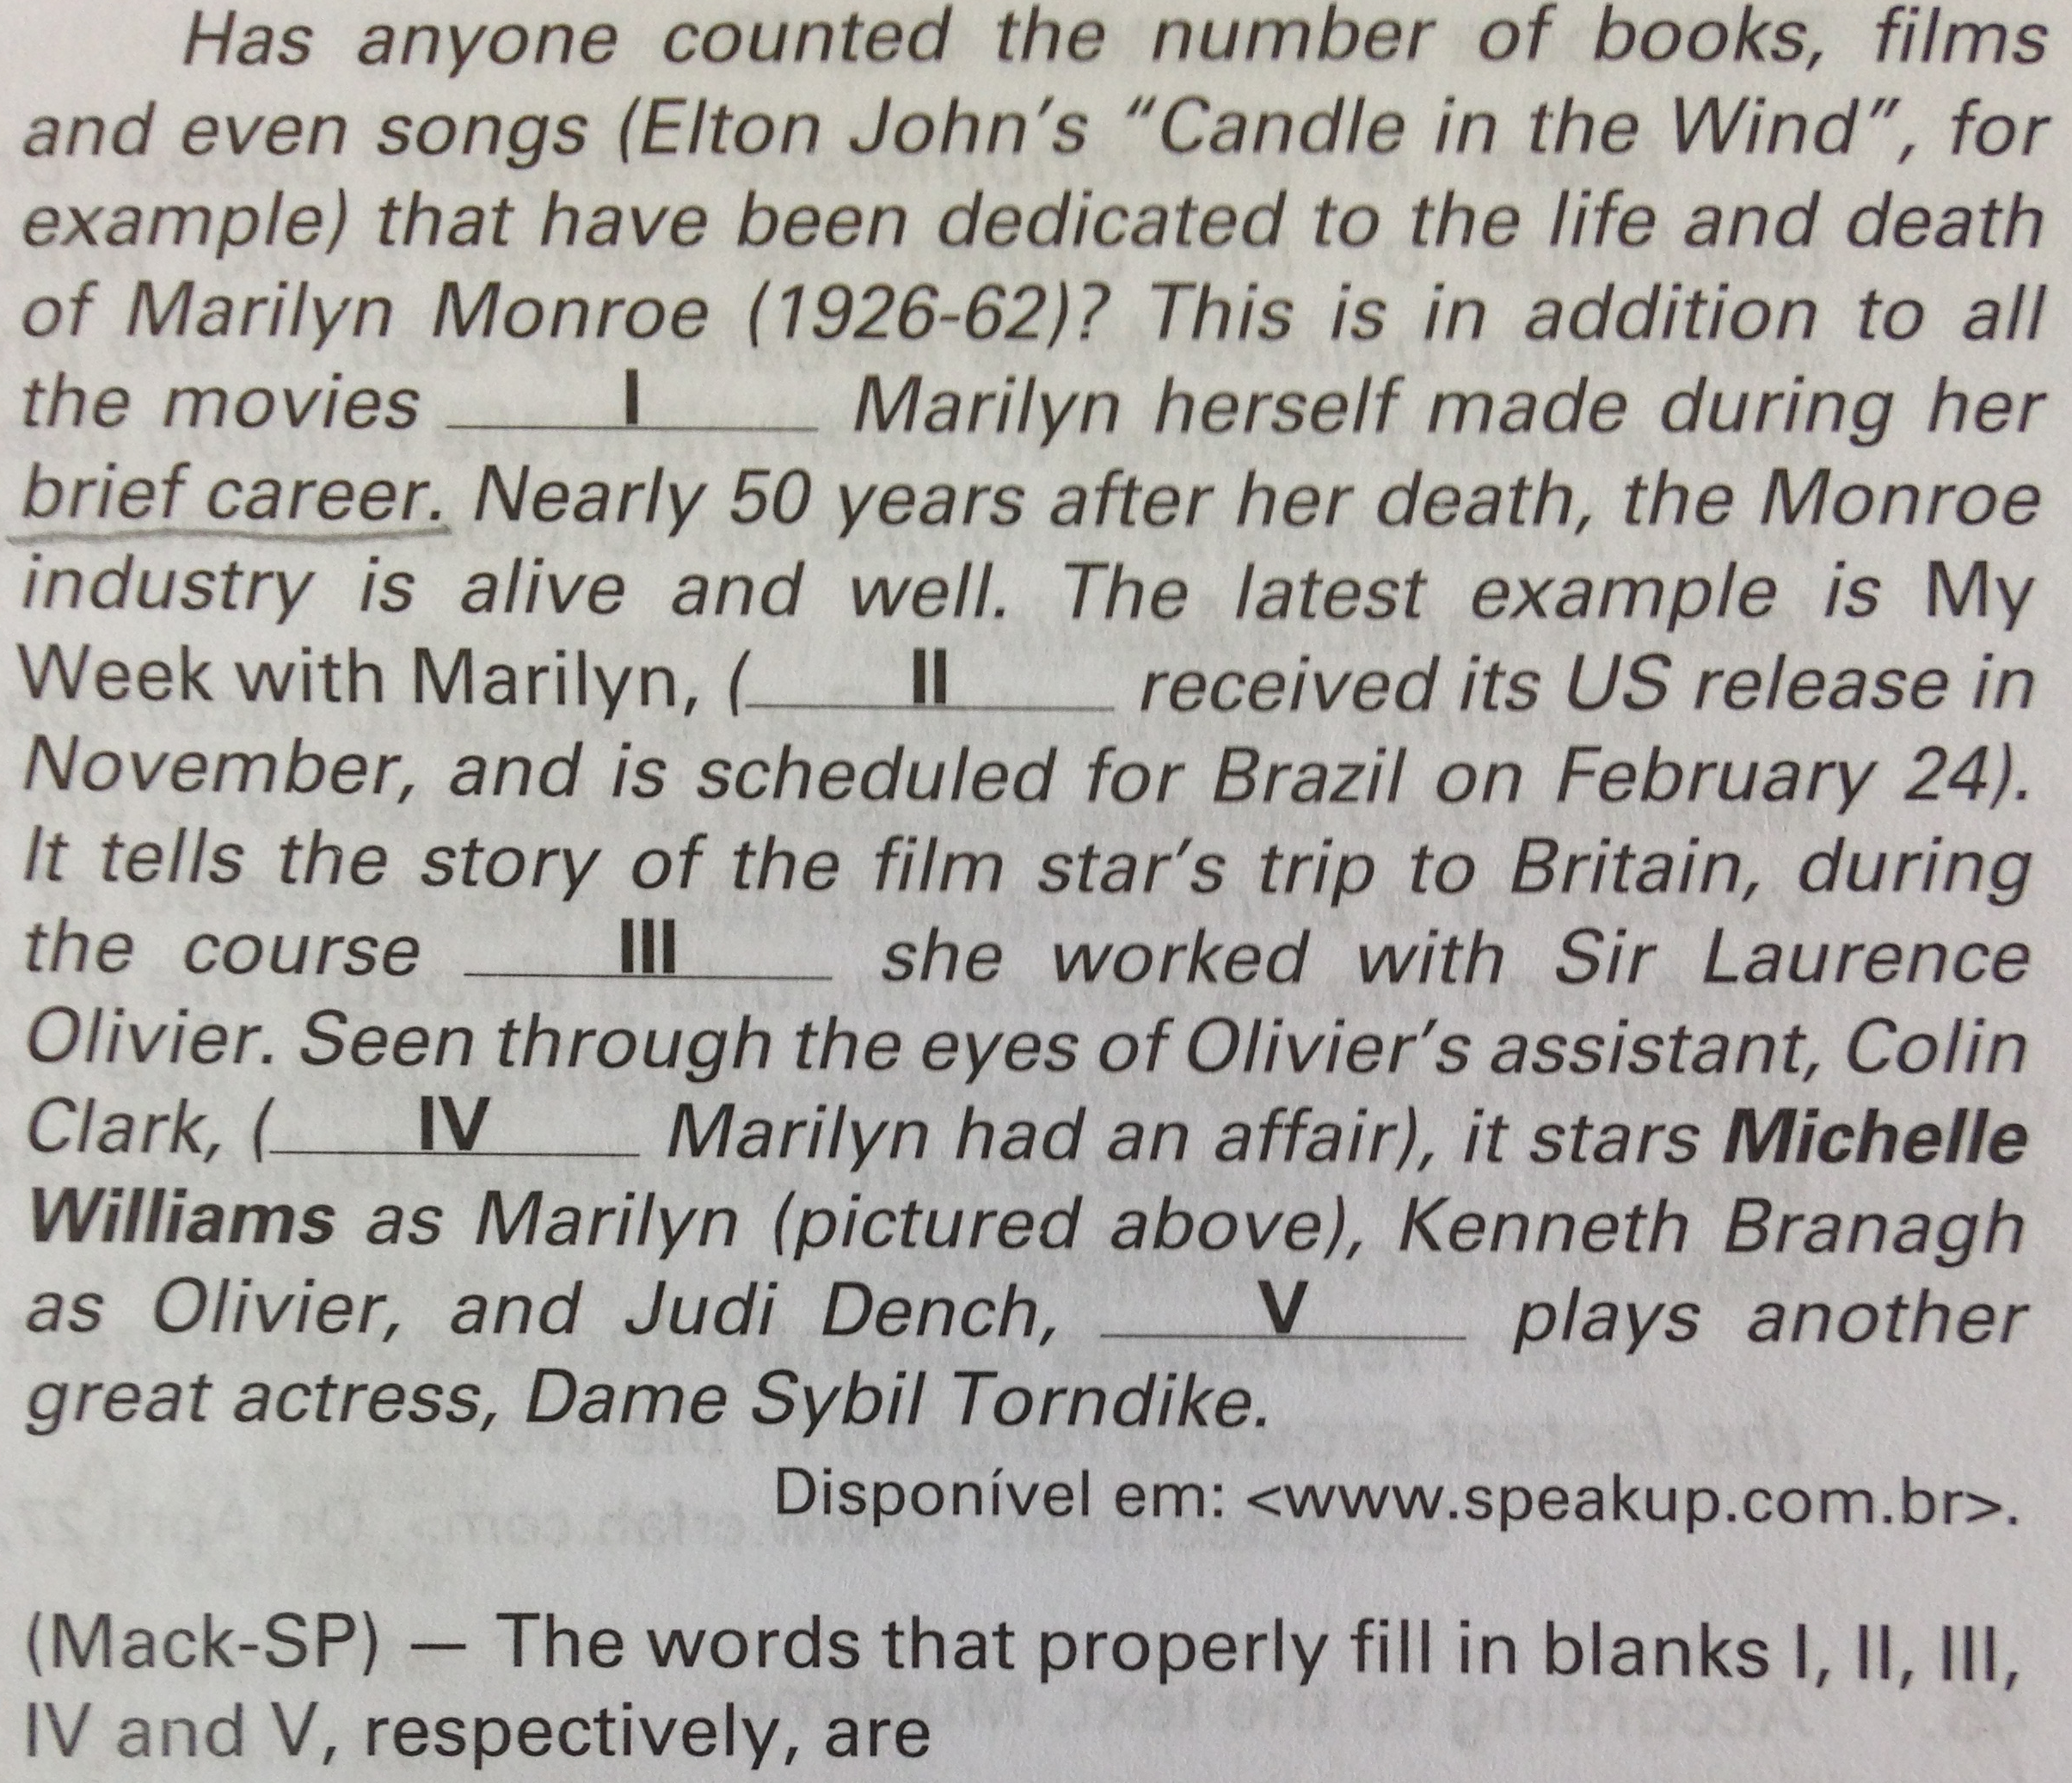
a) that / which / of which / with whom / who.
b) which / which / about whom / with which / who.
c) when / who / whom / with which / who.
d) which / which / from which / with whom / that.
e) that / when / in which / with who / who.

Slide 7
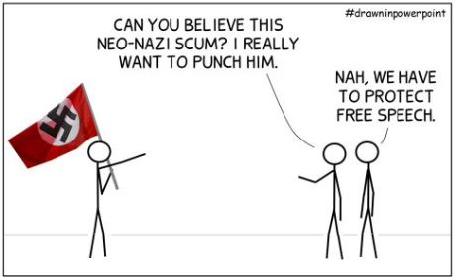
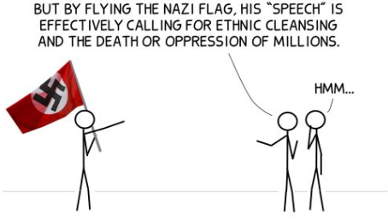
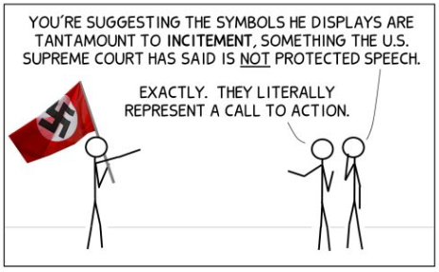


Slide 8
Utopia: Cancer and all other life-threatening diseases are cured, leading to a new age of health and prosperity. Scientists are already using AI tools to make breakthroughs in longevity medicine, which aims to end or even reverse ageing.
Sta. Casa 2024
In the excerpt from the seventh paragraph “which aims to end or even reverse ageing”, the underlined word refers to
(A) “life-threatening diseases”.
(B) “ageing”.
(C) “longevity medicine”.
(D) “prosperity”.
(E) “new age”.

Slide 9
In developing countries there are high levels of what is known as “food loss”, which is unintentional wastage, often due to poor equipment, transportation and infrastructure. In wealthy countries, there are low levels of unintentional losses but high levels of “food waste”, which involves food being thrown away by consumers because they have purchased too much, or by retailers who reject food because of exacting aesthetic standards.
(www.theguardian.com)
UNIFESP 2017
No trecho “which involves food being thrown away by consumers”, o termo em destaque se refere a
(A) food.
(B) wealthy countries.
(C) food loss.
(D) consumers.
(E) food waste.

Slide 10
UNIFESP 2017
In developing countries there are high levels of what is known as “food loss”, which is unintentional wastage, often due to poor equipment, transportation and infrastructure. In wealthy countries, there are low levels of unintentional losses but high levels of “food waste”, which involves food being thrown away by consumers because they have purchased too much, or by retailers who reject food because of exacting aesthetic standards.
(www.theguardian.com)
Segundo o texto,
(A) a perda de alimentos acontece tanto em países ricos como pobres, devido à mudança climática.
(B) os alimentos são jogados fora pelos consumidores e pelos pontos de venda por falta de refrigeração.
(C) a perda não intencional de alimentos acontece em níveis alarmantes em países ricos.
(D) o desperdício de alimentos durante seu transporte ocorre principalmente em países ricos.
(E) os meios de transporte e a infraestrutura deficientes contribuem para a perda não intencional de alimentos.

Slide 11
In developing countries there are high levels of what is known as “food loss”, which is unintentional wastage, often due to poor equipment, transportation and infrastructure. In wealthy countries, there are low levels of unintentional losses but high levels of “food waste”, which involves food being thrown away by consumers because they have purchased too much, or by retailers who reject food because of exacting aesthetic standards.
(www.theguardian.com)
UNIFESP 2017
The text
(A) presents some solutions to both “food loss” and “food waste”.
(B) blames developing countries for most of “food waste”.
(C) contrasts concepts of “food loss” and “food waste”.
(D) infers that consumers should change their attitude towards “food loss”.
(E) indicates that governments are responsible for consumer behaviour.

Slide 12
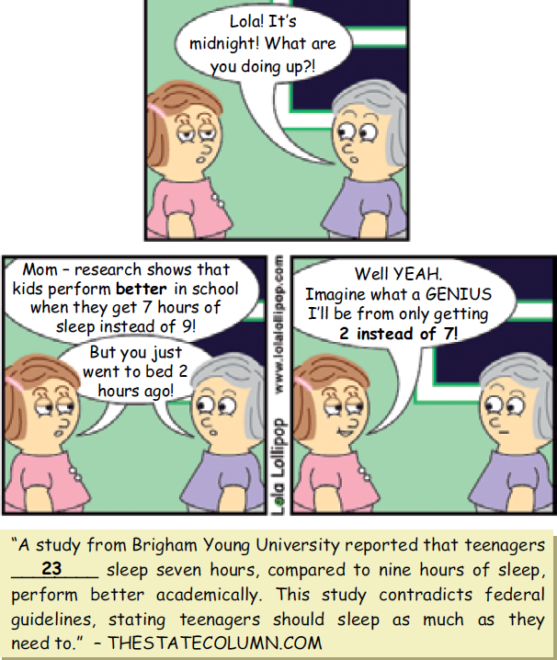
UNESP 2017
According to the cartoon, Lola
(A) has already slept for seven hours.
(B) will sleep until 7 am.
(C) is planning to go to bed at midnight.
(D) used to sleep for nine hours.
(E) went to sleep at 10 pm.

Slide 13
UNESP 2017
Lola thinks that
(A) she is a genius.
(B) it is wise to go to bed no later than midnight.
(C) the less she sleeps, the more intelligent she’ll become.
(D) she’ll please her mother if she gets better grades.
(E) her mom wants her to sleep for at least nine hours.

Slide 14
UNESP 2017
Assinale a alternativa que completa corretamente a lacuna numerada no texto.
(A) which.
(B) when.
(C) while.
(D) whoever.
(E) who.

Slide 15
Há diferença no sentido das duas frases abaixo? Explique.
- All politicians who are involved with corruption must pay for their crimes.
- All politicians, who are involved with corruption, must pay for their crimes.

