Slide 1
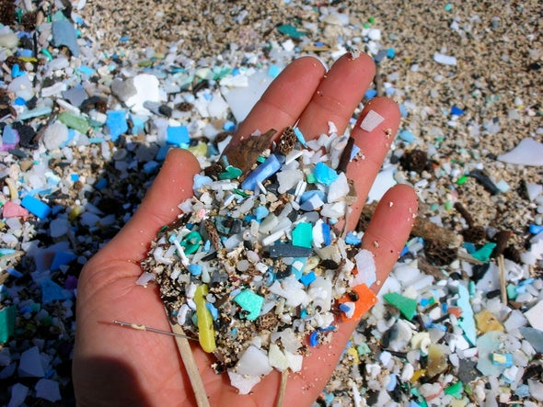
Earth Has a Hidden Plastic Problem—Scientists Are Hunting It Down
Trillions of tiny particles generated by our plastic-reliant society are polluting environments worldwide
By Andrea Thompson on August 13, 2018
Dependente de plástico
https://www.scientificamerican.com/article/microplastics-earth-has-a-hidden-plastic-problem-mdash-scientists-are-hunting-it-down/?redirect=1

Slide 2
partículas
em maio a
emaranhado / tapete
During a research cruise to the Sargasso Sea in fall 1971 marine biologist Ed Carpenter first noticed peculiar, white specks floating amidst the mats of brown sargassum seaweed. After some investigating he discovered they were tiny bits of plastic. He was stunned. If thousands of the broken down particles were showing up in in the middle of the Atlantic Ocean, 550 miles from any mainland, he says, “I figured it’s all over the place.”
Carpenter, now at San Francisco State University, published his observations March 17, 1972, in Science. They were the first inkling plastic pollution is not limited to the plastic bags, soft drink bottles and other visible trash strewn along coastlines and gathering in the infamous Great Pacific Garbage Patch, a vortex of currents that concentrates debris in the Pacific Ocean. Weakened by sunlight and pulverized by winds and waves, those plastic products fracture into ever-smaller pieces.
Along with the tiny, so-called microfibers shed by synthetic fabrics and the beads put in products like toothpaste, these fragments are called microplastics. With 300 million metric tons of plastic produced each year—about the weight of the entire human population—trillions of degraded plastic bits may be lurking largely unseen in the environment, researchers say.
aturdido / estupefato / assombrado
separadas / desmanteladas
pensar / esperar / acreditar / calcular
espalhados
detritos
suspeita
liberados
espreitando / escondendo

Slide 3
variedade
The miniscule dimensions of microplastic—under five millimeters in diameter (about that of a grain of rice)—mean it can be ingested by a broader range of species than larger pieces, from tiny ocean plankton to humans. In animals’ bodies the waste can cause physical damage to organs and also, like a miniscule Trojan horse, ferry in hazardous chemicals and help them accumulate up the food chain.
An explosion of research to track microplastics is revealing a mountain of plastic hidden not only in the oceans but in the world’s rivers, lakes, farm and soil as well as organisms big and small. The stuff is even floating around in the air—from dense urban areas to the remote Arctic Ocean. “It’s everywhere,” says Chelsea Rochman, a microplastics researcher at the University of Toronto.
To understand the impacts—and how to curb the pollution—scientists need to know how much is concentrated in which places, where it is coming from and how it is moving around. Detecting microplastics, though, is complicated by the dizzying array of tens of thousands of polymers they contain, as well as their wide size range—from the scale of that grain of rice down to a virus. “It’s not like you’re trying to sample a contaminant like mercury or lead,” says Richard Thompson, a marine biologist at the University of Plymouth who helped coin the term microplastic. “It’s not a single thing, it’s many different things.”
transportar para dentro
limitar / controlar
conjunto / grupo / grande número de
amostrar

Slide 4
Procurar cuidadosamente, minuciosamente
As scientists comb for microplastics and move away from visual identification to machine sensors, they are finding the stuff at ever-smaller sizes. Most researchers think microplastics are degrading even further into what they call nanoplastics. These infinitesimal specks would be of even greater concern because if ingested, they are likelier to penetrate the gut lining to reach the bloodstream or if inhaled, lodge deep in the lungs. Such nanosize fragments have been shown to form in lab experiments, so most researchers are confident they are out in the environment. But currently, “we don’t have any methods that will isolate nanoplastics” there, Thompson says. Several groups are working on developing ways to illuminate this hidden threat, including researchers at the AWI that have so far shown a way to identify known nanoplastics in samples. When such methods reach fruition, Bergmann expects “we will find that the ocean is much more polluted than we think now.” The same goes for other environments.
alojar / depositar

Slide 5
padronizar
eliminar / descartar
The research community is also working to weed out methods that can under- or overestimate microplastic numbers and to standardize methods so they can compare the results of different studies. Although “there’s still so much to be done, just in understanding the sources and the pathways and the abundance on all of these different systems,” as Mason says, it is becoming clear microplastics, particularly microfibers, are pervasive, with some hotspots hewing close to populated areas. Experts are excited. “The movement of the science is so rapid, I think we’re going to know a ton more in five or 10 years,” Sutton says. They will then have a better idea of which organisms and ecosystems are most threatened, and may be able to advise policy makers on where to intervene to keep plastic out of the environment in the first place.
While the work to locate microplastic continues, scientists are not losing any time tracing the harm it might be doing to organisms and ecosystems. That includes humans, through the health of the soils in which we grow our food, the quality of our drinking water and even more directly as we ingest it and breath it in. As Mason put it: “That’s the question that everyone wants to answer.”
penetrante / infiltrante / presente em grande escala
cortando / passando por
rastreando

Slide 6
1. According to the text:
A) Microplastic pollution is a recent problem and its first evidences were found in the 21st Century.
B) Microplastic can only be found at the Sargassum Sea, the Pacific Ocean and the Artic Ocean.
C) The influence of elements of nature is not the only source of microplastic.
D) Microplastic is easy to detect due to its vast quantity in the environment.
E) Microplastic is hazardous only to smaller species, but it accumulates up the food chain.

Slide 7
2. No trecho “Along with the tiny, so-called microfibers shed by synthetic fabrics and the beads put in products like toothpaste, these fragments are called microplastics.” a expressão em destaque estabelece ideia de:
A) causa
B) simultaneidade
C) consequência
D) contraste
E) inclusão

Slide 8
3. “To understand the impacts—and how to curb the pollution—scientists need to know how much is concentrated in which places, where it is coming from and how it is moving around. Detecting microplastics, though, is complicated by the dizzying array of tens of thousands of polymers they contain, as well as their wide size range—from the scale of that grain of rice down to a virus.”
A respeito das expressões em destaque, é possível afirmar que:
A) Though estabelece ideia de contraste; as well as expressa comparação.
B) Though estabelece ideia de conclusão; as well as expressa inclusão.
C) Though estabelece relação de oposição com a necessidade de se identificar onde estão os microplásticos, sua concentração, sua fonte e sua movimentação; as well as compara os tamanhos dos microplásticos aos de grãos de arroz e ao de um vírus.
D) Though estabelece relação de oposição com a necessidade de se identificar onde estão os microplásticos, sua concentração, sua fonte e sua movimentação; as well as inclui a variação de tamanhos do microplástico como um dos fatores que o torna difícil de ser detectado.
E) Though pode ser traduzido por “portanto”; as well as pode ser traduzido por “bem como”.

Slide 9
4. “Such nanosize fragments have been shown to form in lab experiments, so most researchers are confident they are out in the environment. But currently, ‘we don’t have any methods that will isolate nanoplastics’” there, Thompson says.” No trecho acima, o termo em destaque se refere a:
A) Environment
B) Lab experiments
C) Methods
D) Nanosize fragments
E) Most researchers

Slide 10
5. According to the text:
A) Despite the efforts in researching microplastic, there are no improvements on the research methods.
B) Microplastics can be so small that they cannot become smaller.
C) Bergmann believes that our oceans will be much more polluted in the future.
D) Produce from organic farms are less likely to be contaminated by microplastic.
E) Micropastic can work as a transport for other harmful substances into living organisms.

