Slide 1
What Drives Chronic Disease Across U.S. States?
Predicting Heart Disease, Diabetes, Cancer & Mental Health from CDC Data
Jonathan Chamberlin | Min Yu Huang | Anuhya Mandava | Tsion Teklaeb
DS2500 Section 1 — Spring 2026
Notes:
SPEAKER: Min Yu Huang (30 seconds)
Heart disease kills more Americans than anything else, but the rate varies dramatically from state to state. Mississippi's heart disease mortality rate is nearly double Colorado's. [PAUSE] We wanted to know why. Our team used CDC data covering all 50 states and DC to figure out which health and lifestyle factors actually predict where chronic disease hits hardest. Each of us focused on a different disease area. Jonathan will walk you through our data.

Slide 2
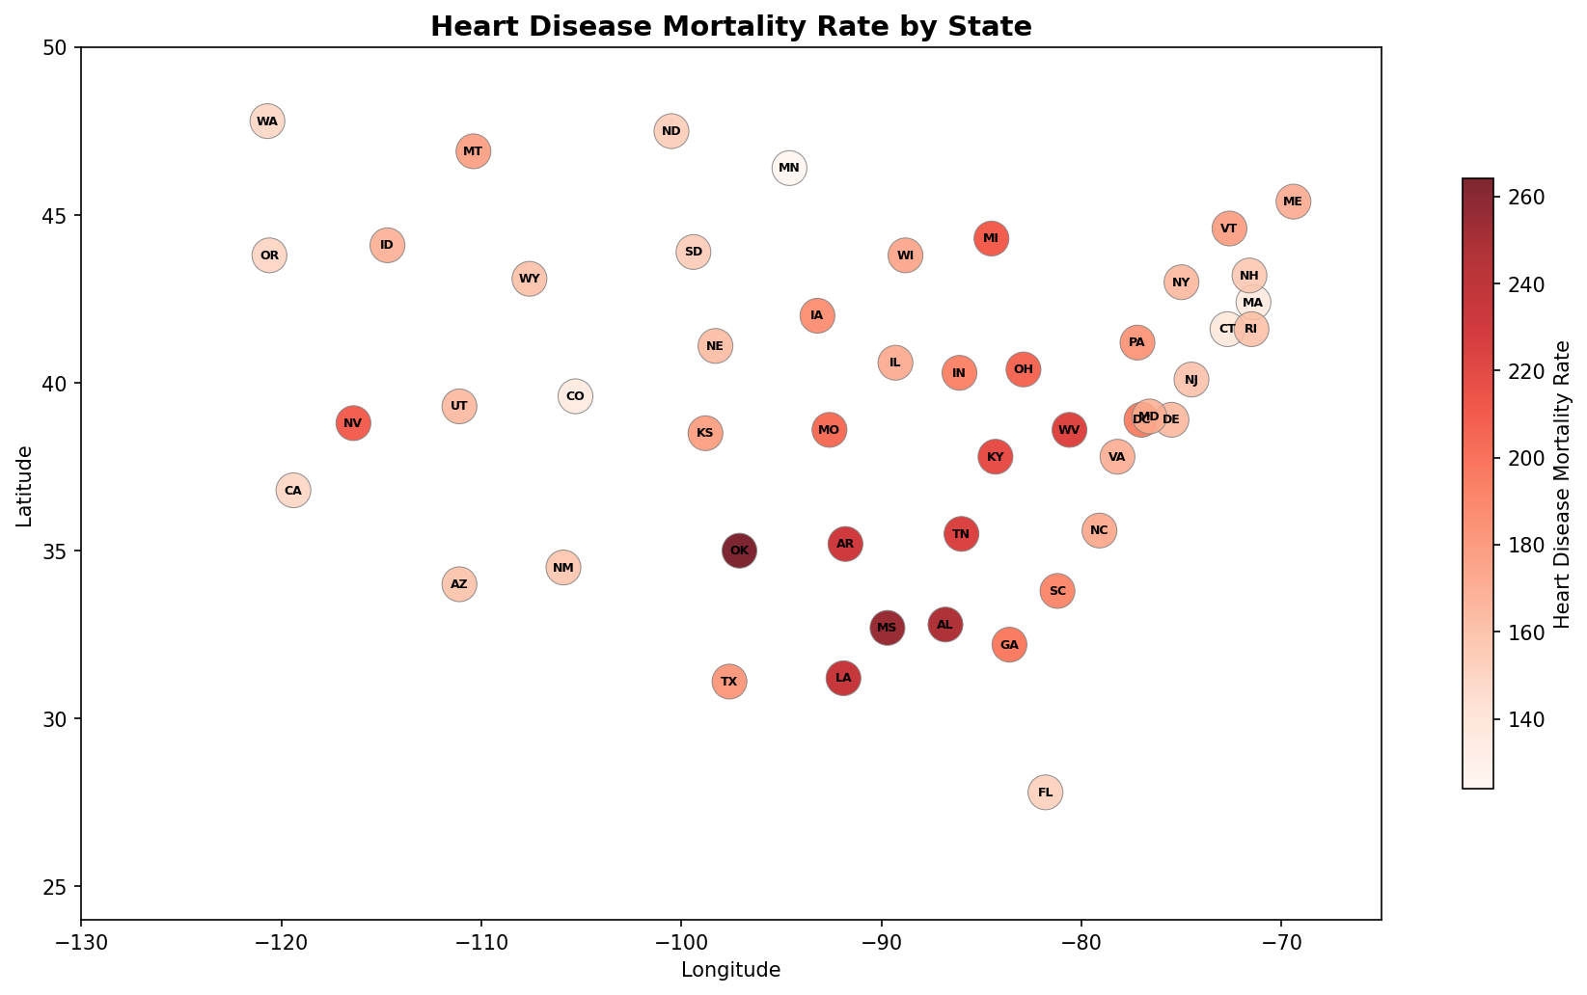
Can We Predict Where Chronic Disease Hits Hardest?
Which factors best predict state-level disease rates?
CDC Chronic Disease Indicators: 50 states + DC, 27 health metrics each
Federal government's official chronic disease tracking system
Goal: target public health interventions where they'll have the most impact
Notes:
SPEAKER: Jonathan Chamberlin (45 seconds)
We pulled our data from the CDC's U.S. Chronic Disease Indicators database. It's the federal government's official chronic disease tracking system.
[POINT TO MAP] This map shows heart disease mortality by state. The Southeast has the highest rates. The question is: what's driving that pattern? Is it smoking? Obesity? Or something else? Anuhya will explain our approach.

Slide 3
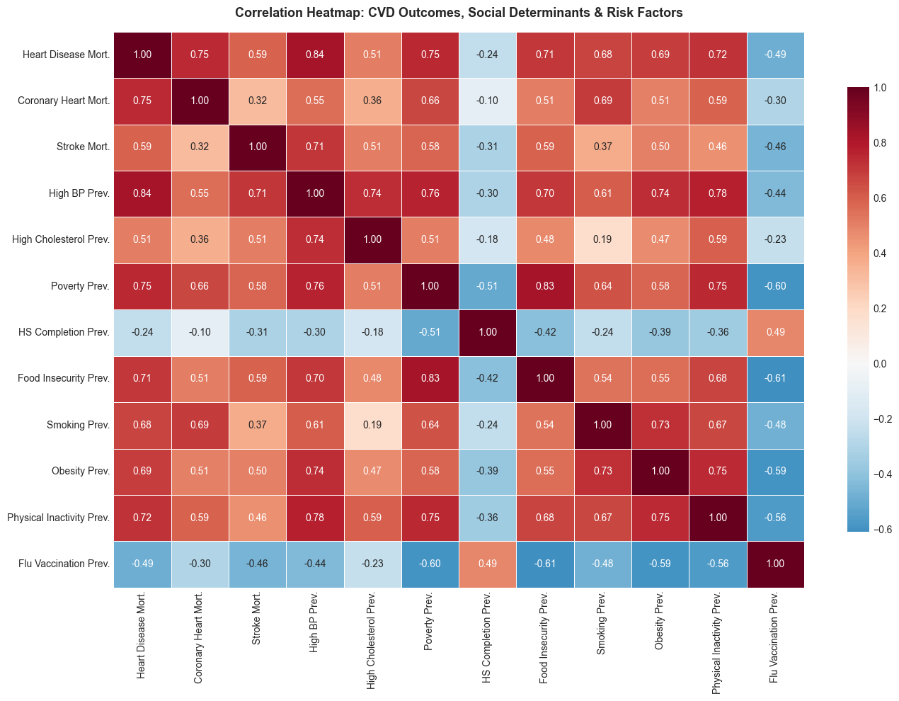
How We Analyzed the Data
Each team member analyzed a different disease pair
Correlation analysis: which factors move together across states?
Two prediction models: one for direct relationships, one for complex patterns
Validated by predicting each state using only the other 50
Notes:
SPEAKER: Anuhya Mandava (45 seconds)
We divided the work by disease. Jonathan took cardiovascular disease. Min Yu handled diabetes and obesity. I covered mental health and alcoholism. Tsion analyzed cancer and COPD.
[POINT TO HEATMAP] This heatmap shows how all our variables relate. Dark red means a strong positive correlation. You can see poverty, obesity, and physical inactivity all cluster together with heart disease mortality.
We built two types of prediction models: one for simple direct relationships, one for more complex patterns. Both gave similar results. Tsion will share what we found.

Slide 4
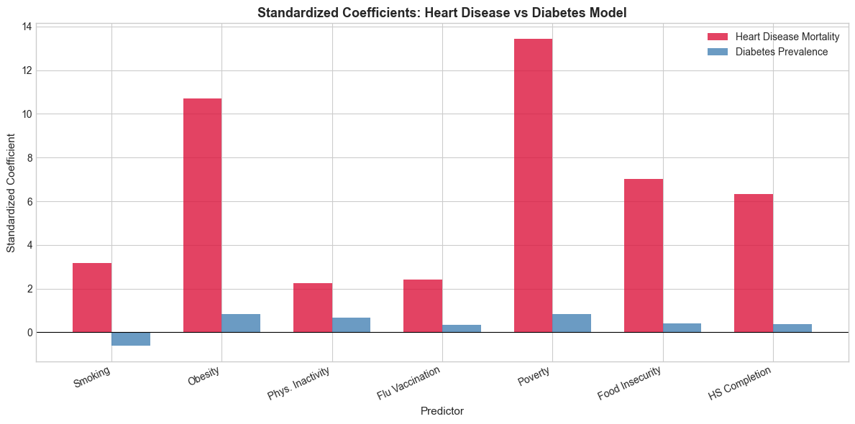
Poverty Predicts Heart Disease More Than Smoking
Best model explains 65% of state-level variation in heart disease mortality
Poverty is the #1 predictor: its effect is nearly 4x larger than smoking's
States above median poverty: significantly higher heart disease mortality (p < 0.0001)
Diabetes tells a different story: obesity, not poverty, is the top driver
Notes:
SPEAKER: Tsion Teklaeb (60 seconds)
Here's our most important finding. Poverty is the strongest predictor of heart disease mortality across states. [PAUSE] It's not close.
[POINT TO CHART] The red bars show each predictor's relative strength. Poverty's effect is nearly four times larger than smoking's. Public health campaigns focus on individual behavior — quit smoking, eat better. But our data suggests the economic environment matters more at the state level.
Diabetes tells a different story. The blue bars show obesity is the dominant driver, not poverty. Different diseases, different drivers. Min Yu will wrap us up.

Slide 5
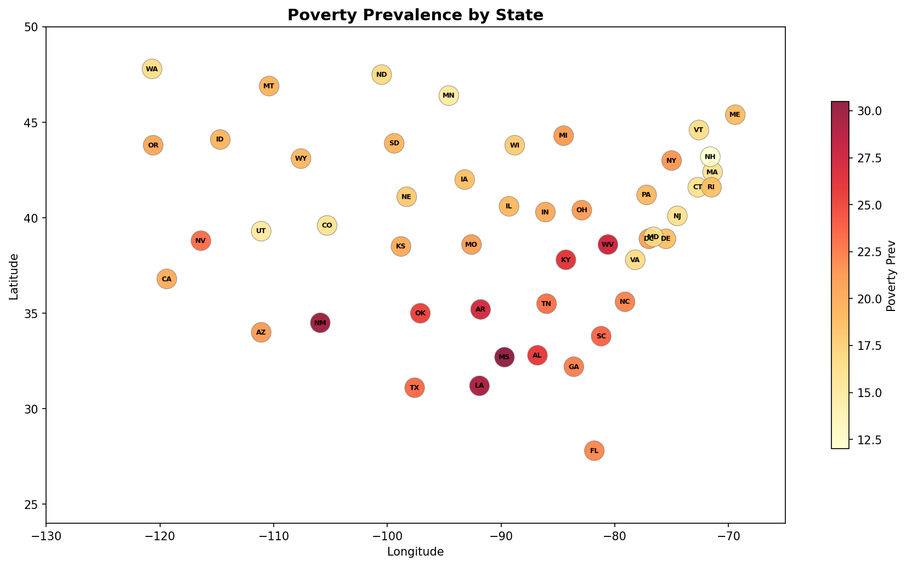
Conclusions
Economic factors predict chronic disease as strongly as lifestyle factors
Southeast clustering of heart disease + poverty: these factors reinforce each other
Public health strategies that only target individual behavior miss the larger picture
Limitation: state-level data (n=51) cannot tell us about individuals
Notes:
SPEAKER: Min Yu Huang (45 seconds)
The biggest takeaway: where you live matters. States with high poverty consistently have high heart disease mortality.
[GESTURE TO MAP] Compare this poverty map to the heart disease map from earlier — the overlap is striking. That pattern held up in our models too.
For public health policy, economic interventions could reduce chronic disease as much as traditional health campaigns. One caveat: our data is at the state level, so we can't say poverty causes heart disease in individuals. We can say states with more poverty have more heart disease, and that relationship is strong and consistent.

