Slide 1
Data Scientist task
Jonathan Dickins

Slide 2
Summary
Preprocessing
Standardising columns, missing values, removing duplicates
Drivers of profit
Generalised linear model demonstrated that TotalPremium and NOB (Property group) significantly influence profit
Predicting sales
Logistic regression model and random forest model compared for predicting the binary variable Sold
Random forest model performed significantly better with higher accuracy and F1 score.
Segmenting customer groups
Seven customer groups identified with Kmeans clustering

Slide 3
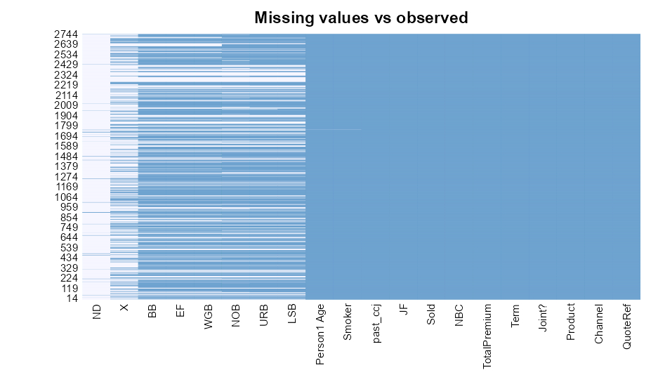
Preprocessing
Standardising columns
Standardising NA/NULL/Other missing values
Transforming columns to correct data type
Removing duplicates
Possible outliers / errors
House price band 99
-999997 values

Slide 4
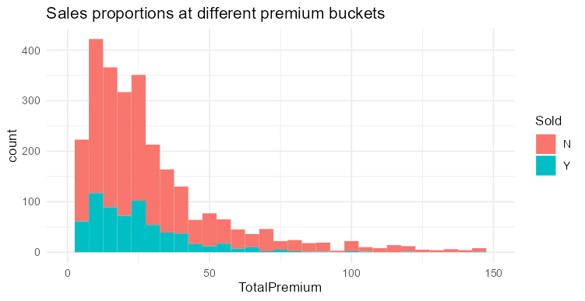
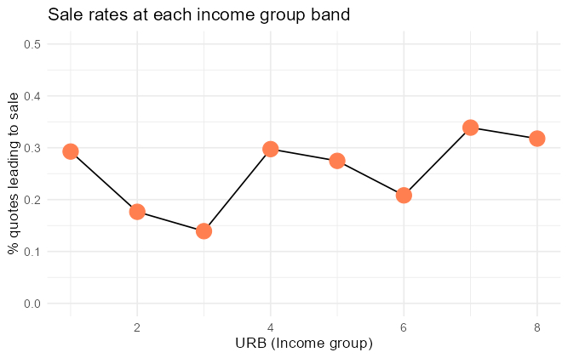
Observations
There don’t appear to be simple relationships between smoker status, age, and cost of premium
Different channels and different products all have similar sale rates
Sale rates are similar at different premium price points
Sale rates broadly increase at higher income group bands

Slide 5
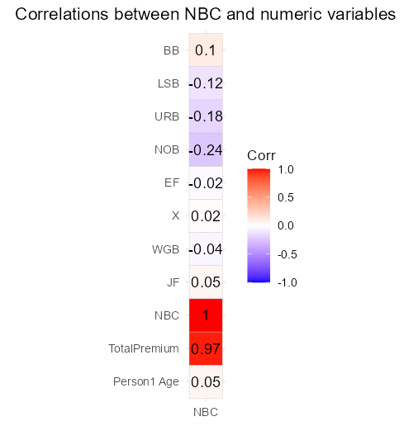
Drivers of profit
What are the main drivers of profit and why?
Things to consider
Interactions between variables
Interpretability important
Selecting features
Correlation matrix for numeric data.
TotalPremium strongly positively correlated with NBC
NOB (Property group), URB (Income group) and LSB (Regional banded house price band) have weak negative correlations with NBC
ANOVA for categorical data
Derived field past_ccj was the only significant term

Slide 6
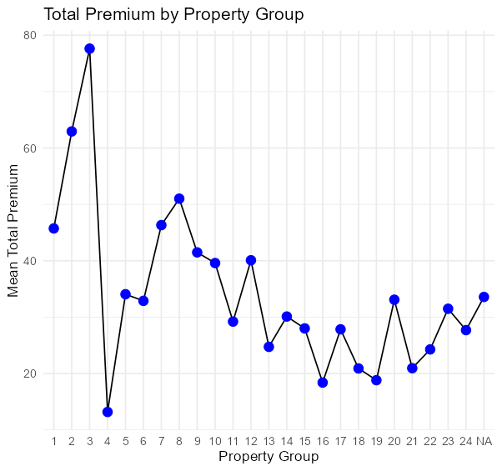
Drivers of profit - GLM
Term | Estimate | t | p
Intercept | -139.38
TotalPremium | 28.95 | 93.61 | <.001
NOB | 5.98 | 4.51 | <.001
TotalPremium*NOB | -0.22 | -8.01 | <.001
TotalPremium and Property group are significant drivers of profit
The influence of Property group is strongest at the lower bands

Slide 7
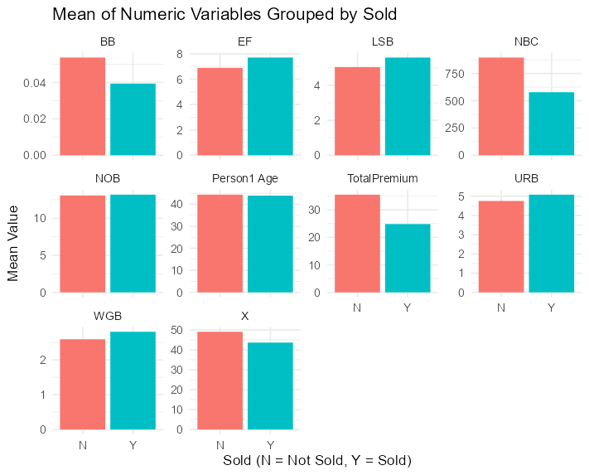
Predicting sales
Can you build a model to predict the probability of sale?
Things to consider
Case imbalance
Missing data
Maximising accuracy
Method
Select variables that differ by sold status
TotalPremium
EF – No. of people not same surname at current address
LSB – Regional banded house price band
URB – Income group
Experiment with different classification methods and compare evaluation metrics

Slide 8
Predicting sales
Logistic regression model
Random forest model
Sold ~ TotalPremium + EF + LSB + URB
Simpler to interpret, but assumes linear relationships
Sold ~ TotalPremium + EF + LSB + URB
Harder to interpret, but handles non-linearity and class imbalance well
Trained on 80/20 split
Accuracy: 0.68
Recall: 0.83
Precision: 0.75
F1 Score: 0.79
Accuracy: 0.89
Recall: 0.94
Precision: 0.91
F1 Score: 0.93

Slide 9
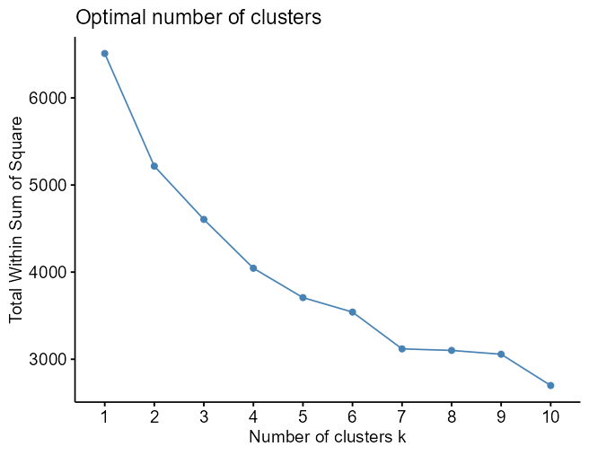
Segmenting customer groups
Can you segment this dataset into specific customer groups?
Things to consider
Missing data
Determining k
Feature selection
Kmeans clustering
Elbow method and NBClust ensemble method both identified seven clusters as optimal.
Used all numeric fields related to customer excluding CCJ data (931 observations)
Principal components analysis for plotting clusters

Slide 10
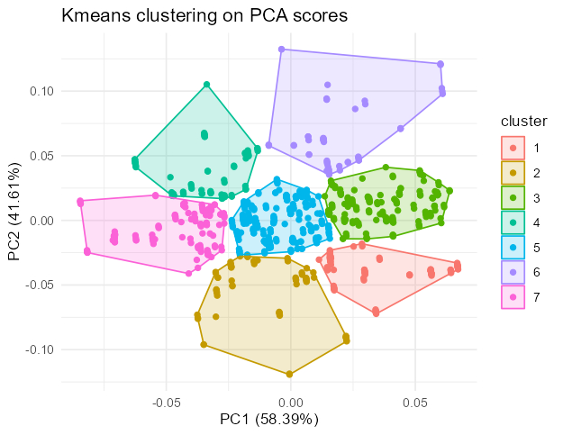
Segmenting customer groups
Cluster (n) | Features
1 (217) | Oldest cluster
2 (152) | Youngest cluster Second lowest income group
3 (152) | Lowest property value group Lowest income group
4 (78) | Longest time at current address Lowest number of other addresses
5 (94) | Highest number of other addresses Shortest time at current address
6 (45) | Lower property value
7 (193) | Highest property value group Joint-highest income group

Slide 11
Considerations for data pipeline
How would you build an automated pipeline to ensure data quality as, over time, new customers request new quotations and purchase life insurance products from the insurer?
Host raw data on cloud service or data warehouse, transform and preprocess into structured database
Check incoming data for outliers, errors, missing values
Ensure no duplication of quotes
Apply transformations if needed
Access to database via cloud service
Ensure data propagates to and from other systems
Monitor whether quoted product has been cancelled
Link quotes to claims

Slide 12
Improvements
Drivers of profit
More comprehensive feature selection and model comparisons
Predicting sales
Test a broader range of hyperparameters using grid search
Segmenting customer groups
Method to incorporate categorical variables
General
Validate on larger dataset
Monitor trends over time

