Slide 1
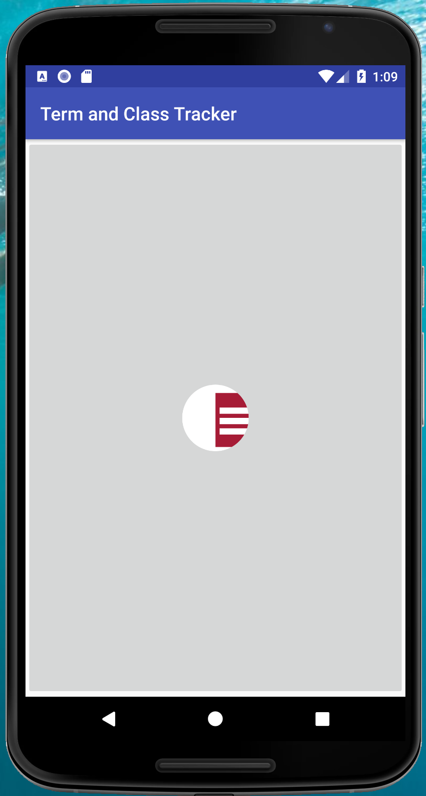
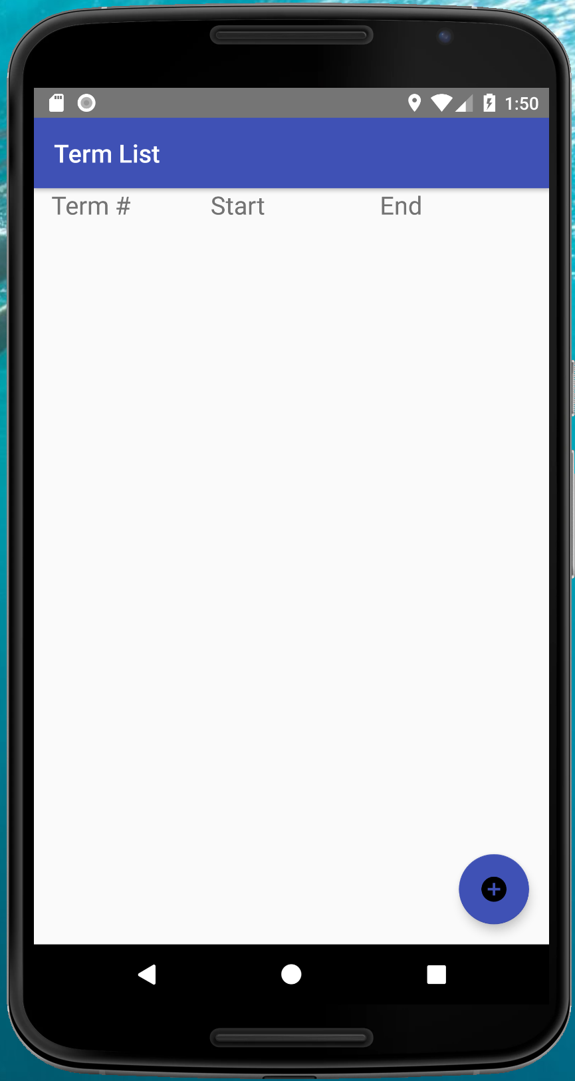
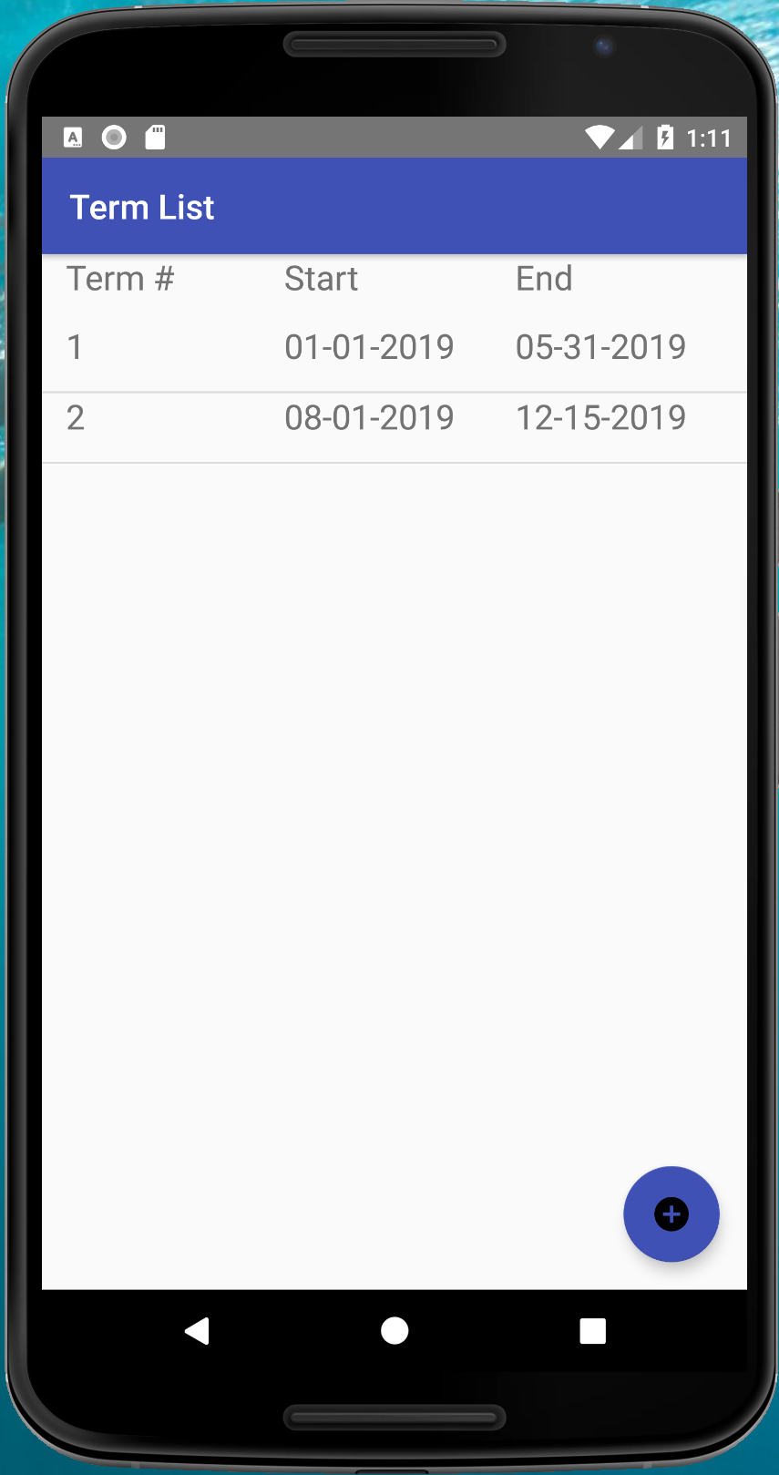
Click for
Term Detail
Home Screen
Click to
Open
Term List
Term List (empty)
Term List
Add Term

Slide 2
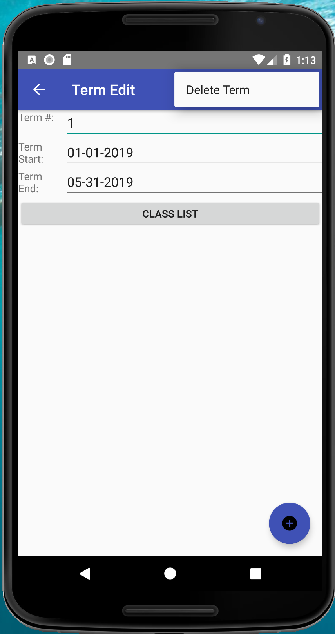
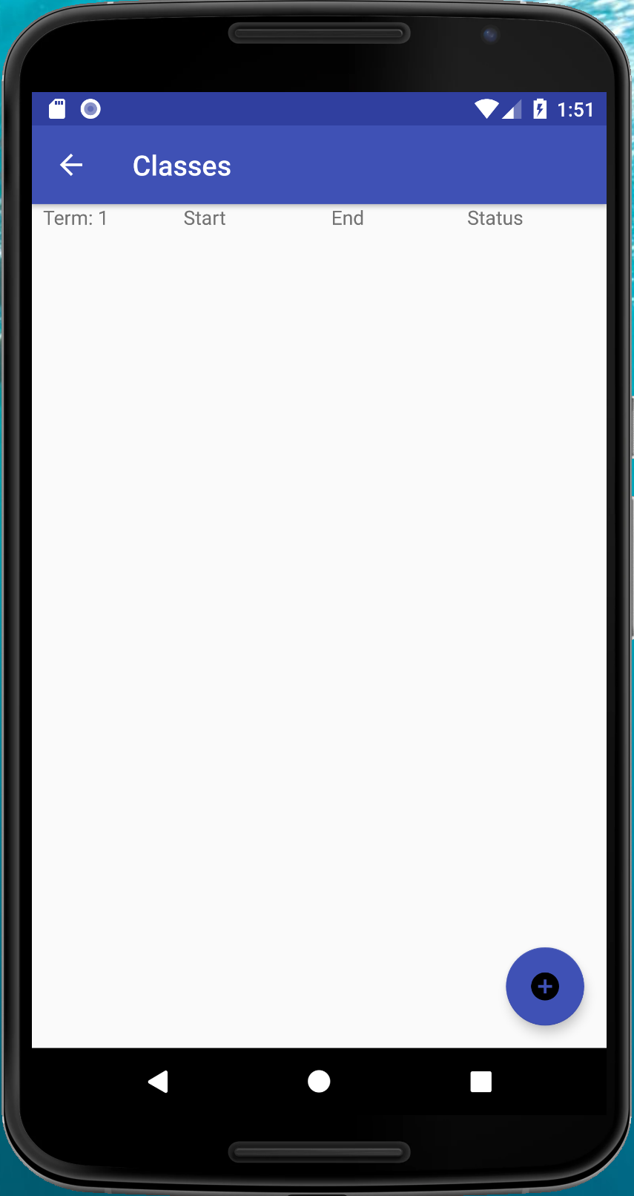
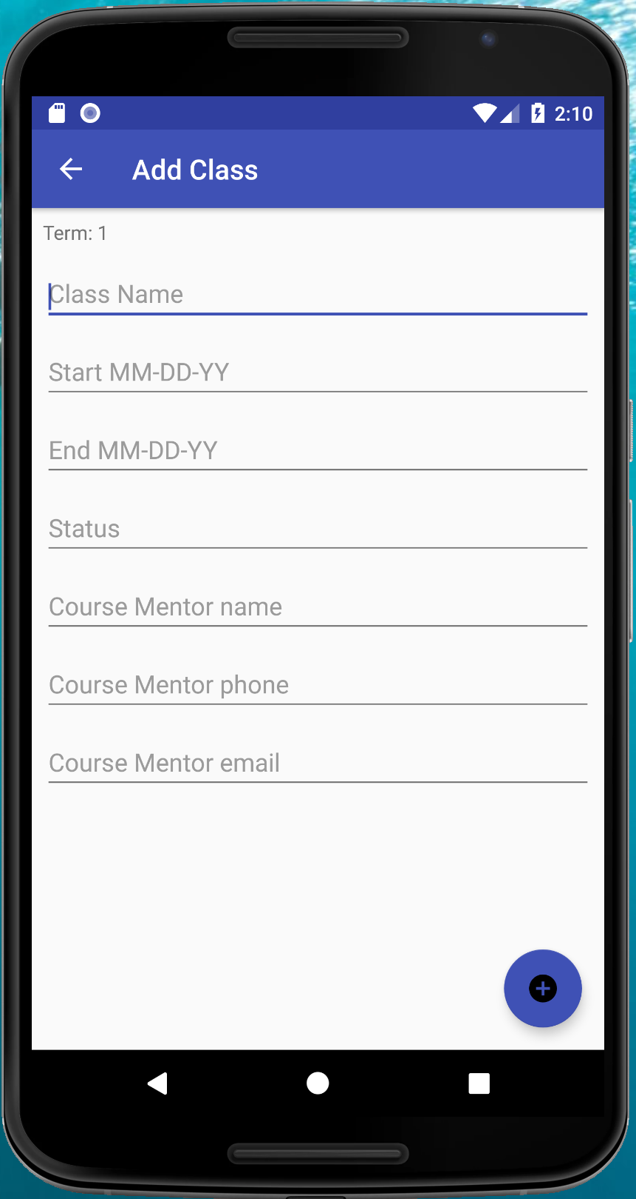
Delete
Term
Edit Term
Details
Click for
Class List
Update
Term Info
Add
Class
Term Detail
Class List (empty)
Click to open
Add Class
Add Class

Slide 3
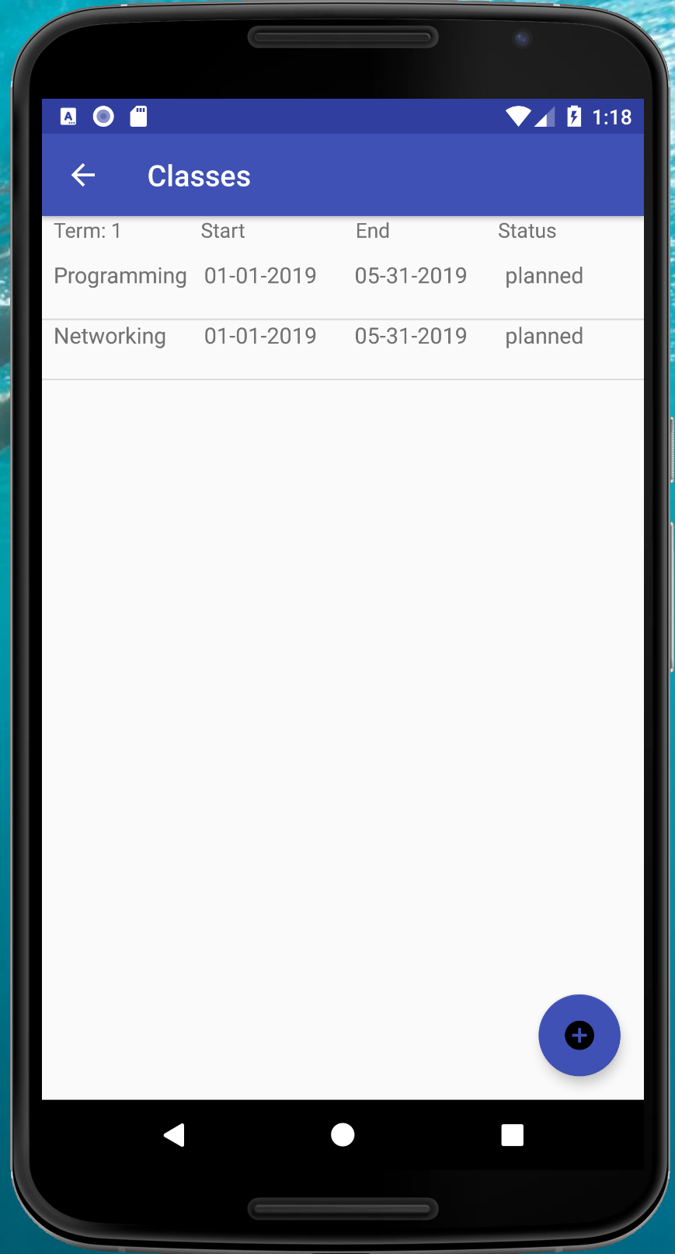
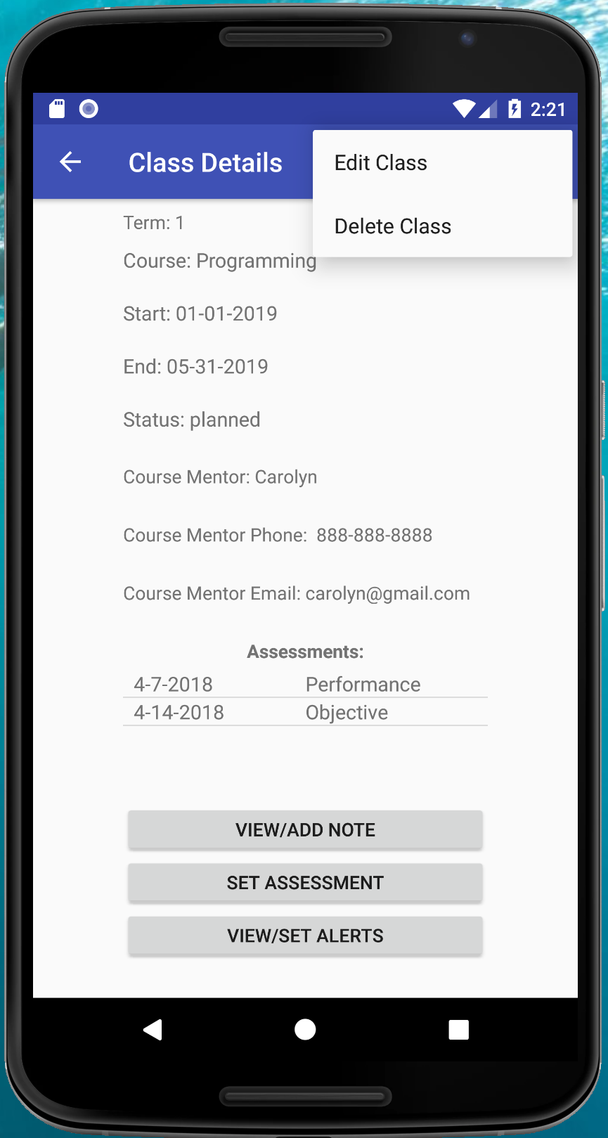
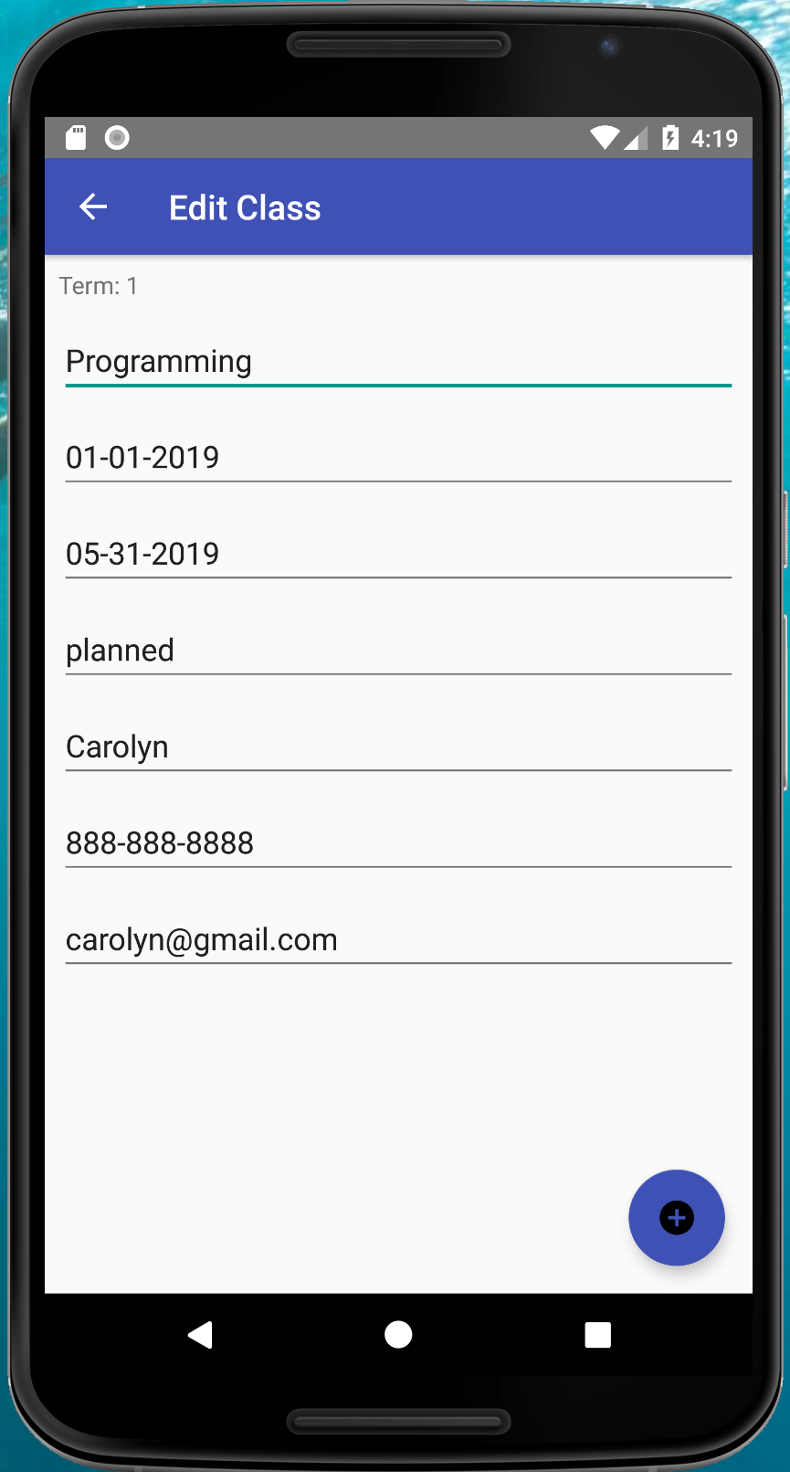
Edit (1) and
Delete
Click to open
Class Detail
Assessment
List, click for
Detail/Edit (2)
Click for
Note List (3)
Update
Class Info
Class List
Class Detail
Click for
Add Assessment (4)
Class Edit (1)
Click for
Alert List (5)

Slide 4
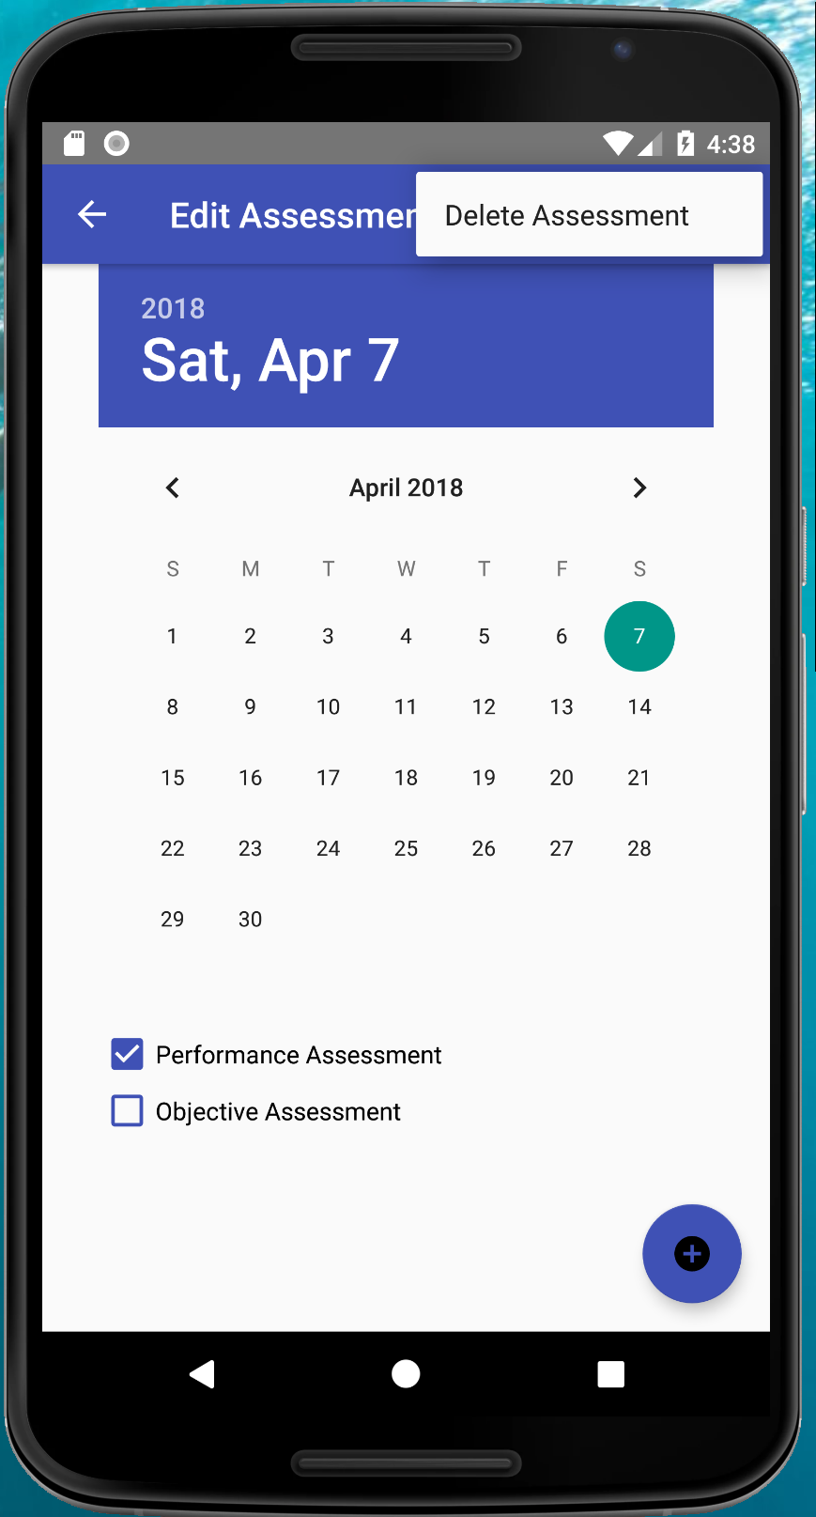
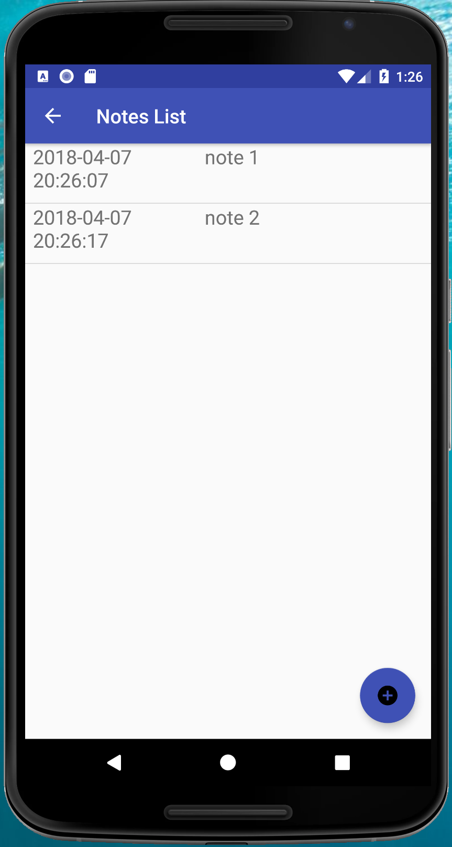
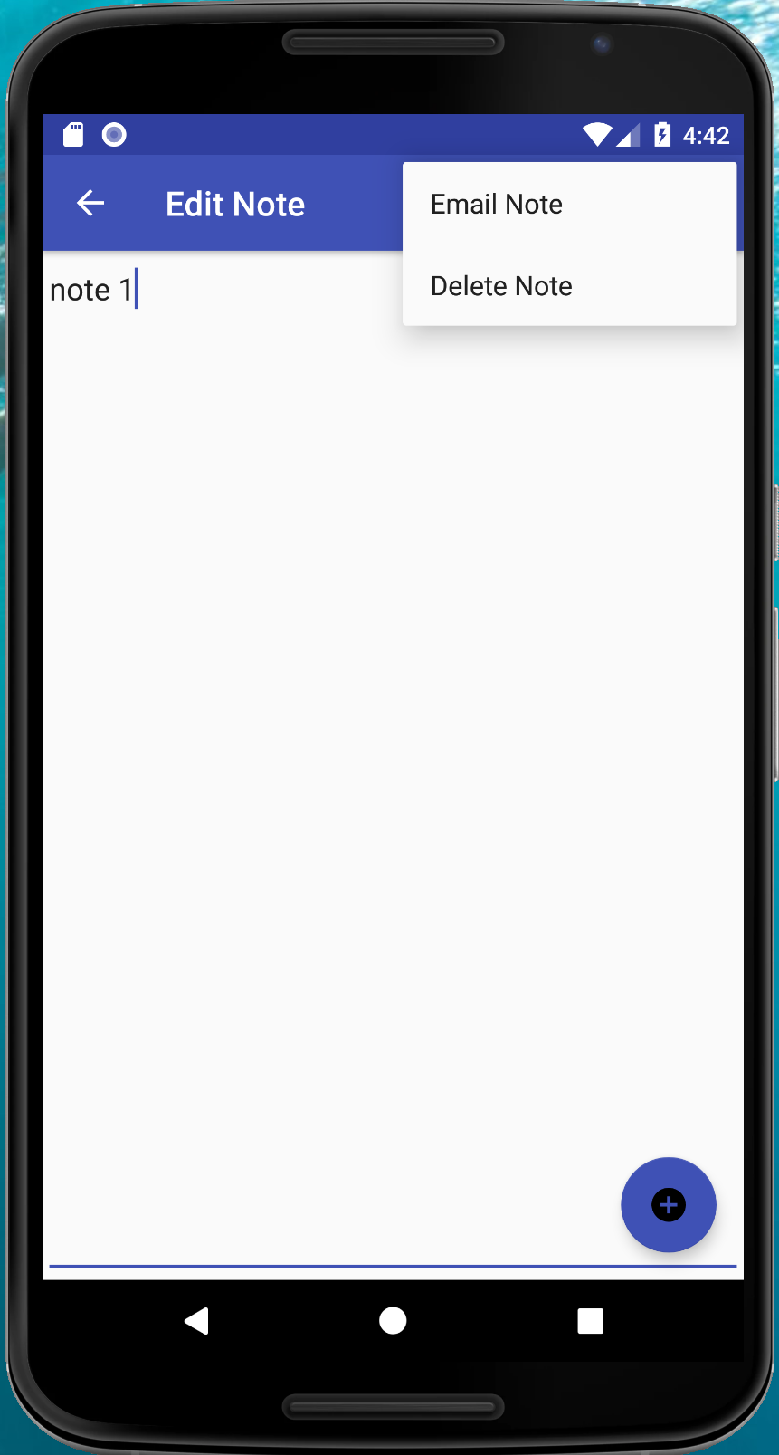
Delete
Assessment
Email,
Delete
Note
Click for
Note Detail
Edit & Delete
Update
Assessment
Add
Note
Update
Note
Assessment Edit (2)
Note List (3)
Note Detail

Slide 5
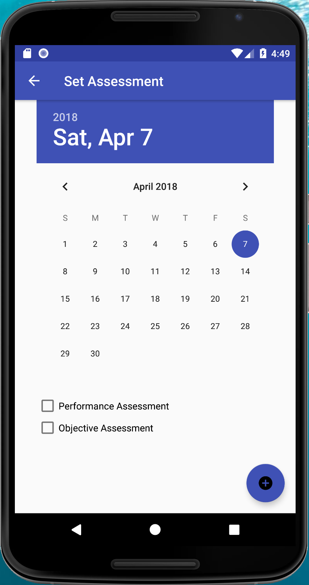
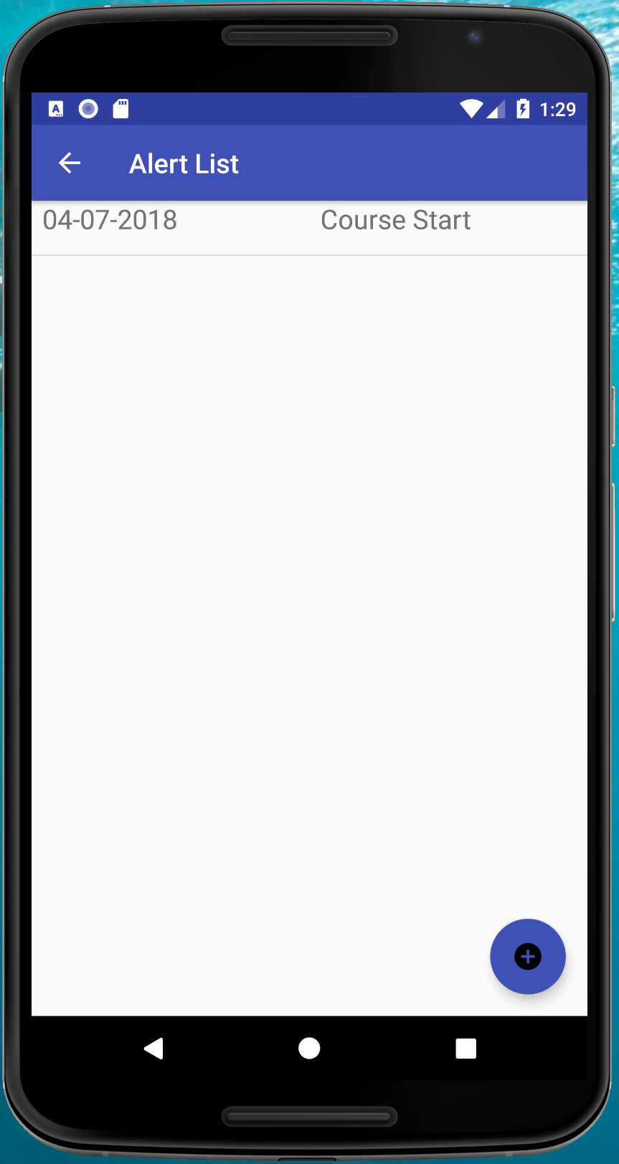
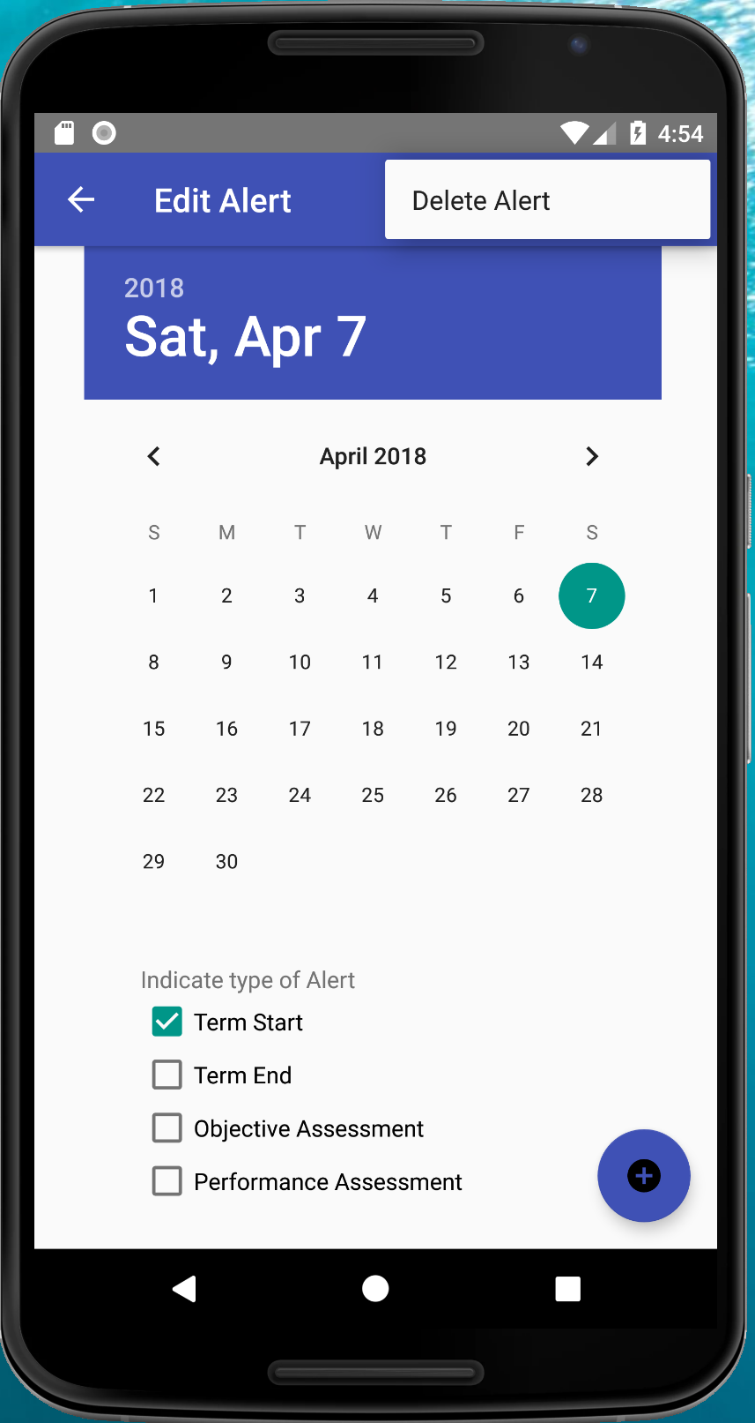
Delete
Alert
Click to
Edit
Alert
Add
Assessment
Add
Alert
Update
Alert
Assessment Add (4)
Alert List (5)
Alert Edit

