Slide 1
.NET 8 MVC to Blazor
Prepared By Jonathan Renatius
Notes:
Get to know everyone

Slide 2
Agenda
Introductions + Setup
What’s New in .NET 8
What is Blazor
MVC or Blazor
Blazor Server and WebAssembly
Coding in Blazor
Mini Lab
Review and Discussions

Slide 3
Learning Objectives
Concept of Modern Web Applications
Difference between MVC and Blazor Server and Blazor WASM
How to Develop in .NET 8 Blazor

Slide 4
Prerequisites
Visual Studio 2022 with .NET 8 Runtime Installed
Experience with .NET 4.8 MVC
Knowledge of C#, HTML, CSS, Javascript

Slide 5
GitHub Repo
https://github.com/jonathan-kairos/mvc-to-blazor

Slide 6
What’s New?

Slide 7
.nET 4.8 to .NET 8
Cross-platform
Dependency Injection Support
Project and App Configuration
C#12
Performance

Slide 8
What is Blazor?

Slide 9
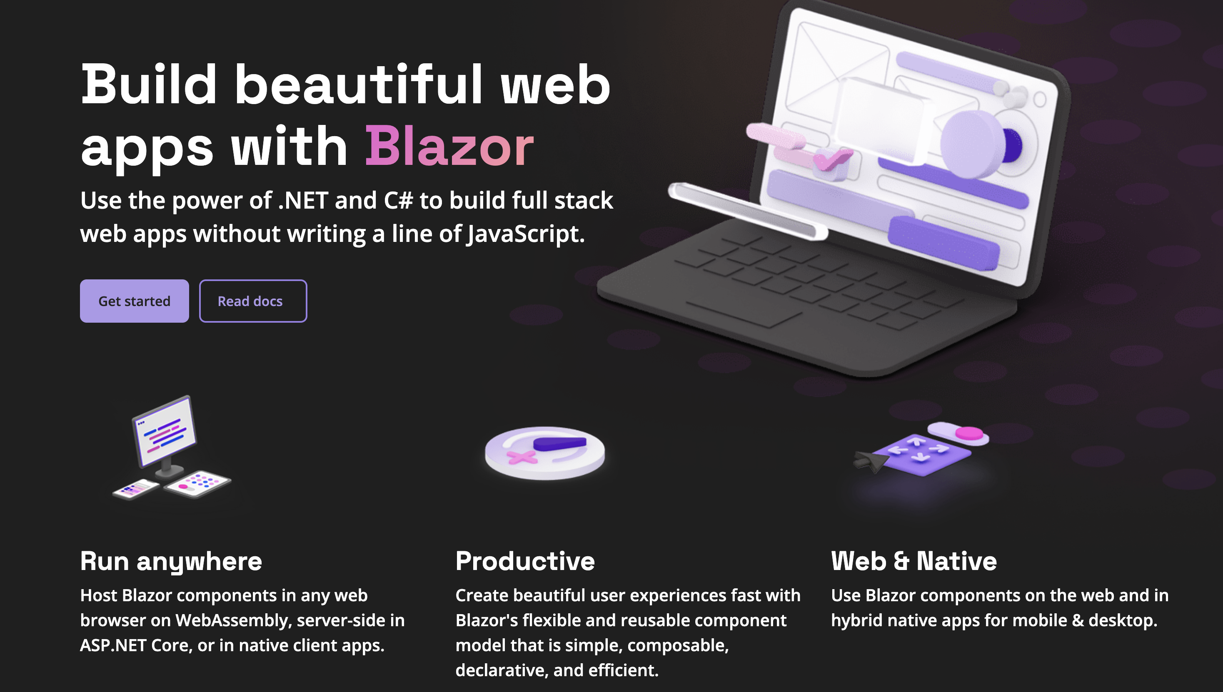

Slide 10
Blazor is an SPA Framework in .NET for Building Interactive Apps Using C#
Notes:
Anyone use React, Vue, or Angular?

Slide 11
Traditional Web

Slide 12
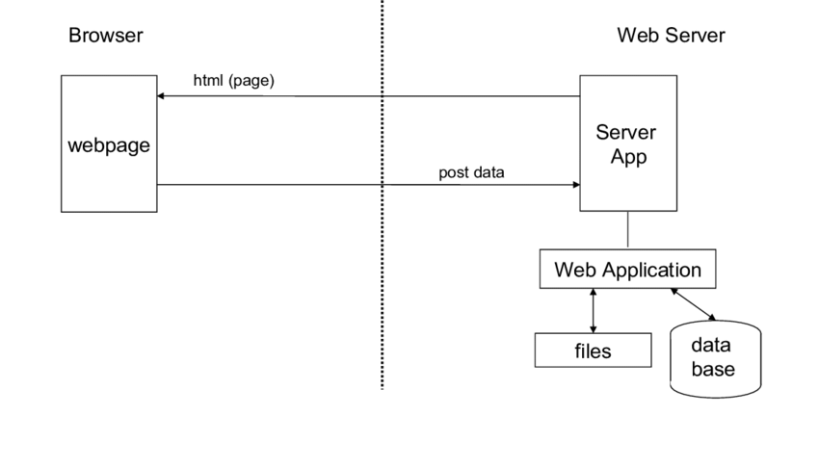
https://www.researchgate.net/profile/Jan-Martin-Jansen/publication/230607097/figure/fig1/AS:669384917938180@1536605209359/The-traditional-architecture-of-an-Internet-Application.png
Notes:
Look at MVC app

Slide 13
MVC or Blazor?

Slide 14
Why MVC?
Mature
Flexible: Control over HTML, CSS, Javascript
Integrations: With Libraries and Platforms
Notes:
Look at MVC app again

Slide 15
Why Blazor?
Unified Backend and Frontend
Component-based: Modular and Reusable
Cross-platform
Notes:
Look at how Blazor app compares

Slide 16
Blazor Server and WebAssembly

Slide 17
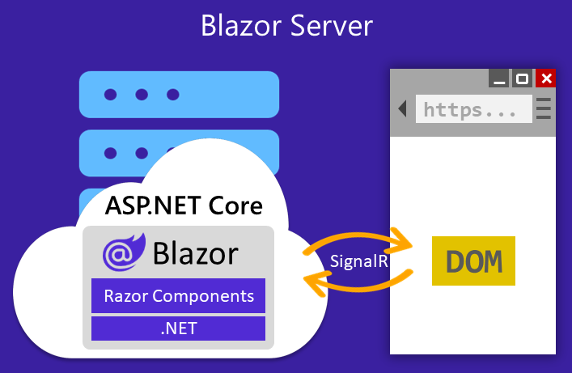
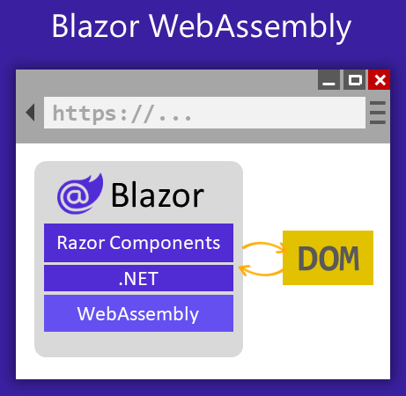
https://learn.microsoft.com/en-us/aspnet/core/blazor/?view=aspnetcore-8.0
Notes:
**Blazor Server:** Executes the application on the server and uses a real-time WebSocket connection to handle UI events and updates through SignalR. It sends UI events from the browser to the server and applies UI updates sent back from the server in real-time.
**Blazor WebAssembly:** Runs the application directly in the browser using a WebAssembly-based .NET runtime. The entire application, along with its dependencies, runs on the client.
Show the applications in real-time

Slide 18
Hands On

Slide 19
Task 1: Create a New Component
Objective: Learn how to create and use a Razor component.
Create a new Razor component named Counter. This component should include a button that, when clicked, increments a counter.
Notes:
@page "/counter"
@rendermode InteractiveServer
<PageTitle>Counter</PageTitle>
<h1>Counter</h1>
<p role="status">Current count: @currentCount</p>
<button class="btn btn-primary" @onclick="IncrementCount">Click me</button>
@code {
private int currentCount = 0;
private void IncrementCount()
{
currentCount++;
}
}

Slide 20
Task 2: Component Parameters
Objective: Understand how to pass parameters to components.
Task: Modify the Counter component to accept a parameter that sets the initial count value.
Notes:
@page "/counter"
@rendermode InteractiveServer
<PageTitle>Counter</PageTitle>
<h1>Counter</h1>
<p role="status">Current count: @currentCount</p>
<button class="btn btn-primary" @onclick="IncrementCount">Click me</button>
@code {
private int currentCount;
[Parameter]
public int InitialCount { get; set; } = 0; // Default to 0 if not specified
protected override void OnInitialized()
{
currentCount = InitialCount; // Set the initial count when the component initializes
}
private void IncrementCount()
{
currentCount++;
}
}

Slide 21
Task 3: Event Handling
Objective: Learn how to handle events in Blazor.
Task: Extend the Counter component to include an event that triggers when the count is incremented and sends the updated count back to the parent component.
Notes:
<Counter OnCountUpdated="HandleCountUpdated" />
@code {
private void HandleCountUpdated(int newCount)
{
// Logic to handle the updated count
Console.WriteLine($"The count was updated to: {newCount}");
}
}
@page "/counter"
@rendermode InteractiveWebAssembly
<PageTitle>Counter</PageTitle>
<h1>Counter</h1>
<p role="status">Current count: @currentCount</p>
<button class="btn btn-primary" @onclick="IncrementCount">Click me</button>
@code {
private int currentCount = 0;
[Parameter]
public EventCallback<int> OnCountUpdated { get; set; }
private async Task IncrementCount()
{
currentCount++;
await OnCountUpdated.InvokeAsync(currentCount);
}
}

Slide 22
Task 4: Data Binding
Objective: Gain familiarity with data binding techniques in Blazor.
Task: Add an input field that allows users to set the initial count value when the button is clicked
Notes:
@page "/counter"
@rendermode InteractiveServer
<PageTitle>Counter</PageTitle>
<h1>Counter</h1>
<p role="status">Current count: @currentCount</p>
<label for="initialCount">Initial Count:</label>
<input type="number" id="initialCount" @bind="initialCount" />
<button class="btn btn-primary" @onclick="IncrementCount">Click me</button>
@code {
private int currentCount;
private int initialCount = 0;
protected override void OnInitialized()
{
currentCount = initialCount; // Initialize the currentCount with the initialCount value
}
private void IncrementCount()
{
currentCount++;
}
}

Slide 23
Task 5: Lifecycle Methods
Objective: Understand the component lifecycle in Blazor.
Task: Use the OnParametersSet method to update the currentCount whenever the InitialCount parameter changes
Notes:
@page "/counter"
@rendermode InteractiveServer
<PageTitle>Counter</PageTitle>
<h1>Counter</h1>
<p role="status">Current count: @currentCount</p>
<label for="initialCount">Initial Count:</label>
<input type="number" id="initialCount" @bind="initialCount" />
<button class="btn btn-primary" @onclick="IncrementCount">Click me</button>
@code {
private int currentCount;
private int initialCount = 0;
protected override void OnParametersSet()
{
// Update the currentCount whenever the InitialCount parameter changes
currentCount = initialCount;
}
private void IncrementCount()
{
currentCount++;
}
}

Slide 24
Task 6: Dependency Injection
Objective: Learn about using services in Blazor components.
Task: Use the CounterService class to get and set the count in Counter component
Notes:
@page "/counter"
@rendermode InteractiveServer
@inject CounterService counterService
<PageTitle>Counter</PageTitle>
<h1>Counter</h1>
<p role="status">Current count: @currentCount</p>
<label for="initialCount">Initial Count:</label>
<input type="number" id="initialCount" @bind="initialCount" />
<button class="btn btn-primary" @onclick="IncrementCount">Click me</button>
@code {
private int currentCount;
private int initialCount = 0;
protected override void OnInitialized()
{
// Initialize the currentCount with the count from the injected CounterService
currentCount = counterService.GetCount();
}
private void IncrementCount()
{
currentCount++;
counterService.SetCount(currentCount); // Update the count in the CounterService
}
}

Slide 25
MudBlazor

Slide 26
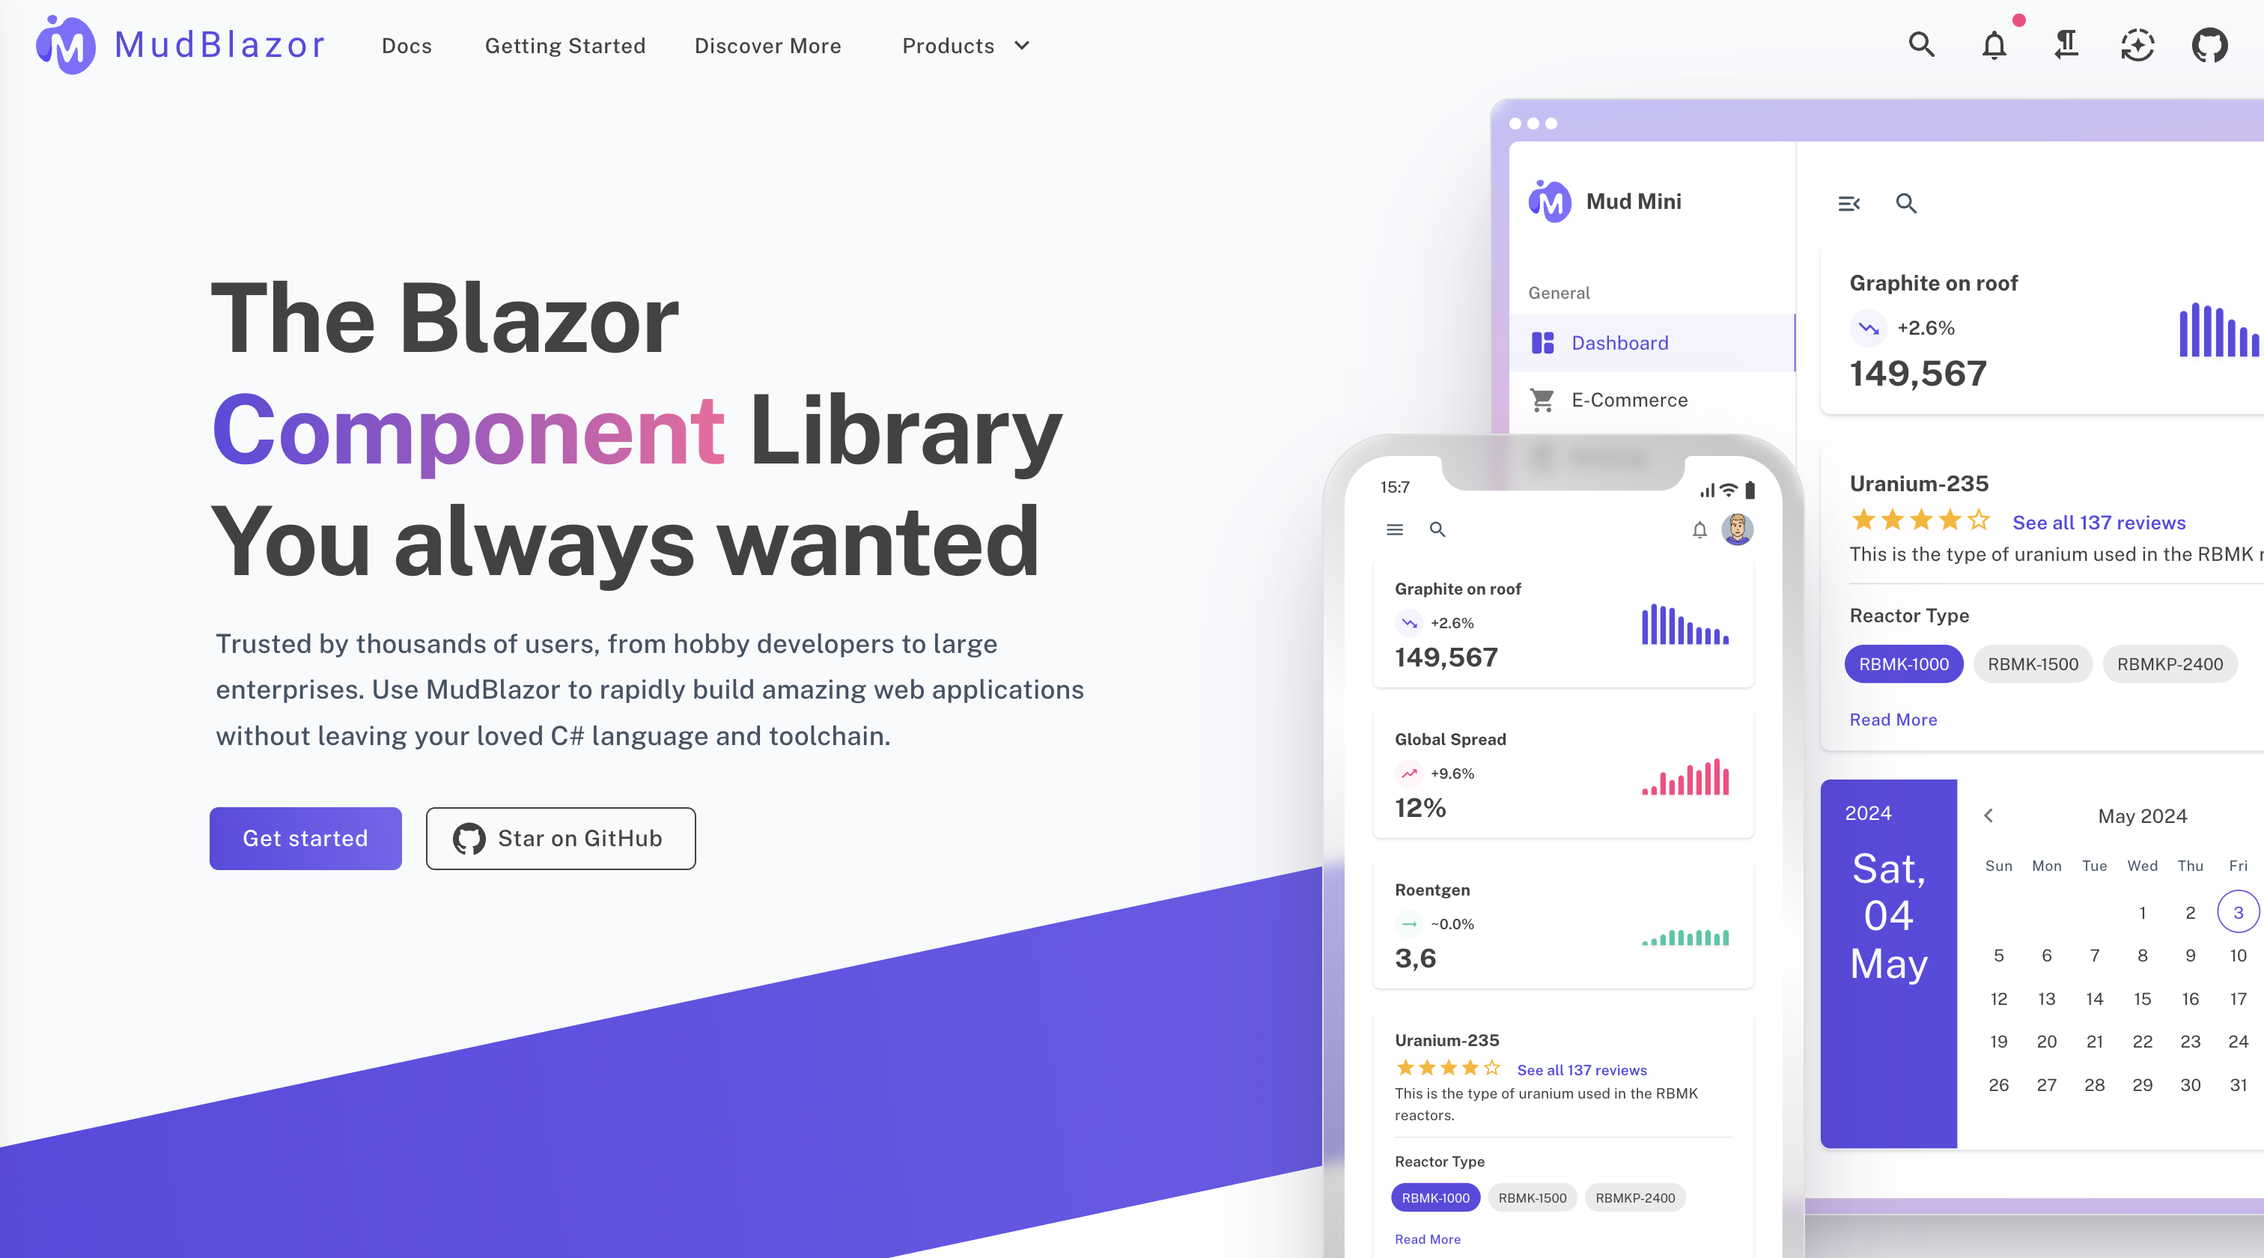
https://mudblazor.com/

Slide 27
Inventory Tracker APP
Notes:
Delete page
routing
api call

Slide 28
Mini Lab

Slide 29

Mini Lab Tasks
Create a button called Check Stock. If the item quantity is 10 or less, highlight the record red
Implement a Create Inventory Item page
Implement data validation for the Create based on the InventoryItem model
Implement the Inventory History page using MudBlazor

Slide 30
Thank You

