Slide 1
LUXDEVHQ DATA SCIENCE AND ANALYTICS CAPSTONE
Customer and Sales Intelligence for a Kenyan Retailer
Evidence for stock, promotion and retention decisions at Duka Bora Supermarkets
Jonathan Kiplagat
Final defence | Data: 2024–2025, 6 stores, KES
Notes:
Good morning. My capstone answers four management questions for Duka Bora, a six-store Kenyan supermarket chain, using two years of sales data. The data is synthetic by design, which I will explain, and the only real external data is the Kenyan public-holiday calendar. I'll take about 15 minutes, then questions.

Slide 2
Duka Bora records every sale but decides on intuition
1
What drives revenue and profit?
2
Who buys, where and when?
Products, categories, prices and promotions
Customers, stores, seasons and the daily rhythm
3
Which customers are drifting away?
4
What demand should we expect?
Valuable customers who have gone quiet
Next month's revenue, with a realistic range
Duka Bora capstone | 2
Notes:
Management records every sale but makes stock, promotion and retention decisions on intuition. They asked four questions, and every milestone of the project feeds at least one of them. Success meant answering each with evidence, checked in more than one tool.

Slide 3
The answers at a glance
KES 2.18M
−4.7%
249
KES 75–85K
Revenue at a 24.7% margin. Clothing earns 46% of profit
Units sold in 2025, while revenue grew 8.8%: growth is price-led
Established customers silent for over 180 days (KES 542K lifetime spend)
Planning figure for January 2026 (model level KES 99K)
Top three actions: protect clothing margins, cap promotion discounts below category margin, and run a measured win-back campaign for the 249 at-risk customers.
Duka Bora capstone | 3
Notes:
Here are the four answers up front. Revenue is 2.18 million shillings at a 24.7% margin, but growth was price-led: units fell. 249 established customers have gone quiet. And January should be planned at 75 to 85 thousand, below the model's underlying level, because January is reliably weak. The rest of the talk shows the evidence.

Slide 4
Eight milestones, one reproducible pipeline
1
2
3
4
5
6
7
8
Frame
Generate
Clean
Explore
SQL
Test
Model
Dashboard
M1
M1
M2 pandas
M3 Seaborn
M4 PostgreSQL
M5 SciPy
M6 scikit-learn
M7 Power BI
3,000
2,650
1,800
40
6
28
raw sales rows
receipts
customers
products, 6 categories
stores
real public holidays
Synthetic by design: shareable without privacy risk, and every pattern has a known cause that the analysis can be checked against.
Duka Bora capstone | 4
Notes:
The work follows CRISP-DM. Synthetic data is generated from documented, seeded rules, then cleaned, explored, loaded into PostgreSQL, tested statistically, modelled and put into Power BI. All logic lives in a src package, the notebooks are executed, and 28 automated tests guard the data, the statistics functions and model leakage.

Slide 5
Cleaning found all 126 injected data-quality issues
126 / 126
Issue | Rows | Decision
Exact duplicates | 12 | Removed
Payment label variants | 30 | Mapped to 4 standard labels
Dates in DD/MM/YYYY | 15 | Parsed with an explicit format
Missing payment method | 10 | 3 recovered from receipt, 7 'Unknown'
Missing customer ID | 25 | 4 recovered, 21 flagged walk-in
Quantity 999 | 4 | Restored from the receipt total
Bulk buys, big electronics | 2 + 356 | Kept: they reconcile
logged issues detected, checked cell by cell against the true data
KES 1.44M
phantom revenue avoided by correcting four quantity-999 errors
Duka Bora capstone | 5
Notes:
During generation I injected 126 realistic issues and logged each one. Cleaning was then audited against that log and against the true data: all 126 were found. The rule was evidence before assumption. The biggest catch: four quantity-999 entry errors would have added 1.44 million shillings of phantom revenue, almost doubling the chain's real revenue. The 28 values with no evidence were labelled, not guessed.

Slide 6
Revenue grew 8.8%, but units fell 4.7%
+8.8%
revenue, 2025 vs 2024
−4.7%
units sold, 2025 vs 2024
Dec ×2
December revenue is about twice January's
Duka Bora capstone | 6
Notes:
The two lines are 2024 and 2025 by month. December is the peak and January the trough in both years. Revenue grew 8.8% and profit 10.7%, but units fell 4.7% and orders grew under 4%. The 4% price review in January 2025 and a richer basket mix explain the gap. If prices stop rising, revenue stalls, so units belong on the management dashboard next to revenue.

Slide 7
Clothing earns 46% of profit on 27% of revenue
Clothing
42% margin. The top 5 profit products are all clothing; school uniforms lead (KES 60.9K profit).
Groceries
25% of revenue, 12% of profit (11.7% margin). Traffic builders.
Promotions
10% off groceries and 20% off electronics left 1–3% margin.
Duka Bora capstone | 7
Notes:
Revenue share against profit share by category. Clothing is the profit engine at a 42% margin, and the top five profit products are all clothing, led by school uniforms. Groceries are the opposite: a quarter of revenue but only 12% of profit, so they build traffic, not profit. Some grocery and electronics promotions discounted more than the margin and kept only 1 to 3%.

Slide 8
A few customers carry the revenue, and many are drifting
61%
of revenue comes from the top 20% of customers
23.4%
of customers ever return for a second order
42% vs 15%
repeat rate, loyalty members vs non-members
Duka Bora capstone | 8
Notes:
The top 20% of customers produce 61% of revenue, yet only 23% of customers ever come back. RFM segmentation, built identically in SQL, Python and Power BI, finds 68 Champions producing 14.7% of revenue. The worrying groups are 'Cannot Lose Them' and 'At Risk': 55 formerly frequent customers who have gone quiet.

Slide 9
Thika is the most efficient store but is shrinking
Store | Revenue (KES) | Margin | Avg order | 2025 growth | Revenue / m²
Nairobi CBD | 525,975 | 24.3% | 818 | +16.9% | 219
Westlands | 433,184 | 26.0% | 899 | +8.7% | 206
Nakuru Town | 335,755 | 25.5% | 905 | −8.6% | 240
Kisumu Town | 317,705 | 22.5% | 892 | +38.2% | 244
Mombasa Town | 309,861 | 25.5% | 677 | +11.5% | 194
Thika | 256,735 | 24.2% | 755 | −14.2% | 285
44%
of revenue from Nairobi CBD and Westlands.
−19%
Thika's change excluding electronics, despite the best revenue per m².
KES 677
Mombasa's average basket, vs 822 chain-wide.
Growth is red when negative and green when positive.
Duka Bora capstone | 9
Notes:
Nairobi CBD and Westlands generate 44% of revenue. Growth figures need care: single electronics sales swing small stores, so I also checked growth without electronics. Kisumu's 38% shrinks to 3.5%, but Thika's decline deepens to minus 19%, even though Thika earns the most per square metre. Mombasa has the smallest baskets.

Slide 10
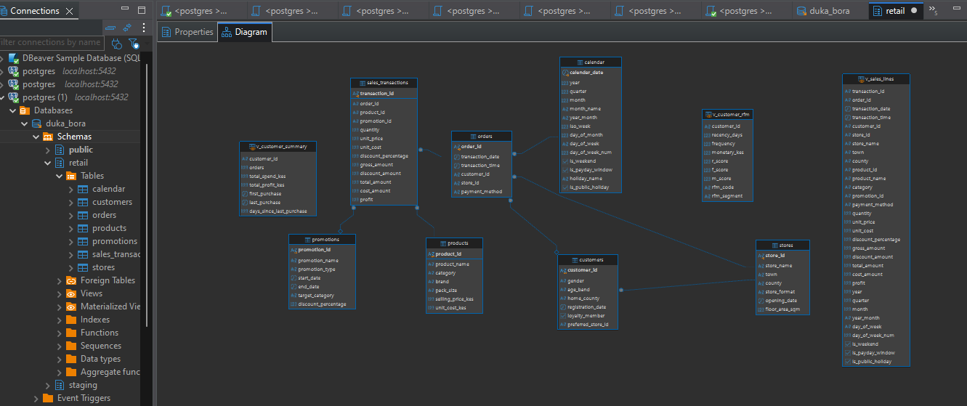
A normalized PostgreSQL database reconciles to the cent
Design
7 tables in 3NF: 2,650 orders, 2,988 lines
Generated money columns
CHECK rules from the cleaning stage
Staging load inside one transaction
DBeaver ER diagram of the retail schema
KES 2,179,214.72
database revenue = Python revenue, 0 mismatches on 2,988 lines
Duka Bora capstone | 10
Notes:
The cleaned data is loaded into a third-normal-form PostgreSQL database. Receipt-level facts are stored once in the orders table, and money columns are generated by the database so they cannot disagree with quantity and price. Seven scripts answer the business questions with joins, CTEs and window functions. The data-quality script proves the database revenue matches Python on all 2,988 lines.

Slide 11
Significant is not the same as important
Question | Test | Result | Effect size | Meaning
Promotions lift units? | Mann-Whitney, Holm | p < 0.001, 6 of 6 categories | +0.49 units (CI 0.21–0.93) | Small real uplift
Order value by store? | Kruskal-Wallis | p = 0.017 | ε² = 0.003 | Real but tiny
Units by category? | Kruskal-Wallis | p ≈ 10⁻⁵² | ε² = 0.083 | Multi-buys fit staples
Payment by category? | Chi-square | Holm p = 0.043 | V = 0.056 | Cards for electronics
Time of day by category? | Chi-square | p = 0.33 | V = 0.043 | One staffing plan
No causal claims: promotions were not randomly assigned, so the next step is a controlled store-level trial.
Duka Bora capstone | 11
Notes:
Each test was chosen after checking assumptions. The data is skewed, so the main tests are non-parametric, with effect sizes and confidence intervals. Promotions do lift units, by about half a unit per line, in all six categories, but not enough to pay for discounts above the margin. Stores differ significantly in order value, but the store explains just 0.3% of the variation: real, but not worth a store-specific strategy.

Slide 12
The forecast is honest about its uncertainty
KES 98.8K
Jan 2026 point forecast (80% range 82–121K)
KES 17.5K
test MAE (16.5%); naive baseline 18.4K
KES 75–85K
recommended January plan: Januaries ran 65–70K
Duka Bora capstone | 12
Notes:
One-month-ahead forecasts, walk-forward, so each month uses only the past. Damped Holt had the lowest validation error and also ranked first on the untouched test months, with an MAE of 17,500 shillings, 16.5%. But it beats the naive baseline by only 5%, which is not conclusive on six months, and most of its test error is the December peak, because two years of data cannot support a validated seasonal model. For January 2026 it gives 98,800 with an 80% range of 82 to 121 thousand. Both previous Januaries were 65 to 70 thousand, so I recommend planning for 75 to 85 thousand.

Slide 13
A simple rule finds non-returners with 93% precision
93%
of customers the rule flagged really did not return
249
established customers flagged today, of 419
KES 541,641
lifetime spend of the flagged customers
Duka Bora capstone | 13
Notes:
For churn, established customers are scored at a snapshot and labelled by whether they bought in the next six months. The 180-day threshold comes from the data: 90% of repeat-purchase gaps are 173 days or shorter. In cross-validation all three models tied, so the one-standard-error rule chose the simplest: silent for more than 180 days. On a later, out-of-time test it reached AUC 0.80 with 93% precision. Logistic regression ranked slightly better, so it becomes the priority score. The Random Forest overfit. Today 249 customers are flagged.

Slide 14
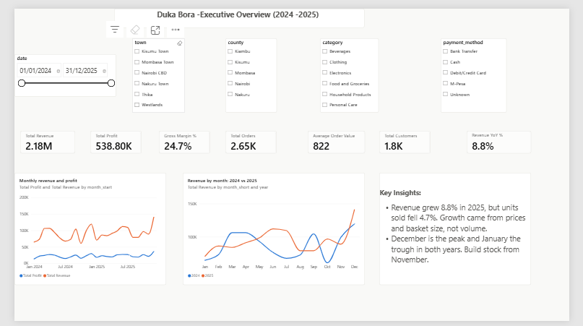
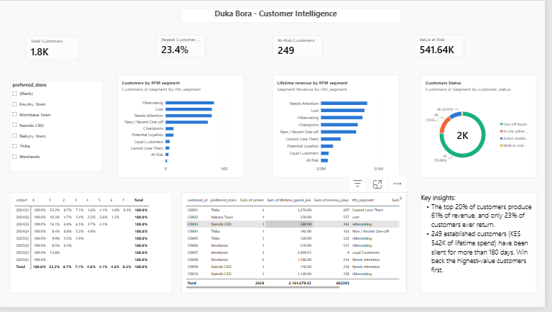
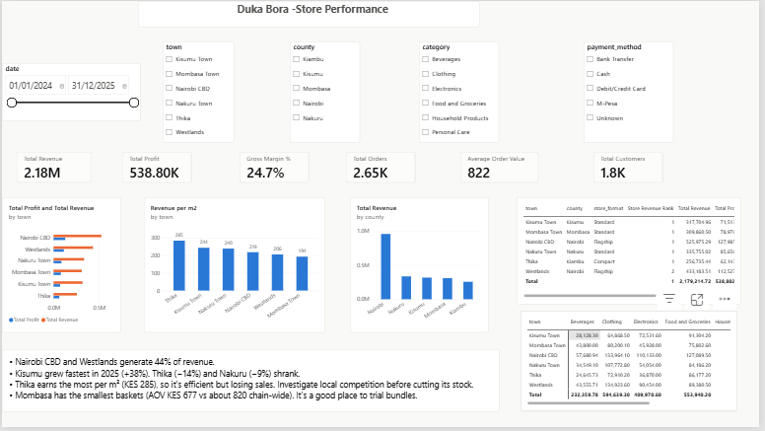
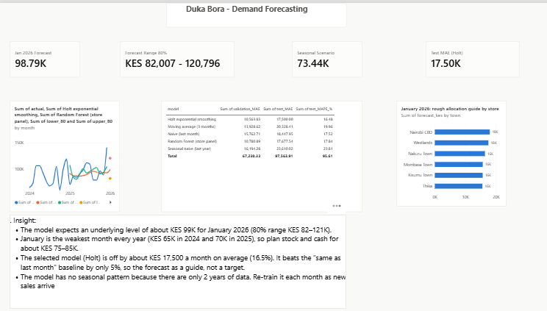
A five-page Power BI dashboard for managers
Executive Overview
Customer Intelligence
Store Performance
Demand Forecasting
Duka Bora capstone | 14
Notes:
The dashboard runs on a star schema exported from the project, with DAX measures that have written definitions. The five pages follow the management questions: overview, products, customers, stores and forecasting. Synced slicers and cross-filtering let a manager click a product or store and see everything update. Every headline number matches the Python and SQL results.

Slide 15
Six recommendations, each with a measure of success
1
Protect clothing margins
2
Cap promotion discounts
3
Win back 249 customers
Keep uniforms stocked before each term; no clothing discounts.
Keep every discount below the category margin.
Highest value first, with a random 20% control group.
KPI: clothing margin
KPI: margin per campaign
KPI: return rate vs control
4
Investigate Thika
5
Bundles in Mombasa
6
Plan January at 75–85K
Check competition and range before cutting stock.
Add-on displays to grow the smallest baskets.
Build stock from November for the December peak.
KPI: revenue excl. electronics
KPI: average order value
KPI: forecast vs plan
Duka Bora capstone | 15
Notes:
Six actions, each tied to evidence and a KPI. If management could do only one, it should be the win-back campaign: it targets 542 thousand shillings of past spend with a list that proved 93% precise, and the control group means its value can be measured rather than assumed.

Slide 16
Limitations and next steps
Limitations
Synthetic data: methods transfer, figures do not
Two years: no validated seasonal model; 6 test months
Observational: promotion and loyalty effects are associations
Small churn samples; probabilities are rankings, not calibrated
No data on competitors, stock-outs or the economy
Next steps
Seasonal forecast (Holt-Winters or SARIMA) with 3+ years of data
Randomized promotion and win-back trials
Basket analysis to design the Mombasa bundles
Customer lifetime value to prioritize retention spend
Automated refresh from PostgreSQL to Power BI
Duka Bora capstone | 16
Notes:
The main limitation is that the data is synthetic: the methods transfer to real data, the figures do not. Two years is too short for a validated seasonal model, and promotion and loyalty effects are associations. The next steps follow directly: a seasonal model with more history, randomized trials for causal effects, basket analysis for the Mombasa bundles, and an automated refresh pipeline.

Slide 17
Thank you. Questions?
Clothing earns the profit, prices drive the growth, and 249 valuable customers are waiting to be won back.
github.com/jonathan-kiplagat/kenyan-retail-customer-sales-intelligence
Full report, methodology, SQL documentation and model evaluation in the repository
Notes:
To close: clothing earns the profit, prices drive the growth, and 249 valuable customers are waiting to be won back. Everything is reproducible from the repository. Thank you, I'm happy to take questions. (Prepared answers: milestone_8_documentation/defence_qa.md.)

