Slide 1
The Wisdom of Mobs
A Mob Programming Primer

Slide 2
Definition: Mob programming is a software development approach where the whole team works on the same thing, at the same time, in the same space, and at the same computer. This is similar to pair programming where two people sit at the same computer and collaborate on the same code at the same time.
Mob programming is more about working well together than the mob. - Woody Zuill

Slide 3
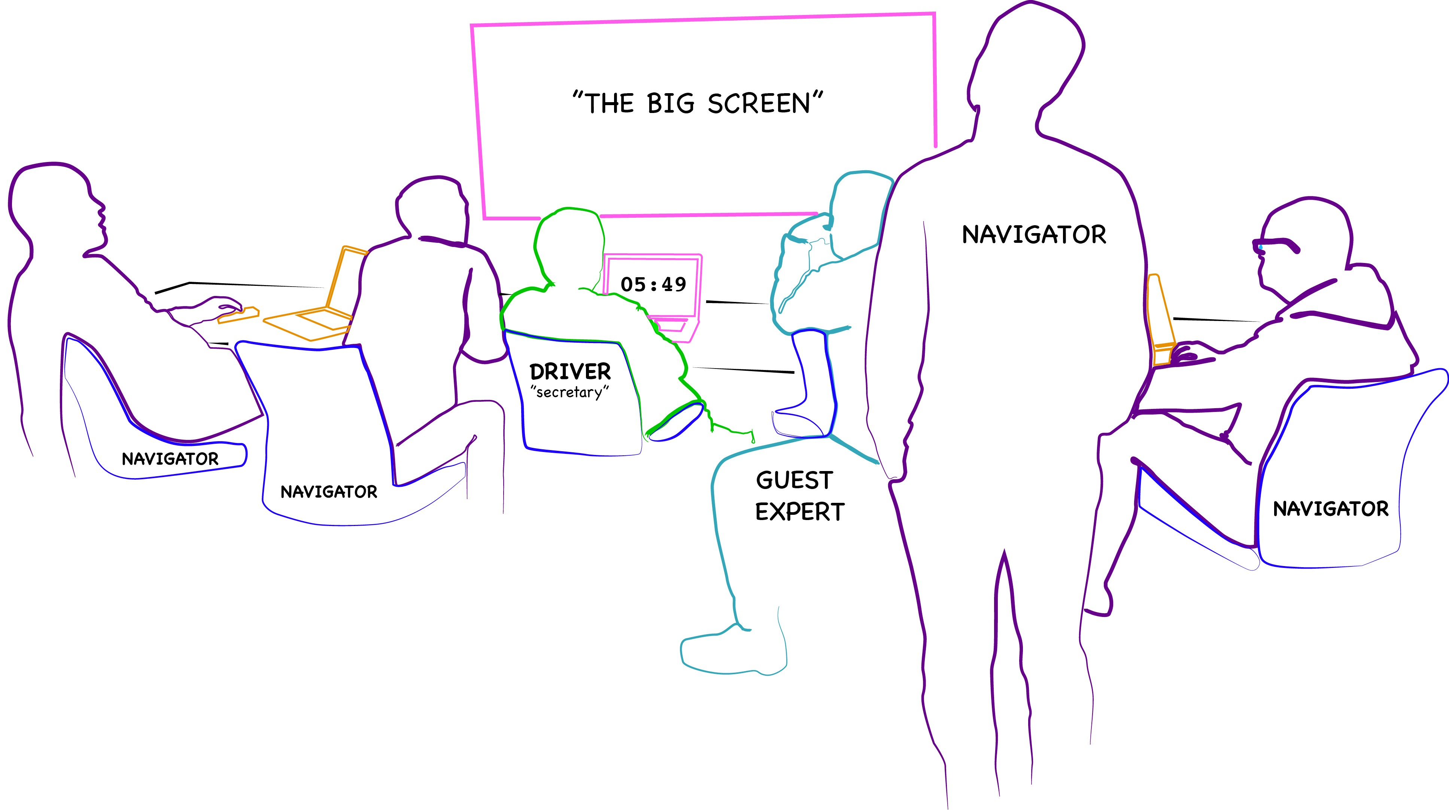
The Setup

Slide 4
Why mobbing? - Pros
Productivity
Knowledge Sharing
Why not - Cons
Productivity
Everyone needs to be on the same schedule

Slide 5
Mobbing Rules
Driving is optional.
Role rotation is about 7 minutes.

Slide 6
Resources
Books
Remote Mob Programming: At home, but not alone. Kindle Edition
Code with the Wisdom of the Crowd by Mark Pearl
Videos
Mob Programming: A Whole Team Approach by Woody Zuill
Taming the Mob: An Intro to Mob Programming by New Relic
Podcasts
Woody Zuill on the Hanselminutes Podcast

