Slide 1
The Wisdom of Mobs
A Mob Programming Primer

Slide 2
Definition: Mob programming is a software development approach where the whole team works on the same thing, at the same time, in the same space, and at the same computer. This is similar to pair programming where two people sit at the same computer and collaborate on the same code at the same time.
Mob programming is more about working well together than about the mob. - Woody Zuill

Slide 3
Disclaimer
No expert am I. I have very little actual mob programming experience. I wish I had more because it seems like a good idea to me. The limited experience I do have is from a Software Craftsmanship Meetup Group that I used to attend a while back.

Slide 4
Why mobbing? - Pros
Productivity
Knowledge Sharing
Collective Intelligence
Higher quality code
Why not - Cons
Productivity
Everyone needs to be on the same schedule

Slide 5
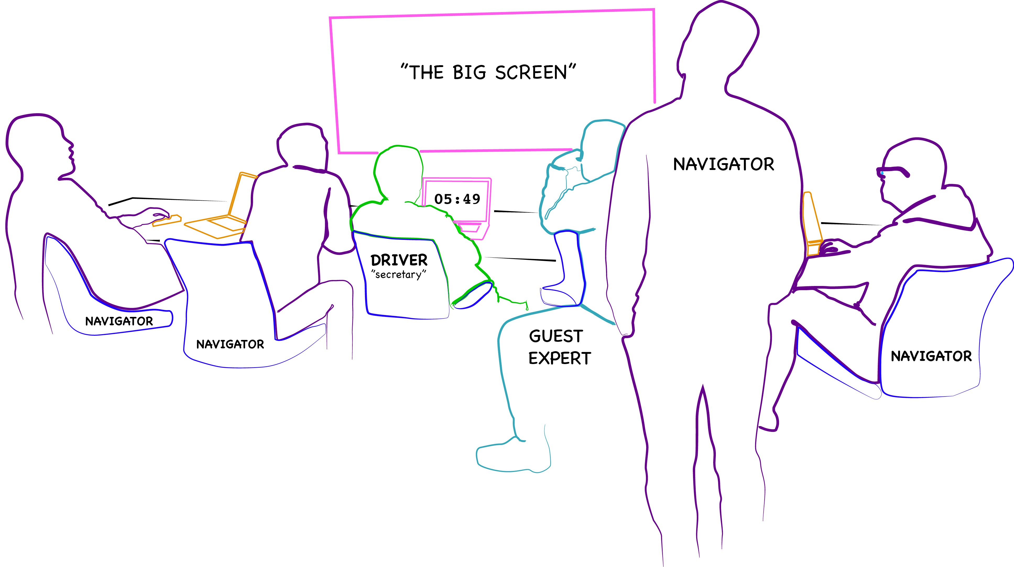
The Setup

Slide 6
Mobbing Rules
One person controls the keyboard, this is the typist. The rest of the mob discusses the problem, agrees on the solution, and instructs the typist. The typist follows their instructions, puts them into code, and may ask clarifying questions to understand the solution. The rest of the mob guides the typist as needed. We value the typist as they allow the rest of the mob to focus on solving the problem. The typist must not code on their own. This balances the participation of all team members and it reduces the dominance of strong characters.
Driving is optional.
Role rotation is about 5-7 minutes.
Mobbers are treated with kindness, consideration and respect.
Open Mob Timer and add drivers who want to drive.

Slide 7
Test Driven Development Environment
On my machine, I have IntelliJ set up.
What I’d thought we’d do is to give Microsoft Teams control to the driver.

Slide 8
Red, Green, Refactor
The red, green, refactor approach helps developers compartmentalize their focus into three phases:
Red — think about what you want to develop
Green — think about how to make your tests pass
Refactor — think about how to improve your existing implementation

Slide 9
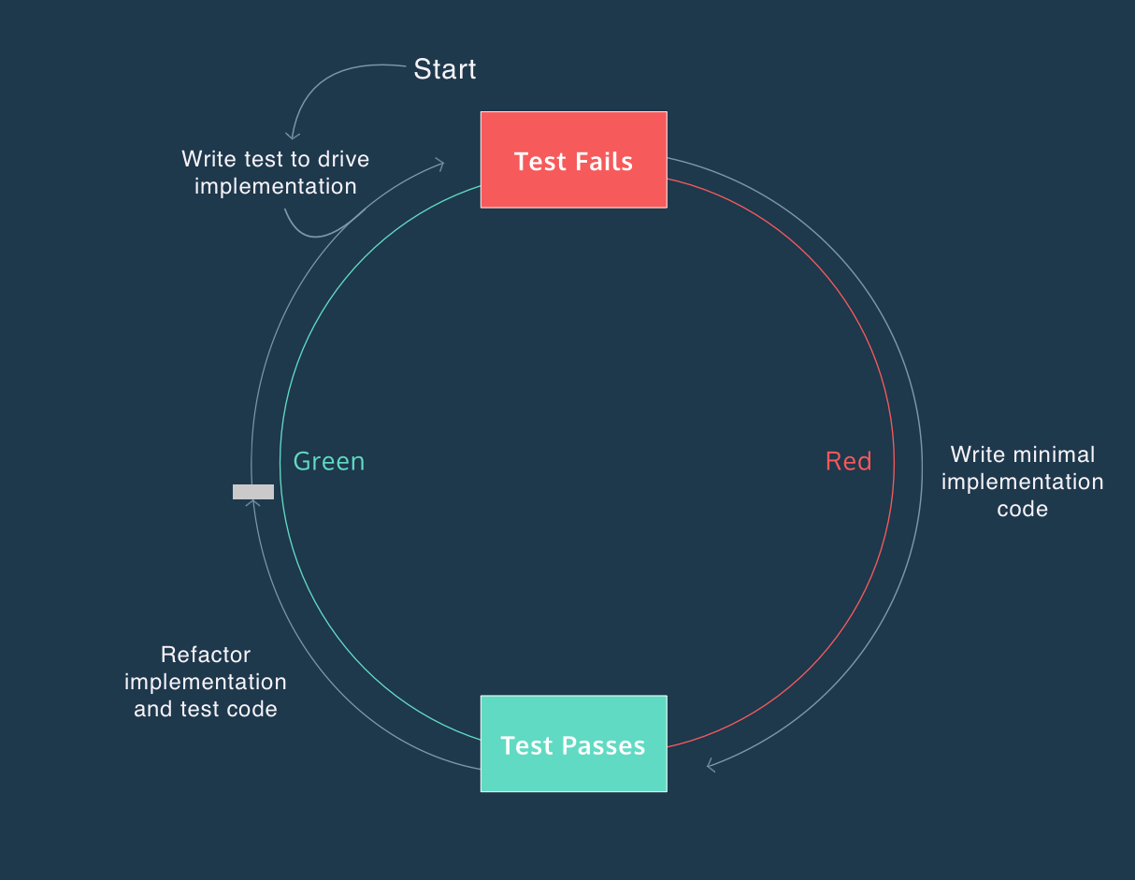

Slide 10
Rather than Starting from Scratch, I thought it might be interesting to do a Mob Debugging Exercise Prospects – 3 Katas to Choose From - Take a Vote?
1. Bowling Score Calculator (Fix broken test “FinalBallBug_168” in src/test/java/com/yb/bowling/BowlingGameTest.java)
2. Roman Numeral Converter: Convert Roman numerals into Arabic numbers or vice versa. (At lease 3 broken tests in: src/RomanNumeralsTest.java)
3. Three Card Poker (There are 3 broken tests in: src/test/java/com/kata/poker/GameTest.java)

Slide 11
Problem Description: Calculating a Bowling Game Score
A game of bowling consists of ten frames. Each frame except for the tenth consists of one or two balls that are rolled in an attempt to knock down the ten pins at the end of the alley. Knocking down all ten pins on the first ball of the frame is called a strike, and the second ball of the frame is not rolled. Knocking down all ten pins with both balls (having left some up with the first ball) is called a spare. If both attempts to knock down the pins leave some standing, the frame is called an open frame. A spare in the tenth frame gives the bowler one extra ball; a strike in the tenth gives him or her two extra balls. A bowling score is computed as follows. A strike counts as 10 points plus the sum of the next two balls. A spare counts as 10 points plus the next ball. Any other balls merely count as themselves, as do any bonus balls rolled as a result of a strike or a spare in the tenth frame.
Suppose for example that the sequence of balls was:
1 2 3 4 5 6 7 8 9 10
9 1 0 10 10 10 6 2 7 3 8 2 10 9 0 9 1 10
The cumulative score for the ten frames would be
1 2 3 4 5 6 7 8 9 10
10 30 56 74 82 100 120 139 148 168

Slide 12
Problem Description: Convert Roman Numeral to Their Arabic Equivalent
Create a program that takes a list of strings (roman numerals) and returns a list of numbers assume the number is between 1 and 3999, inclusively. The Romans wrote their numbers using letters; specifically the letters 'I' meaning '1', 'V' meaning '5', 'X' meaning '10', 'L' meaning '50', 'C' meaning '100', 'D' meaning '500', and 'M' meaning '1000' There were certain rules that the numerals followed which should be observed:
* The symbols 'I', 'X', 'C', and 'M' can be repeated at most 3 times in a row.
* The symbols 'V', 'L', and 'D' can never be repeated
* The '1' symbols ('I', 'X', and 'C') can only be subtracted from the 2 next highest values
(e.g. 'IV' and 'IX', 'XL' and 'XC', 'CD' and 'CM’)
* Only one subtraction can be made per numeral ('XC' is allowed, 'XXC' is not) The '5' symbols
('V', 'L', and 'D') can never be subtracted

Slide 13
3 Card Poker
See hand rankings at: 3 Card Poker Hand Rankings

Slide 14
Resources
Books
Remote Mob Programming: At home, but not alone. Kindle Edition
Code with the Wisdom of the Crowd by Mark Pearl
Videos
Mob Programming: A Whole Team Approach by Woody Zuill
Taming the Mob: An Intro to Mob Programming by New Relic
Podcasts
Woody Zuill on the Hanselminutes Podcast

Slide 15
Websites
Mob Timer
Mob Programming at Wikipedia
I did mob programming every day for 5 months. Here's what I learnt.
Bowling Score Calculator
Roman Numeral Converter
3 Card Poker Hand Rankings
GitHub
This Slide Deck
Only-1-Bug Java-Bowling-Game Source Code
Roman Numeral Kata Source Code
3 Card Poker Source Code
Composable Batch Files
Pluralsight
Setting up a Java Development Environment

Slide 16
No Más

