Slide 1
Core Concepts: Everything is an Object & Message Passing
1. Everything is an Object[2]
In Smalltalk, every value is an object: integers, Boolean values, nil, classes, even control structures themselves.
There are no "primitive types" (in Python, int and bool are also objects, but Smalltalk is more pure - even the "if" statement is the result of an object sending a message).
2. Message Passing
There are no function calls; only messages are sent to objects. Syntax: Recipient Message Name [Parameters].
Messages can carry blocks (code blocks) as parameters to implement control flow.

Slide 2
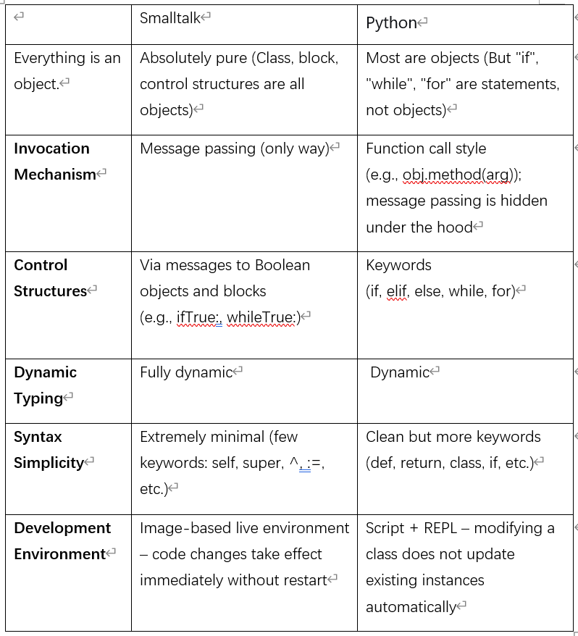
Smalltalk vs Python
Summary:
Smalltalk: The ultimate pure object-oriented language, all logic is implemented through message passing, with extremely high consistency. Python: Multi-paradigm, retains procedural statements, making it more intuitive for most developers.[4]

Slide 3
Grammatical Differences & The Impact of Smalltalk on Modern Languages
1. A simple example of the syntax of Smalltalk
There are almost no keywords: only self, super, true, false, nil, ^ (for returning), and := (for assignment). No type declaration, no function keyword (compared to Python's def). All the code is message expressions without statements.[3]
2. Define a method: Calculate factorial
Smalltalk:
factorial: n
^ n = 1 ifTrue: [1] ifFalse: [n * (self factorial: n-1)]
Python:
def factorial(n):
return 1 if n == 1 else n * factorial(n-1)
Summary:
Python was inspired by Smalltalk in many aspects (such as dynamic nature and object model), but for practicality and ease of learning, procedural statements were retained. The "pure message passing" concept of Smalltalk is more fully embodied in Ruby.[1]

Slide 4
References
[1] A. Kay, “The early history of Smalltalk,” in Proceedings of the second ACM SIGPLAN conference on History of programming languages (HOPL-II), Cambridge, MA, USA, 1993, pp. 69–95.
URL: https://dl.acm.org/doi/10.1145/154766.155364
[2] D. Ingalls, “Design principles behind Smalltalk,” BYTE Magazine, vol. 6, no. 8, pp. 286–298, Aug. 1981.
URL: https://dept.cs.williams.edu/~freund/cs334/static/auxread/smalltalk/smalltalk.html
[3] A. Goldberg and D. Robson, Smalltalk-80: The Language and its Implementation. Reading, MA, USA: Addison-Wesley, 1983.
https://www.semanticscholar.org/paper/Smalltalk-80%3A-The-Language-and-Its-Implementation-Goldberg-Robson/d097e2d4d0f2d399f8dcffa96f277aad033e2261
[4] S. Ducasse, A. Lienhard, and L. Renggli, “Seaside: A flexible environment for building dynamic web applications,” IEEE Software, vol. 24, no. 5, pp. 56–63, Sep./Oct. 2007.
URL: https://ieeexplore.ieee.org/document/4302687

