Slide 1
Applications & Conclusion
A Look at Its Legacy and Modern Influence

Slide 2
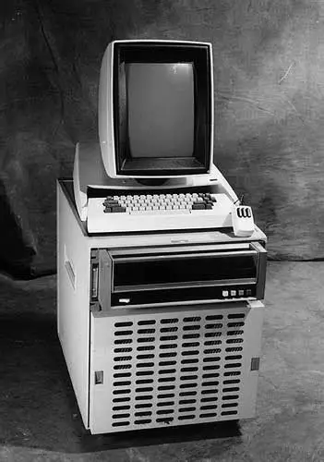
Historical Use Cases: A Pioneer in GUI and Beyond
The Cradle of Graphical User Interfaces (GUI)
Xerox Alto/Star: In the 1970s, Smalltalk pioneered overlapping windows, pull-down menus, and the desktop metaphor.
Foundation of Modern OS:Heavily influenced the design of macOS, Windows, and Linux desktops.
Early Applications in Finance & Research
Xerox Alto/Star: In the 1970s, Smalltalk pioneered overlapping windows, pull-down menus, and the desktop metaphor.
Foundation of Modern OS: Heavily influenced the design of macOS, Windows, and Linux desktops.

Slide 3
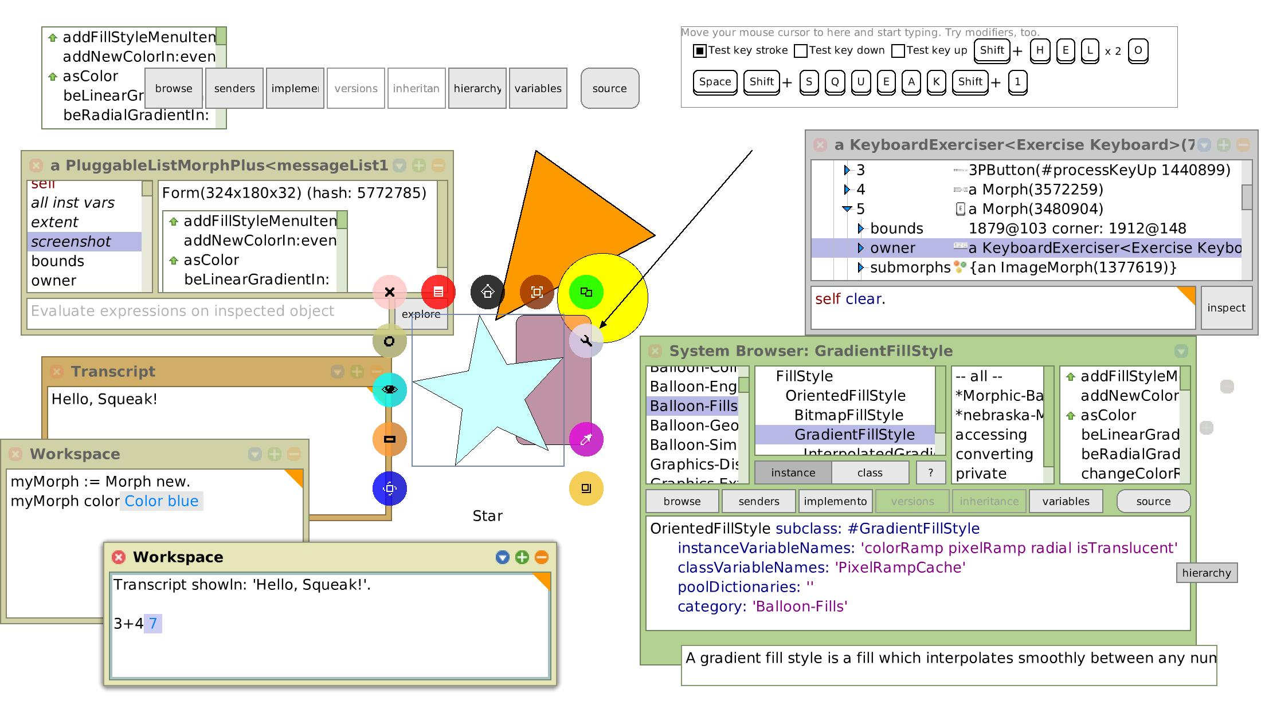
Modern Niche Uses: A Small but Active Community
A Niche but Active Ecosystem
Squeak/Pharo: Modern dialects actively maintained, ideal for education and rapid prototyping.
Seaside: A powerful Smalltalk web framework for building highly interactive web apps.
Education & Rapid Prototyping
Teaching OOP: A classic, effective tool for demonstrating the pure essence of Object-Oriented Programming.
GUI Development: Build graphical interfaces and prototypes instantly without complex compilation steps.

Slide 4
Conclusion: The Enduring Legacy of Smalltalk
The "Archetype" of OOP
Smalltalk defined the revolutionary "everything is an object" paradigm and the message-passing model. Its design directly influenced the architecture of modern languages like Objective-C, Ruby, and Python.
Lessons for Modern Engineering
• A simple, unified mental model yields immense expressive power.
• Prioritized user experience and system extensibility over raw speed.
• Pioneered the value of interactive, live development environments (IDEs).
Smalltalk's True Legacy
It lies not in its past market share, but in the fundamental, elegant ideas it introduced to the world of programming—ideas that continue to shape how we build software today.

