Slide 1
Untrained CNN
Trained CNN
Network
Wavelet Transform
Train Neural Network
Operation
Timeseries
Images
Data
Unlabeled Images
Predicted Labels
Labels
Labels

Slide 2
Timeseries
Domain A
Transition
Domain B
wtCNN
Model Output
Outlier Detection
Likelihood
Early Warning Threshold

Slide 3
Untrained CNN
Trained CNN
Network
Wavelet Transform
Train Neural Network
Operation
Timeseries
Images
Data
Unlabeled Images
Predicted Labels
Labels
Labels

Slide 4
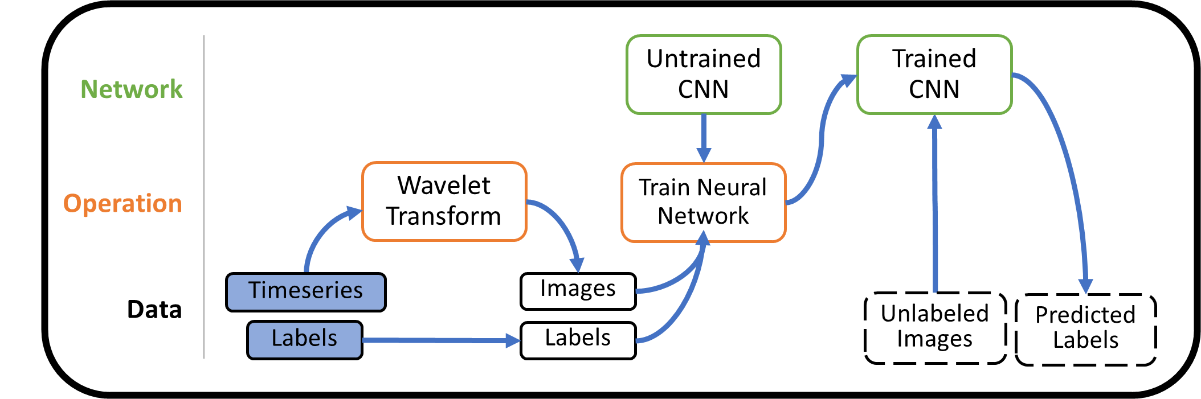

Slide 5
Timeseries
Label
0/1
Variable
Timeseries
Variable
Label

Slide 6
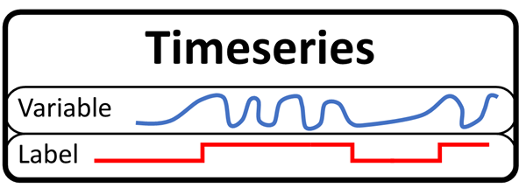
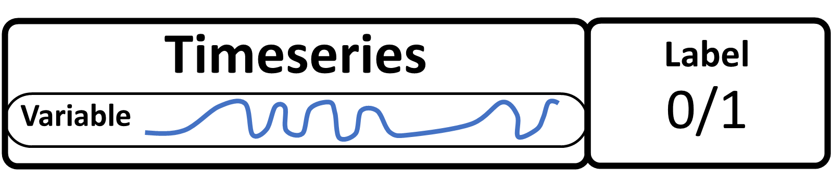


Slide 7
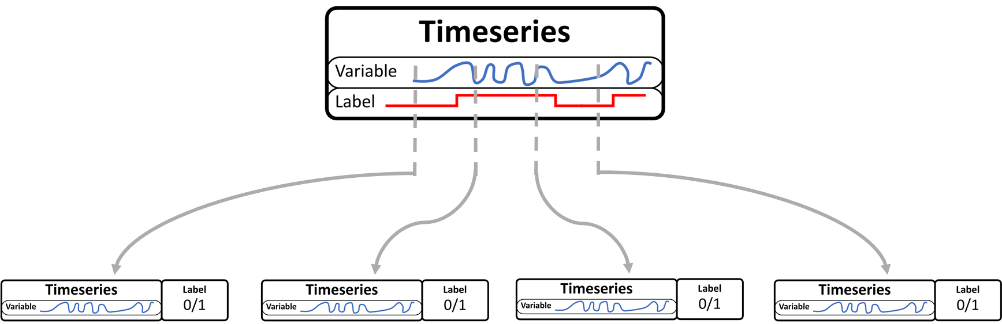

Slide 8

A: Standard Labeled Timeseries
B: Timeseries with Detailed Label
C: Windowed Analysis allows a detailed timeseries to be processed by wtCNN

